Slide 1
Summary of Subtyping
苏航
2024-05-09

Slide 2
Metabolism Subtyping

Slide 3
Data Description
101 Samples
Data Preprocess
171 metabolites
Log
Norm
Dimension Reduction
Not done since 171 is a relatively low dimension

Slide 4
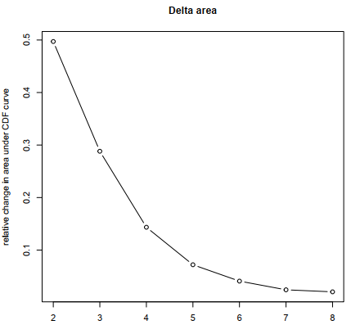
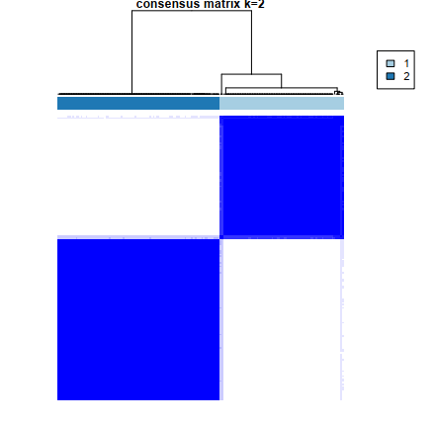
Decide K=2
Evidence shows that 2 is the best cluster number
As the number of clusters increases, clustering consistence drops
Heatmaps obtained using 3-clusters do not have boundaries as clear as 2-clusters (Showed in next 2 pages)

Slide 5
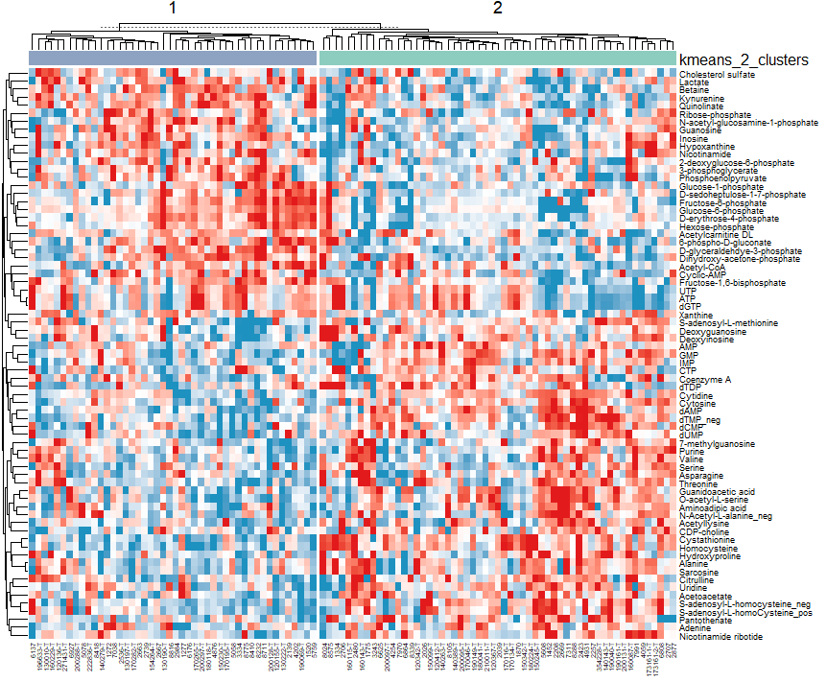
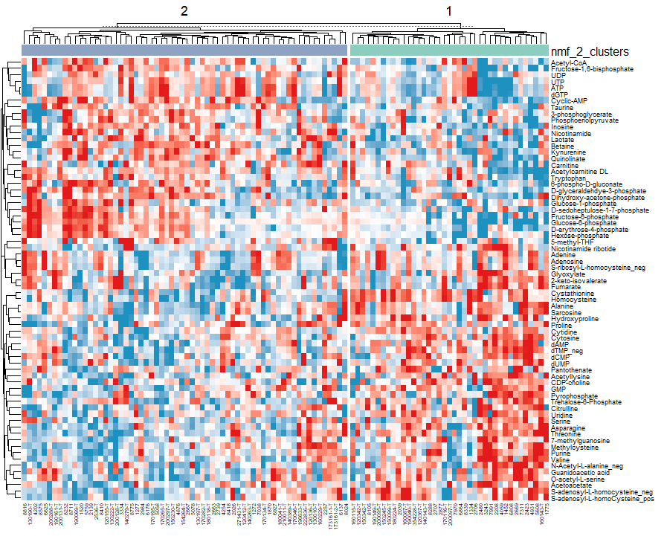
K=2

Slide 6
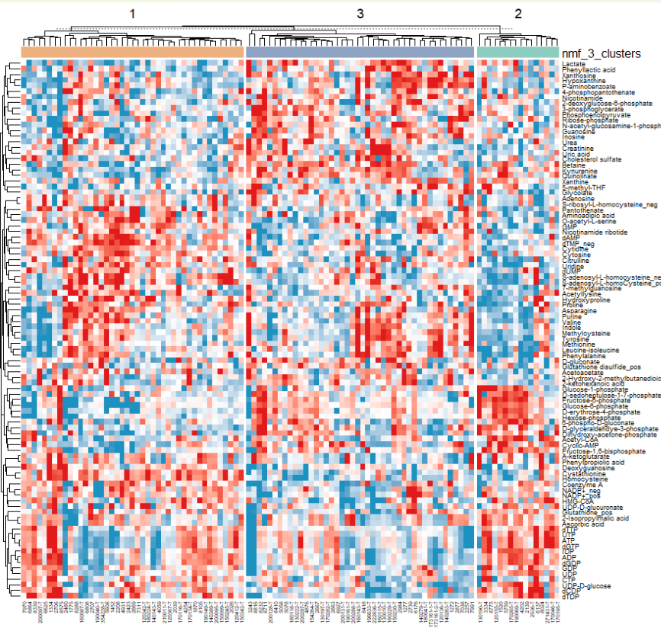
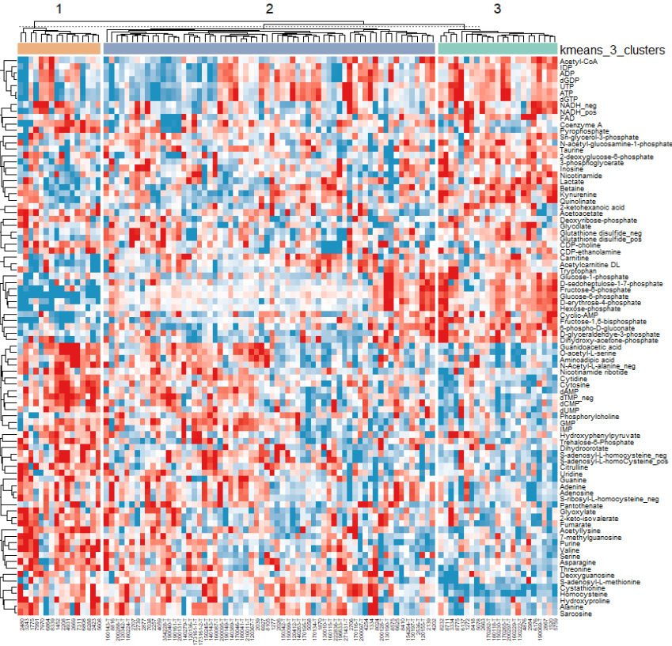
K=3

Slide 7
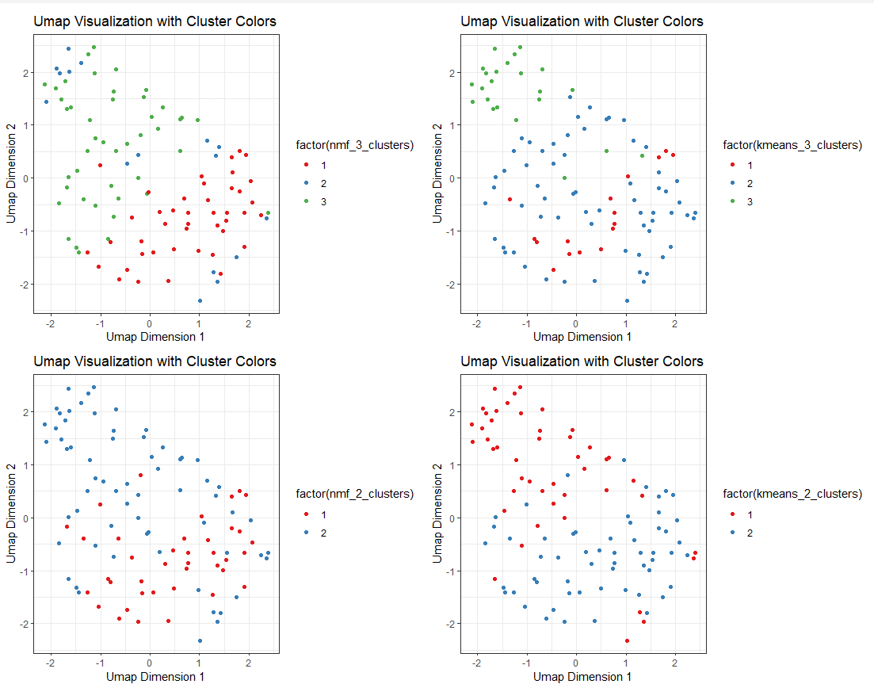
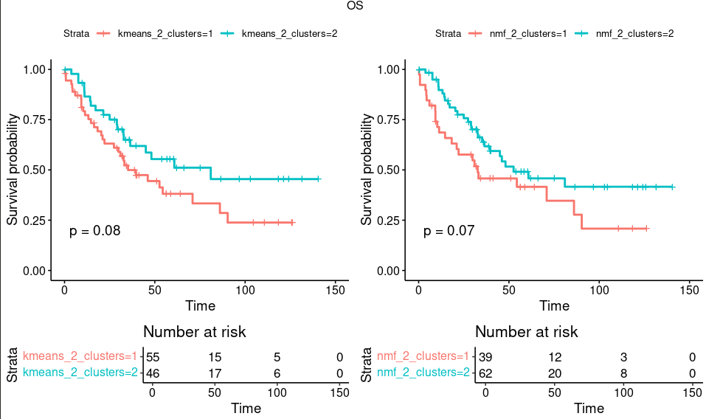
Survival Result
101 Samples

Slide 8
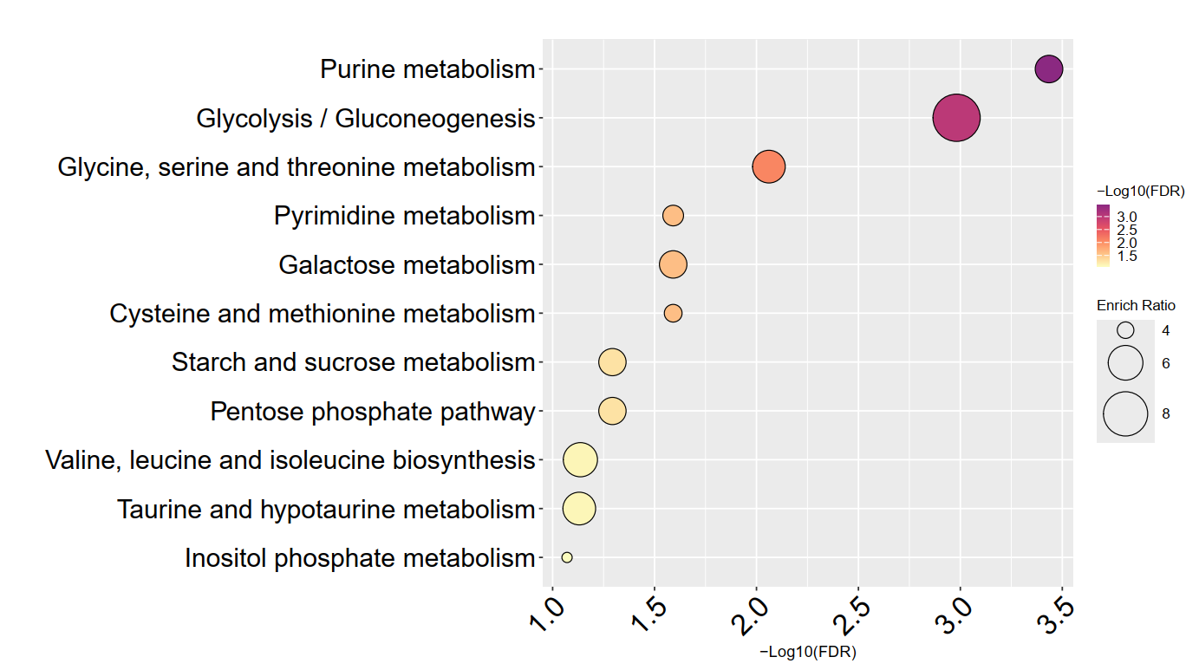
KEGG Pathway

Slide 9
Lipidomic Subtyping

Slide 10
Data Description
101 Samples
Data Preprocess
755 lipids, 574 left after deleting odd chain
Log
Norm
Dimension Reduction
PCA: 574 lipids -> 51 components

Slide 11
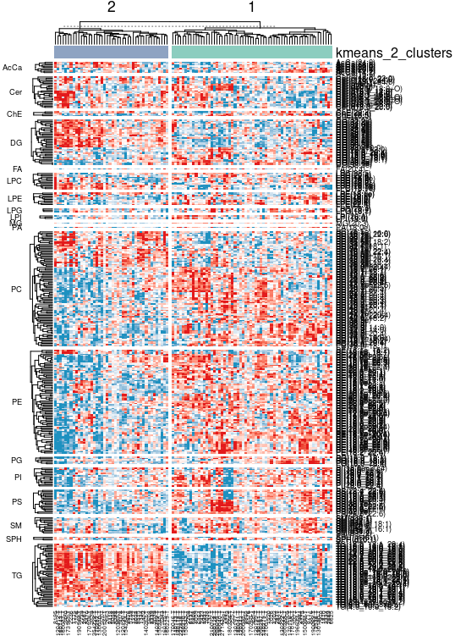
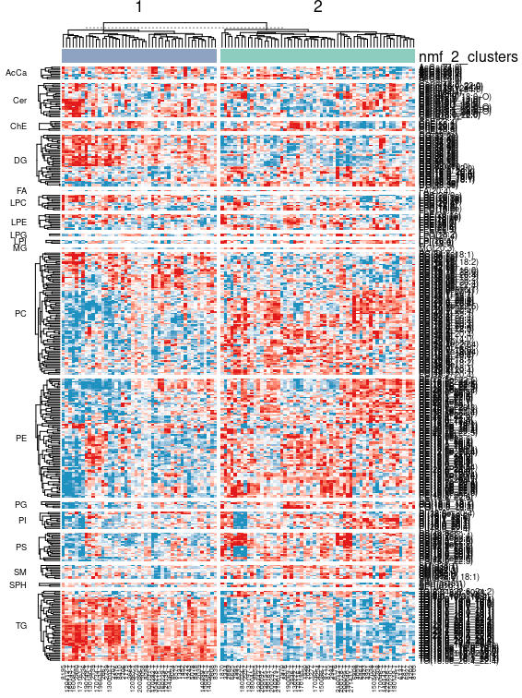
K=2

Slide 12
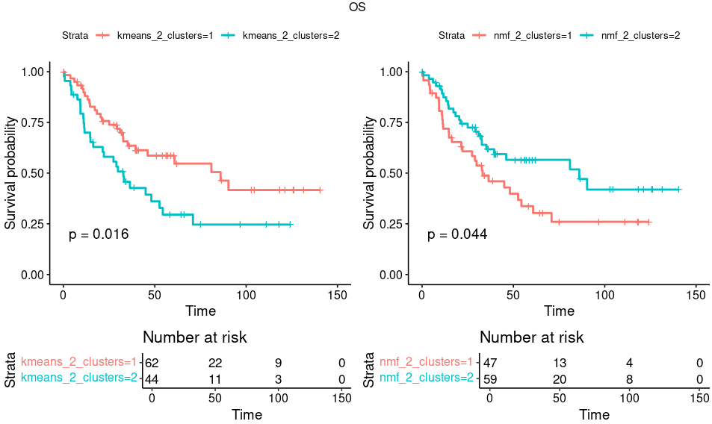
Survival

Slide 13
RNA Analysis

Slide 14
Data Description
93 Samples have RNA counts data
Data Preprocess
58818 counts, 28332 left after QC ( 20 reads as threshold )
高生存相对于低生存
Kmeans
Up 15154
Down 13178
NMF
Up 15124
Down 13208

Slide 15
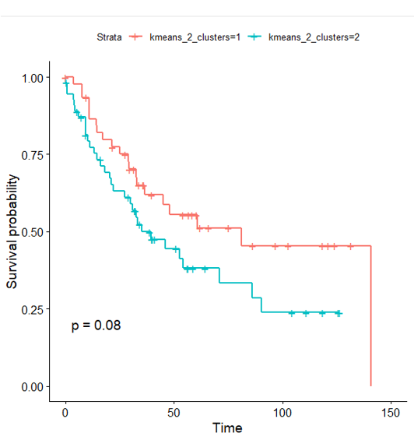
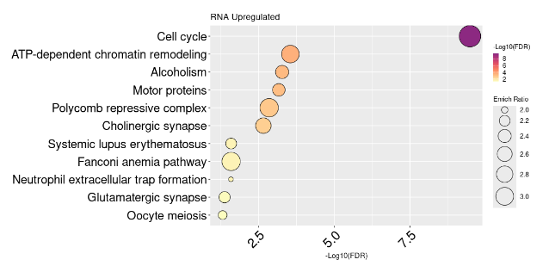
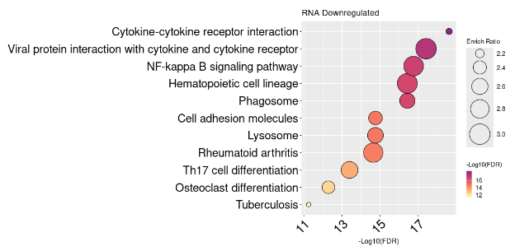
KEGG for Metabolite Kmeans Subtyping

Slide 16
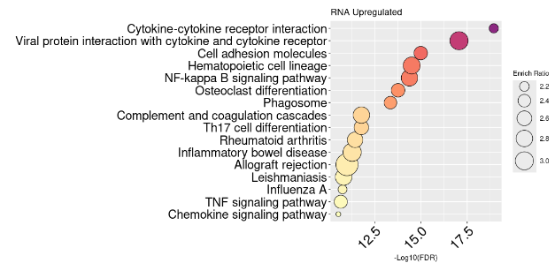
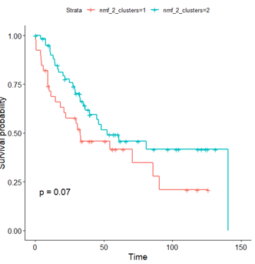
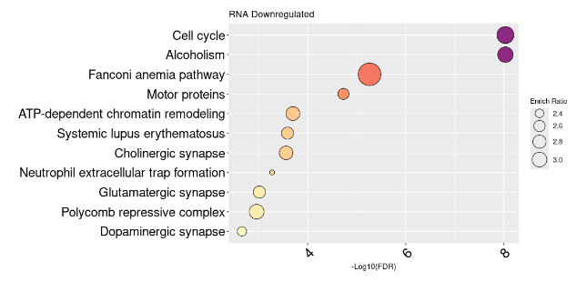
KEGG for Metabolite NMF Subtyping

Slide 17
Multi-Omics

