Slide 1
Lipidomic
苏航
2024-8013

Slide 2
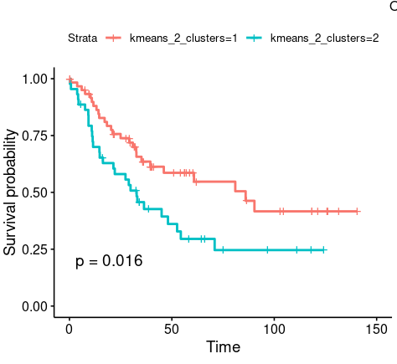
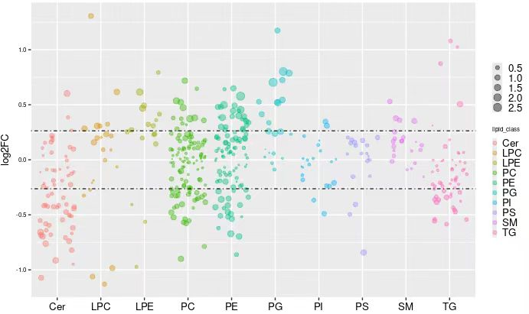
Landscape
Based on Clustering
2 compared to 1 (high to low)
Down: Cer, TG, PS
Up: LPE, PG, SM

Slide 3
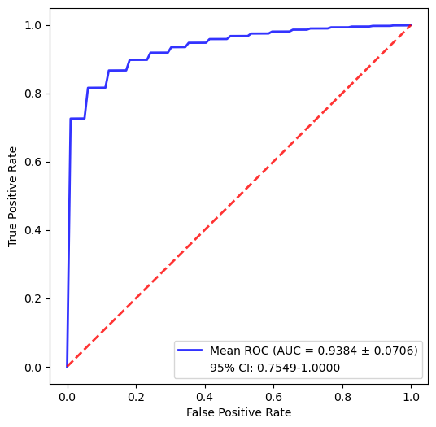
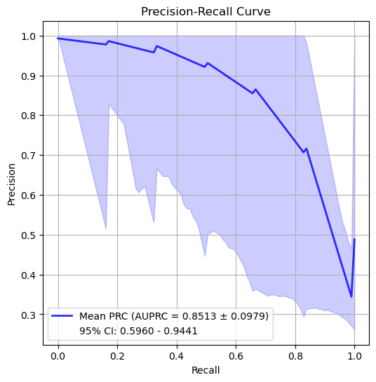
24-24 Survival

Slide 4
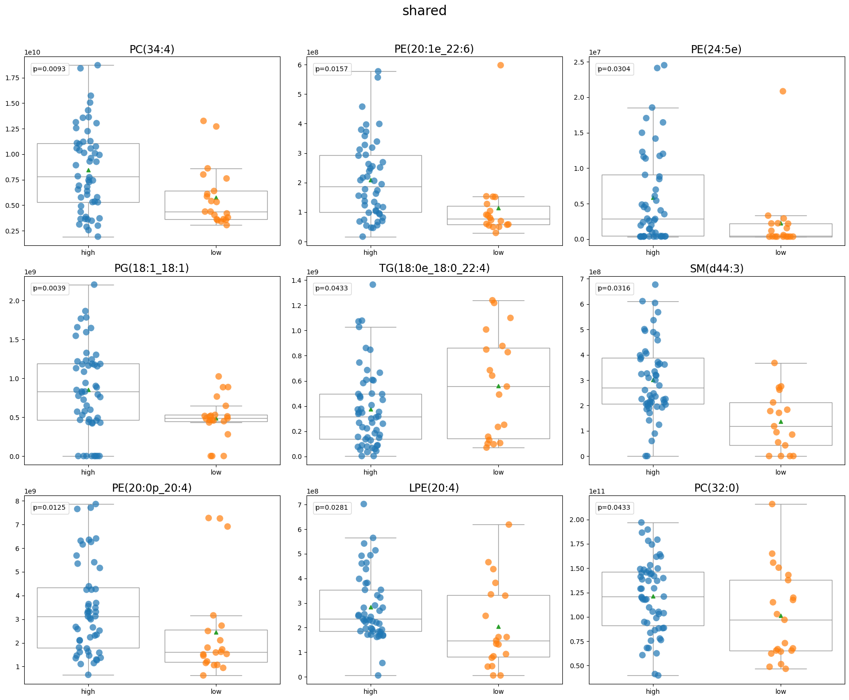

Slide 5
Lipid：cluster->heatmap(pvalue 1 0.05)->bubble->boxplot

