Slide 1
Subtype
苏航
2024-08-22

Slide 2
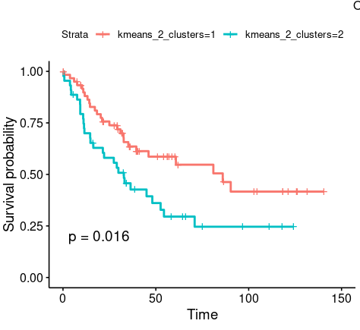
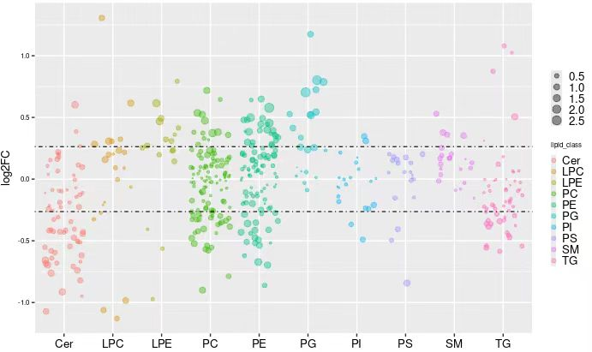
Landscape
Based on Clustering
2 compared to 1 (high to low)
Down: Cer, TG, PS
Up: LPE, PG, SM

Slide 3
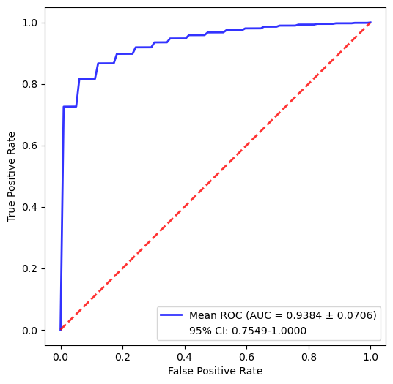
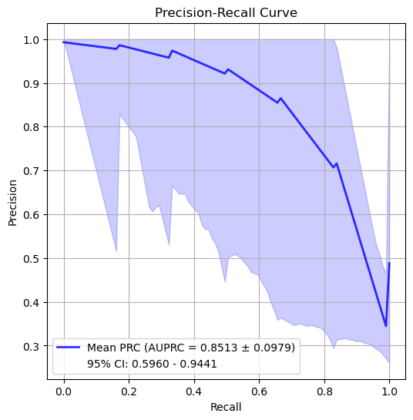
24-24 Survival

Slide 4
