Slide 1













Solomon
solomon-g6gecxa4gwc9caeh.eastus2-01.azurewebsites.net

Slide 2



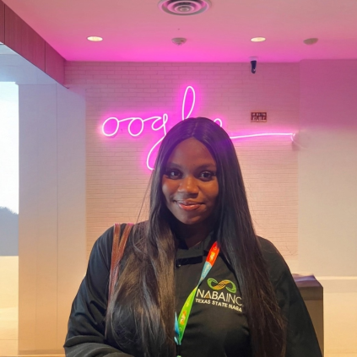

Lauren Wong
Michael Lee
Hackathon Role: UX/UI Designer, Business Analyst
Skills: Figma, Power BI, Adobe Creative Suite, Canva, Azure DevOps
Education: Master’s in Computer Science at GeorgiaTech
Hackathon Role: Technical Architect
Skills: IT Auditing, Finance, DevOps
Education: Master’s in Computer Science at GeorgiaTech
Kimberly Odili-Onu
Praveen Bevara
Hackathon Role: Sales & Marketing Manager
Skills: Power BI, Tableau, financial modeling,
MATLAB, R, Python
Education: Bachelor’s in Finance at Texas State University
Hackathon Role: Network Engineer
Skills: Python, SQL, Azure, Security, Networking, Solidity
Education: Bachelor’s in Information Security at
Chandigarh University

Slide 3

Judgement of Solomon
The Judgement of Solomon is a story from the Old Testament in which Solomon ruled between two women who both claimed to be the mother of a child. Solomon ordered the baby be cut in half, with each woman to receive one half.
The first woman accepted the compromise as fair, but the second begged Solomon to give the baby to her rival, preferring the baby to live, even without her.
Solomon ordered the baby given to the second woman, as her love was selfless, as opposed to the first woman's selfish disregard for the baby's actual well-being.

Slide 4

AI-driven business strategy – Acts as a change management expert, offering real-time insights and structured frameworks.
01.
Seamless workflow integration – Supports ROI calculations, Kanban planning, research aggregation, and strategy execution
Use Cases
02.
Customizable & scalable – Works with preloaded or custom frameworks, making it adaptable across industries.
03.

Slide 5
Go-Live Timeline
0.5
1
100
Demo
Minimum Viable Product
Broad Adoption

Slide 6






Azure AI Services
Frontend
Azure OpenAI Service
Azure Embeddings
Azure Virtual Machine
Azure App Service
Sharepoint
Vite
Node.js
React
DevOps
Workflow Automation
Technologies Used
Elestio
N8N
Database Technologies
Miscellaneous
Mermaid Markdown
SERP API
Supabase
PostgreSQL

Slide 7
Product Valuation using a Target Customer
User Persona: Daniel Carter
35-year-old middle manager in San Francisco, earning $280,000 annually.
Manages a team of 12 and works with the CEO on cost optimization and strategic investments.
Struggles with fragmented data and complex spreadsheets when calculating ROI.
Needs a tool to simplify ROI calculations and provide actionable insights.
Solution Features:
ROI Calculator: Streamlines financial data input, generates insights, and visualizes ROI.
Diagrams Page: Applies business strategy frameworks and generates financial reports.
Research Page: Provides industry trends and case studies for informed decision-making.
Planning Page: Gives users a customizable planning board & tracks project tasks.

Slide 8
SWOT Analysis
Weaknesses
Threats
Limited AI Customization
Early-Stage Market Penetration
Dependence on Data Inputs
Competition from Enterprise Financial Tools
Our User Resistance to AI Decision-Making
Data Privacy & Compliance Concerns
Strengths
Opportunities
AI-Powered Predictive Insights
Dynamic & Visual ROI Calculator
Context-Aware Chatbot
Seamless Data Integration
Expansion into Various Business Sectors
Strategic API Integrations
Enhanced AI-Driven Research

Slide 9
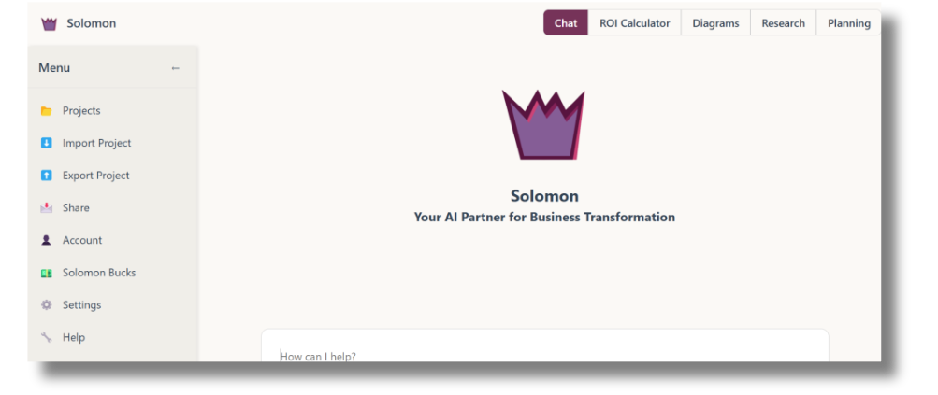
Frontend

Slide 10
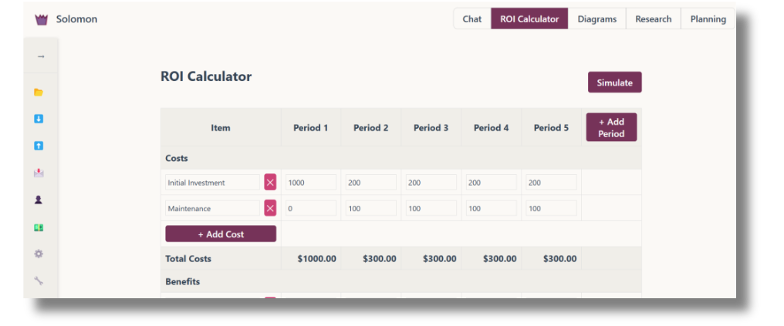
Frontend

Slide 11
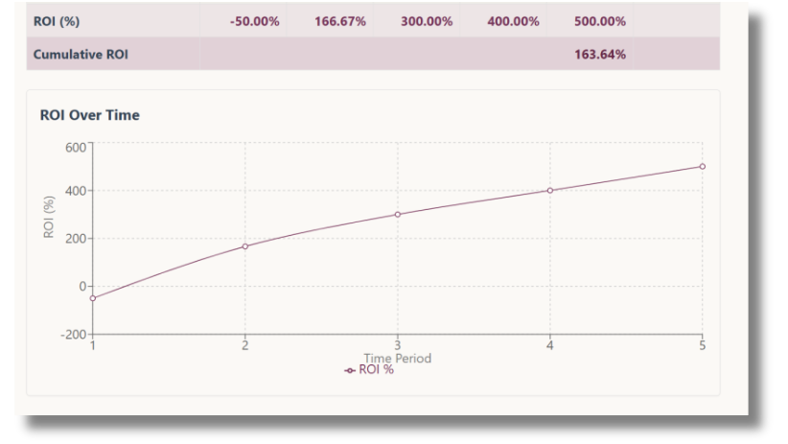
Frontend

Slide 12
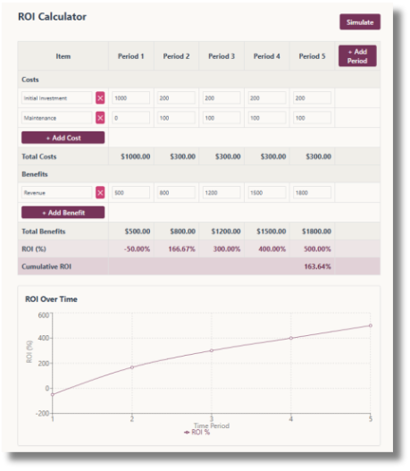
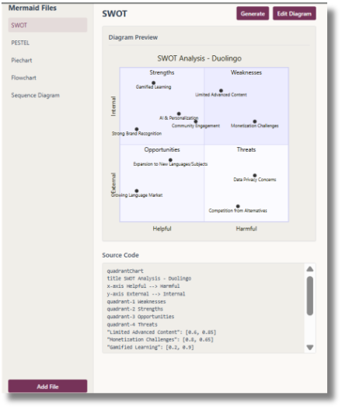
Frontend

Slide 13
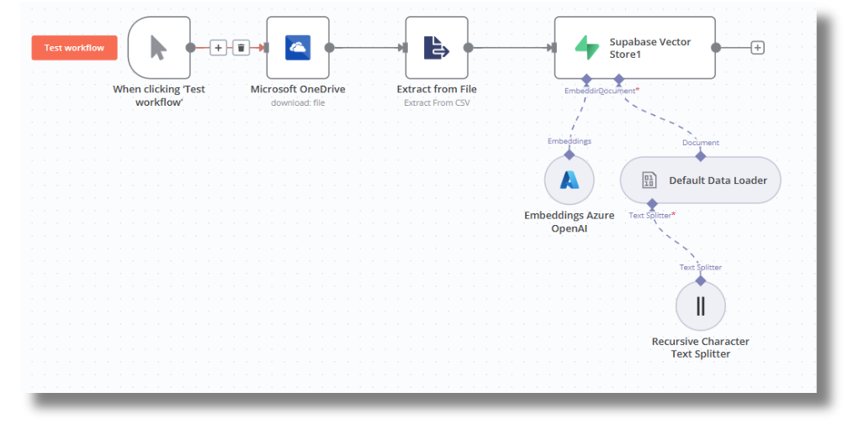
Backend

Slide 14
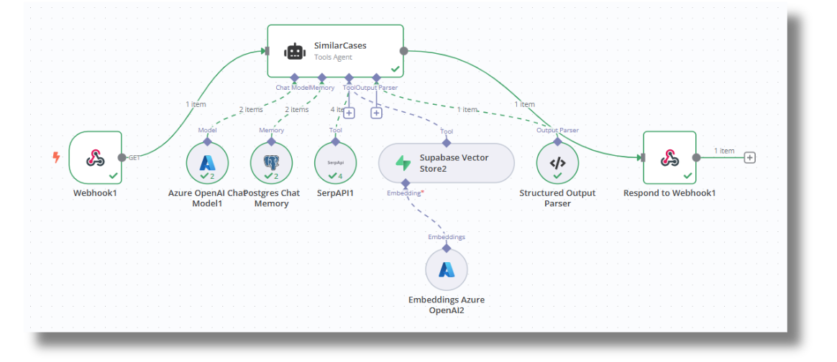
Backend

Slide 15
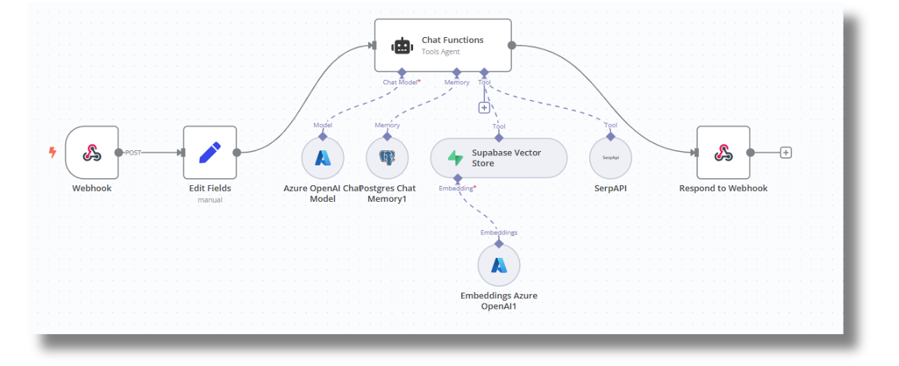
Backend

Slide 16

Responsible AI
Reliability and Safety
Privacy and Security
Guardrails
Audit Trails
Private Data

Slide 17

Reponsible AI
Fairness
Inclusiveness
Transparency
Accountability
Global Evidence on Gender Gaps and Generative AI
TechBridge

Slide 18

Our Pricing
Entry
Buiness
Enterprise
Up to 250k SB
250k - 1M SB
1M+SB
$0.07
$0.05
$0.03
1,000(SB) Solomon
Bucks
1,000(SB) Solomon
Bucks
1,000(SB) Solomon
Bucks
+ A Freemium Plan when you join -
"Secure free 10K Solomon Bucks for your first month and choose a plan based on your business needs."

Slide 19




Marketing Channels
LinkedIn & Twitter
Product Hunt & Business Newsletters (TLDR)
Quick access with thought leadership content, case studies, and customer testimonials
Attract early adopters and developers for testing.

Slide 20


Special Thanks To Our Advisors
Chinmay Anaokar
Kyle Johnson
Building Scalable SaaS
Cloud & AI Strategist
Tech Leader
AWS Authorized Instructor
LinkedIn: https://www.linkedin.com/in/chinmay-anaokar/
Senior Cloud Solution Architect at Microsoft
Associate Professor at UMGC
LinkedIn: https://www.linkedin.com/in/kyleljohnson/

Slide 21
Thank you very much!

