Slide 1
Securing IIS Against Code Red II
Jason Fossen
SANS Institute

Slide 2
What Is “Code Red”?
IIS 4.0/5.0 Worm.
Spreads through TCP port 80 (HTTP).
Scans random IP addresses.
Resides in memory only! No files.
Buffer overflow attack to run code in System context.
Hundreds of thousands of IIS servers infected – with more to come!

Slide 3
What Damage Does It Cause?
Early version, website defacement.
Next version, no defacement and improved IP address scanning.
Code Red II, installs Trojan.
Tomorrow’s version…?

Slide 4
Who Is Vulnerable?
IIS 4.0 and IIS 5.0
Windows NT 4.0 with Option Pack.
Windows 2000 Server and Advanced Server installs IIS by default.
Cisco 600 Series DSL Routers.
  Reports of other HTTP-enabled devices being adversely affected too.

Slide 5
Cisco 600 Series DSL Routers
Unrelated vulnerability (bad luck).
Router will stop forwarding packets after being scanned with Code Red.
Install Cisco patch:
  http://www.cisco.com/warp/public/707/cisco-code-red-worm-pub.shtml

Slide 6
How Does The Exploit Work?
Buffer overflow in IDQ.DLL, the ISAPI Extension for .ida and .idq files.
Files used by Indexing Service, but this service does not need to be running.
IDQ.DLL runs in Inetinfo.exe by default, which runs as Local System.
Injected code is embedded in the initial GET request.

Slide 7
What Does the GET Request Look Like in the Logs?
GET /default.ida XXXXXXXXXXXXXXXXXXXXXXXXXXXXXXXX XXXXXXXXXXXXXXXXXXXXXXXXXXXXXXXXXXXXXXXXXXXXXXXXXXXXXXXXXXXXXXXXXXXXXXXXXXXXXXXXXXXXXXXXXXXXXXXXXXXXXXXXXXXXXXXXXXXXXXXXXXXXXXXXXXXXXXXXXXXXXXXXXXXXXXXXXXXXXXXXXXXXXXXXXXXXXXXXXXXXXXXXXXXXXXXXXXX%u9090%u6858%ucbd3%u7801%u9090%u6858%ucbd3%u7801%u9090%u6858%ucbd3%u7801%u9090%u9090%u8190%u00c3%u0003%u8b00%u531b%u53ff%u0078%u0000%u00=a
HTTP status response code 404 – you’re OK!
HTTP status response code 200 – you were patched!
No record whatsoever? Infected! (or not scanned yet)

Slide 8

How Do I Stop It?
Apply patch from Microsoft.
Reboot.
Unmap all unused ISAPI Extensions.
Best
Practices

Slide 9
Step 1:
Download The Microsoft Patch
Windows NT and Windows 2000 have their own separate patches:
http://www.microsoft.com/ 
technet/security/bulletin/MS01-033.asp
Create a folder anywhere on your hard drive, e.g.,“Microsoft-Patches”, and save the file there.

Slide 10
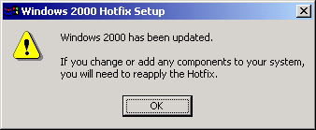
Step 2:
Double-Click in Windows Explorer.
Open Windows Explorer and go to the \Microsoft-Patches folder.
Windows 2000: double-click the long file: q300972_w2k_sp3_x86_en.exe
Windows NT:
Q300972i.exe

Slide 11
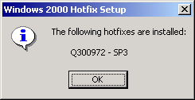
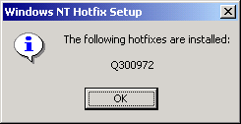
Step 3:
Reboot To Clear Worm from RAM.
Code Red resides in memory only, no files on the hard drive are infected.
Optional: Open a command-prompt window and run patch with –L switch, e.g., “q300972i.exe –L”.

Slide 12
Shortcomings of “The Patch”
Patch successfully blocks Code Red, but scans can cause some IIS servers to stop responding to HTTP requests.
Windows 2000 Advanced Server tends to do this more than regular Server.
ASP Problems (rumors only).
Redirection Problems – Unrelated!
  A separate patch for IIS 4.0 only.

Slide 13
The Long-Term Solution…
Code Red and the Internet Printing exploit are two recent examples of ISAPI Extension buffer overflows.
Why not stop new ISAPI Extension buffer overflow attacks before hackers even discover them?

Slide 14
Remove Unused ISAPI Extensions
Filename extensions, like .ASP and .IDA, are associated with DLLs inside IIS.
When IIS receives a request for a file with one of these special extensions, control of the request is passed to the DLL.
This is how the DLL is attacked!

Slide 15
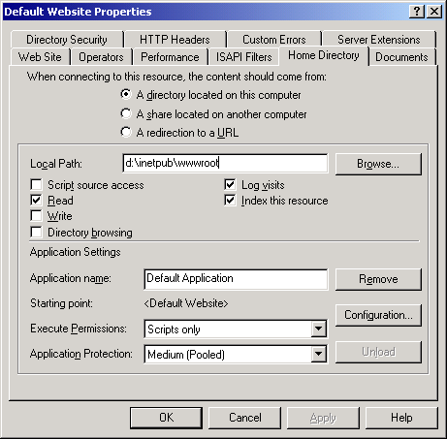
Step 1:
Go To Properties of Each Website
In the “Internet Services Manager” tool, right-click on each website, and select Properties.
Click on the “Home Directory” tab.

Slide 16
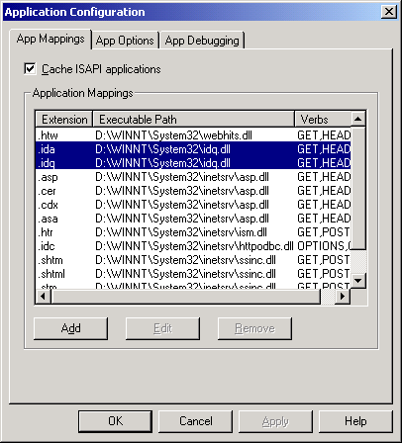
Step 2:
Click On the Configuration Button.
Click on the Configuration button.
Click the “App Mappings” tab.
These are your ISAPI Extensions!

Slide 17
Step 3:
Talk To The Webmasters
If you are not the webmaster, ask them, “Which of these file types (.ASP, .IDA, .STM, etc.) are we using?”
Don’t Worry! If you delete a mapping here, you are not deleting files. You can simply add the mapping back again later (with the Add button).

Slide 18
Step 4:
Remove All Unused Mappings
Highlight each unused mapping and click the Remove button.
Delete them all if you can!
If in doubt, only remove the mappings for .IDA, .IDQ, .HTR and .PRINTER.

Slide 19
For The Scripters Out There:
ADSUTIL.VBS
This command will delete all mappings on the Default Website (site number 1):
cscript.exe adsutil.vbs set w3svc/1/root/scriptmaps “”
Instead of empty double-quotes, list the mappings you want instead, each separated by a single space:
".asp,C:\Winnt\System32\inetsrv\asp.dll,1,GET,HEAD,POST,TRACE“
".asa,C:\Winnt\System32\inetsrv\asp.dll,1,GET,HEAD,POST,TRACE"
".shtm,C:\Winnt\System32\inetsrv\ssinc.dll,1,GET,POST“

Slide 20
My ISAPI Mappings Reappeared Again Later! (???)
You changed one of the “Windows Components” with the Add/Remove Programs Applet in Control Panel.

Slide 21
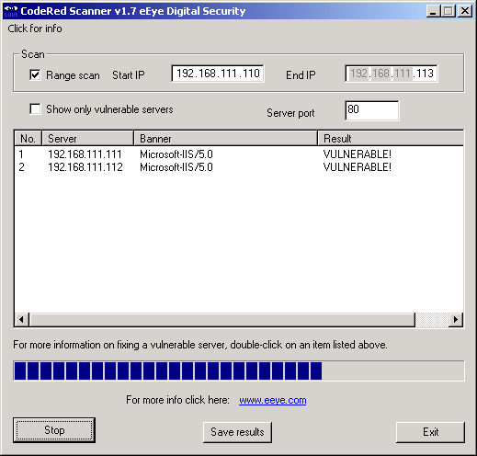
Code Red Scanner www.eEye.com
From the guys who discovered the vulnerability and named the worm after a soda…
http://www.eEye.com/html/Research/Tools/

Slide 22
Code Red II – Andromeda Strain
Better IP scanning (ARP flooding too).
Win2000 only! WinNT simply crashes.
Copies CMD.EXE as ROOT.EXE to:
  C: and D:\Inetpub\Scripts\
  C: and D:\progra~1\common~1\system\MSADC\
/Scripts and /MSADC permissions.
/C and /D virtual IIS folders.
  Read, Write and Execute permission (of course!).

Slide 23
Code Red II – Andromeda Strain
<continued>
Disables Windows File Protection.
Trojan Explorer.exe in C:\ and D:\
  Uses “Relative Shell Path Exploit”
  Refreshes every 10 minutes.
Requires its own separate patch!
http://www.microsoft.com/technet/security/bulletin/MS00-052.asp

Slide 24
I’m Already Infected!
What Should I Do?
Feeling Lucky?
  Disconnect box.
  Get both patches.
  Get updated virus data.
  Delete Explorer.exe’s.
  Reboot.
  Apply both patches.
  Reboot and scan.
  Delete Root.exe’s.
  Delete registry changes.
  Harden IIS.
Not Feeling Lucky?
  Disconnect box.
  Reformat drives.
  Reinstall OS.
  Apply Service Pack.
  Apply both patches.
  Get updated virus data.
  Harden IIS.
www.incidents.org

Slide 25

What Can I Do To Help Avoid Getting Hacked Like This Again?
Subscribe to e-mail security bulletins.
Obtain the latest Service Pack and patches.
Read your e-mail and apply new patches!
Tomorrow is just one
hack away…

Slide 26
Subscribe To E-Mail Security Bulletins
Microsoft Security Notification Service
  http://www.microsoft.com/security/
SANS Institute NewsBites
  http://www.sans.org/newlook/digests/newsbites.htm
  http://www.sans.org/newlook/digests/ntdigest.htm

Slide 27
Obtain The Latest Service Pack
And Patches From Microsoft
Choose Your Operating System:
  http://www.microsoft.com/windows2000/
  http://www.microsoft.com/ntserver/
Sort Patches by OS and Service Pack:
  http://www.microsoft.com/technet/security/current.asp

Slide 28
Hotfix Checking Tool for IIS 5.0
Will list exactly which patches are not installed on IIS 5.0 servers.
Continuously updated XML database.
Local or remote servers.
Can be scheduled to run every night.
Scripts can be customized!
http://www.microsoft.com/technet/security/tools.asp

Slide 29
Summary of URLs
Page 1 of 2
Original eEye Digital Security Analysis of Code Red:
  http://www.eEye.com/html/Research/Advisories/
eEye Code Red Scanner Tool:
  http://www.eEye.com/html/Research/Tools/
CERT Advisory CA-2001-19 on Code Red:
  http://www.cert.org/advisories/CA-2001-19.html
Microsoft Code Red patch:
  http://www.microsoft.com/technet/security/bulletin/MS01-033.asp
Cisco 6000 DSL Router patch:
  http://www.cisco.com/warp/public/707/cisco-code-red-worm-pub.shtml

Slide 30
Summary of URLs
Page 2 of 2
Microsoft Security Notification Service:
  http://www.microsoft.com/security/
SANS Institute NewsBites and Windows Digest:
  http://www.sans.org/newlook/digests/newsbites.htm
  http://www.sans.org/newlook/digests/ntdigest.htm
Microsoft Service Packs and Patches:
  http://www.microsoft.com/windows2000/
  http://www.microsoft.com/ntserver/
  http://www.microsoft.com/technet/security/current.asp
  http://www.microsoft.com/technet/security/tools.asp

Slide 31

IIS Security – No Problem!
We hope you found this presentation useful and timely.
SANS provides a five-day “Securing Windows 2000” series of seminars, including IIS security.
http://www.sans.org

