Slide 1


Algorithms for Learning and Testing High-Dimensional Statistical and Causal Relations
Arnab Bhattacharyya
School of Computing
National University of Singapore
Indian Institute of Science, Bangalore
July 21, 2022

Slide 2
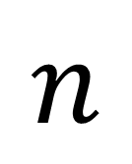
$$n$$
Other
Hormones
Gene expression levels
Antibodies
Growth factors
Tumor presence

Slide 3
Question: For a given thyroid hormone level, is thyroid cancer independent of the growth signaling protein BRAF?
How do we answer such questions with finite amount of data and limited computational resources?
Statistical
Question: A novel treatment inhibits expression of HER-2 and fusion proteins. Does it affect the likelihood of lung cancer?
Causal

Slide 4

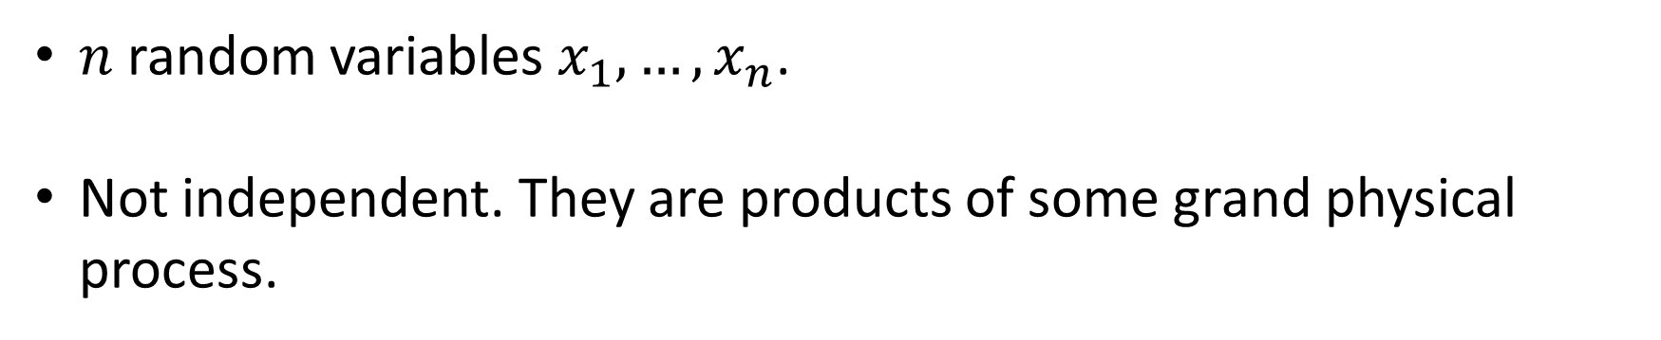


$$x_{2} x_{3} x_{4}$$
$$x_{n}$$
$$x_{1}$$
$n$ random variables $x_{1},…, x_{n}$.
Not independent. They are products of some grand physical process.

Slide 5
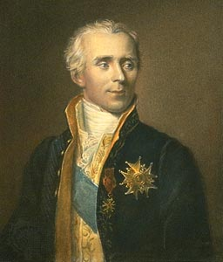
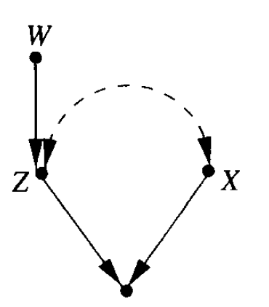





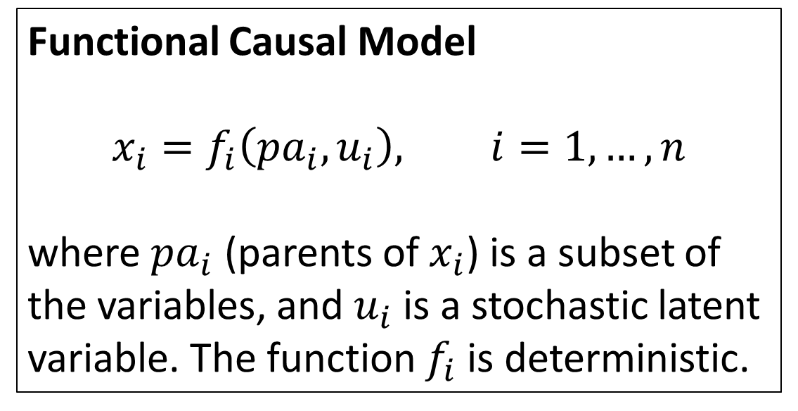

« Nous devons donc envisager l'état présent de l'universe comme l'effet de son état antérieur, et comme la cause de celui qui va suivre. » -- Essai philosophique sur les probabilités, Pierre-Simon Laplace, 1814
Functional Causal Model
$$x_{i}=f_{i}\left(pa_{i}, u_{i}\right), i=1,…, n$$
where $pa_{i}$ (parents of $x_{i}$) is a subset of the variables, and $u_{i}$ is a stochastic latent variable. The function $f_{i}$ is deterministic.
Causal Diagram
$$X_{1}$$
$u_{1},u_{2},u_{4}$ independent
$$u_{2}=u_{3}$$
“confounding”
$$X_{3}$$
$$X_{2}$$
$$X_{4}$$

Slide 6
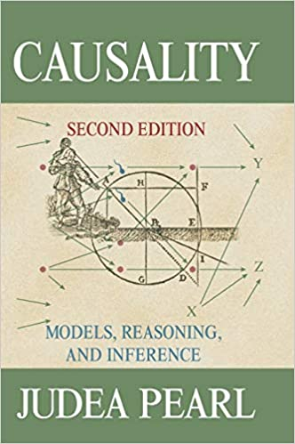

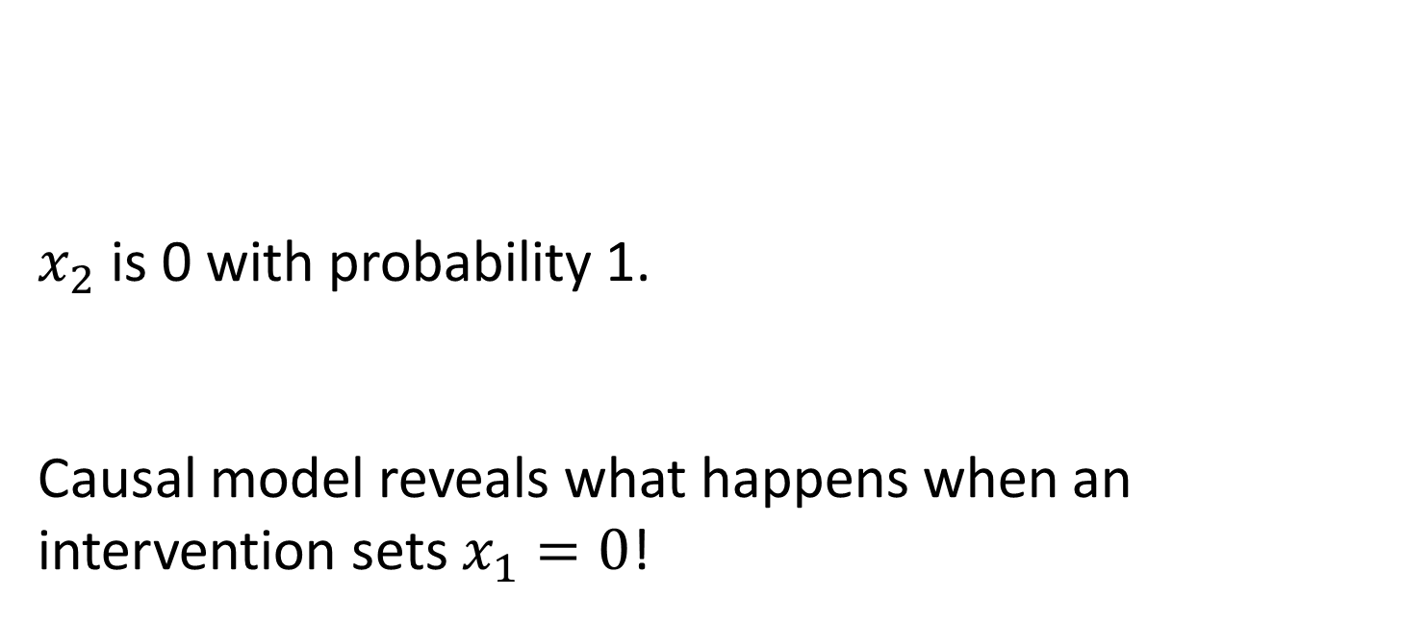


A Quick Example
$$u_{1}∼\text{Unif}(\left\{0,1\right\})$$
$$x_{1}=u_{1}$$
$$x_{2}=x_{1}⊕u_{1}$$
$x_{2}$ is 0 with probability 1.
Causal model reveals what happens when an intervention sets $x_{1}=0$!
$$x_{1}$$
$$x_{2}$$

Slide 7
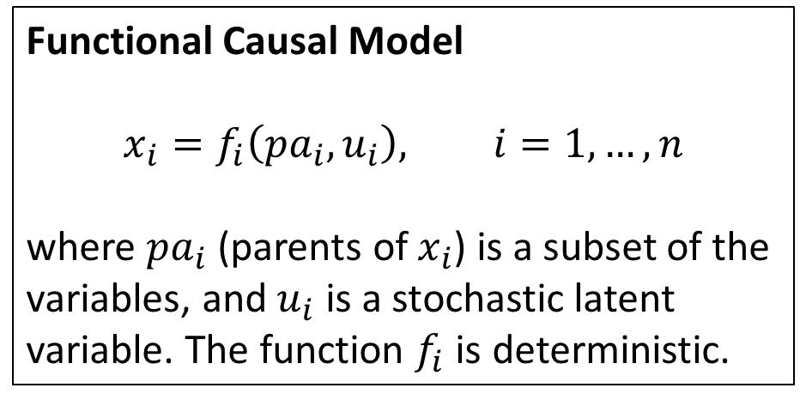
Functional Causal Model
$$x_{i}=f_{i}\left(pa_{i}, u_{i}\right), i=1,…, n$$
where $pa_{i}$ (parents of $x_{i}$) is a subset of the variables, and $u_{i}$ is a stochastic latent variable. The function $f_{i}$ is deterministic.
Throughout, assume that causal diagram is acyclic.
Explicitly specifies the effects of an exogenous treatment/intervention.
Captures what we intuitively mean by a causal process.

Slide 8
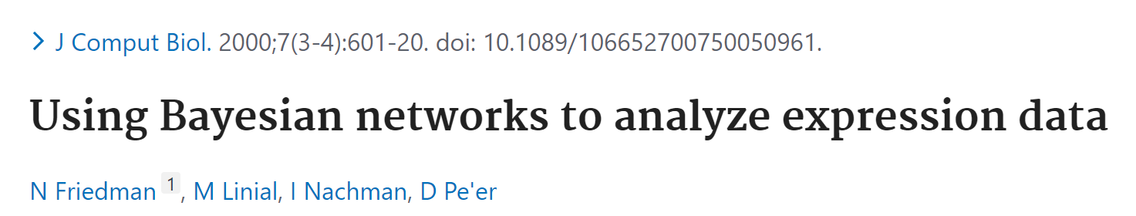
Bayesian Networks
When interpreted non-causally, as purely statistical model, FCM’s are called Bayes nets.
Bayes nets successfully used to model distributions where dependencies are localized.

Slide 9
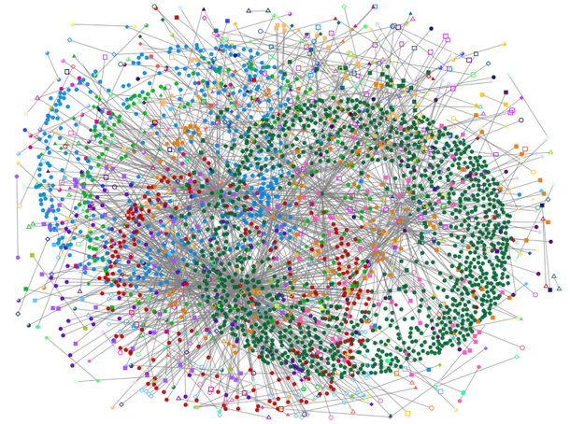
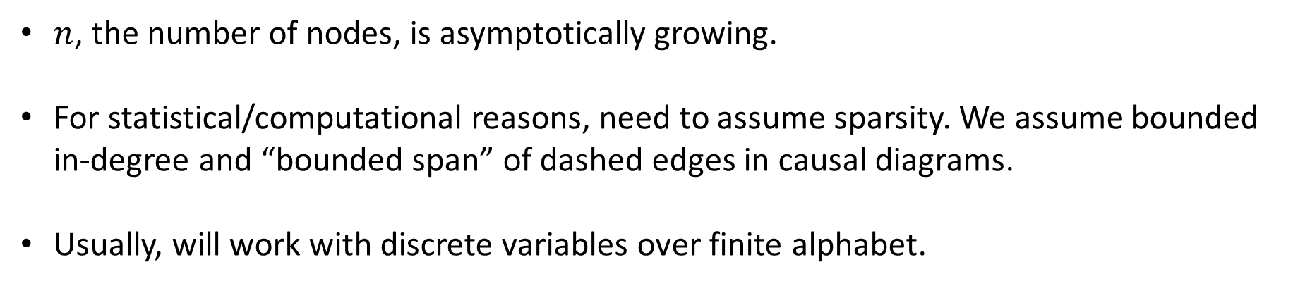
Data
Causal Model
$n$, the number of nodes, is asymptotically growing.
For statistical/computational reasons, need to assume sparsity. We assume bounded in-degree and “bounded span” of dashed edges in causal diagrams.
Usually, will work with discrete variables over finite alphabet.

Slide 10
Problems
Statistical/Causal Estimation (diagram known)
Distribution learning (observational or post-treatment)
Distance estimation
Testing validity of parameters
Statistical/Causal Discovery (diagram unknown)
Structure learning from observational and possibly interventional data
Testing structure

Slide 11
Problems
Statistical/Causal Estimation (diagram known)
Distribution learning (observational or post-treatment)
Distance estimation
Testing validity of parameters
Statistical/Causal Discovery (diagram unknown)
Structure learning from observational and possibly interventional data
Testing structure

Slide 12

Distance Measures
$$TV\left(P,Q\right)=\frac{1}{2}\sum_{x}{\left|P\left(x\right)−Q\left(x\right)\right|}$$
$$KL\left(P,Q\right)=\sum_{x}{P\left(x\right)\log{\frac{P\left(x\right)}{Q\left(x\right)}}}$$

Slide 13
Discovery

Slide 14
Problems
Statistical/Causal Estimation (diagram known)
Distribution learning (observational or post-treatment)
Distance estimation
Testing validity of parameters
Statistical/Causal Discovery (diagram unknown)
Structure learning from observational and possibly interventional data
Testing structure

Slide 15

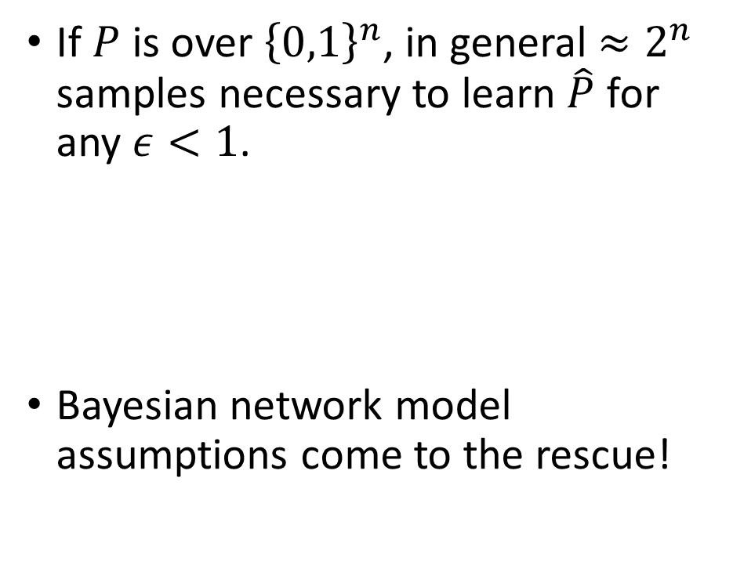
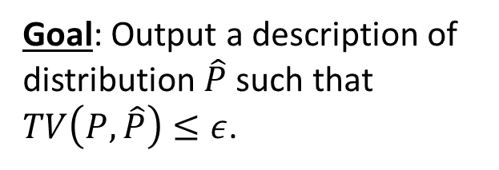
Learning High-Dimensional Distributions
If $P$ is over ${\left\{0,1\right\}}^{n}$, in general ${≈2}^{n}$ samples necessary to learn $\hat{P}$ for any $ε<1$.
Bayesian network model assumptions come to the rescue!
unknown distribution $P$
independent samples
Goal: Output a description of distribution $\hat{P}$ such that $TV\left(P, \hat{P}\right)≤ε$.

Slide 16
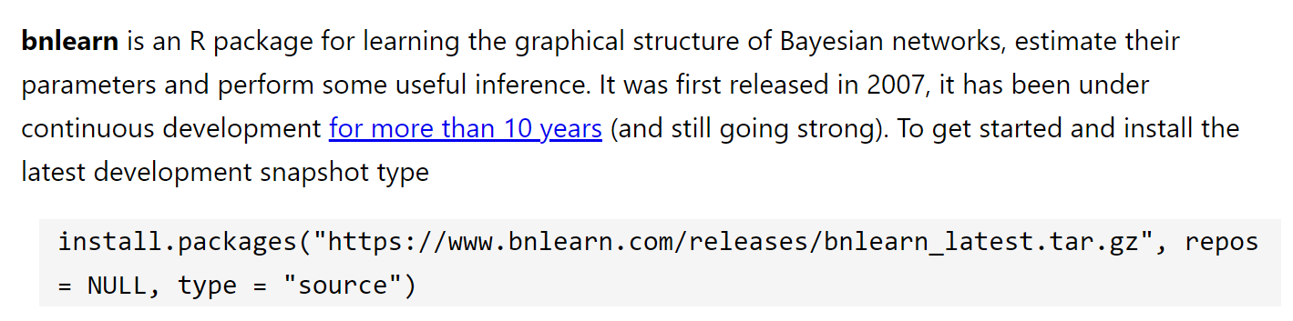
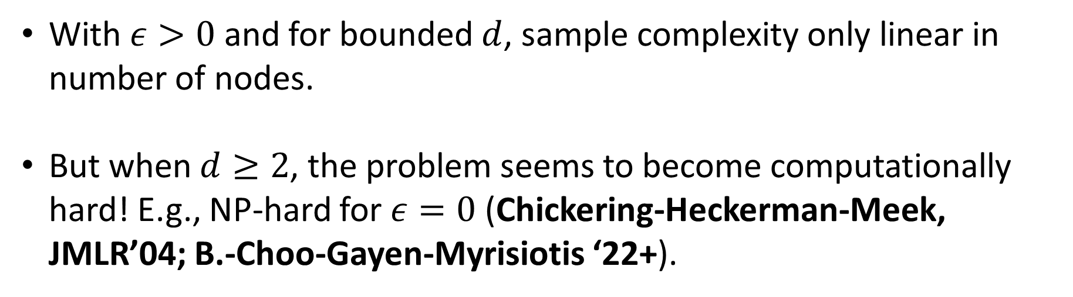
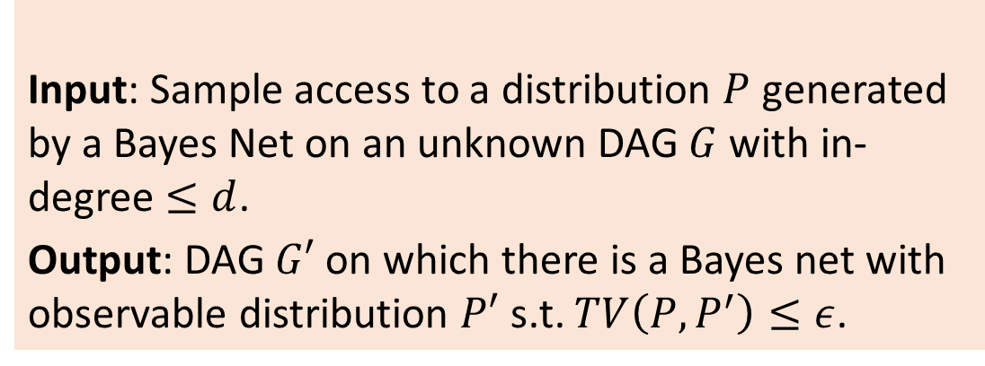

Setup
Input: Sample access to a distribution $P$ generated by a Bayes Net on an unknown DAG $G$ with in-degree $≤d$.
Output: DAG $G′$ on which there is a Bayes net with observable distribution $P′$ s.t. $TV\left(P,P^{′}\right)≤ε$.
With $ε>0$ and for bounded $d$, sample complexity only linear in number of nodes.
But when $d≥2$, the problem seems to become computationally hard! E.g., NP-hard for $ε=0$ (Chickering-Heckerman-Meek, JMLR’04; B.-Choo-Gayen-Myrisiotis ‘22+).
OPEN: Complexity when $ε>0$?

Slide 17
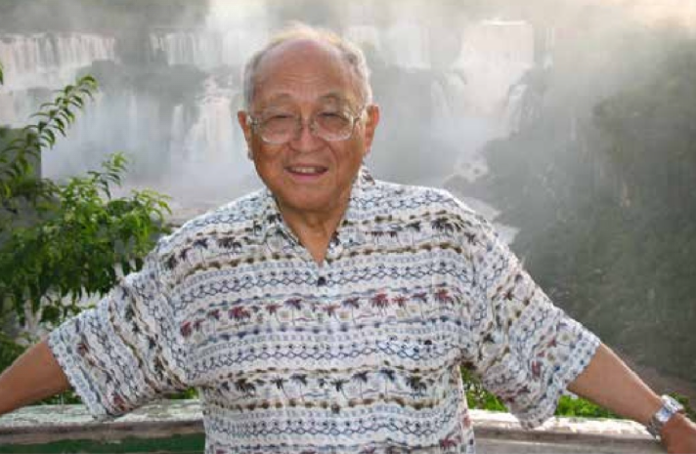

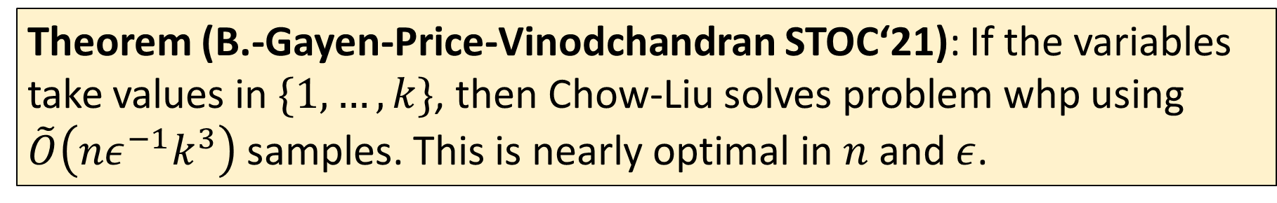
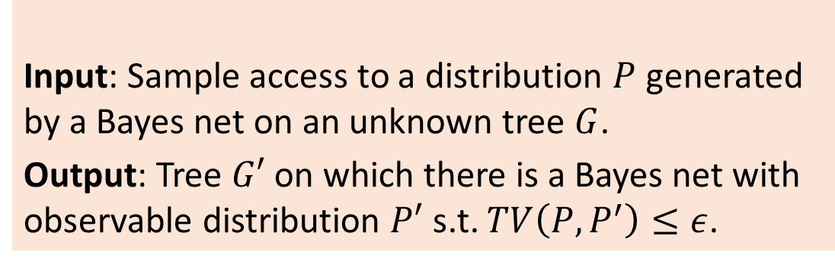
Setup
Input: Sample access to a distribution $P$ generated by a Bayes net on an unknown tree $G$.
Output: Tree $G′$ on which there is a Bayes net with observable distribution $P′$ s.t. $TV\left(P,P^{′}\right)≤ε$.
Maximum likelihood tree given by Chow-Liu algorithm (1968).
No formal finite sample guarantee prior to our work (concurrent with (Daskalakis-Pan, STOC ‘21)).
Theorem (B.-Gayen-Price-Vinodchandran STOC‘21): If the variables take values in $\{1,…, k\}$, then Chow-Liu solves problem whp using $\tilde{O}\left(nε^{−1}k^{3}\right)$ samples. This is nearly optimal in $n$ and $ε$.

Slide 18
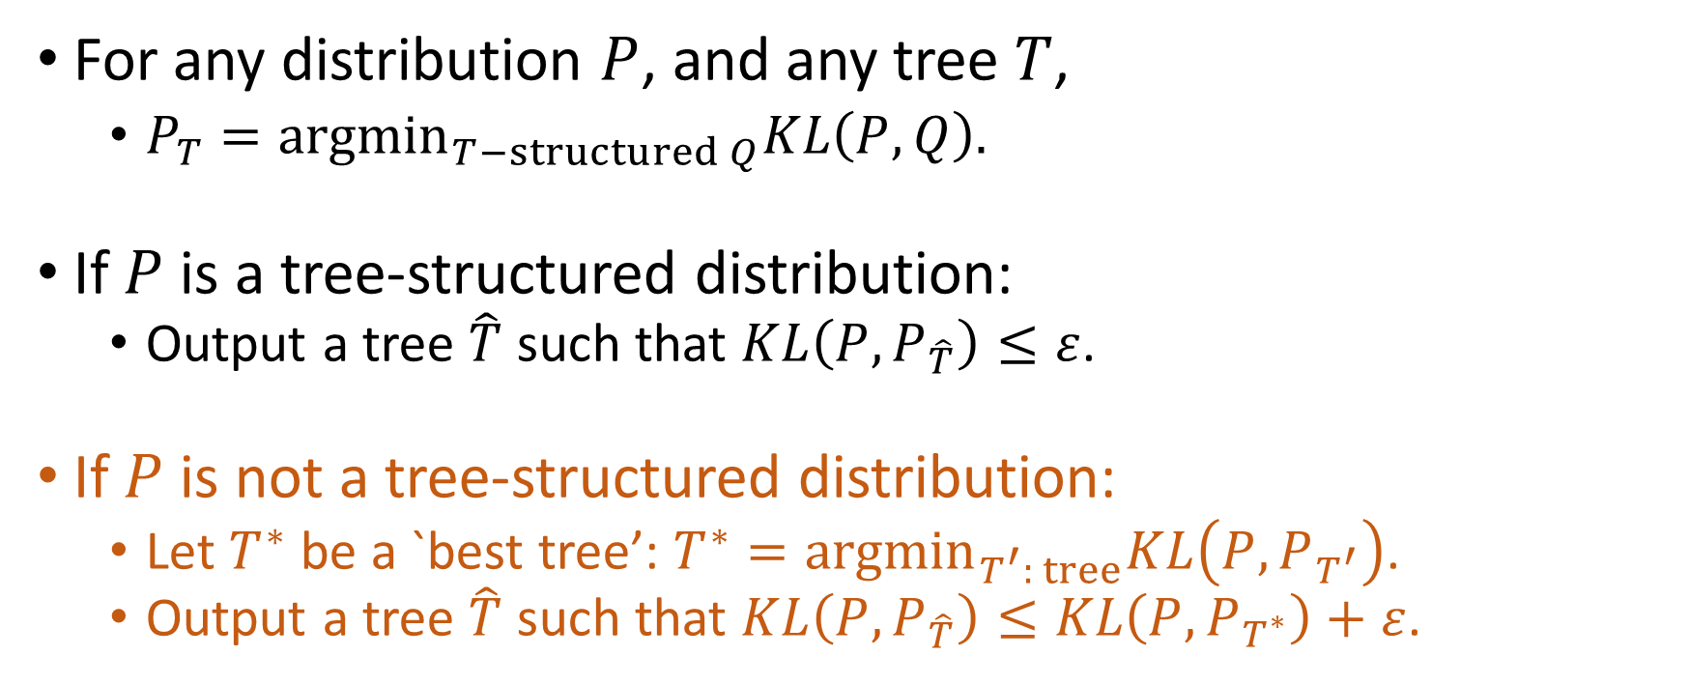
Objective: Approximate Tree
For any distribution $P$, and any tree $T$,
$P_{T}={argmin}_{T−structured Q}KL\left(P,Q\right).$
If $P$ is a tree-structured distribution:
Output a tree $\hat{T}$ such that $KL\left(P,P_{\hat{T}}\right)≤ε$.
If $P$ is not a tree-structured distribution:
Let $T^{∗}$ be a `best tree’: ${T^{∗}=argmin}_{T^{′}: tree}KL\left(P,P_{T^{′}}\right)$.
Output a tree $\hat{T}$ such that $KL\left(P,P_{\hat{T}}\right)≤KL\left(P,P_{T^{∗}}\right)+ε$.
Notes:
~Empirical works, we won’t discussing in this talk, we focus on the structure learning part.

Slide 19
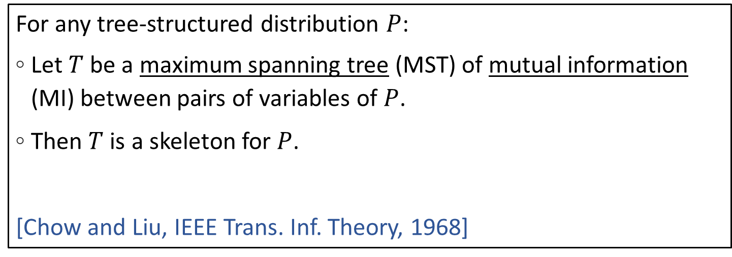
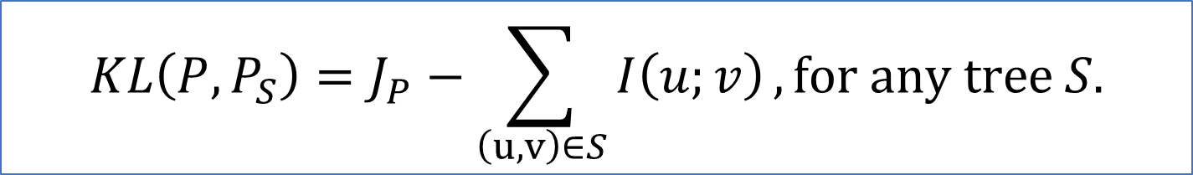
Chow-Liu Tree
needs infinite samples
$$KL\left(P,P_{S}\right)=J_{P}−\sum_{\left(u,v\right)∈S}{I\left(u;v\right)}, for any tree S.$$
For any tree-structured distribution $P$:
Let $T$ be a maximum spanning tree (MST) of mutual information (MI) between pairs of variables of $P$.
Then $T$ is a skeleton for $P$.
[Chow and Liu, IEEE Trans. Inf. Theory, 1968]
Notes:
Chow-Liu eqn.: minimizing KL $≡$ maximizing MI.

Slide 20
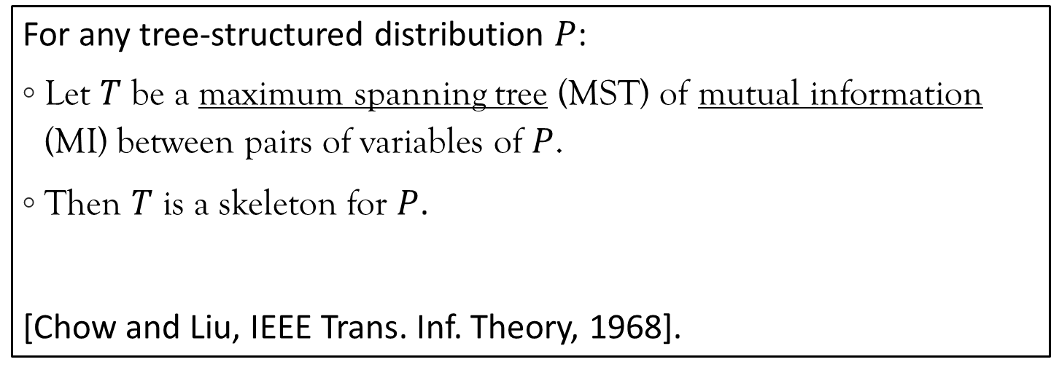
Chow-Liu Tree
Use empirical MI
$$KL\left(P,P_{S}\right)=J_{P}−\sum_{\left(u,v\right)∈S}{I\left(u;v\right)}, for any tree S.$$
For any tree-structured distribution $P$:
Let $T$ be a maximum spanning tree (MST) of mutual information (MI) between pairs of variables of $P$.
Then $T$ is a skeleton for $P$.
[Chow and Liu, IEEE Trans. Inf. Theory, 1968].
Notes:
Chow-Liu eqn.: minimizing KL $≡$ maximizing MI.

Slide 21
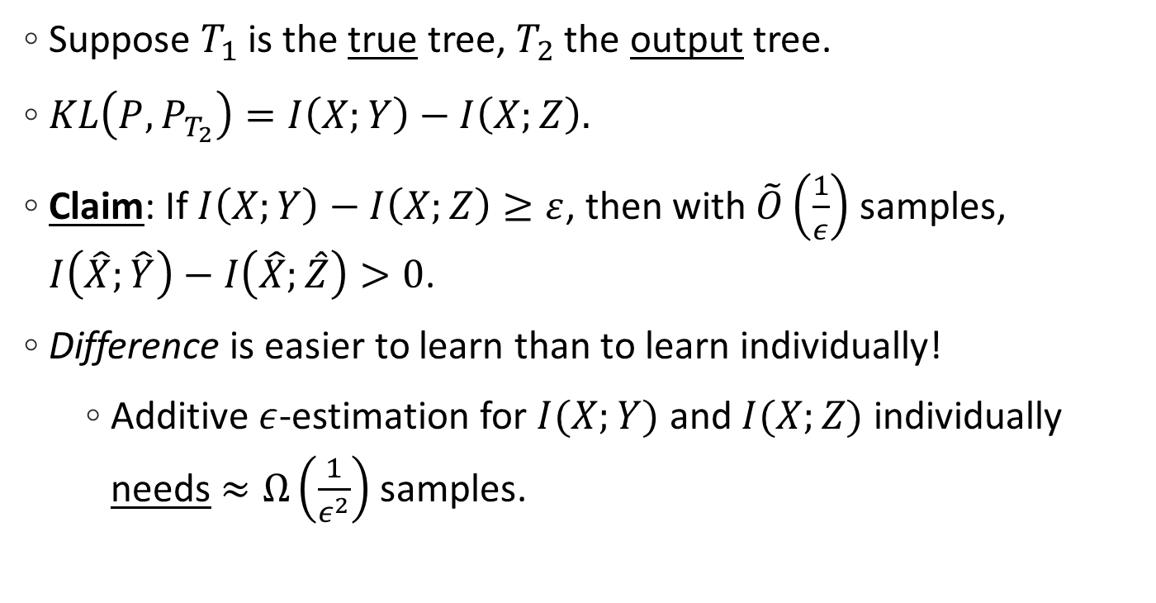


P is Tree-structured Three-variable Case
x
Suppose $T_{1}$ is the true tree, $T_{2}$ the output tree.
$KL\left(P,P_{T_{2}}\right)=I\left(X;Y\right)−I\left(X;Z\right).$
Claim: If $I\left(X;Y\right)−I\left(X;Z\right)≥ε$, then with $\tilde{O}\left(\frac{1}{ε}\right)$ samples, $I\left(\hat{X};\hat{Y}\right)−I\left(\hat{X};\hat{Z}\right)>0$.
Difference is easier to learn than to learn individually!
Additive $ε$-estimation for $I(X;Y)$ and $I(X;Z)$ individually needs $≈Ω\left(\frac{1}{ε^{2}}\right)$ samples.
y
z
$$T_{1}$$
x
y
z
$$T_{2}$$
Notes:
Equivalent to saying I hat difference is non-negative.

Slide 22

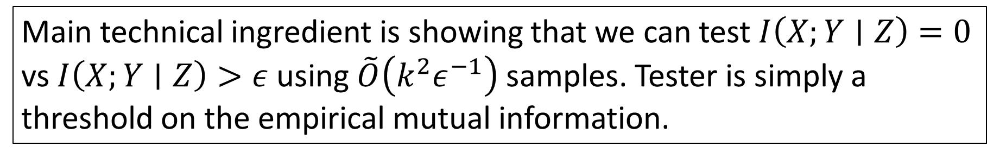
Setup
Input: Sample access to a distribution $P$ generated by a Bayes net on an unknown tree $G$.
Output: Tree $G′$ on which there is a Bayes net with observable distribution $P′$ s.t. $TV\left(P,P^{′}\right)≤ε$.
Theorem (B.-Gayen-Price-Vinodchandran STOC‘21): If the variables take values in $\{1,…, k\}$, then Chow-Liu solves problem whp using $\tilde{O}\left(nε^{−1}k^{3}\right)$ samples. This is nearly optimal in $n$ and $ε$.
OPEN: Is $\tilde{O}\left(kε^{−1}\right)$ samples enough?
Main technical ingredient is showing that we can test $I\left(X;Y∣Z\right)=0$ vs $I\left(X;Y∣Z\right)>ε$ using $\tilde{O}\left(k^{2}ε^{−1}\right)$ samples. Tester is simply a threshold on the empirical mutual information.

Slide 23

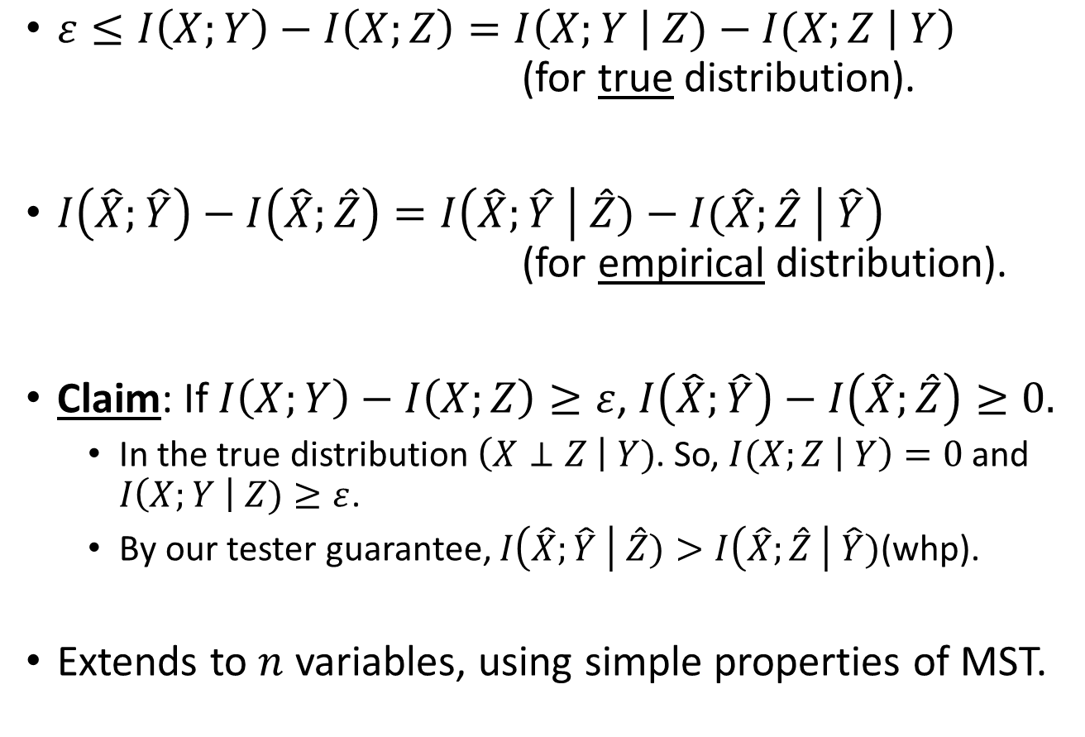

Sketch of Analysis
$ε≤I\left(X;Y\right)−I\left(X;Z\right)=I\left(X;Y \right| Z)−I(X;Z \left| Y\right)$ (for true distribution).
$I\left(\hat{X};\hat{Y}\right)−I\left(\hat{X};\hat{Z}\right)=I\left(\hat{X};\hat{Y} \right| \hat{Z})−I(\hat{X};\hat{Z} \left| \hat{Y}\right)$ (for empirical distribution).
Claim: If $I\left(X;Y\right)−I\left(X;Z\right)≥ε$, $I\left(\hat{X};\hat{Y}\right)−I\left(\hat{X};\hat{Z}\right)≥0.$
In the true distribution $\left(X⊥Z \right| Y)$. So, $I(X;Z \left| Y\right)=0$ and $I\left(X;Y \right| Z)≥ε$.
By our tester guarantee, $I\left(\hat{X};\hat{Y} \right| \hat{Z})>I\left(\hat{X};\hat{Z} \right| \hat{Y})$(whp).
Extends to $n$ variables, using simple properties of MST.
x
y
z
$$T_{1}$$
x
y
z
$$T_{2}$$
Notes:
Chow-Liu eqn.: minimizing KL $≡$ maximizing MI.

Slide 24
Problems
Statistical/Causal Estimation (diagram known)
Distribution learning (observational or post-treatment)
Distance estimation
Testing validity of parameters
Statistical/Causal Discovery (diagram unknown)
Structure learning from observational and possibly interventional data
Testing structure

Slide 25
[Doll-Hill, “Smoking and Carcinoma of the Lung”, ’50]
Smoking
Lung Cancer
: Smokers more likely than non-smokers to get lung cancer.
British Medical Research Council
Notes:
We all have heard “correlation does not imply causation”. Let’s see an actual example of this.
Studies found that smokers are nearly 25 times more likely to get lung cancer than non-smokers. That’s consistent with the view that smoking causes lung cancer. But it’s also consistent with another hypothesis: there’s an underlying unknown gene that both makes the person want to smoke and also increases the chance of lung cancer. This alternate hypothesis was made by Ronald Fisher, the founder of modern statistics and also a chain smoker!
What experiment would you do to distinguish between the two?

Slide 26
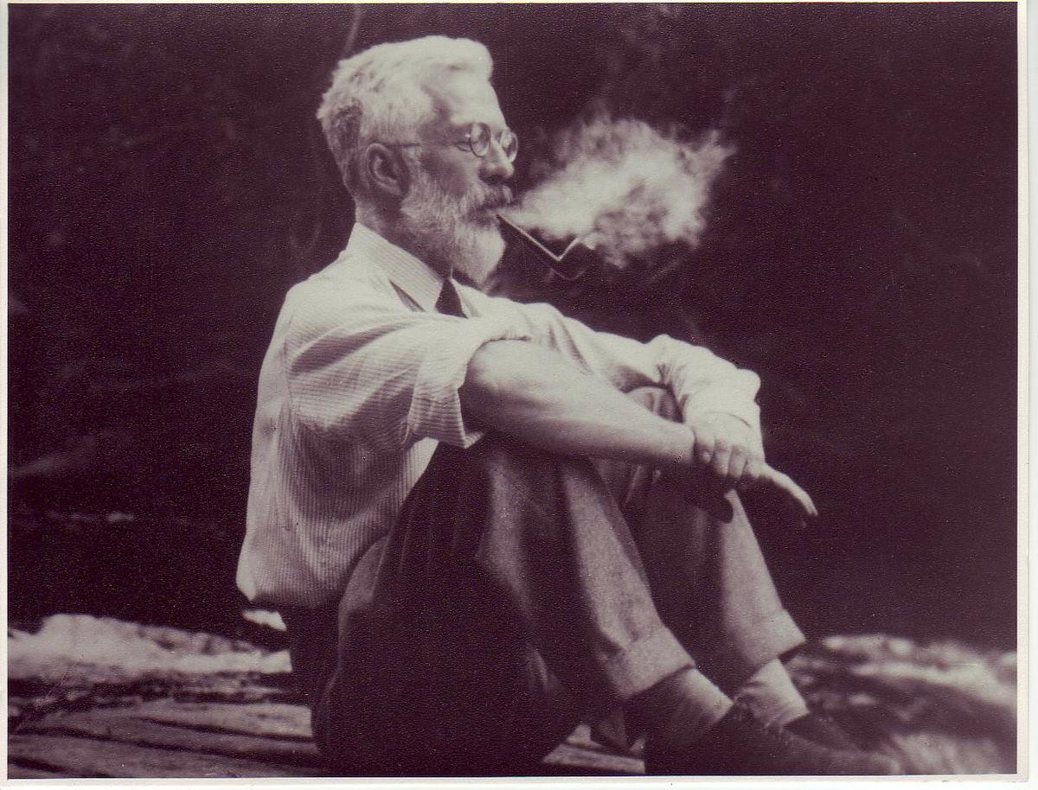
[Doll-Hill, “Smoking and Carcinoma of the Lung”, ’50]
Smoking
Lung Cancer
Smoking
Lung Cancer
Smoking
Gene
Lung Cancer
: Smokers more likely than non-smokers to get lung cancer.
British Medical Research Council
Notes:
We all have heard “correlation does not imply causation”. Let’s see an actual example of this.
Studies found that smokers are nearly 25 times more likely to get lung cancer than non-smokers. That’s consistent with the view that smoking causes lung cancer. But it’s also consistent with another hypothesis: there’s an underlying unknown gene that both makes the person want to smoke and also increases the chance of lung cancer. This alternate hypothesis was made by Ronald Fisher, the founder of modern statistics and also a chain smoker!
What experiment would you do to distinguish between the two?

Slide 27
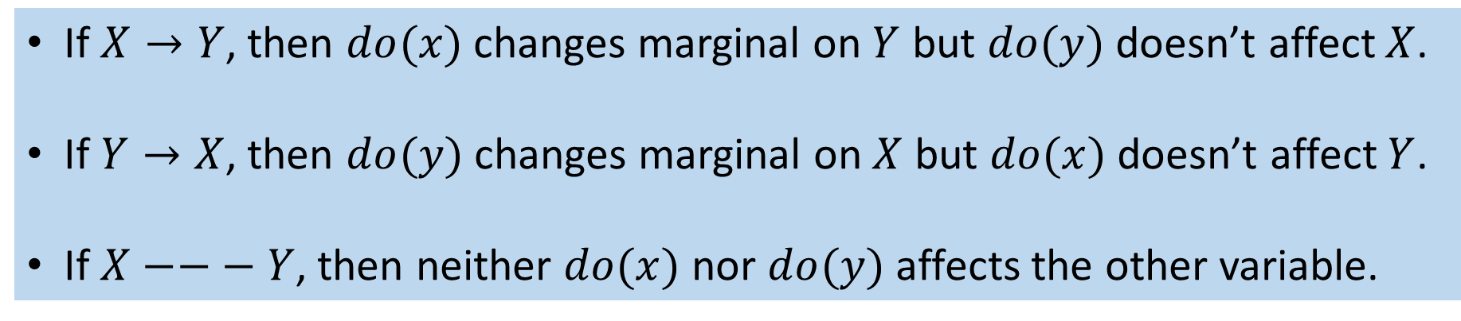
Which way’s the arrow?
Only rigorous way to find the true direction is to conduct interventions.
If $X→Y$, then $do(x)$ changes marginal on $Y$ but $do(y)$ doesn’t affect $X$.
If $Y→X$, then $do(y)$ changes marginal on $X$ but $do(x)$ doesn’t affect $Y$.
If $X−−− Y$, then neither $do(x)$ nor $do(y)$ affects the other variable.

Slide 28
Learning from Interventions
Interventions implemented by randomized controlled trials where the number of samples is finite.
Question: How many samples from observational and interventional distributions do we need to determine the truth? Can we save on interventional samples if we take more observational samples?

Slide 29
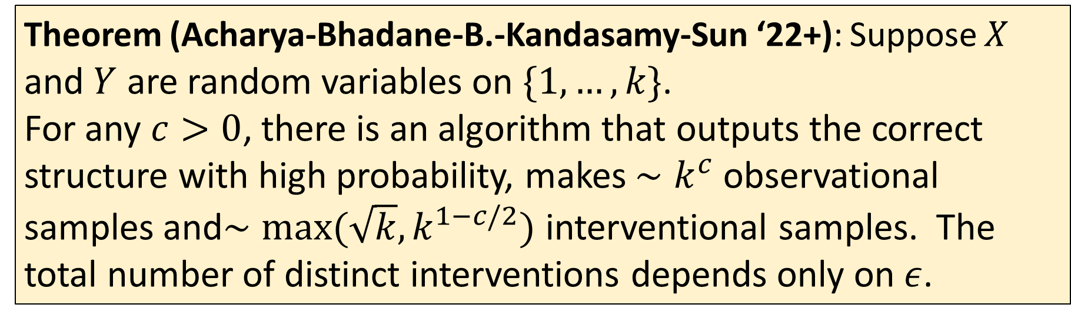
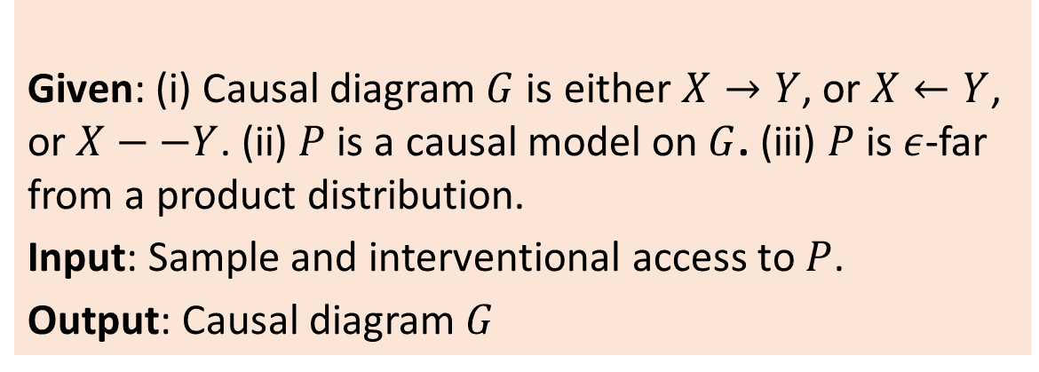
Setup
Given: (i) Causal diagram $G$ is either $X→Y$, or $X←Y$, or $X−−Y$. (ii) $P$ is a causal model on $G$. (iii) $P$ is $ε$-far from a product distribution.
Input: Sample and interventional access to $P$.
Output: Causal diagram $G$
Theorem (Acharya-Bhadane-B.-Kandasamy-Sun ‘22+): Suppose $X$ and $Y$ are random variables on $\{1,…, k\}$.
For any $c>0$, there is an algorithm that outputs the correct structure with high probability, makes $∼k^{c}$ observational samples and$∼max⁡(\sqrt{k},k^{1−c/2})$ interventional samples. The total number of distinct interventions depends only on $ε$.

Slide 30
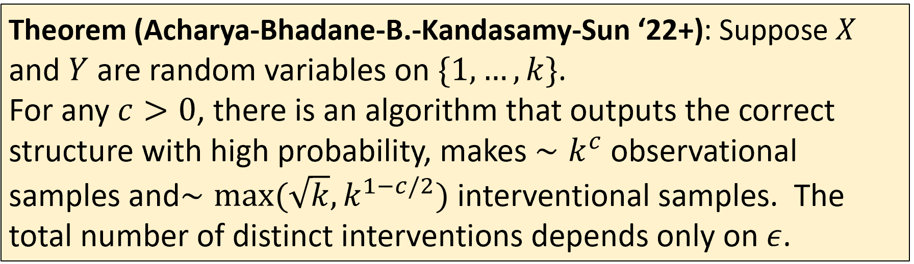
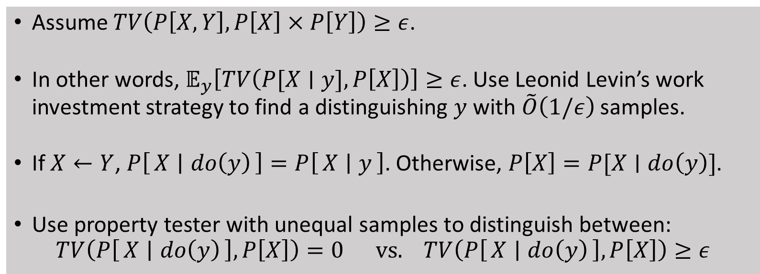
Sketch of Analysis
Assume $TV\left(P\left[X,Y\right], P\left[X\right]×P\left[Y\right]\right)≥ε$.
In other words, $𝔼_{y}\left[TV\left(P[X∣y], P\left[X\right]\right)\right]≥ε$. Use Leonid Levin’s work investment strategy to find a distinguishing $y$ with $\tilde{O}\left(1/ε\right)$ samples.
If $X←Y$, $P\left[X ∣ do\left(y\right)\right]=P\left[X ∣ y\right]$. Otherwise, $P\left[X\right]=P[X∣do\left(y\right)]$.
Use property tester with unequal samples to distinguish between: $TV\left(P\left[X ∣ do\left(y\right)\right], P\left[X\right]\right)=0 \text{vs}\text{.} TV\left(P\left[X ∣ do\left(y\right)\right],P\left[X\right]\right)≥ε$

Slide 31
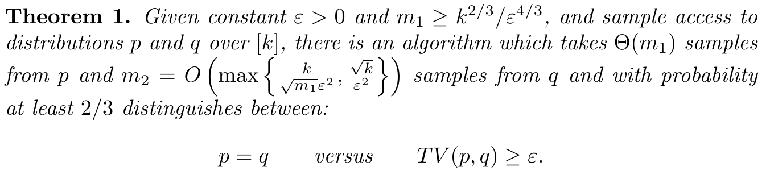
Closeness Testing
[Bhattacharya-Valiant, “Testing Closeness with Unequal Samples”, ’15]

Slide 32
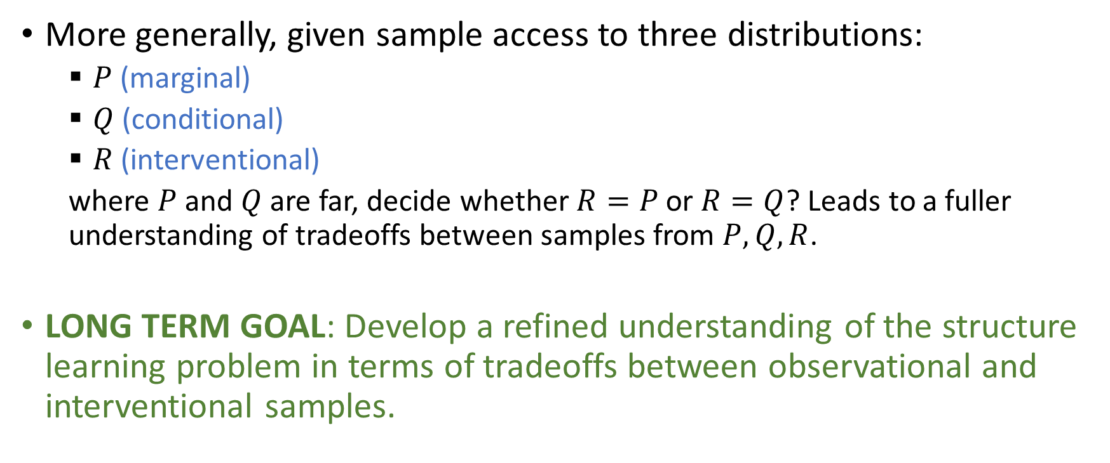
More Remarks
More generally, given sample access to three distributions:
$P$ (marginal)
$Q$ (conditional)
$R$ (interventional)
where $P$ and $Q$ are far, decide whether $R=P$ or $R=Q$? Leads to a fuller understanding of tradeoffs between samples from $P, Q, R$.
LONG TERM GOAL: Develop a refined understanding of the structure learning problem in terms of tradeoffs between observational and interventional samples.

Slide 33
Problems
Statistical/Causal Estimation (diagram known)
Distribution learning (observational or post-treatment)
Distance estimation
Testing validity of parameters
Statistical/Causal Discovery (diagram unknown)
Structure learning from observational and possibly interventional data
Testing structure

Slide 34
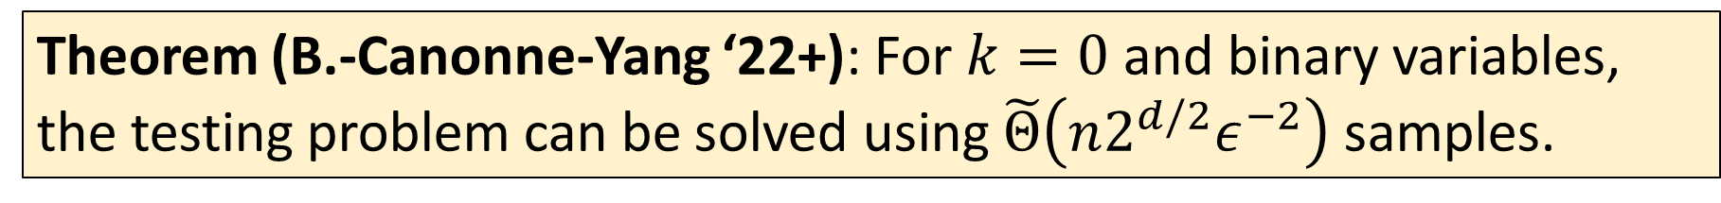
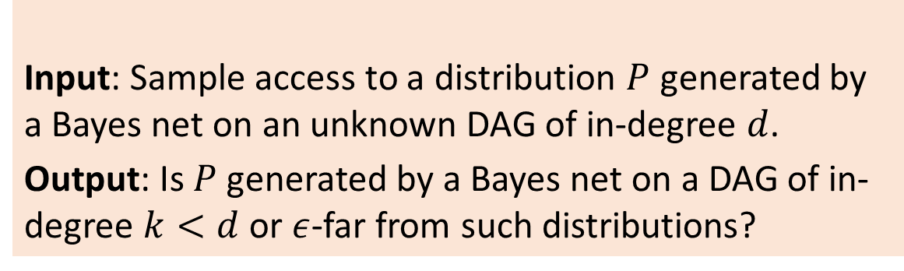
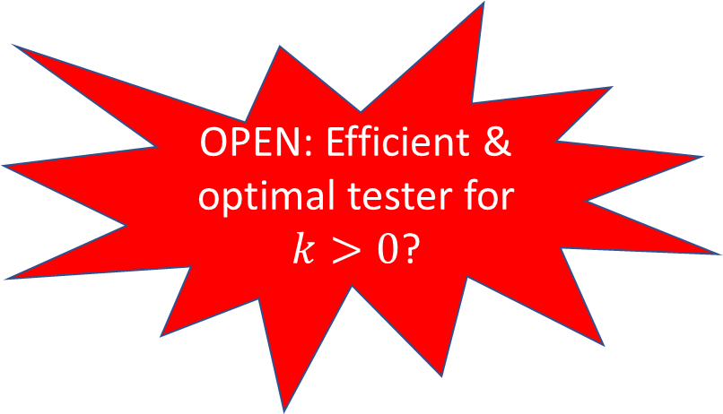
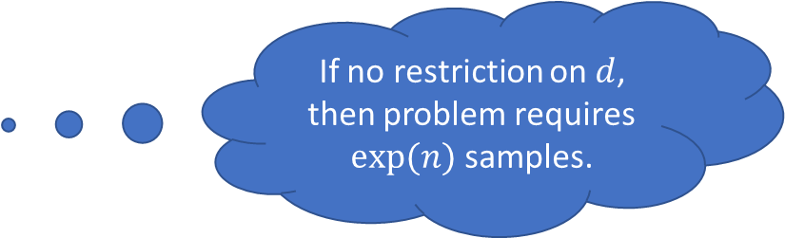
Setup
Input: Sample access to a distribution $P$ generated by a Bayes net on an unknown DAG of in-degree $d$.
Output: Is $P$ generated by a Bayes net on a DAG of in-degree $k<d$ or $ε$-far from such distributions?
If no restriction on $d$, then problem requires $exp⁡(n)$ samples.
Theorem (B.-Canonne-Yang ‘22+): For $k=0$ and binary variables, the testing problem can be solved using $\tilde{Θ}\left(n2^{d/2}ε^{−2}\right)$ samples.
OPEN: Efficient & optimal tester for $k>0$?
OPEN: Test other graphical properties, e.g., connectedness.
The algorithm tests for independence on each subset of $d+1$ variables. Lower bound is technically quite involved.

Slide 35
Estimation

Slide 36
Problems
Statistical/Causal Estimation (diagram known)
Distribution learning (observational or post-treatment)
Distance estimation
Testing validity of parameters
Statistical/Causal Discovery (diagram unknown)
Structure learning from observational and possibly interventional data
Testing structure

Slide 37
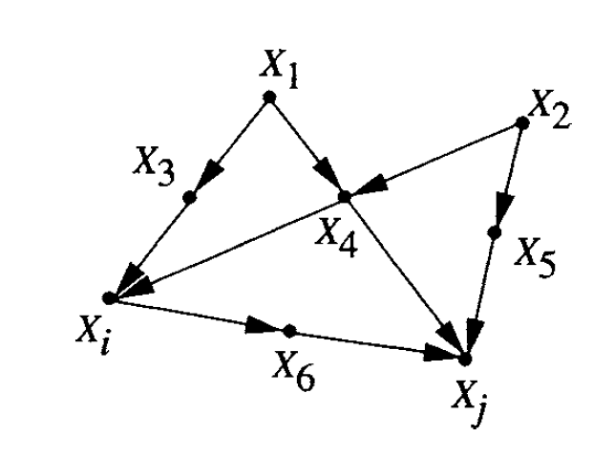
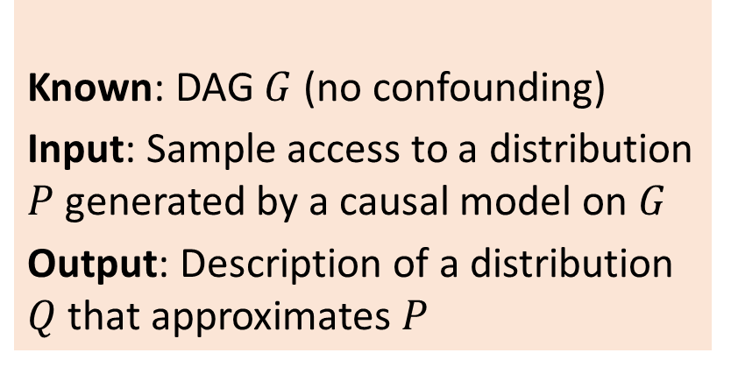
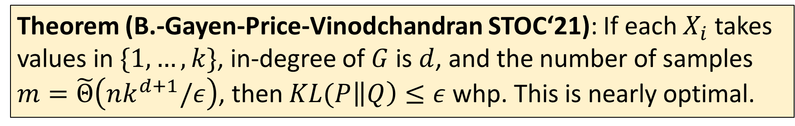


Setup
Known: DAG $G$ (no confounding)
Input: Sample access to a distribution $P$ generated by a causal model on $G$
Output: Description of a distribution $Q$ that approximates $P$
$$X_{7}$$
$$X_{8}$$
Theorem (B.-Gayen-Price-Vinodchandran STOC‘21): If each $X_{i}$ takes values in $\{1,…, k\}$, in-degree of $G$ is $d$, and the number of samples $m=\tilde{Θ}\left(nk^{d+1}/ε\right)$, then $KL(P\left\|Q\right)≤ε$ whp. This is nearly optimal.

Slide 38
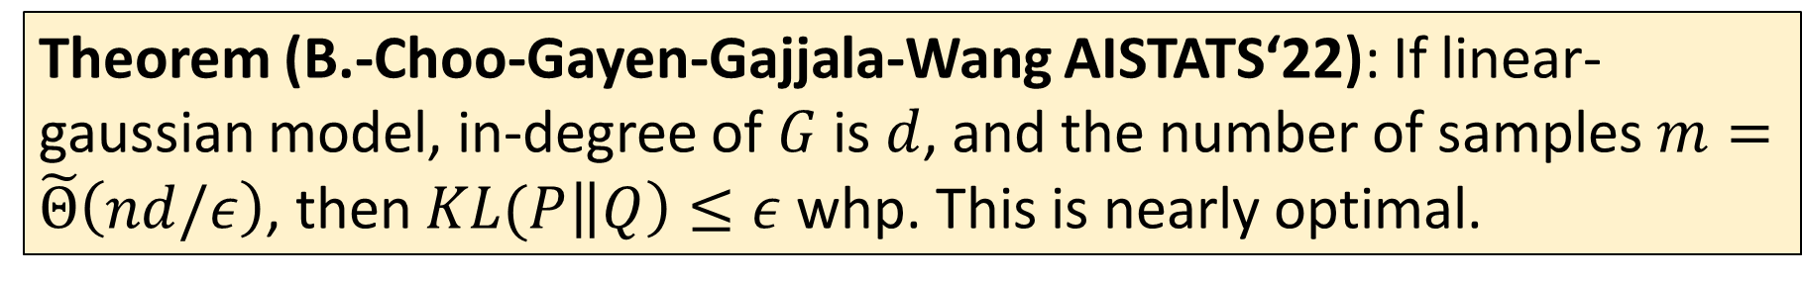
Setup
Functions linear
Latent vars gaussian
Known: DAG $G$ (no confounding)
Input: Sample access to a distribution $P$ generated by a causal model on $G$
Output: Description of a distribution $Q$ that approximates $P$
$$X_{7}$$
$$X_{8}$$
Theorem (B.-Choo-Gayen-Gajjala-Wang AISTATS‘22): If linear-gaussian model, in-degree of $G$ is $d$, and the number of samples $m=\tilde{Θ}\left(nd/ε\right)$, then $KL(P\left\|Q\right)≤ε$ whp. This is nearly optimal.

Slide 39
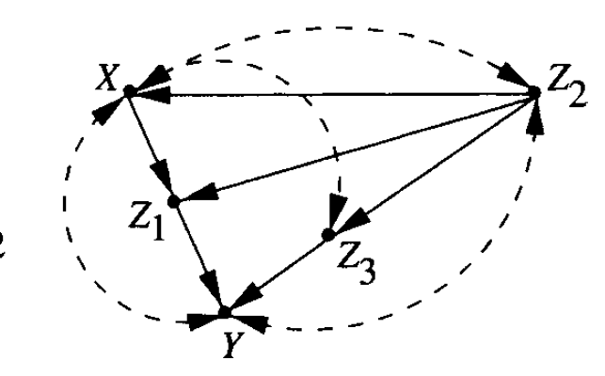
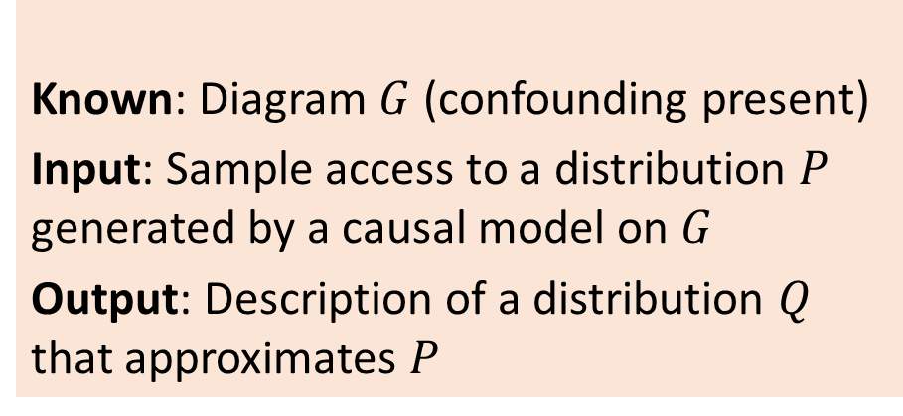
Setup
Known: Diagram $G$ (confounding present)
Input: Sample access to a distribution $P$ generated by a causal model on $G$
Output: Description of a distribution $Q$ that approximates $P$
If arbitrary confounding, then distribution can be arbitrary, and problem is intractable.
c-component: connected component through dashed arcs
If c-component sizes bounded, then similar bounds possible.

Slide 40
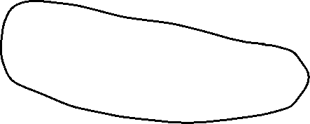
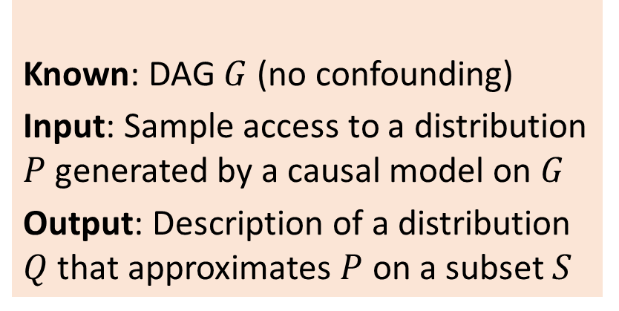

Setup
Known: DAG $G$ (no confounding)
Input: Sample access to a distribution $P$ generated by a causal model on $G$
Output: Description of a distribution $Q$ that approximates $P$ on a subset $S$
$$X_{7}$$
$$X_{8}$$
$$S$$

Slide 41
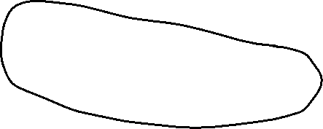



Setup
Known: DAG $G$ (no confounding)
Input: Sample access to a distribution $P$ generated by a causal model on $G$
Output: Description of a distribution $Q$ that approximates $P$ on a subset $S$
$$X_{7}$$
$$X_{8}$$
$$S$$
What do we really mean by description of $Q$?
Two possibilities:
Sampler: Generate a box so that when you press a button, you get a sample from $Q$.
Sampler($Q$)

Slide 42

Setup
Known: DAG $G$ (no confounding)
Input: Sample access to a distribution $P$ generated by a causal model on $G$
Output: Description of a distribution $Q$ that approximates $P$ on a subset $S$
$$X_{7}$$
$$X_{8}$$
$$S$$
What do we really mean by description of $Q$?
Two possibilities:
Sampler: Generate a box so that when you press a button, you get a sample from $Q$.
$$z∼Q$$
Sampler($Q$)

Slide 43




Setup
Known: DAG $G$ (no confounding)
Input: Sample access to a distribution $P$ generated by a causal model on $G$
Output: Description of a distribution $Q$ that approximates $P$ on a subset $S$
$$X_{7}$$
$$X_{8}$$
$$S$$
What do we really mean by description of $Q$?
Two possibilities:
Sampler: Generate a box so that when you press a button, you get a sample from $Q$.
Evaluator: Generate a box that takes in an input $z$ and outputs the mass $Q(z)$.
$$z$$
$$Q(z)$$
Evaluator($Q$)

Slide 44

Setup
Known: DAG $G$ (no confounding)
Input: Sample access to a distribution $P$ generated by a causal model on $G$
Output: Description of a distribution $Q$ that approximates $P$ on a subset $S$
$$X_{7}$$
$$X_{8}$$
$$S$$
Learning a sampler is easy! First, learn $Q_{0}$ on all variables as before. Then, generate samples from $Q_{0}$ but retain only the $S$ part. Guarantee: If $KL(P \left\|Q_{0}\right)≤ε$, $TV\left(P{\left.​\right|}_{S},Q_{0}{\left.​\right|}_{S}\right)≤\sqrt{2ε}$.
Learning an evaluator is hard! The graph isomorphism problem reduces to it (B.-Gayen-Kandasamy-Vinodchandran AISTATS‘22).
OPEN: What is the true complexity?

Slide 45
Problems
Statistical/Causal Estimation (diagram known)
Distribution learning (observational or post-treatment)
Distance estimation
Testing validity of parameters
Statistical/Causal Discovery (diagram unknown)
Structure learning from observational and possibly interventional data
Testing structure

Slide 46

Approximate Model Equivalence
There can be different Bayes nets yielding the same observable distribution.
Even more ambiguity if distributions can be approximately equal.
Can we test such approximate equivalence efficiently?

Slide 47




Setup
Input: Descriptions of two distributions $P$ and $Q$ as Bayes nets.
Output: Compute $TV(P,Q)$.
$$P$$
$$Q$$
Theorem (B.-Gayen-Meel-Myrisiotis-Pavan-Vinodchandran ’22+): Deciding whether $TV(P,Q)$ equals zero or not is NP-hard for Bayes nets $P$ and $Q$ of in-degree 2.
Relative approximation NP-hard

Slide 48

Setup
Purely computational problem!
Input: Descriptions of two distributions $P$ and $Q$ as Bayes nets.
Output: Compute $TV(P,Q)$.
$$P$$
$$Q$$
Theorem (B.-Gayen-Meel-Myrisiotis-Pavan-Vinodchandran ’22+): Computing $TV(P,Q)$ between two product distributions $P$ and $Q$ is #P-hard.

Slide 49


Setup
Approach quite general and extends beyond Bayes nets. E.g., gaussians and ferromagnetic Ising models
Input: Descriptions of two distributions $P$ and $Q$ as Bayes nets
Output: Approximate $TV(P,Q)$ upto $±ε$.
$$P$$
$$Q$$
$TV\left(P,Q\right)=\frac{1}{2}\sum_{x}{\left|P\left(x\right)−Q\left(x\right)\right|}$ $=\frac{1}{2}\sum_{x}{P\left(x\right)⋅\left(\left(1−\frac{Q\left(x\right)}{P\left(x\right)}\right)⋅1\left[P\left(x\right)>Q(x)\right]\right)}$
Can estimate TV additively by sampling from $P$ and empirically averaging above estimand (B.-Gayen-Meel-Vinodchandran NeurIPS’20).
Gives an efficient tolerant testing algorithm for Bayes nets with bounded in-degree.
OPEN: Efficient tolerant testing without learning?

Slide 50


Setup
Input: Descriptions of two product distributions $P$ and $Q$.
Output: Approximate $TV(P,Q)$ upto multiplicative $(1±ε)$ factor.
$$P$$
$$Q$$
A bit surprisingly, poly time algorithm possible in some cases! (B.-Gayen-Meel-Myrisiotis-Pavan-Vinodchandran ‘22+)
For example, $Q$ is uniform.
Approximating $\sum_{S}{\max\left(0, \prod_{i∈S}{p_{i}}\prod_{i∉S}{\left(1−p_{i}\right)−2^{−n}}\right)}$ reduces to approximating # of sets $S$ such that $\prod_{i∈S}{\frac{p_{i}}{1−p_{i}} }$ lies in an interval, which reduces to approximate knapsack counting (Dyer STOC’03).
Algorithm for more general class of distributions using some ideas from (Gopalan-Klivans-Meka FOCS‘11).

Slide 51
Problems
Statistical/Causal Estimation (diagram known)
Distribution learning (observational or post-treatment)
Distance estimation
Testing validity of parameters
Statistical/Causal Discovery (diagram unknown)
Structure learning from observational and possibly interventional data
Testing structure

Slide 52





Setup
Known: DAG $G$ (no confounding), causal model $Q$ on $G$
Input: Sample access to a distribution $P$ generated by a causal model on $G$
Output: Is $P=Q$ or $TV\left(P,Q\right)>ε$?
$$P$$
$$Q$$
Nature
Scientist’s proposal
OPEN: Similar results for continuous variables?
If distributions are product on ${\left\{1,…, k\right\}}^{n}$, then sample complexity is $Θ\left(\sqrt{nk}/ε^{2}\right)$ samples (Daskalakis-Pan COLT‘17, Canonne-Diakonikolas-Kane-Stewart COLT‘17, B.-Gayen-Kandasamy-Vinodchandran ALT‘21).
Test statistic: $T=\frac{\sum_{i}{{\left(N_{i}−mq_{i}\right)}^{2}−N_{i}}}{mq_{i}}$ where $N_{i}$ is the sample count of $i$.
If $G$ has in-degree $d$, then current best bound is $O\left(nk^{0.75(d+1)}ε^{−2}\right)$ samples (Daskalakis-Pan COLT’17).
OPEN: Tester with $\sim \sqrt{n}$ samples?

Slide 53



Setup
Known: DAG $G$ (no confounding), causal model $Q$ on $G$
Input: Sample access to a distribution $P$ generated by a causal model on $G$
Output: Is $TV\left(P,Q\right)<ε$ or $TV\left(P,Q\right)>2ε$?
$$P$$
$$Q$$
Nature
Scientist’s proposal
In (B.-Gayen-Meel-Vinodchandran, NeurIPS’20), algorithm estimates the distribution $P$ and then additively estimates TV distance. Sample complexity linear in $n$.
OPEN: Is tolerant testing easier than learning $P$?

Slide 54
Problems
Statistical/Causal Estimation (diagram known)
Distribution learning (observational or post-treatment)
Distance estimation
Testing validity of parameters
Statistical/Causal Discovery (diagram unknown)
Structure learning from observational and possibly interventional data
Testing structure

Slide 55




Setup
$$S$$
Known: Diagram $G$ (confounding present)
Input: Sample access to a distribution $P$ generated by a causal model on $G$, subset $S$ of variables.
Output: Description of a distribution $Q$ that approximates $P[x_{1}…, x_{n}∣do\left(x_{S}=a\right)]$.
Even infinitely many samples from the observational distribution may not yield enough information about the interventional.

Slide 56







Identifiability of Interventions
$$P_{1}$$
$$P_{2}$$
$$u_{1}∼\text{Unif}(\left\{0,1\right\})$$
$$x_{1}=u_{1}$$
$$x_{2}=0$$
$$u_{1}∼\text{Unif}(\left\{0,1\right\})$$
$$x_{1}=u_{1}$$
$$x_{2}=x_{1}⊕u_{1}$$
$$x_{1}$$
$$x_{2}$$
Observable distribution of $(x_{1},x_{2})$ exactly the same. But:
$$P_{1}\left(x_{2}=0 ∣ do\left(x_{1}=0\right)\right)=1; P_{2}\left(x_{2}=0 ∣ do\left(x_{1}=0\right)\right)=\frac{1}{2}$$
Impossible to predict interventional effect from observations, only knowing $G$.

Slide 57




Identifiability of Interventions
$$x_{1}$$
$$x_{3}$$
$$x_{2}$$
For any causal model on this diagram, interventional distribution identifiable from observations.
Example:
$$\operatorname{Pr}\left[x_{2}=1, x_{3}=0∣do(x_{1}=0)\right] \\ =\operatorname{Pr}\left[x_{2}=1 ∣ x_{1}=0\right]⋅\sum_{a}{\operatorname{Pr}\left[x_{1}=a\right]⋅Pr⁡[x_{3}=0∣x_{1}=a, x_{2}=1]}$$

Slide 58






Identifiability of Interventions
Interventions always identifiable from observational distribution, if no confounding.
(Tian-Pearl, AAAI’02) and (Shpitser-Pearl, AAAI’06) exactly characterized the causal diagrams for which interventional distribution not identifiable from observations.
Atomic Interventions
$$x_{1}$$
$$x_{2}$$
$$x_{1}$$
$$x_{2}$$
$$x_{3}$$
Theorem (Tian-Pearl, AAAI’02): For a causal model on a set of variables $V$ containing a variable $X$, $P[V∣do\left(X\right)]$ is identifiable from observations iff no child of $X$ is in the same c-component as $X$.

Slide 59

Atomic Interventions
Theorem (B.-Gayen-Kandasamy-Maran-Vinodchandran, ICML ‘21): Given a causal diagram $G$ on a set of variables $V$ containing a variable $X$, let $S_{1}$ be the c-component containing $X$. Suppose $P$ is a causal model on $G$. Assume:
(identifiability) no child of $X$ is in the same c-component as $X$;
(positivity) any assignment to $S_{1}∪Pa(S_{1})$ occurs with prob. $≥α$;
(sparsity) in-degree $≤d$, c-component size $≤k$
Then, $P\left(V ∣ do\left(X\right)\right)$ can be learned (as estimator or sampler) upto TV error $ε$ using $\tilde{O}\left(\exp\left(kd\right)⋅nα^{−k}ε^{−2}\right)$ observational samples.
Generalization to large interventions in (B.-Gayen-Kandasamy-Raval-Vinodchandran, AISTATS’22)

Slide 60





$$P$$
Suppose the causal diagram (after removing dashed edges) looks like:
$$D$$
Fact: $P\left[V∖\{X\} ∣ do\left(X=x\right)\right]$ can be viewed as the marginal of the observational distribution of new Bayes net $D$ to all variables except $X$.

Slide 61


Generate samples from $D$ using samples from $P$. Causes $α^{−k}$ overhead.
Apply fixed-structure distribution learning algorithm to learn $D$.
Marginalize out $X$.
OPEN: Non-parametric generalization for continuous variables?
OPEN: Robust learning?

Slide 62

Conclusion
Finite-sample PAC style bounds for distribution and causal learning problems. Hopefully, demonstrated the plethora of open problems that still abound.
Longer term visions:
Finite sample bounds for tools from econometrics and potential outcome theory?
Counterfactual learning

