Slide 1
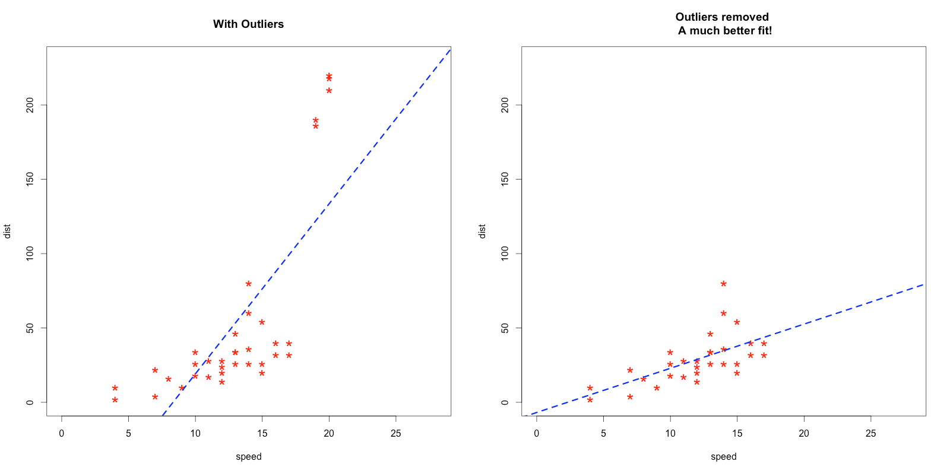
Impact of Outliers

Slide 2
Data Preprocessing
Issues in datasets
Missing values
Noise values
Irrelevant features
Duplicated records
Outliers
Categorical features
…

Slide 3
Noise, Missing Values & Outliers
Missing Value: Not given
Noise Value: Attribute level anomaly
Outlier: Record or instance level anomaly
Anomaly or outliers are the values that doesn’t comply with the rest of the values.
They are much difference from the rest which makes them doubtful to be legitimate.

Slide 4
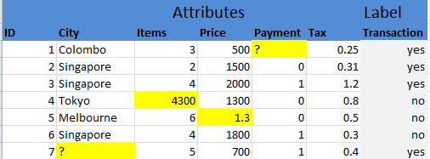
Preprocessing
Detection
Handling

