Slide 1
Handling Missing and Noise Values
Deletion Strategy
Replacement Strategy
Using Statistical Measures
Using Clustering
Pattern based Approach (A combination of clustering, classification and other techniques)

Slide 2
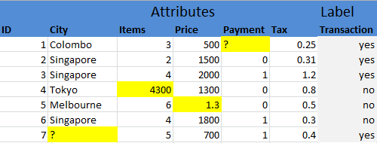
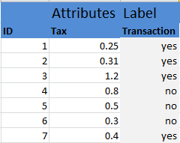
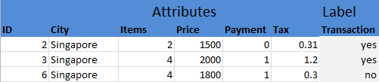
1. Deletion Strategy
Delete the records with missing values(s)
Delete the column or attribute with missing values

Slide 3
Handling Context
Global Context
Local (Concept Restricted) Context

Slide 4
2. Replacement Strategy
2. Replacing Missing Values by all the possible values of that Context

Slide 5
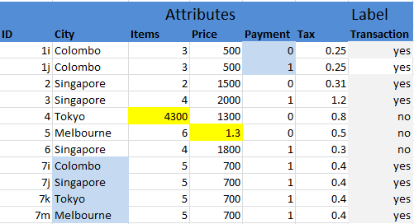
Global Replacement

Slide 6
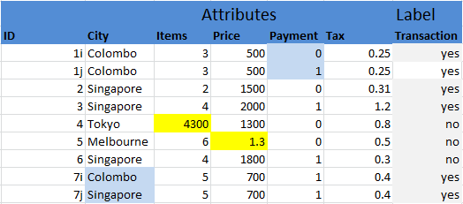
Local Replacement

Slide 7
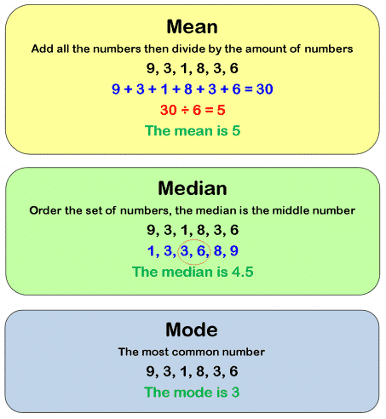
3. Handling with Statistical Measures
Mode
Median
Mean

Slide 8

Mode (Global or Local)

Slide 9
Median (Global or Local)

Slide 10
Mean (Global or Local)

Slide 11

Detection
Missing Values: Obvious
Noise Values (Univariate Outliers):

Slide 12
Using Median
Range of Normality
cutoff = k * median, k = [1, 4]
{median - cutoff, median + cutoff}
Can be used in both Global and local context

Slide 13


Using Mean
$$μ=\frac{\sum_{i=1}^{N}{x_{i}}}{N}$$
Range or Normality
{mean - 3 x std, mean + 3 x std}
{μ - σ x 3, μ + 3 x σ }
$$σ=\sqrt{\frac{\sum_{i=1}^{N}{{(x_{i}−μ)}^{2}}}{N}}$$

Slide 14


Z-score
Z-score method can also be used for defining the range of normality for identifying outliers
Range of normality or acceptable values is,
$$z=\frac{x − μ}{σ}$$
normal$=\{−3, 3\}$

Slide 15
Interquartile Range Method
Interquartile range (IQR) is the range between the 75th and the 25th percentile of the data.
25th, 50th and 75th percentiles are also called quartile because they separate the data into 4 parts

