Slide 1
Outliers
Point outlier
Context outlier
Collective outlier

Slide 2
Outliers (Multivariate)
Hawkins (1980) “An outlier is an observation that deviates so much from other observations as to arouse suspicion that it was generated by a different mechanism”
Barnett & Lewis (1994) “An outlier is the one that appears to deviate markedly from other members of the sample in which it occurs”
Johnson (1992) “An observation in a dataset that appears to be inconsistent with the remainder of the that set of data”

Slide 3
Local Outlier Factor (LOF)
Calculate LOF for each data point
If LOF (x) ≈ 1 not an outlier
If LOF (x) >> 1 outlier
Breunig, M. M., Kriegel, H. P., Ng, R. T., & Sander, J. (2000, May). LOF: identifying density-based local outliers. In ACM sigmod record (Vol. 29, №2, pp. 93–104). ACM.

Slide 4
A density based outlier detection mechanism
Define a parameter k
K too small (leads to more errors when there are many noise values)
K too large (can miss on outliers)

Slide 5
K-distance
Distance of the k-th neighbor from the point of reference.
Reachability Distance
Reach-dist(a, b) = max{k-distance(b), dist(a, b)}

Slide 6
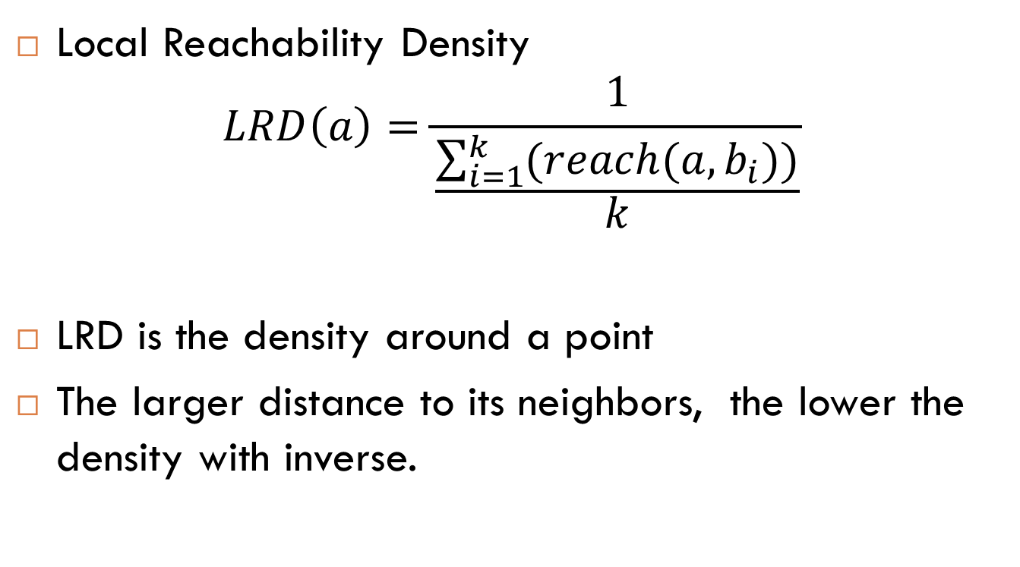
Local Reachability Density
$$LRD\left(a\right)=\frac{1}{\frac{\sum_{i=1}^{k}{(reach(a,b_{i}))}}{k}}$$
LRD is the density around a point
The larger distance to its neighbors, the lower the density with inverse.

Slide 7

$$LOF\left(a\right)= \frac{\sum_{i=1}^{k}{\left(\frac{LRD(b_{i})}{LRD(a)}\right)}}{k}$$
The lower it is the less denser, it is around that point.

