Slide 1
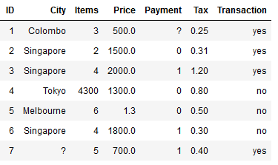
Feature Scaling

Slide 2
Why Feature Scaling
Not to discriminate among the features, particularly with distance based models
Few algorithms converges faster e.g., Neural Networks
Essential in some cases e.g., with PCA

Slide 3

1. Normalization
Bringing the values into the range of [0, 1]
$x_{new}=\frac{x−x_{min}}{x_{max}−x_{min}}$

Slide 4

2. Standardization
Bringing the values centered around 0
$x_{new}=\frac{x−μ}{σ}$

Slide 5

3. Robust scaler
Similar to Normalization scheme but robust to outliers
$x_{new}=\frac{x−q50}{q75−q25}$

