Slide 1
The Essence of CNN
Anuj Attri
Presented to ICGEL and ASL Lab
Integration Control, Guidance and Estimation Lab
Indian Institute of Science, Bangalore

Slide 2
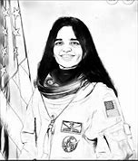
General CNN Architecture for Greyscale Image
S=1
Pooling
Pooling
Convolution
Convolution
Input
kxkx1xn
nxnx1
Loss_function
Y_Pred
Flattening
Backpropagation
Activation
s stride
Forward Pass
Backward Pass

Slide 3
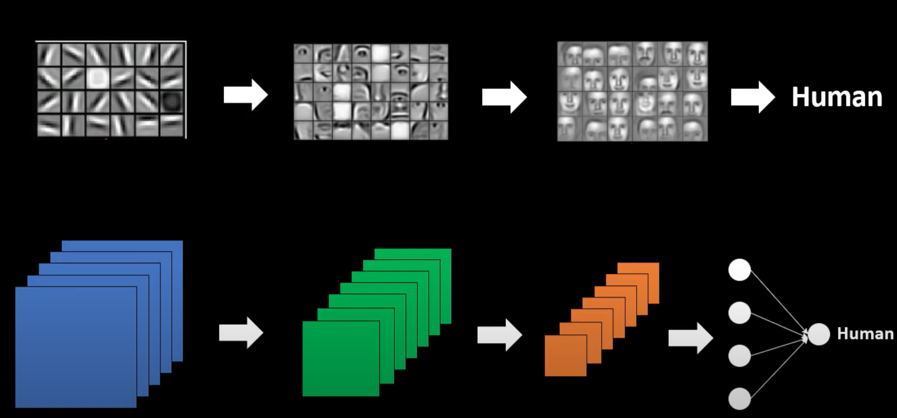
Visualizing CNN Architecture
Human

Slide 4
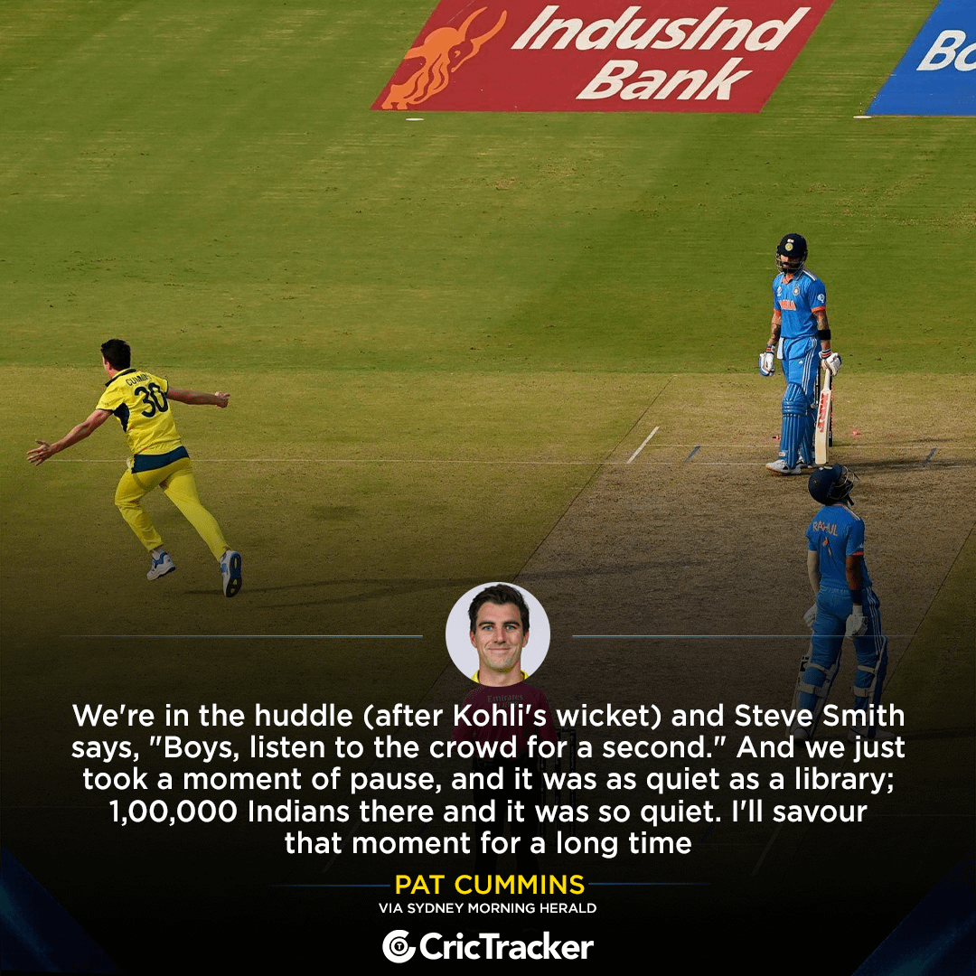
General CNN Architecture for RGB Image
Conv1
5x5x3x4
S=1
MaxPool1
2x2
S=2
Conv2
3x3x4x8
S=1
MaxPool2
2x2
S=2
6x6x8
28x28x4
14x14x4
12x12x8
32x32x3
Loss_function
Y_Pred
Backpropagation
Activation
120
288
s stride
Forward Pass
Backward Pass

Slide 5
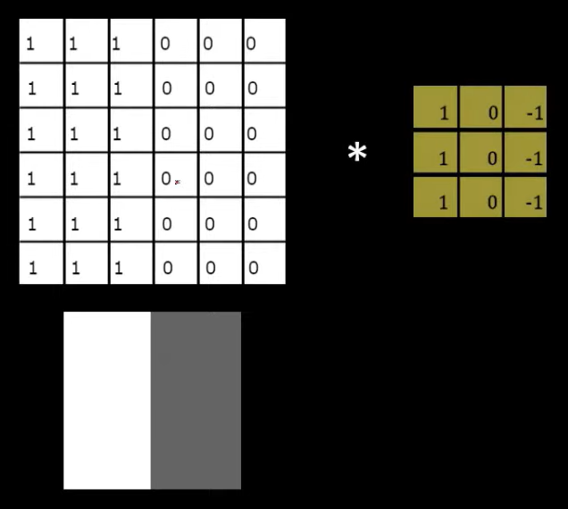
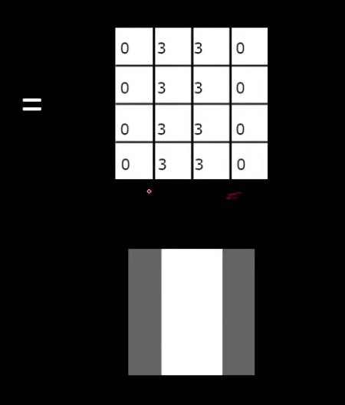
Convolution Concept of a filter
=
*

Slide 6
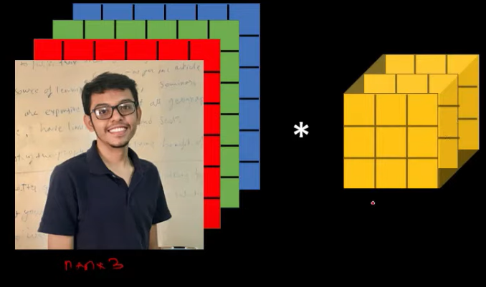
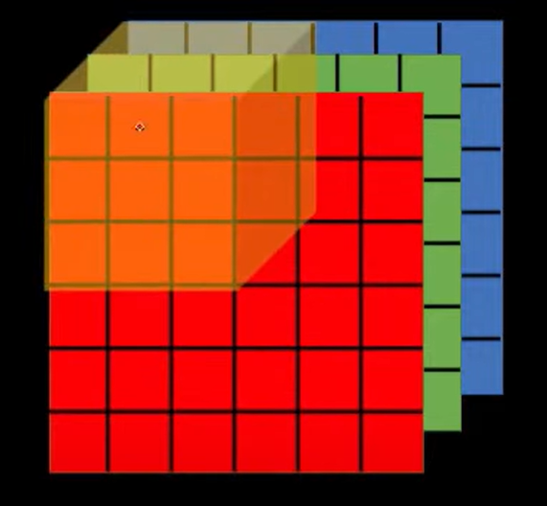
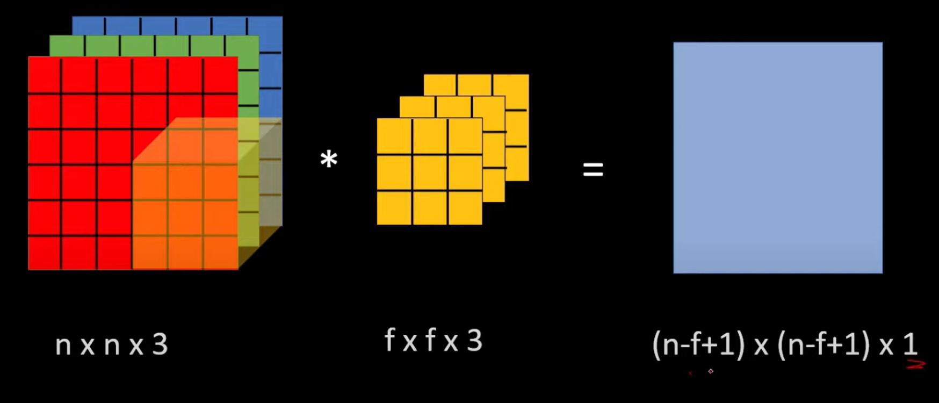
RGB Image Convolution
nxnx3
KxKx3
(n-K+1)x(n-K+1)x1

Slide 7







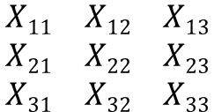








Backpropagation in CNN
x
*
Z
Loss_Function(L)
$$\frac{∂L}{∂Z}$$
K,B
$$\frac{∂L}{∂K}$$
$$\frac{∂L}{∂B}$$
Notations:
Forward Pass
x
Backward Pass
$$\begin{matrix}X11 & X12 & X13 \\ X21 & X22 & X23 \\ X31 & X32 & X33\end{matrix}$$
$$\left[\begin{matrix}Z_{11} & Z_{12} \\ Z_{21} & Z_{22}\end{matrix}\right]$$
$$Input$$
*
$$\left[\begin{matrix}K_{11} & K_{12} \\ K_{22} & K_{22}\end{matrix}\right]$$
$$+ B$$
$$=$$
K,B
$$Kernel, Bias$$
*
$$Convolution$$
Z$11=X11K11+X12K12+X21K21+X22K22+B$
Z$12=X12K11+X13K12+X23K21+X23K22+B$
Z
$$Feature Map$$
Z$21=X21K11+X22K12+X31K21+X32K22+B$
Z$22=X22K11+X23K12+X32K21+X33K22+B$

Slide 8


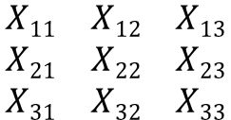


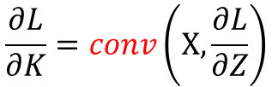


x
*
Z
Loss_Function(L)
$$\frac{∂L}{∂Z}$$
K,B
$$\frac{∂L}{∂B}$$
$$\frac{∂L}{∂K}$$
Equations:
$$\frac{∂L}{∂K}=conv\left(X,\frac{∂L}{∂Z}\right)$$
$$\left[\begin{matrix}\frac{∂L}{∂z_{11}} & \frac{∂L}{∂z_{12}} \\ \frac{∂L}{∂z_{21}} & \frac{∂L}{∂z_{22}}\end{matrix}\right]$$
$$\left[\begin{matrix}\frac{∂L}{∂k_{11}} & \frac{∂L}{∂k_{12}} \\ \frac{∂L}{∂k_{21}} & \frac{∂L}{∂k_{22}}\end{matrix}\right]$$
$$\begin{matrix}X11 & X12 & X13 \\ X21 & X22 & X23 \\ X31 & X32 & X33\end{matrix}$$
*
=
$$\frac{∂L}{∂B}=sum\left(\frac{∂L}{∂Z}\right)$$

Slide 9
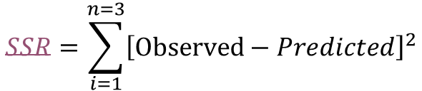
Main Idea of Backpropagation
Effective Dosage
In-Effective Dosage
Yes(1)
W₃
W₁,b₁
Sum
b₃
Output
input_{i}
W₂,b₂
W₄
No(0)
Dosage
$$SSR=\sum_{i=1}^{n=3}{{\left[Observed−Predicted\right]}^{2}}$$
Initializing Random values for b₃:
W₁=3.34, b₁=-1.43, W₂=-3.53,b₂=0.57, W₃=-1.22,W₄=-2.30, b₃=0

Slide 10
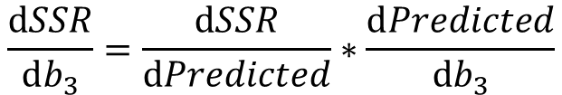
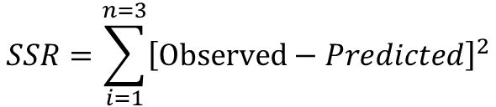


$$SSR=\sum_{i=1}^{n=3}{{\left[Observed−Predicted\right]}^{2}}$$
$$\frac{ⅆSSR}{ⅆb_{3}}=\frac{ⅆSSR}{ⅆPredicted}∗\frac{ⅆPredicted}{ⅆb_{3}}$$
$\frac{ⅆSSR}{ⅆb_{3}}=−15.7$ = Slope
$$Leaning rate=0.1$$
New_{b3}= Old_{b3}- Learning rate(Slope) = 1.57
b₃=2.61

Slide 11
Thank-You

Slide 12
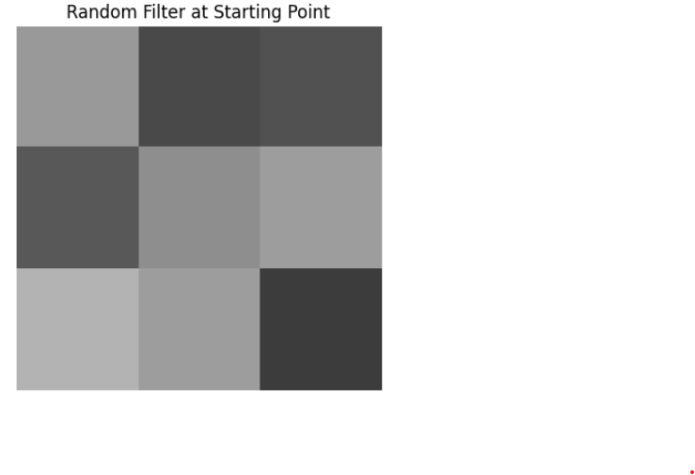
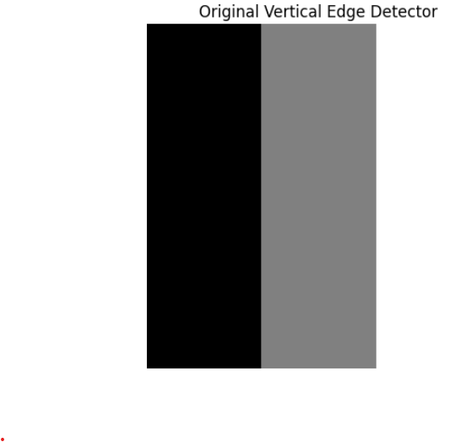
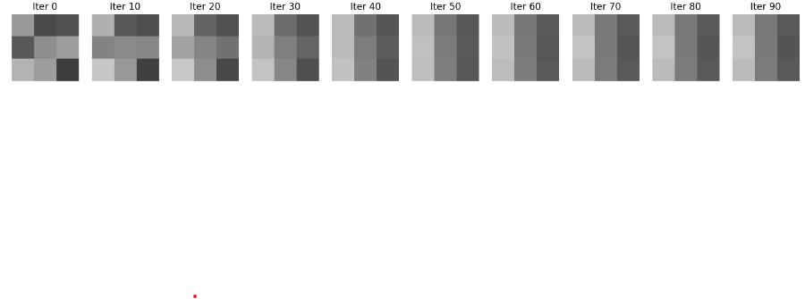
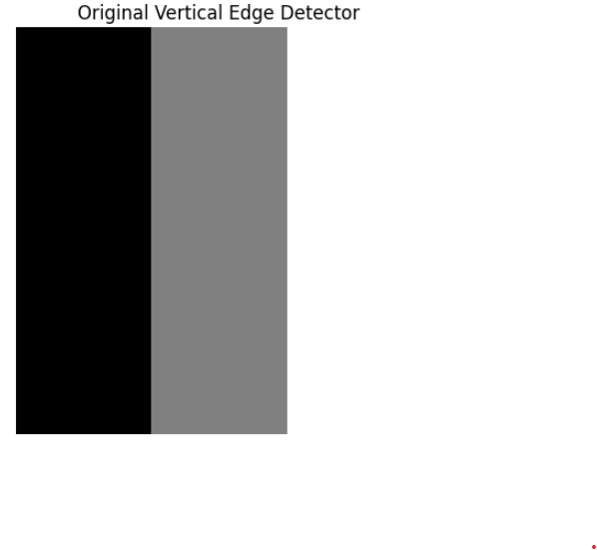
Random Filter to an Edge Detector
Random Filter
Vertical Edge Detector
Iter n

Slide 13

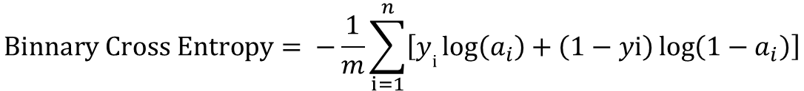
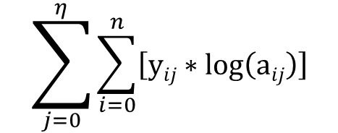
Loss Functions in CNN
$$Binnary Cross Entropy= −\frac{1}{m}\sum_{i=1}^{n}{\left[yⅈ\log\left(a_{i}\right)+\left(1−yⅈ\right)\log\left(1−a_{i}\right)\right]}$$
$$\sum_{j=0}^{η}{\sum_{i=0}^{n}{\left[yij∗\log\left(aij\right)\right]}}$$
$$Catagorical Cross Entropy=$$

