Slide 1
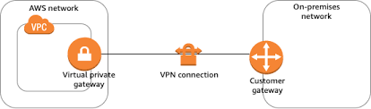
vpc
Private datacenter of corporate office
Site-to-Site vpn
Aws cloud
AWS Classic VPN or an AWS VPN
charged for each VPN connection hour that your VPN connection is provisioned and available.
You are charged for data transfer out from Amazon EC2 to the internet.
It uses Internet Protocol Security (IPSec) and all data gets travels in an encrypted VPN connection .

Slide 2
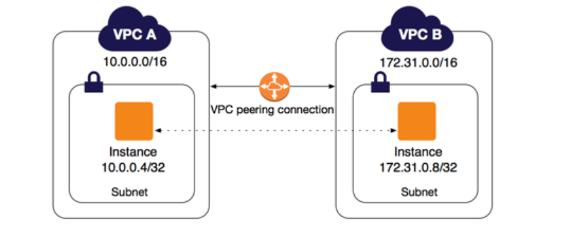
vpc1
vpc1
Vpc peering
Aws cloud
Aws cloud
Vpc peering allows to transfer traffic through private IP of each VPC.
Instances in either VPC can communicate with each other as if they are within the same network. You can create a VPC peering connection between your own VPCs, or with a VPC in another AWS account. The VPCs can be in different regions (also known as an inter-region VPC peering connection).
Traffic always stays on the global AWS backbone, and never traverses the public internet.
all data transfer over a VPC Peering connection that stays within an Availability Zone (AZ) is now free. All data transfer over a VPC Peering connection that crosses Availability Zones will continue to be charged at the standard in-region data transfer rates.

Slide 3
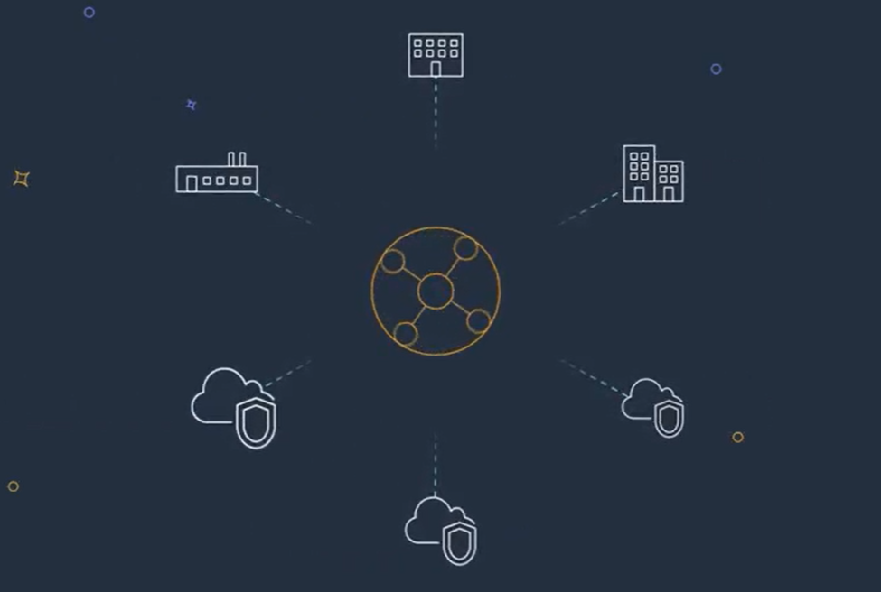
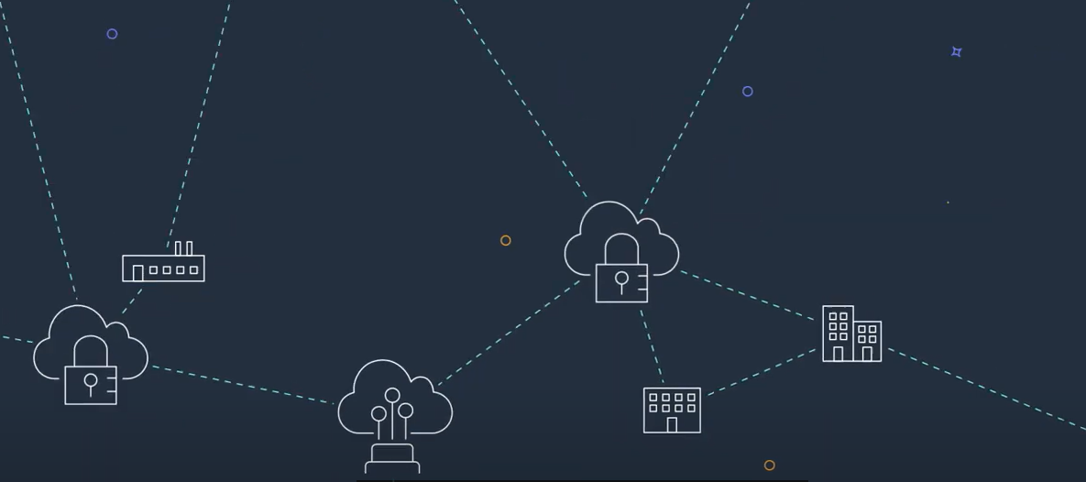
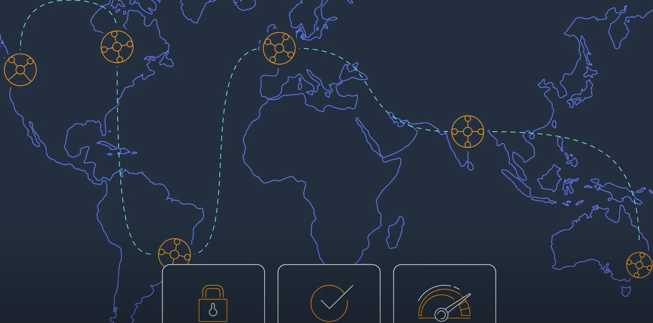
AWS Transit Gateway
When number of VPCs increases to 100s or 1000s aws vpn with multiple accounts and direct connect makes everything complicated.
AWS Transit Gateway connects your Amazon Virtual Private Clouds (VPCs) and on-premises networks through a central hub.
As you expand globally, inter-Region peering connects AWS Transit Gateways together using the AWS global network. Your data is automatically encrypted and never travels over the public internet.
Aws Transit Gateway
Aws VPNs and Direct Connect

Slide 4
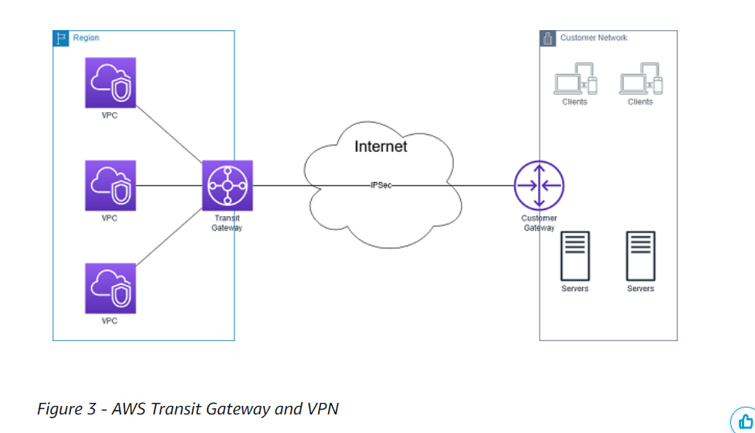

Slide 5
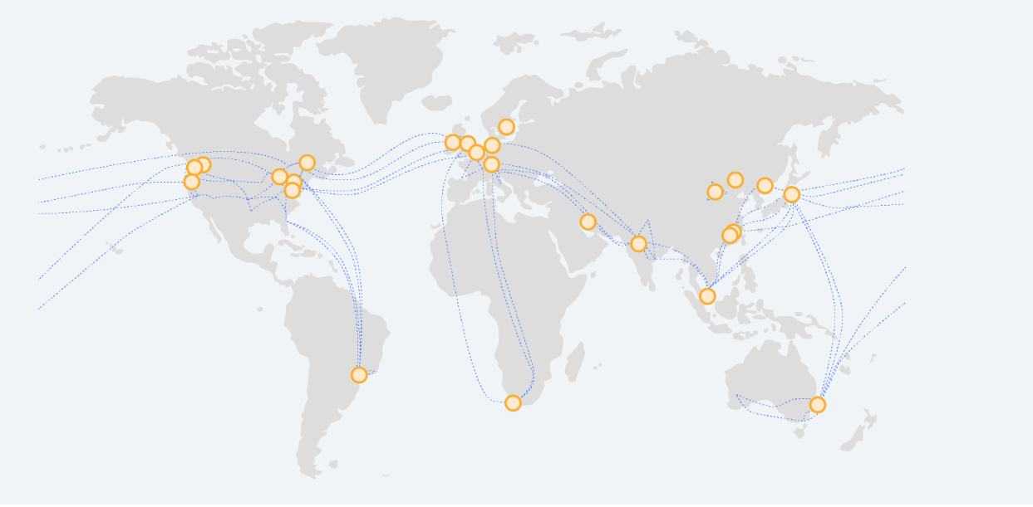
Global Infrastructure
Every data center, AZ, and AWS Region is interconnected via a purpose-built, highly available, and low-latency private global network infrastructure. The network is built on a global, fully redundant, parallel 100 GbE metro fiber network that is linked via trans-oceanic cables across the Atlantic, Pacific, and Indian Oceans, as well as the Mediterranean, Red Sea, and South China Seas.

Slide 6
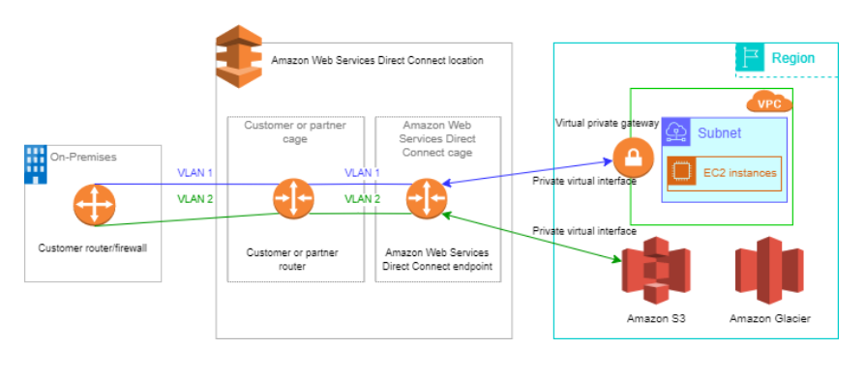
Direct Connect
AWS Direct Connect links your internal network to an AWS Direct Connect location over a standard Ethernet fiber-optic cable. One end of the cable is connected to your router, the other to an AWS Direct Connect router.
AWS Direct Connect locations in public Regions or AWS GovCloud (US) can access public services in any other public Region (excluding China (Beijing and Ningxia)). In addition, AWS Direct Connect connections in public Regions or AWS GovCloud (US) can be configured to access a VPC in your account in any other public Region (excluding China (Beijing and Ningxia).
You can therefore use a single AWS Direct Connect connection to build multi-Region services. All networking traffic remains on the AWS global network backbone, regardless of whether you access public AWS services or a VPC in another Region.

Slide 8
AWS Direct Connect SiteLink
SiteLink, a new feature of AWS Direct Connect (DX), makes it easy to send data from one Direct Connect location to another, bypassing AWS Regions. If you recall, Direct Connect is a cloud service that links your network to AWS, bypassing the internet to deliver more consistent, lower-latency performance. Prior to SiteLink, it was not possible to route traffic directly between Direct Connect locations. Now, you can create global, reliable, and pay-as-you-go connections between the offices and data centers in your global network by sending data over the fastest path between AWS Direct Connect locations.
When using SiteLink, you first connect your on-premises networks to AWS at any of over 100 Direct Connect locations worldwide. Then, you create Virtual Interfaces (VIFs) on those connections and enable SiteLink. Once all VIFs are attached to the same Direct Connect gateway (DXGW), which is a global and highly available AWS resource, you can start sending data between them. Your data follows the shortest path between AWS Direct Connect locations to its destination, using the fast, secure, and reliable AWS global network. You don’t need to have any resources in any AWS Region to use SiteLink. SiteLink is available at all AWS Direct Connect locations today, except for those used by GovCloud or those in China. If you are using Direct Connect now, either through a direct or hosted connection, you have everything you need to use SiteLink. No new connections are required. Please refer to the Direct Connect SiteLink pricing for our most current pricing information.

Slide 9
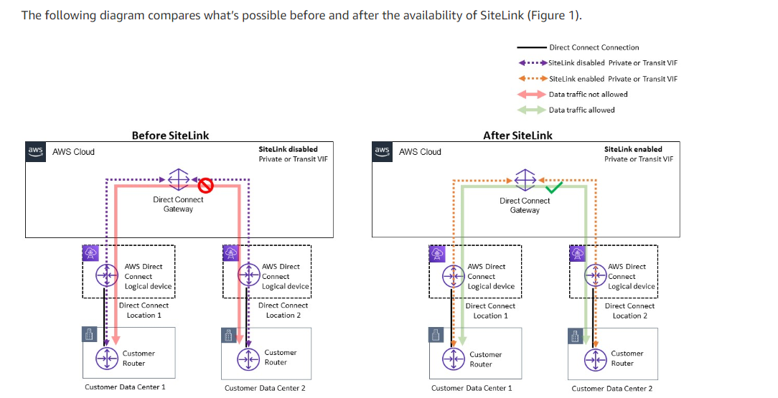

Slide 10
AWS PrivateLink
AWS PrivateLink is a highly available, scalable technology that enables you to privately connect your VPC to services as if they were in your VPC. You do not need to use an internet gateway, NAT device, public IP address, AWS Direct Connect connection, or AWS Site-to-Site VPN connection to allow communication with the service from your private subnets. Therefore, you control the specific API endpoints, sites, and services that are reachable from your VPC.

