Slide 1

Play Now
About Us GitHub Repo
Ipsum lorem…..
….
…..
…….
…………
……………
………………..
……………………….
………………………………
………………………………………..
How to Play the Game

Slide 2
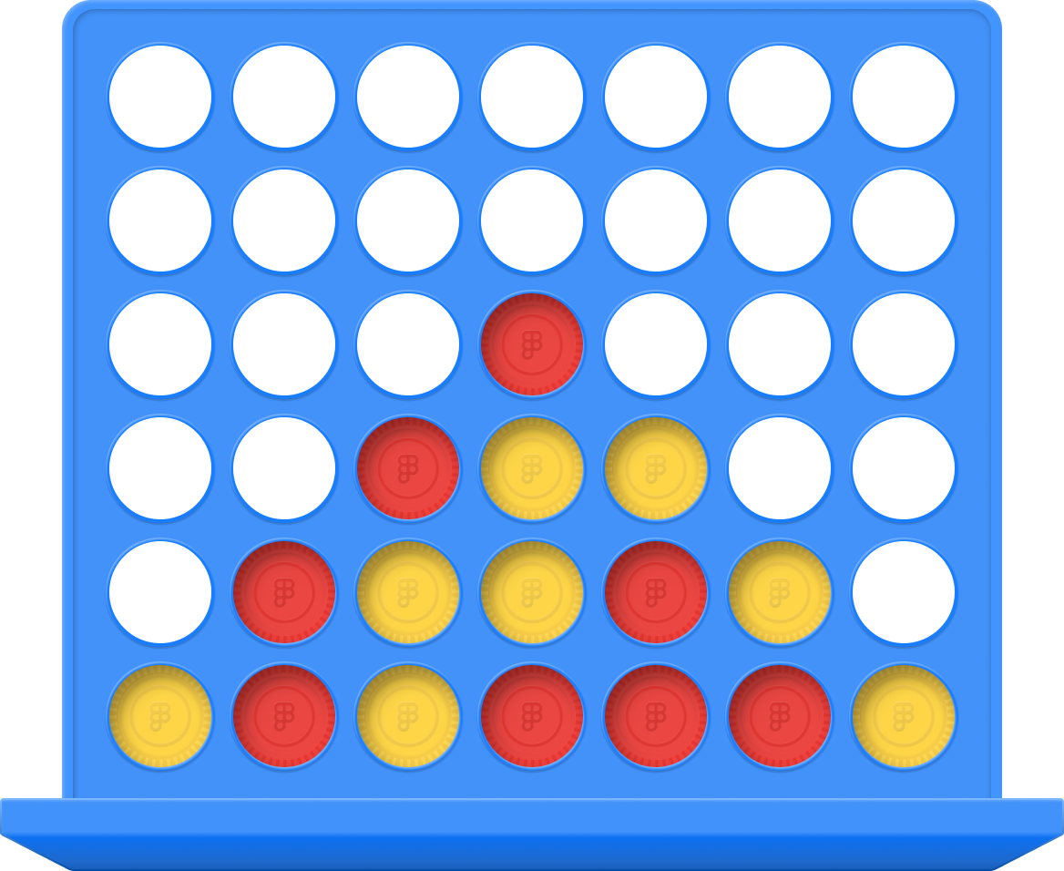
Play
[6][5]
[0][0]
Reset
X Axis (first dimension)

Slide 3

Team Bios

