Slide 1
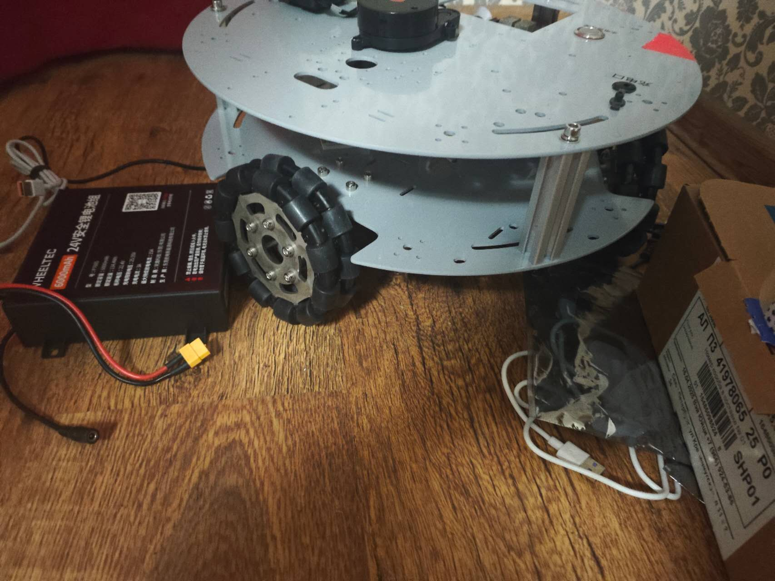
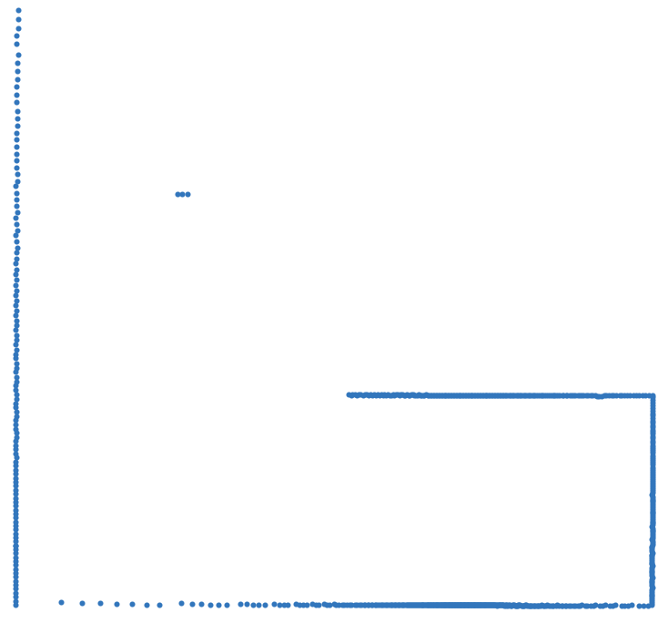
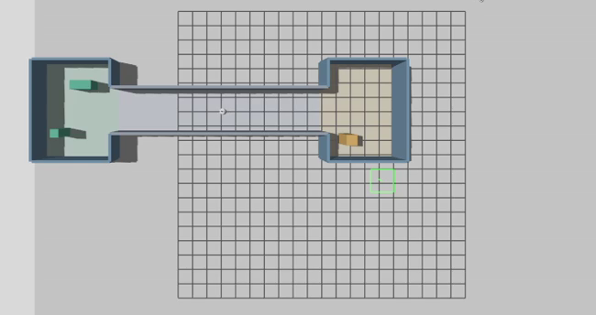
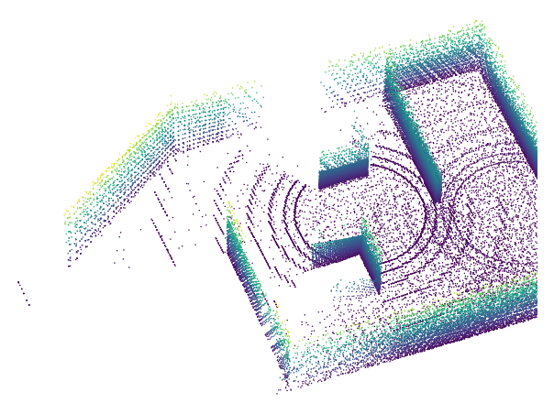
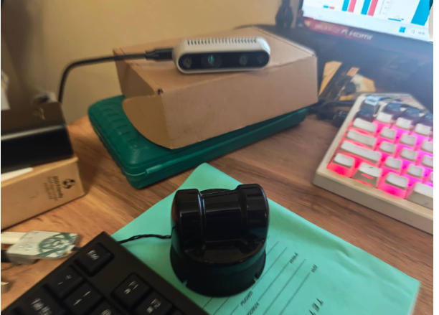
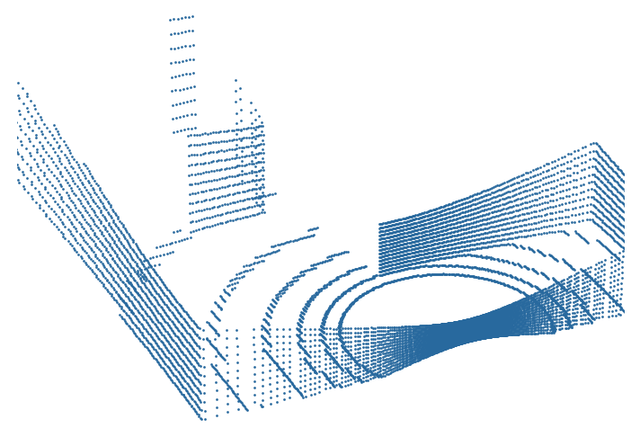
Robust localization and SLAM
Dynamic environments and localization self-recovery
01 Robot platform
02 Observations
03 Pose and map
04 Open question
Pose estimation
Pose hypotheses (schematic)
Physical omnidirectional base
Gazebo: 2D laser scan
Gazebo: corridor degradation
1 Detect tracking loss
2 Diagnose the cause
Mapping A: provided poses
3 Recover the pose
Map estimation
4 Confirm over time
2D LiDAR + depth camera
Gazebo: 3D laser scan
Omnidirectional base
2D + independent 3D LiDAR
Laser scans
and motion input
Joint estimation
of pose and map
After tracking loss:
recover and confirm
Candidate question: avoid false convergence when useful geometry returns
Physical photos. Gazebo scans, provided-pose 3D map and corridor. Physical tests pending.
Notes:
Conceptual SLAM pose-map loop. Localizers: AMCL, IR-MCL, AdaM-MCL, NDT and GICP. Map cleaners: DUFOMap and BeautyMap. These have different roles; the sketch does not imply all these methods jointly implement SLAM. Mapping A uses provided poses; physical tests pending. Pose glyph is schematic, not measured particles. All raster sources: docs/assets/direction/sources.json. Style reference only: D:\workspace\semantic\output\ITMO_Thesis_Proposal_Simple_Talk_Illustrated.pptx

