Slide 1
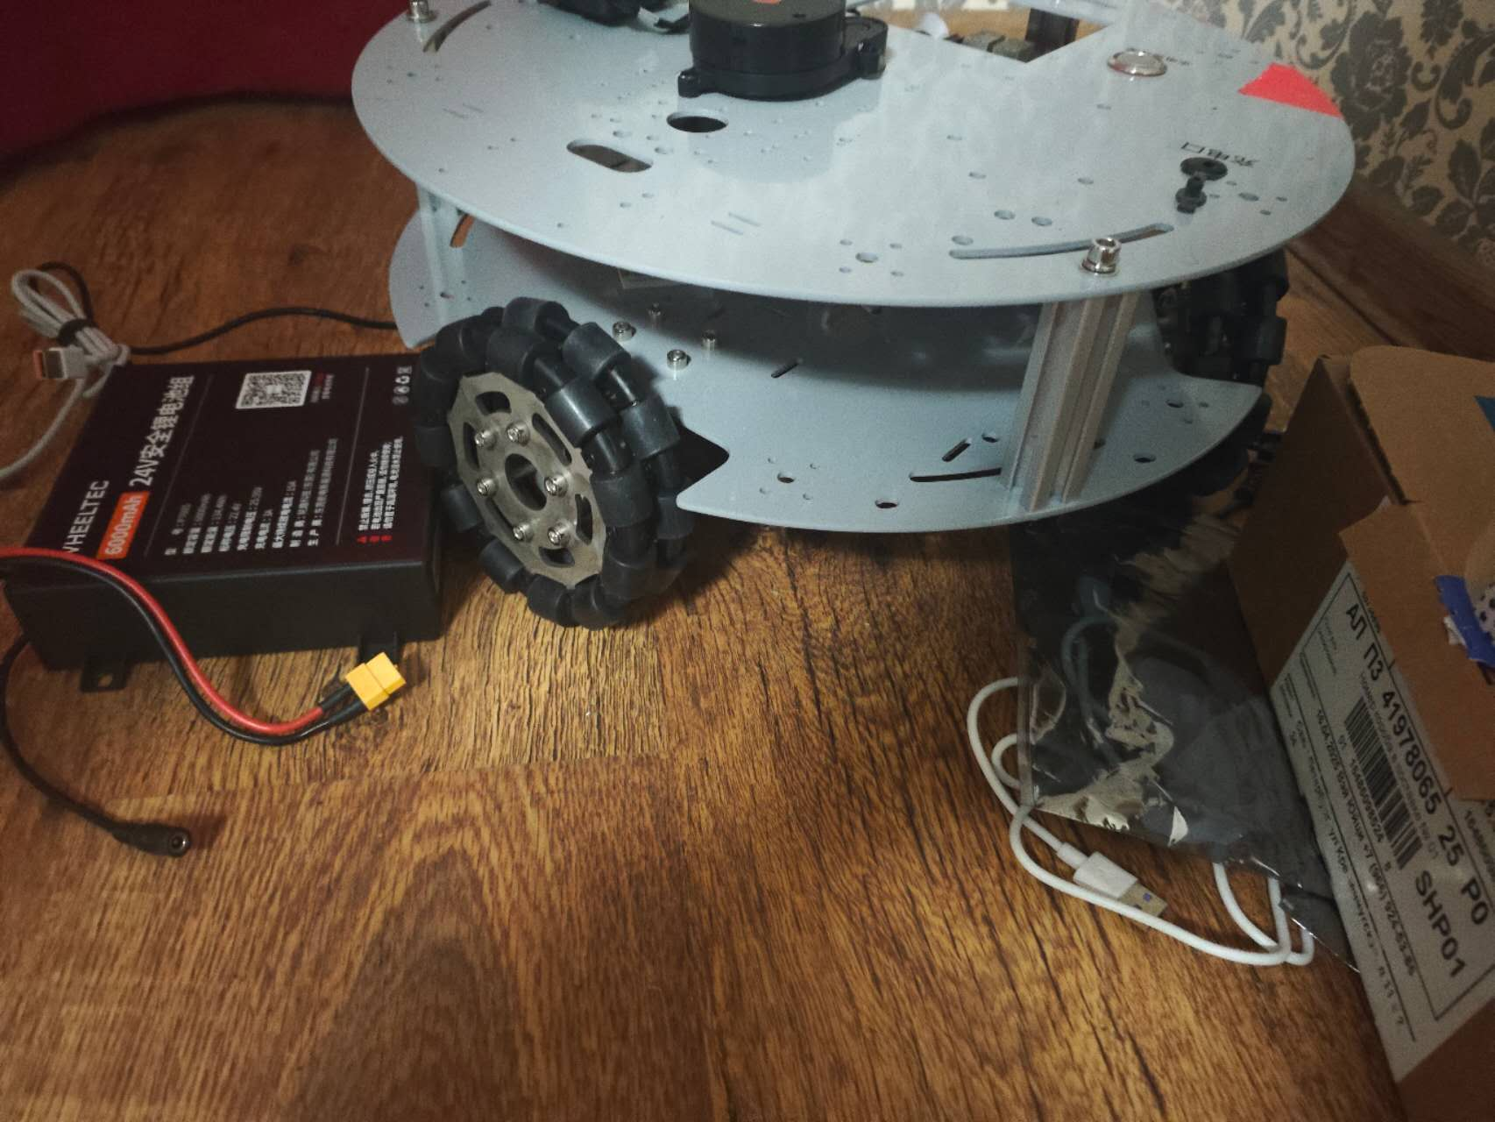
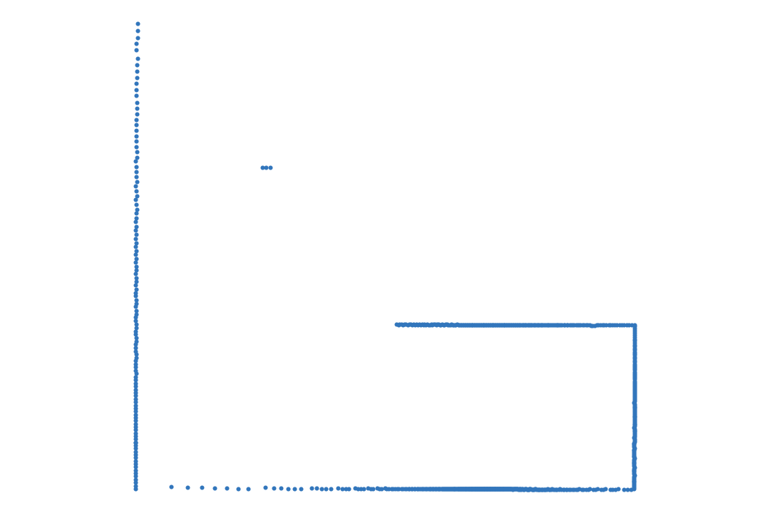
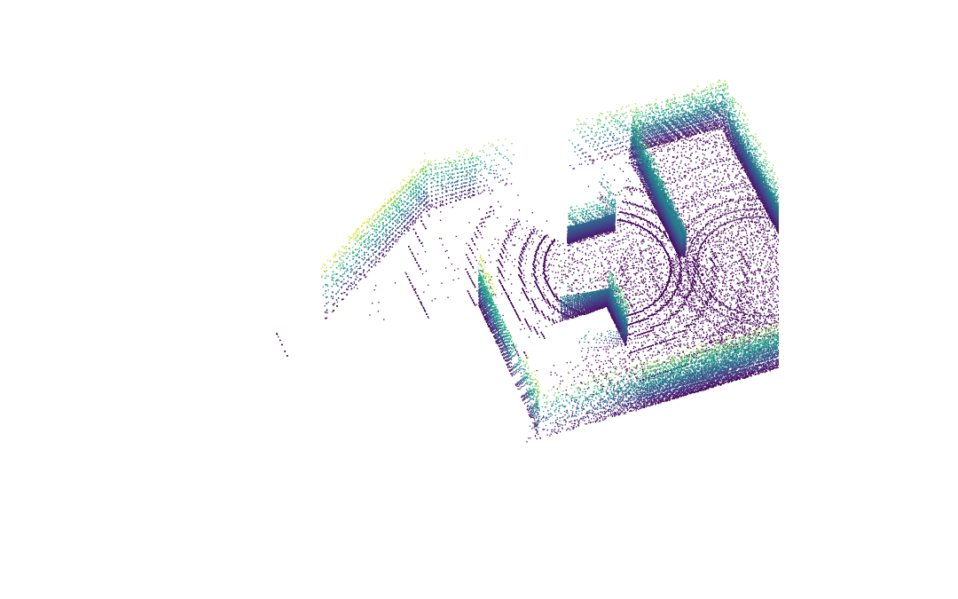
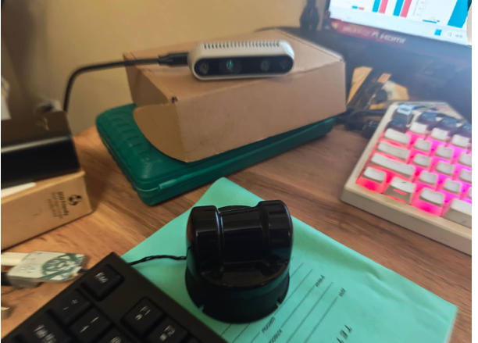
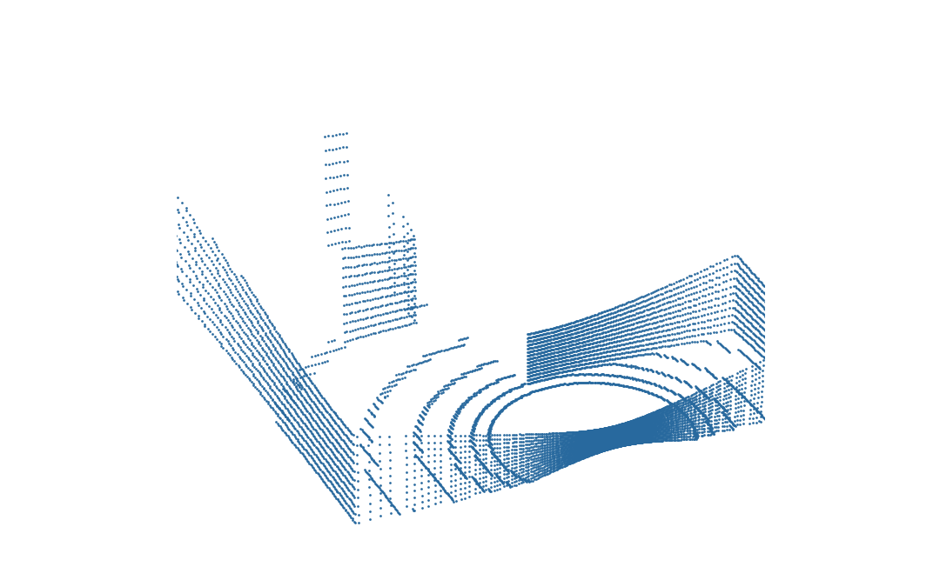
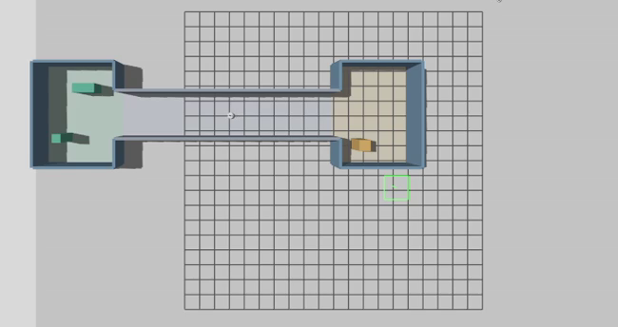
SLAM and dynamic robustness: where is our open question?
SLAM estimates pose and map jointly. Recovery concerns pose estimation after tracking fails.
failure
Robot platform
Sensor observations
Pose estimation
Open question: localization recovery
AMCL / IR-MCL / AdaM-MCL
NDT / GICP
1 Detect
Lost tracking? Residual / uncertainty
Pose hypotheses (schematic)
2 Diagnose
Weak geometry / obsolete map
Map constrains pose
Pose guides mapping
Map estimation / update
3 Recover
Relocalize / regain stable constraints
Gazebo: 2D laser scan
Physical omni chassis
4 Confirm
Sustained accuracy over a window
Gazebo: 3D laser scan
2D LiDAR + depth camera
Provided-pose 3D map (Gazebo)
DUFOMap / BeautyMap: map cleaning
Actual Gazebo degradation scenario
Current scope: 2D SLAM + provided-pose 3D mapping + fixed-map localization. Physical tests pending.

