Slide 1
Chapter 2.2
Iterative, Evolutionary, and Agile
A Continuation

Slide 2
2.4 Example Iterative and Evolutionary Analysis and Design?
Excellent example. Many details will be forthcoming to explain all this.
Overview of a simple example on 20 iterations (over a year) project:
  Before the first iteration, hold an initial requirements workshop with client and senior developers. In the UP this is the Inception Phase (covered in detail in next lectures)
    Define the project objectives;
    Do high-level requirements analysis by identifying use cases (say 30 are found) and features; (use cases covered in a later chapter) 30 is a large number!!!! (High level: naming; short description; not much more in high level (façade) use cases). Place holders….
      Study problem domain….
    Identify non-functional requirements (look and feel, efficiency etc.)
      These are typically ‘quality factors’ such as reliability, efficiency, scalability, learnability, maintainability, security, correctness, etc. To be covered later)

Slide 3
2.4 Example Iterative and Evolutionary Analysis and Design?
  Before the first iteration – continuing……
    Pick the 10% of the use cases with a blending of:
      Architecturally Significant; (require significant work!! Design, build, test…)
      High marketing value; high business value; core needs
      High risk Address these first!!
    this leads to say parts of three use cases: say UC2, UC11 and UC14;
    Recognize that these are likely scenarios WITHIN each of these use cases and not the entire use case….
    Do a detailed analysis of the functional and non-functional requirements for these three use cases (or scenarios from the use cases); Note perhaps 10% of use cases are now significantly analyzed. 90% not.
    Review everything with everybody;
  This is done before we actually START iteration one. This is the iteration planning for iteration 1, which will take place in the Elaboration Phase.
  This (and much more – vision docs, risks lists, business rules, etc.) is done during Inception. Sometimes, we say that there is one iteration in Inception. Arguable.

Slide 4
  Then the developers alone hold an iteration planning meeting to define a subset of UC2, UC11 and UC14 for the first iteration to fit within a, say, 4 weeks time box (do not be too greedy!). Document the subset.
  Maybe tentatively schedule 2nd and more tentatively the 3rd iterations;
    Excellent. Realize these are scenarios. Scope the iteration.
  3. Iteration 1 (in UP terms this is the start of the Elaboration Phase) which mainly deals with critical architectural modelling and risk reduction…
    Perform OOA using the Domain Model captured in UML; review by all developers (3 days?); What is domain modelling??
    Also includes several additional diagrams such as sequence and collaboration diagrams; perhaps state diagrams and more. But at a high analysis level…
    Perform OOD documentation the Design Model using UML; (in pairs, review by all) (eg. 2 days); Design in UML; decide on methods, etc… Perhaps some sequence / communication diagrams.

Slide 5
Continuing….
    Start programming, integrating and testing using previous UML models as starting points; Try to update models; (
      (Using Scrum as the agile methodology here) hold daily stand-up meetings (e.g. two weeks);
    One week before the end review and de-scope if necessary; Yes. (Since work efforts should be prioritized, those scenarios (work units) not able to be done within the time-box are considered for later iterations.)
    On Tuesday of the last week: code freeze to provide increment;
    On Wednesday demo partial system to external stakeholders: get and document feedback; measure according to predefined expectations; assessment!!!
    2nd requirements workshop: refine previous workshop document and detail another important 10-15% of the use cases
    End of iteration 1

Slide 6
  Repeat for Iteration 2 : similar steps;
  Four iterations and five requirements workshops so that at the end of iteration 4, perhaps 80% or 90% of the requirements have been written in details but only 10% of the system has been implemented;
  The end of the Elaboration Phase when most of the requirements have been detailed by iterations and some the system is available. All estimates should be reviewed
  Note this is the end of the Elaboration Phase (UP discussed ahead) All of the use cases / scenarios that have high risk, are architecturally significant, and provide core functionalities are addressed.
  Requirements are significantly refined due to feedback and assessment.
  Rhythm is established; initial increments provided to stakeholders.
  And yes, we are about 20% into the duration of the overall project.
  Can redo project estimates that will be much more trustworthy!!
  Life Cycle Architectural milestone – go / no-go decisions can be made. (more ahead in RUP)
  The UP Construction Phase can start: many more iterations, major requirements change is less likely during this period. Can be more ambitious on the amount of work to be performed. Keep learning and getting feedback;
  In the UP the last phase is the Transition Phase: beta tests and deployment

Slide 7
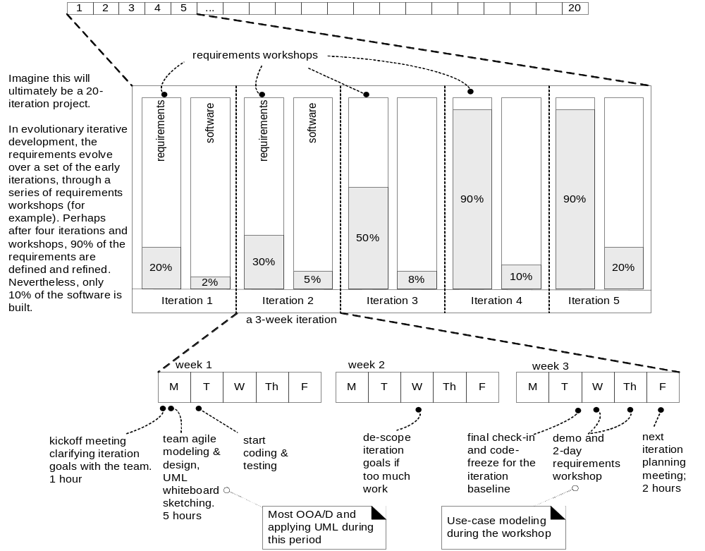
A look at elaboration iterations

Slide 8
At the end of Elaboration, the second phase of the Unified Process, there is a huge milestone.
The milestone is called the Life Cycle Architecture milestone.
Perhaps the most critical phase of the Unified Process
A go-no go decision is made to proceed or stop
All the really tough stuff is addressed. Major risks mitigated; architecturally significant use – cases resolved …
Much more when we formally cover the Unified Process.

Slide 9
Inception
Elaboration
Construction
Transition
Iteration 1
Iteration …
Iteration …
Iteration …
Iteration …
…
Use Case A
Simplified
…
…
Use Case A
Full
…
Use Case
…
Use Case
…
Use Case
…
Use Case B
Full
…
Use Case
…
Use Case
…
Use Case
…
Coding & Testing
OOA
OOD
Integration
Fig 2.8a Agile UP Schedule Overview

Slide 10
You Know you did not Understand Iterative Development When:
You try to define all the requirements details before you start (or the entire detailed design;
You spend weeks doing UML modelling before programming;
You think that inception = requirements analysis, elaboration = design and construction = coding;
Your iterations are months long rather than weeks;
Your plans are fussy, overly detailed, document led and rigorously enforced;
People work in isolation, handing one document after another to the next person (e.g. requirements specification from analyst to a designer, design document to programmer, code to tester);

Slide 11
Very Important – again:
Which use cases to schedule in the elaboration phase? (at the beginning of a project).
Select use cases for elaboration and action according to:
  Risks : to drive down the highest risks early on;
  Core value Client needs : to build visible core features that the client cares most about
  Architecturally-significant use –case scenarios.

Slide 12
6 What are Agile Methods and Attitudes?
“Agile methods apply time-boxed iterative and evolutionary development, that employ adaptive planning, promote incremental delivery, and include other value and practices that encourage agility – rapid and flexible response to change. “
No single way to pin down agile
Many agile approaches.
All have:
  Time-boxed iterations and
  Evolutionary refinement of plans, requirements and design
  Based on feedback and measurement.
Advocates also push that agile development includes simplicity, lightness, communication, and self-organization of teams….

Slide 13
Agile Methods
Perhaps the most popular is Scrum (drawing coming up)
Characteristics:
  Common project workroom
  Self-organizing teams
  Daily stand-up meetings
See references and assigned homework
Another popular (much less popular) agile approach is Extreme Programming XP (drawing coming up)
Characteristics
  Programming pairs
  Test driven development
See references and assigned homework.

Slide 14
Agile Methods - continued
Another is the Unified Process (Rational Unified Process – the RUP)
Characteristics
  Can include some of the practices from Scrum, XP, and several others.
Other agile methods include Feature-Driven Development (FDD), and DSDD.
Use UML modeling for the difficult to understand features – architecturally significant features. For understanding the features!!
  Class modeling (static); sequence and communication diagrams (dynamic)… and more.

Slide 15
The Agile Manifesto
Individuals and interactions over processes and tools
Working software over comprehensive documentation
Customer collaboration over contract negotiation
Responding to change over following a plan..
See the Agile Principles on page 29.
See www.agilemanifesto.com

Slide 16
Principles behind the Agile Manifesto
We follow these principles:
Our highest priority is to satisfy the customer through early and continuous delivery of valuable software.
Welcome changing requirements, even late in development.
Agile processes harness change for the customer's competitive advantage.
Deliver working software frequently, from a couple of weeks to a couple of months, with a preference to the shorter timescale.
Business people and developers must work together daily throughout the project.
Build projects around motivated individuals.
Give them the environment and support they need, and trust them to get the job done.
The most efficient and effective method of conveying information to and within a development team is face-to-face conversation.

Slide 17
Principles behind the Agile Manifesto
Working software is the primary measure of progress.
Agile processes promote sustainable development.
The sponsors, developers, and users should be able to maintain a constant pace indefinitely.
Continuous attention to technical excellence and good design enhances agility.
Simplicity--the art of maximizing the amount of work not done--is essential.
The best architectures, requirements, and designs emerge from self-organizing teams.
At regular intervals, the team reflects on how to become more effective, then tunes and adjusts its behavior accordingly.

Slide 18
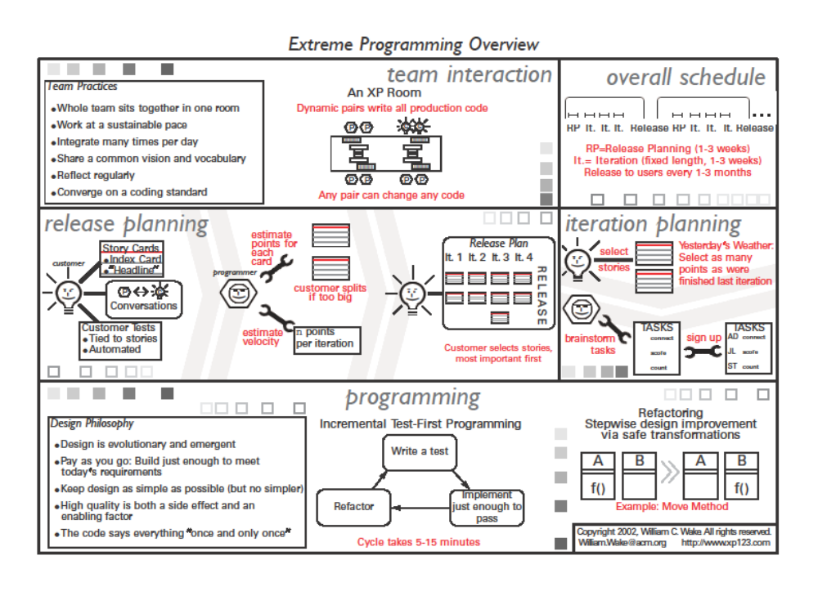
XP Overview – one pager

Slide 19

Scrum One-Pager
Roles
Key Artifacts
Key Meetings
Development Process
Product Backlog
  List of requirements & issues
Owned by Product Owner
Anybody can add to it
Only Product Owner prioritizes
Sprint Planning Meeting
  Hosted by ScrumMaster; ½-1 day
  In: Product Backlog, existing product, business & technology conditions
1. Select highest priority items in Product Backlog; declare Sprint Goal
2. Team turns selected items into Sprint Backlog
Out:: Sprint Goal, Sprint Backlog
Product Backlog
Increment
PO
Product Owner: Set priorities
Sprint:
30 days each
Sprint Goal
  One-sentence summary
Declared by Product Owner
Accepted by team
Sprint Planning Meeting
SM
Sprint Goal
ScrumMaster: Manage process, remove blocks
Daily Scrum
  Hosted by ScrumMaster
  Attended by all, but Stakeholders don’t speak
Same time every day
  Answer: 1) What did you do yesterday? 2) What will you do today? 3) What’s in your way?
Team updates Sprint Backlog; ScrumMaster updates Blocks List
Sprint Backlog
Sprint Backlog
  List of tasks
Owned by team
Only team modifies it
Daily Scrum
Blocks List
Daily Work
Product
T
Blocks List
  List of blocks & unmade decisions
Owned by ScrumMaster
Updated daily
Team: Develop product
Increment’
Sprint Review Meeting
  Hosted by ScrumMaster
Attended by all
Informal, 4-hour, informational
Team demos Increment
All discuss
Hold retrospective
  Announce next Sprint Planning Meeting
Sprint Review Meeting
SH
Increment
  Version of the product
Shippable functionality (tested, documented, etc.)
Product Backlog’
Stakeholders: observe & advise

Slide 20
Scrum Master is responsible for making sure a Scrum team lives by the values and practices of Scrum. The ScrumMaster protects the team by making sure they do not over-commit themselves to what they can achieve during a sprint.
The ScrumMaster facilitates the daily scrum and becomes responsible for removing any obstacles that are brought up by the team during those meetings.
The ScrumMaster role is typically filled by a project manager or a technical team leader but can be anyone.
Scrum Sprint: Simple statement of the Goal of a ScrumSprint Should be stated terms of value recognizable to the Product Owner (usually: working software). The goal helps team members focus: to recognize what is important when weighing options during the Scrum Sprint.

Slide 21
Daily Scrum: On each day of a sprint, the team holds daily meetings (“the daily scrum”). Meetings are typically held in the same location and at the same time each day. Ideally the daily scrums are held in the morning as they help set the context for the coming day's work.

Slide 22
2.7 Agile Modeling
Remember, Visual Modeling is one of the Best Practices…
When we do UML Modeling, we are really doing OOA/OOD.
Agile Modeling is used to understand the problem space and the solution space.
Not to directly support programming!!

Slide 23
Agile Methods - Principles
Model in pairs!! Don’t model on your own.
Share understanding.
Do static views –
  UML class diagrams and then
Do dynamic views –
  Interaction diagrams (sequence and collaboration diagrams)

Slide 24
Agile UP Note:
UP never meant to be a heavy-weight methodology, even though some of the activities tend to be implemented with too much strictness.
Meant to be agile.
Will cover the RUP and Process in next series of slides.
One last look at two important models:
  A static class diagram and a
  Dynamic interaction (sequence) diagram.

Slide 25
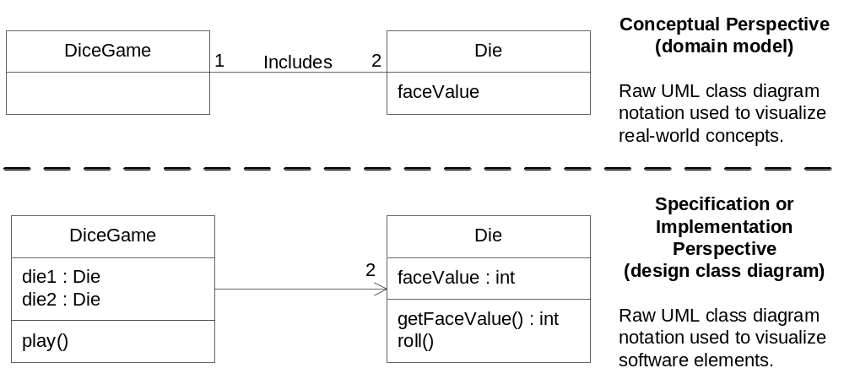
Compare Domain Model Entity with Design class Diagram
Static Views

Slide 26
Fully Developed Class Design Model
Uses
Store
1
ProductSpecification
address : Address
name : Text
1
description : Text
price : Money
itemID: itemID
1
ProductCatalog
addSale()
Contains
1
Looks-in
1
1
getSpecification()
1
Houses
Illustrates non-attribute visibility
Describes
1
1
*
Register
SaleLineItem
Captures
Sale
Contains
1
1
Date : Date
isComplete : Boolean
time : Time
quantity : Integer
endSale()
enterItem()
makePayment()
1
getSubtotal()
becomeComplete()
makeLineItem()
makePayment()
getTotal()
Payment
*
1
amount : Money
Logs-completed
Paid-by
1

Slide 27
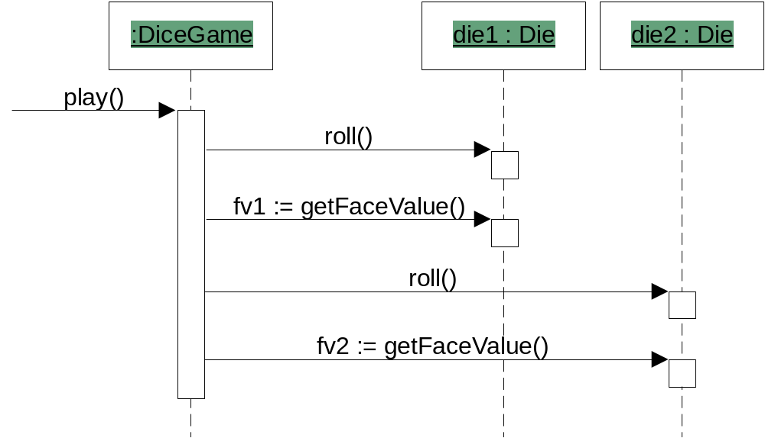
Sample (abbreviated) Interaction Diagram

Slide 28
More on Agile UP
UP is both iterative and evolutionary.
Requirements and Designs are not completed before implementation.
Requirements and Design are refined through the iterations based on feedback.
No detailed plans here; No fine-grained plans here.
Iteration plans are only planned one iteration in advance due to the need for feedback on the previous iteration.
Overall plans are called Phase Plans or Evolution Plans. Detailed plans are the iteration plans.

