Slide 1

Aggregation methods in MongoDB

Slide 2
Contents
What are aggregation methods?
What is it like in SQL?
Three methods in MongoDB
Single purpose aggregation operations
Aggregation pipelining
Map Reduce programming

Slide 3
Aggregation methods
The grouping of values from multiple records together to return computed results, rather than raw data.
Results such as sum, average, maximum, minimum.
Data is grouped according to one or more fields.
Warning: "Aggregate Data Modelling" is a very different concept.

Slide 4
SQL example
Cust_id | amount | Status
A123 | 500 | A
A123 | 250 | A
B212 | 200 | A
A123 | 300 | D
SELECT cust_id, SUM(amount) FROM orders
GROUP BY cust_id;

Slide 5
Three methods in MongoDB
Single purpose aggregation operations
simple but very limited
Aggregation pipelining
more efficient but limitations
Map Reduce programming
Flexible but more complicated
Distributed processing model to run well across cluster

Slide 6
Single Purpose Aggregation
Two built-in MongoDB operations that aggregate documents from single collection:
Count
Distinct
(Group method deprecated since V3.4)

Slide 7
Count operation
Given this small collection:
{cust_id:”A123”, amount:500}
{cust_id:”A123”, amount:250}
{cust_id:”B212”, amount:250}
What is the result from each of these? Db.orders.count() Db.orders.count({cust_id:”A123”})

Slide 8
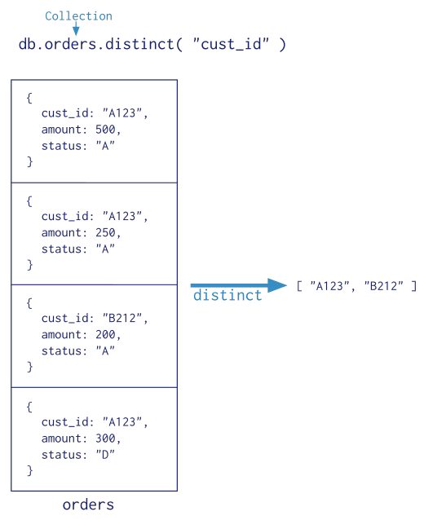
Distinct operation
db.orders.distinct("cust_id")
Returns array of values with no duplicates

Slide 9
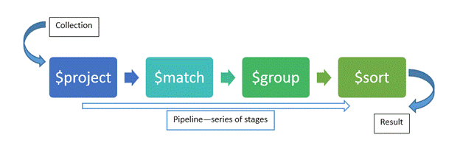
Aggregation Pipelines
A sequence of stages/processes
Transform or reshape data
Filter data
Group and sort data
Calculate data such as sum or average

Slide 10
aggregate() method
db.collection.aggregate(pipeline, options)
pipeline is array of aggregation operators:
$project : select, reshape data
$match : filter data
$group : aggregate data
$sort : sort data
$limit : limit data
$unwind : deconstruct array field
https://docs.mongodb.com/manual/reference/meth od/db.collection.aggregate/

Slide 11
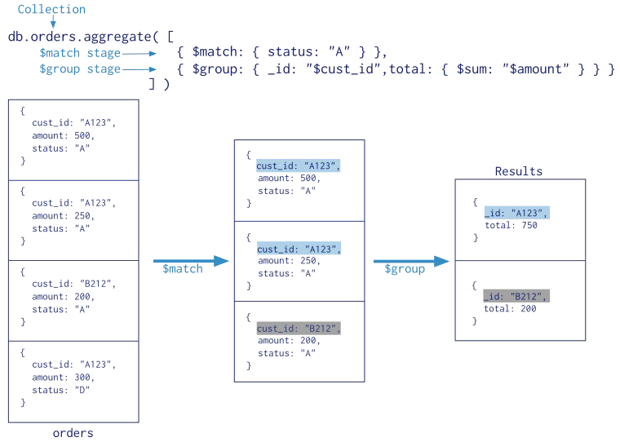

Slide 12
Field paths
Field path used to access fields within documents in aggregate pipeline.
Prefixed by dollar sign ($)
{$group: {_id : "$name"}}
Means create field called _id and set its value to distinct values of field called name
$name is on the RHS where literal value might be. It acts like a variable

Slide 13
Field paths
To refer to the field itself, just use the field name, e.g. name
To refer to the contents of a field, prefix $, e.g. $name
For example {name: "Pete"}
name refers to the field called name and $name would become "Pete" for this document.

Slide 14
Pipeline examples
USA zip code document:
{ "_id" : "82001",
"city" : "CHEYENNE",
"loc" : [
-104.796234,
41.143719
],
"pop" : 33107,
"state" : "WY" }
// zip code
// city name
// location as
// longitude and
// latitude pair
// population
// state abbreviation

Slide 15
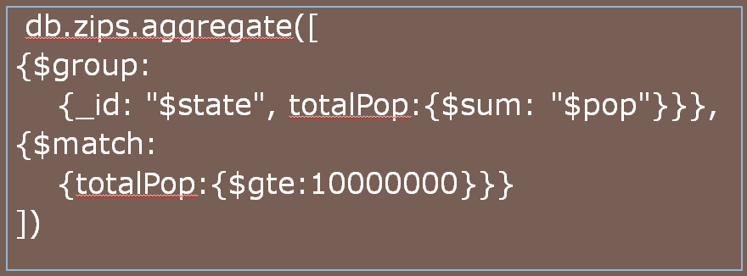
Pipeline example (1)
Find all states with total population of over 10 million people

Slide 16
Pipeline example (1)
$group operator creates document for each state, with id equal to value of state
{ "_id" : "WY", "totalPop" : 453528 }
$match those new documents (like a find())
{ "_id" : "CA", "totalPop" : 29754890 }

Slide 17
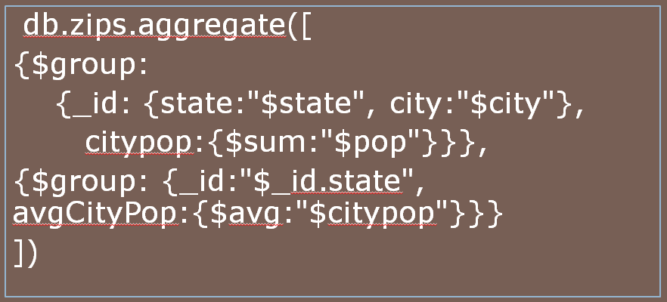
Pipeline example (2)
List average city population by state

Slide 18
Pipeline example (2)
Pipeline contains two groups.
First $group operator creates new documents for every combination of city and state and for each calculates sum of population across all its zipcodes.
{ "_id" : "01013", "city" : "CHICOPEE",
"loc" : [ -72.607962, 42.162046 ], "pop" :
23396, "state" : "MA" }
{ "_id" : "01020", "city" : "CHICOPEE", "loc"
: [ -72.576142, 42.176443 ], "pop" : 31495,
"state" : "MA" }

Slide 19
Pipeline example (2)
Second $group takes these new documents from first $group as input.
It groups by state and calculates its average city population.
{ "_id" : "MA", "avgCityPop" : 14855.37 }
Powerful multi-group aggregation.

Slide 20
Map Reduce Programming
Three possible stages:
Map
Reduce
Finalize (optional)
Map
Reduce
Finalize
Each represented as a function.

Slide 21
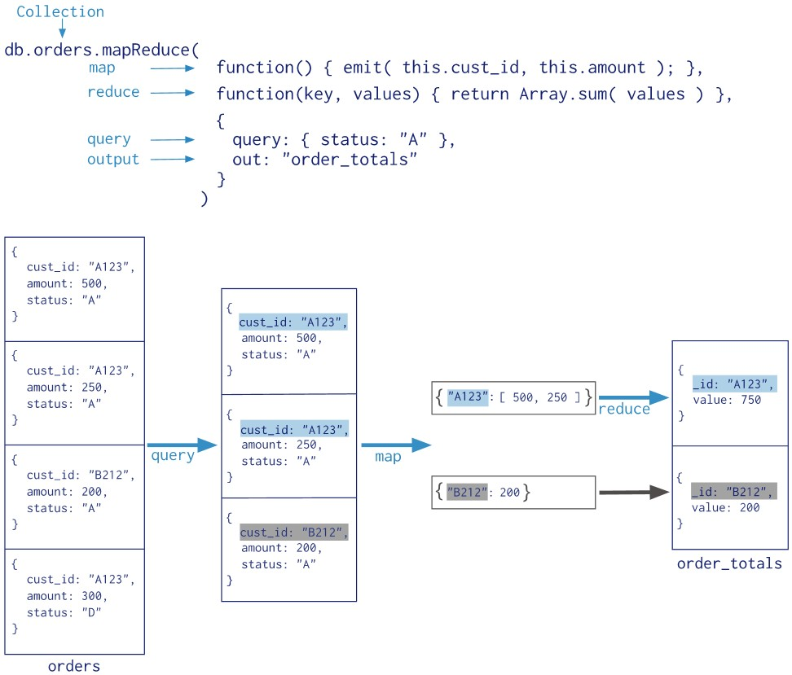

Slide 22
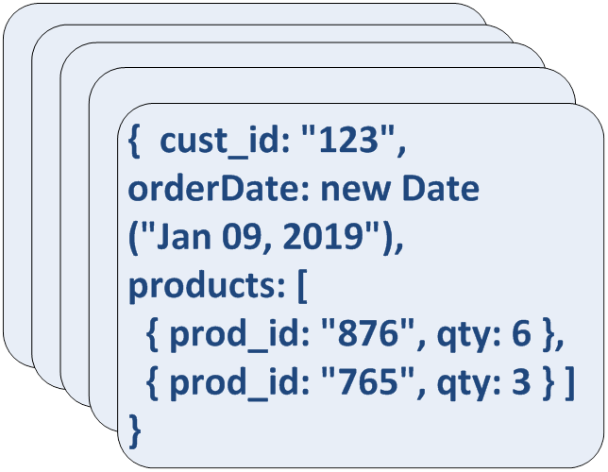
Full Map Reduce Example
Given a collection of orders:
What is the Total and Average Quantity for each product ordered?

Slide 23
Objective
Calculate Number of Orders, Total Quantity and Average Quantity for each Product ordered
{ cust_id: "123", orderDate: new Date ("Jan 09, 2019"),
products: [
{ prod_id: "876", qty: 6 },
{ prod_id: "765", qty: 3 } ]
}
{ _id: 876 value: { count: 3,
qty: 18, avg: 6 } }

Slide 24
Map Function
{ key: 876 value: { count: 1, qty: 6 } }
{ key: 765 value: { count: 1, qty: 4 } }
{ cust_id: "123", orderDate: new Date ("Jan 09, 2019"),
products: [
{ prod_id: "876", qty: 6 },
{ prod_id: "765", qty: 3 } ]
}
{ key: 876 value: { count: 1, qty: 7 } }
{ key: 765 value: { count: 1, qty: 3 } }
Map
{ key: 876 value: { count: 1, qty: 5 } }
Map processes each document from Collection
Map performs selection and grouping

Slide 25
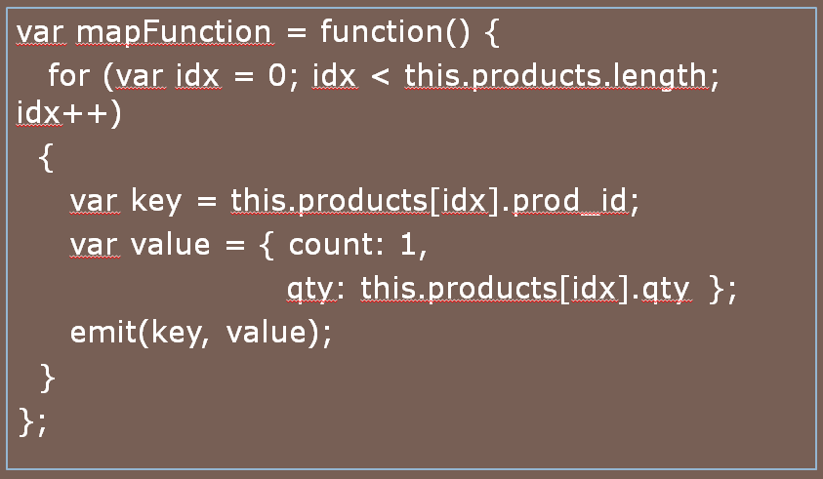
Map Function

Slide 26
Map Function
No parameters and no return value.
Called with every document in query result set.
Accesses each doc via variable called
this, such as this.cust_id
Produces new document by calling
emit()
Emitted docs must be key:value pairs

Slide 27
Reduce Function
{ key: 876 value: { count: 1, qty: 6 } }
{ key: 876
{ key: 876 value: { count: 1, qty: 7 } }
value: [
{count: 1, qty: 6},
{count: 1, qty: 5},
{count: 1, qty: 7}
] }
{ _id: 876 value: { count: 3, qty: 18 } }
Reduce
{ key: 876 value: { count: 1, qty: 5 } }
Function reduces the value array for each grouped key to a single object by summing the count fields and summing the qty fields.

Slide 28
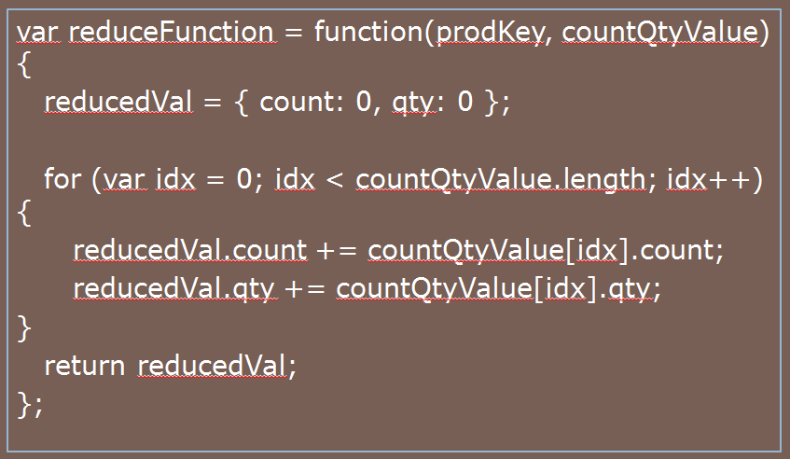
Reduce Function

Slide 29
Reduce Function
Takes two parameters: Key and array of values (from Map function).
Outputs an object
Calculation is on all of values in array (for given key).
Can be simple like sum or something more complex like this example.

Slide 30
Finalize Function
{ _id: 876 value: { count: 3, qty: 18 } }
{ _id: 876 value: { count: 3,
qty: 18, avg: 6 } }
Finalize
Function modifies the object from the reduce function to calculate and add the average quantity.

Slide 31
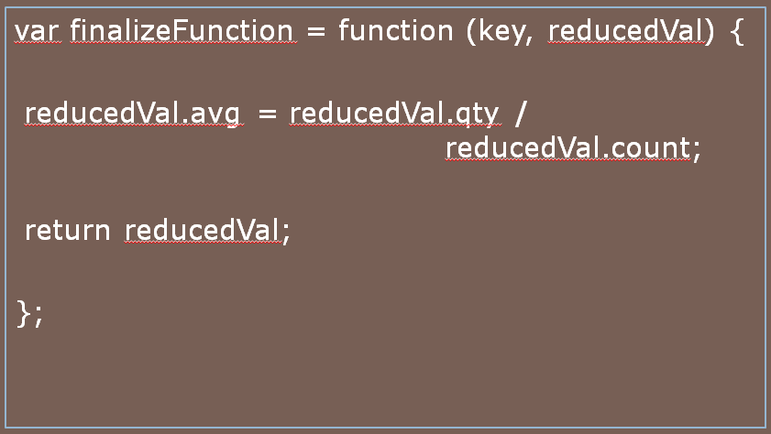
Finalise Function

Slide 32

Finalise Function
Takes two parameters: Key and Value (output from Reduce function).
Outputs computation across the members of the Value object
Number of Orders and Total Quantity for each Product needed from Reduce Function to calculate Average Quantity.

Slide 33
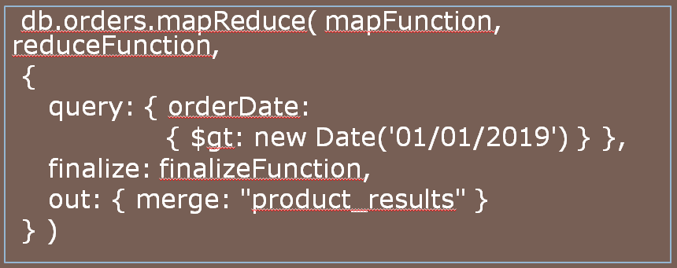
Map-Reduce Operation
Query limits documents processed.
Outputs new collection.
https://docs.mongodb.com/manual/core/map-reduce/

Slide 34

Summary
What are aggregation methods?
What is it like in SQL?
Three methods in MongoDB
Single purpose aggregation operations
Aggregation pipelining
Map Reduce programming

Slide 35
Thanks for listening
Any questions?

