Slide 1
Import/Exporting and Indexing
in MongDB

Slide 2

Contents
Importing data
Is there existing data?
Where are the field names?
Exporting data
Indexes
What are they?
Why do we need them?
How does MongoDB implement them?
When do we index?

Slide 3
Importing and Exporting data

Slide 4
Inserting single document
Can enter data into MongoDB using command line like this:
db.books.insert({name: "Brave New World", author: "Aldous Huxley"})
But say we have a huge amount of data
– we do not want to insert manually.

Slide 5
Importing data
MongoDB utility to import JSON, CSV and TSV data:
mongoimport /d test /c books
/file books.json
Reads in data from file called book.json into books collection of the test database.
Can specify data format /type csv

Slide 6
Importing data
If no collection name given, collection is named from file name without extension:
mongoimport /d test /file books.json
/ignoreBlanks if CSV contains sparse data (blanks). Otherwise fields created with null

Slide 7

Upserting data
/mode upsert inserts new data but replaces matching data. Inserts if no match or updates if is does.
Can specify fields to match for upsert with /upsertFields otherwise upsert defaults to matching _id
Indexes should exist for these fields to ensure adequate performance (more later …)

Slide 8
Specifying field names
Need field names for csv or tsv files.
/fields name, author can specify list of field names on command line.
/headerline if first line of file contains field names.
/fieldFile bookheaders.txt reference file contain list of field names.
https://docs.mongodb.com/manual/reference/program/mongoimport/

Slide 9
Exporting data
mongoexport /d test /c books /out books.json
Writes out all documents from books collection of the test database into file called book.json.
Possible to output CSV but usually does not map well.
Export from BSON to JSON does not always map well either.
https://docs.mongodb.com/manual/reference/mongodb-extended-json/

Slide 10
Exporting options
/query ‘{author: "Aldous Huxley”} exports just part of
collection.
/fields title specifies a subset of names of fields to export.
/sort orders the output.
/skip and /limit to reduce number of exported documents
https://docs.mongodb.com/manual/reference/program/mongoexport/

Slide 11
Indexing data

Slide 12
Indexing in general
Data structures to look up data
Imagine a 4000 page cookbook with unordered set of recipes. How do you find a recipe?
We need an index on recipes:
Caramelized Garlic Hummus: 35
Chai Muffins: 3191
Chilli Ginger and Garlic Sauce: 893

Slide 13
Indexing in general
An index on ingredients might be helpful too?
Bok Choy: 4, 19, 43, 87, 105, 1213, …
Broccoli: 2, 45, 87, 91, 384, …
Broad Beans: 1020, 1034, 2003, 2126, …
A compound index is more useful:
Bok Choy
Bok Choy Apple Slaw: 105
Brothy Chinese Noodles: 43
Green Chicken Curry: 87

Slide 14
Indexing in MongoDB
Indexes are special data structures that store small portion of collection’s data set in easy to traverse form.
Index stores value of specific field or set of fields, ordered by value of field
Each entry in index points to DB document.
Like an index in a book.
https://docs.mongodb.com/manual/indexes/

Slide 15
Indexing in MongoDB
Indexes support efficient execution of queries in MongoDB.
Without indexes, MongoDB must scan every document in a collection to select those documents that match query criteria.
MongoDB defines indexes at collection level.
Supported on any field or sub-field of documents in collection.

Slide 16
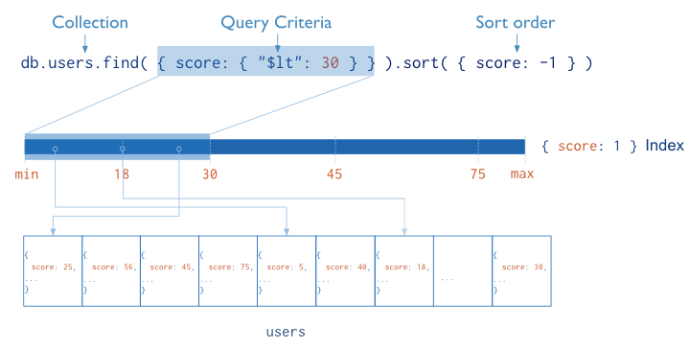
Index in MongoDB

Slide 17
Index structure
MongoDB uses B-Trees which are common DB index structures:
205 | 317 | 531
100 103 107
206 220 257
318 322 357
532 761 920
103 Desai | 206 Smith | 220 Patel | 100 Miller | 357 Davies | 257 Mary | 107 Miller | 318 King | 920 Jones | 322 Peters | 761 Bond | 532 Wong

Slide 18
Benefits of Indexing
Non-index look up requires linear time O(n)
B-tree divides and conquers shortening time required to O(log n)
n/2^{x}=1 , n=2^{x}
Log₂(n) = x
Log₂(4000) ≈ 12

Slide 19
Benefits of Indexing
Indexes held in RAM
Results are already ordered without the need for additional sort after a query.
Covered results do not need DB access at all – just return data from index. For example, count scores under 30 if score field has index.
Range searches are quicker

Slide 20
The Explain Method
db.zips.explain( "allPlansExecution").find(
{pop:{$lt:50}} )
Results without index on pop:
stage : COLLSCAN
nReturned : 356
totalDocsExamined : 29353
Results with index on pop:
stage : IXSCAN
nReturned : 356
totalDocsExamined : 356

Slide 21

Types of MongoDB Indexes
Default _id index : each object ID automatically assigned to each document is indexed by default
Single field index : db.cookbook.createIndex({recipeName: 1}, {name: "recipeIndex"})
Compound index : db.cookbook.createIndex({ingredientNam e: 1, recipeName: 1})
Order is important. Sorts first on ingredient and then recipe. No need for single field index on ingredient.

Slide 22
Types of MongoDB Indexes
Multikey index : Index array fields. MongoDB creates separate index entries for every element of array.
For example, given document like this:
{ name: "lawnmower",
tags: ["tools", "outdoor", "gardening"] }
Index {"tags":1} multiple key entries
will reference same document.

Slide 23

Types of MongoDB Indexes
Geospatial Indexes : indexes world coordinates. Geographical distances calculated efficiently e.g. takeaways in 5 mile radius.
Text Indexes : large index of words but ignores ‘a’, ‘the’ etc.
Hashed Indexes : Indexes hash of field to support hash based sharding so docs are more evenly distributed across clusters (more in future lecture...)

Slide 24
MongoDB Index Properties
Unique Indexes : Reject duplicate values for the indexed field.
db.uni.createIndex({StudentNo: 1},
{unique: true})
Used on _id default index.

Slide 25
MongoDB Index Properties
Sparse Indexes : only index docs that have index field, so only contains subset of whole collection.
db.uni.createIndex({Category: 1},
{sparse: true})
Full (non-sparse) indexes contain every doc in collection, using null for those that do not contain indexed field.
Sparse and Unique index prevents duplicates but allows docs to omit value.

Slide 26
Managing MongoDB Indexes
db.books.getIndexes()
db.cookbook.dropIndex(recipeIndex)
db.cookbook.dropIndex(recipeName_1)

Slide 27
When to choose Indexes
Only index what you need,
Don’t build too many so RAM is filled.
Choose indexes for frequent and targeted queries and updates.
Indexes can slow down large numbers of inserts, updates and deletes as the indexes must be altered too.
Querying all docs does not use index.

Slide 28
Index Hinting
If searching across many fields
And more than one field has index
And there is no compound index
Then hint tells MongoDB optimiser which index to use
db.employees.find( {jobCode:"FT", salary:{$lt:35000}},{name:1}).hint( "jobCode_1") )

Slide 29
Summary
Importing data
Upserting
Specifying field names for csv or tsv
Exporting data
Indexes
Data structures to look up data in DB
Supports efficient retrieval of data
Db.col.CreateIndex()creates B-tree
Choose for frequent targeted queries.

Slide 30
Thanks for listening
Any questions?

