Slide 1
Statistics

Slide 2
Why use statistics?

Slide 3
Define study question
Choose a suitable test
Set null and alternative hypothesis
Calculate a test statistic
Calculate a p-value
Make a decision and interpret your conclusions

Slide 4
Research question
What do you want to test?
What are your hypotheses?
What will you measure (data) to test these hypotheses?
What are your variables?

Slide 5
Hypothesis testing
Null hypothesis
No difference, effect, relationship etc
H₀
Alternative (research) hypothesis
There is an effect, difference relationship
H_{A}

Slide 6
Data and variables
Data
Measurements from experiment
Answers to questionnaire
Variable
Measurement that varies between subjects e.g. gender, height, knee flexion angle etc

Slide 7
Variables
Dependent variables
Outcome variable
May depend on or be influenced by other variables
Independent variables
Explanatory/predictor variables
Variables we think may influence the dependent variable
Independent
Affects
Dependent

Slide 8
Data types
Variables
Scale
(numerical/quantitative)
Categorical
(groups/categories)
Continuous
Measurements
takes any value
Discrete:
Counts/ integers
(whole numbers)
Ordinal:
obvious order
(race results; 1st, 2nd, 3rd)
Nominal:
no meaningful order
(male/female [binary])

Slide 9
Example: Questionnaire results
What is your favourite subject?
Psychology, motor control, biomechanics, physiology
Categorical: Nominal
Gender?
Male, female
Categorical: Nominal (binary)
Do you consider yourself to be good at statistics?
Strongly agree, agree, not sure, disagree, strongly disagree
Categorical: ordinal
Score in recent statistics test
0-100%
Scale: continuous

Slide 10
What are you testing for?
Relationships
Relationship between two scale/continuous variables
An association between two categorical variables
Correlation vs relationship
Differences between groups (testing averages)
Independent groups: comparing 2+ DIFFERENT groups of subjects
Repeated measures: measuring the same variable repeatedly, using the same subjects over 2+ time points/conditions

Slide 11
Testing relationships
Investigating relationships between | Dependent variable | Independent variable | Test
2 categorical variables | Categorical | Categorical | Chi-squared test
2 Scale variables | Scale | Scale | Pearson’s correlation
Predicting the value of a dependent variable from the value of a independent variable | Scale | Scale/binary | Simple Linear Regression
 | Binary | Scale/ binary | Logistic regression
Note: Multiple linear regression is when there are several independent variables

Slide 12
Research question | Dependent variable | Independent variables | Test
Does attendance affect exam score? | Exam score (Scale) | Attendance (Scale)
Do women do more housework than men? | Housework (hrs per week) (scale) | Gender (Binary) Hours worked (Scale)
Were Americans more likely to survive on board the Titanic? | Survival (Binary) | Nationality (Nominal)
 | Survival (Binary) | Nationality , Gender, class

Slide 13
Research question | Dependent variable | Independent variables | Test
Does attendance affect exam score? | Exam score (Scale) | Attendance (Scale) | Correlation/ regression
Do women do more housework than men? | Housework (hrs per week) (scale) | Gender (Binary) Hours worked (Scale) | Regression
Were Americans more likely to survive on board the Titanic? | Survival (Binary) | Nationality (Nominal) | Chi-squared
 | Survival (Binary) | Nationality , Gender, class | Logistic regression (when dependent can only be classified into groups)

Slide 14
Comparing means
Independent t-test
2
Comparing BETWEEN groups
One way ANOVA
3+
Comparing means
Paired t-test
Comparing measurements WITHIN the same subject
2
Repeated measures ANOVA
3+
ANOVA = Analysis of variance
www.statstutor.ac.uk
Notes:
Go through the 4 different tests. The following exercise asks which of these 4 tests is appropriate.

Slide 15
Research question | Dependent variable | Independent variable | Test
Do women do more housework than men? | Housework (hrs per week) (Scale) | Gender (Nominal)
Does Margarine X reduce cholesterol? Everyone has cholesterol measured on 3 occasions | Cholesterol (Scale) | Occasion (Nominal)
Which of 3 diets is best for losing weight? | Weight lost on diet (Scale) | Diet (Nominal)

Slide 16
Research question | Dependent variable | Independent variable | Test
Do women do more housework than men? | Housework (hrs per week) (Scale) | Gender (Nominal) | Independent t-test
Does Margarine X reduce cholesterol? Everyone has cholesterol measured on 3 occasions | Cholesterol (Scale) | Occasion (Nominal) | Repeated measures ANOVA
Which of 3 diets is best for losing weight? | Weight lost on diet (Scale) | Diet (Nominal) | One-way ANOVA
If more than two grouping variables (ANOVA), use a post hoc IF difference is significant

Slide 17
Parametric or non-parametric?
Parametric
Assumes data follows a particular distribution e.g. normal distribution, equal variance
Non-parametric
Don’t make assumptions about the distribution of the data
Usually based on ranks rather than actual data
Can be used when data is; skewed, ordinal, small sample sizes
Used if data doesn’t meet the assumptions of the parametric test

Slide 18
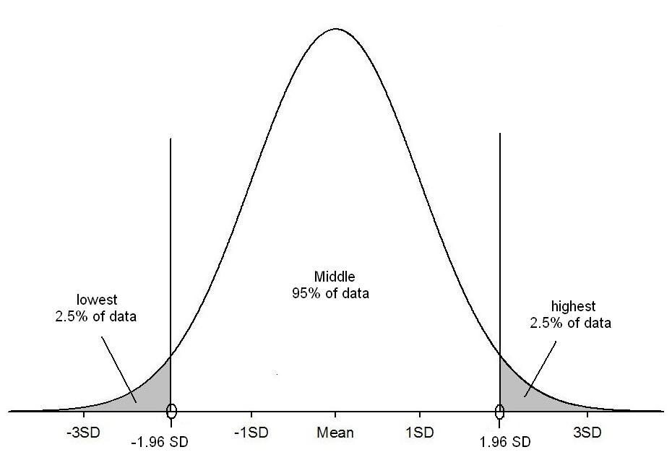
Normal distribution
95% of values

Slide 19
Non-parametric tests
Relationships
If 2 ordinal variables or doesn’t meet the assumptions of Pearson’s correlation: Spearman’s correlation
Non-parametric regression: Kendall robust line-fit
Comparing means
Independent t-test: Mann-Whitney test
One-way ANOVA: Kruskall-Wallis
Paired t-test: Wilcoxon signed rank test
Repeated measures ANOVA: Friedman test

Slide 20
Errors
Type 1 errors:
False positive
Test returns a significant result when there is no difference
E.g. if do multiple t-tests on the same data you increase your chance of making a type 1 error with each additional comparison. ANOVA controls for these errors.
Type 2 errors:
False negative
Test returns a non-significant result when there is a difference

Slide 21
References
Dytham C (2011) Choosing and using statistics: A biologists guide. Wiley-Blackwell: West Sussex, UK
http://www.statstutor.ac.uk/

