Slide 1
Text Generation for Creative Writing
By Pallavi Sikha

Slide 2
Data Overview
Total books: 52478
Unique authors: 28227
Average rating: 4.02

Slide 3
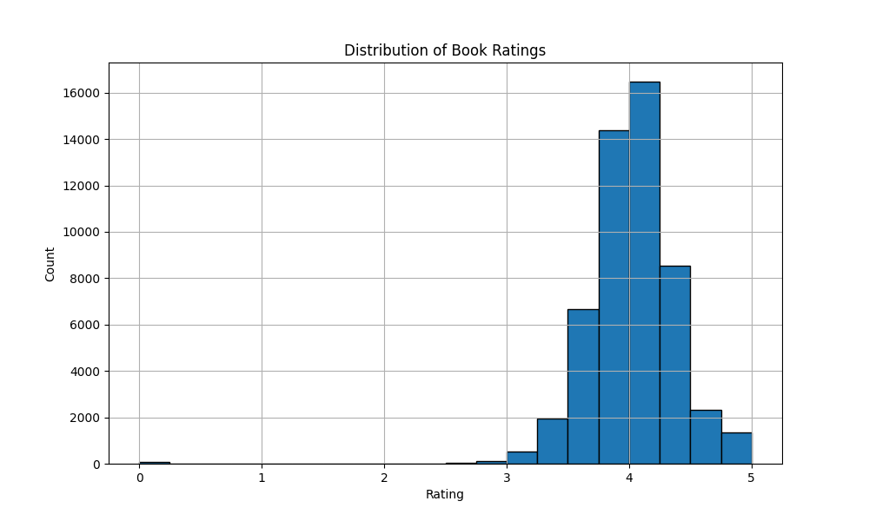
Rating Distribution

Slide 4
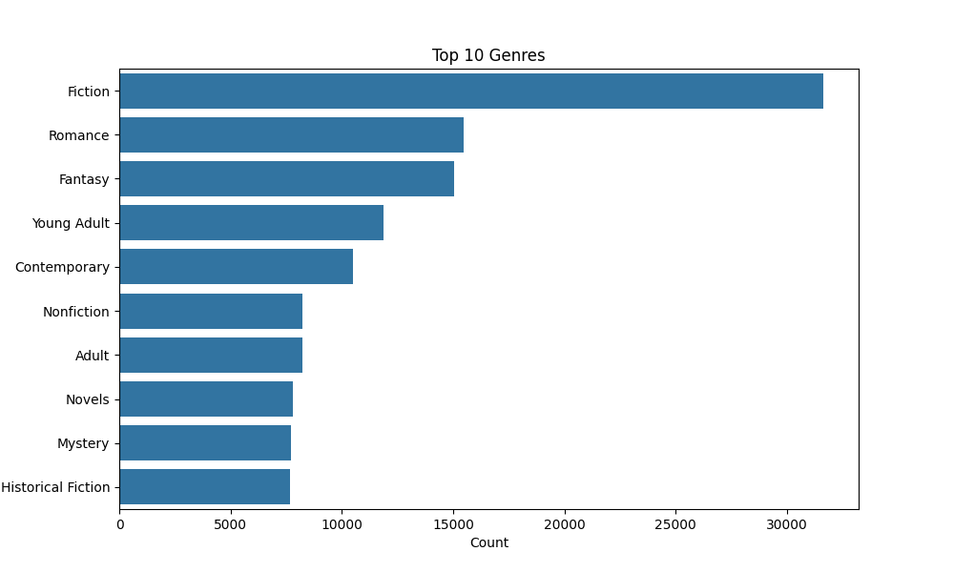
Top 10 Genres

Slide 5
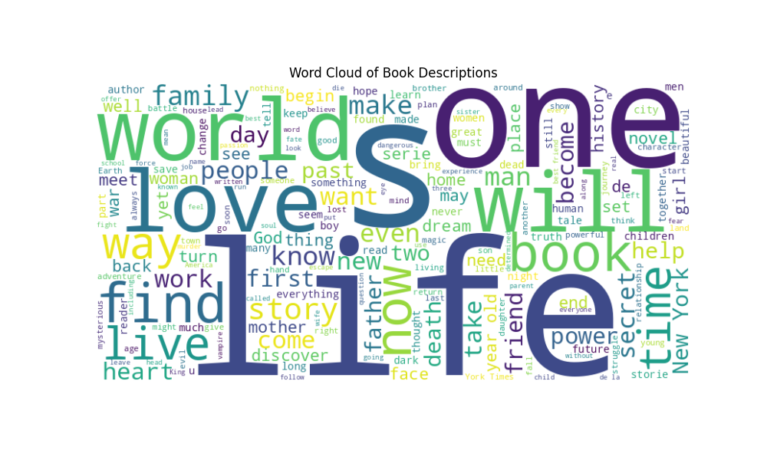
Word Cloud of Book Descriptions

Slide 6
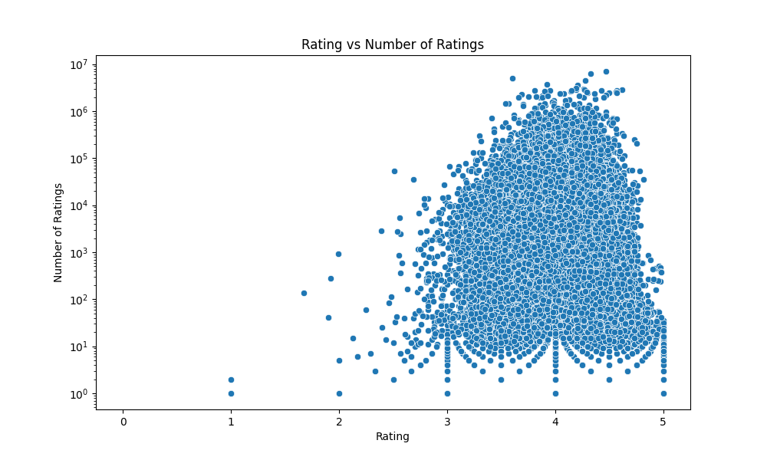
Rating vs Number of Ratings

Slide 7
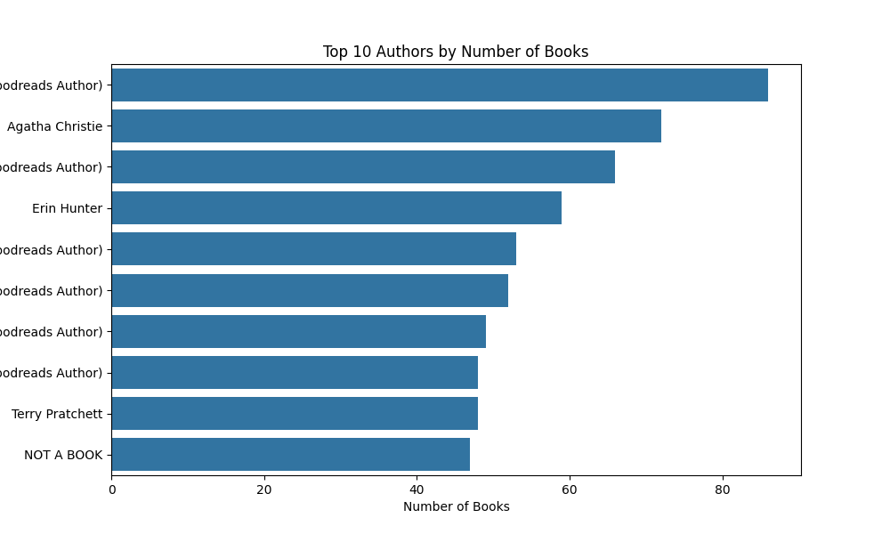
Top 10 Authors by Number of Books

Slide 8
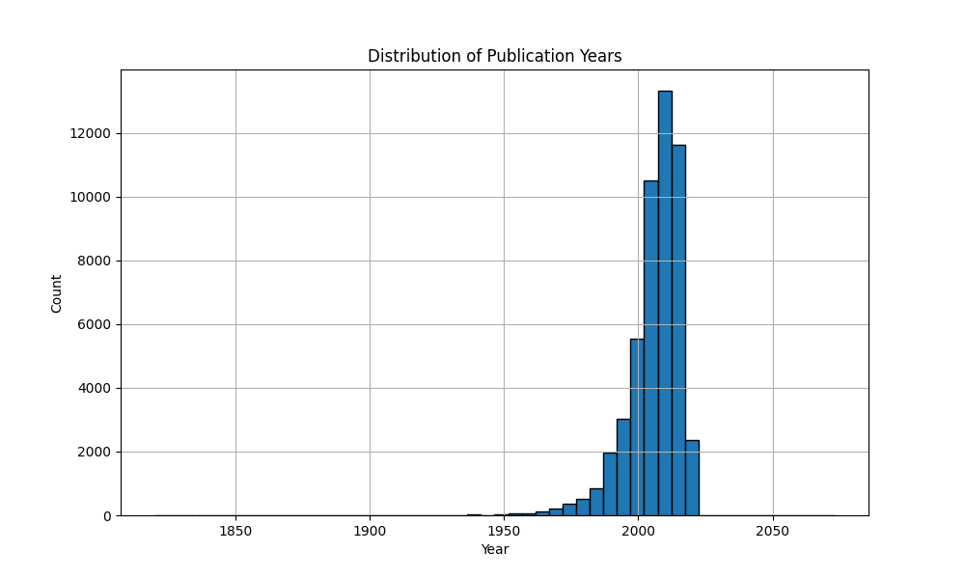
Distribution of Publication Years

Slide 9
Conclusion
• Rich dataset with diverse books and authors
• Potential for interesting text generation
• Consider ethical implications in creative writing

