Slide 1
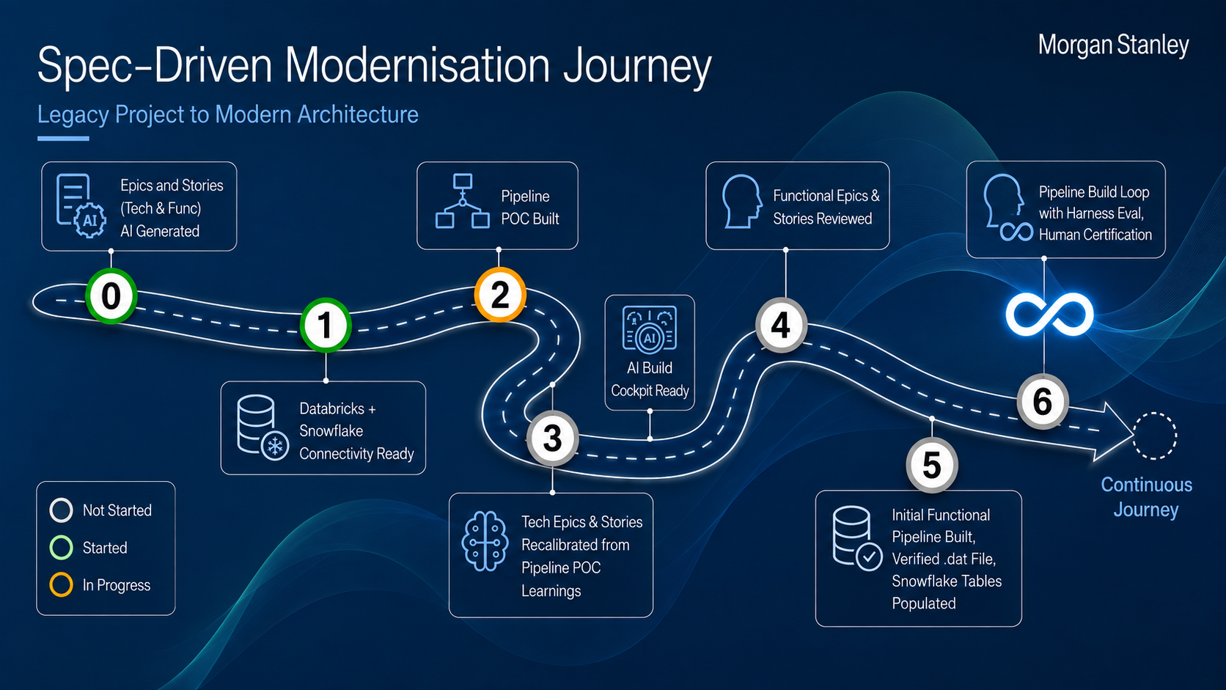
Spec-Driven Modernisation Journey
Morgan Stanley
Legacy Project to Modern Architecture
Epics and Stories
(Tech & Func)
AI Generated
Pipeline
POC Built
Functional Epics &
Stories Reviewed
Pipeline Build Loop
with Harness Eval,
Human Certification
0
2
1
4
AI Build
Cockpit Ready
6
Databricks +
Snowflake
Connectivity Ready
3
5
Continuous
Journey
Not Started
Tech Epics & Stories
Recalibrated from
Pipeline POC
Learnings
Initial Functional
Pipeline Built,
Verified .dat File,
Snowflake Tables
Populated
Started
In Progress

