Slide 1
EVERYONE TO SHARE HIS/HER PAGE … 1 PPT slide
General guidance
It is strictly your page. Make it more visual rather text.
It will be a slideshow during dinner - Visible & accessible to everyone.
Don’t clutter. Less is more. 2-4 things you want everyone to know and remember about you.
Limit career achievements … it is not LinkedIn.
Anything interesting … Funny and silly will go a long way and catch the attention.
We will also open it to people not able to attend … it is all about bonding and sharing
  Most likely everything will be put together in a book form and gifted to everyone (depending in availability of funding)

Slide 2
IDEAS …
Title: Name/ Branch/ roll number, any nick name
Then
Picture from RIT days (group or individual) … if not from RIT campus, then any picture from 1998-2002.
Any memorable thing to highlight from RIT days … not more than 2
Now
Yours and your family picture … We all look very different today
Current location … pic of a city icon (say, Gateway of India for Mumbai, or Big Ben – London, or country map/flag
Profession (optional) … what do you do? Example: Company logo, title
Anything you want everyone to know and remember … something unique, hobbies, milestone, kids, pets
Feedback
Ask you spouse and kids for input before you submit

Slide 3


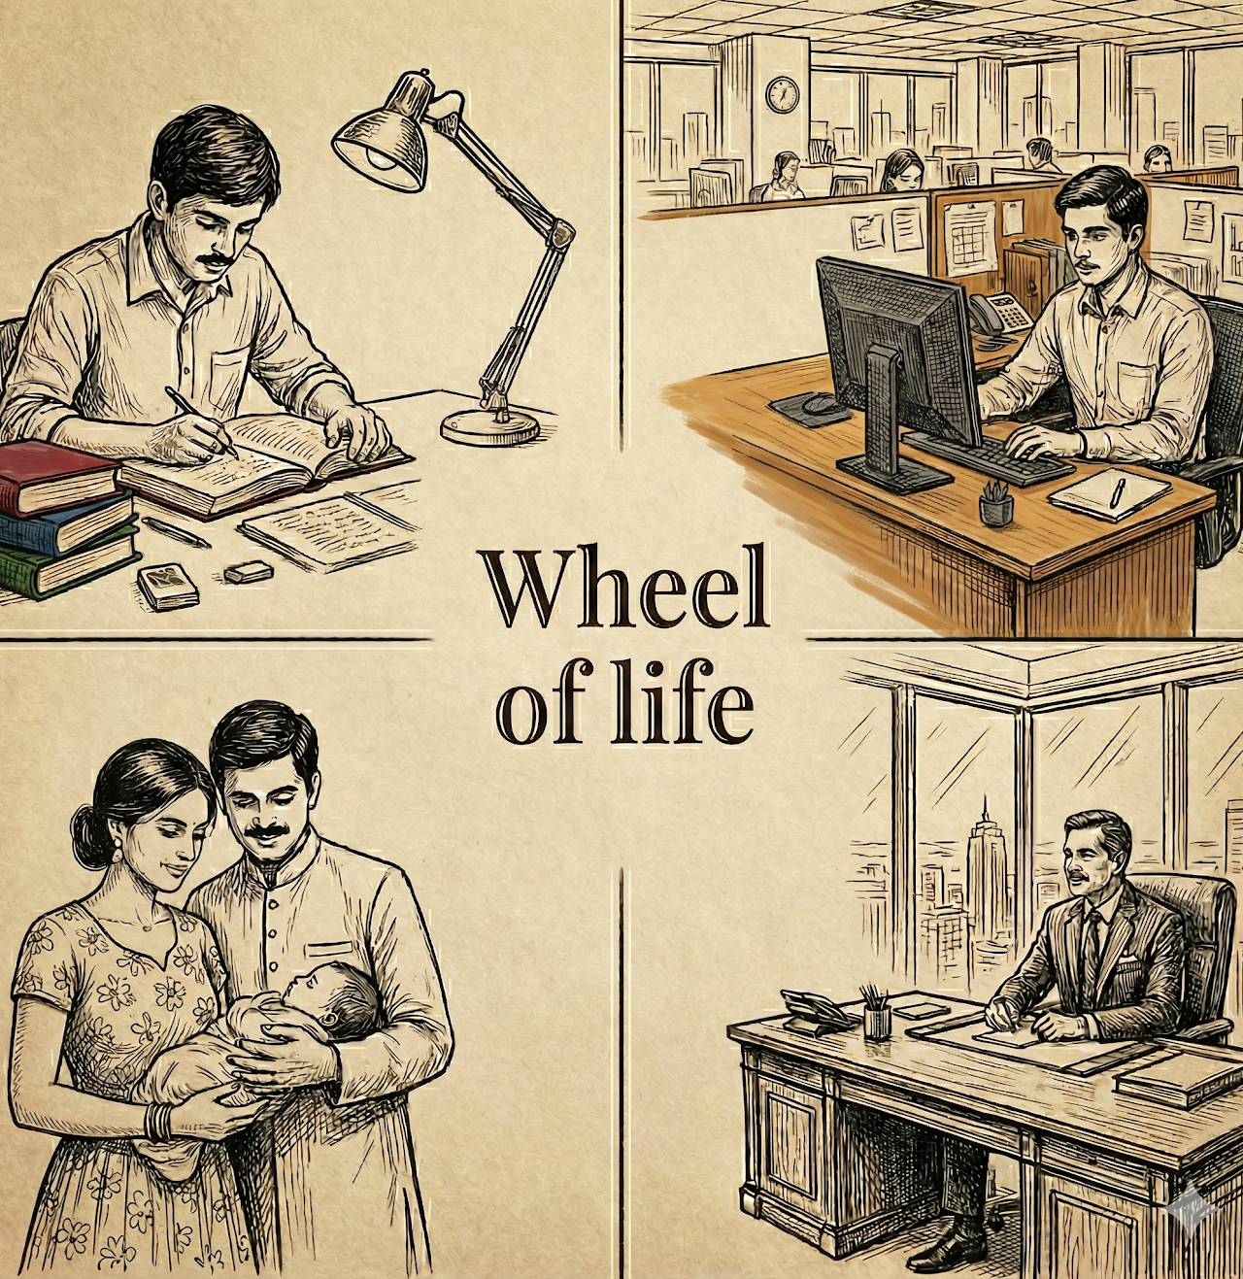
RIT Silver jubilee 1998-2002
Jan 24-26th
Life is the art of building relationships, creating unforgatable moments, and leaving something that outlives us
… RIT gave us everything

