Slide 1

Elastic

Slide 2
Agenda
Introduction
Elastic Stack
Components of Elastic Stack
Few Use cases in Big Data world
Elastic
Data Ingestion
Indexing
Data Analysis
Demo & Labs

Slide 3
Introduction
What is it
Open source, distributed search and analytics engine (java based search and indexing library)
Distributed Cluster features, sharding for Indexes, advanced search and aggregation
Index data of all types
Scalable
Core of "Elastic Stack" (formerly ELK stack)
What can I do with it?
Index data - Structured or unstructured (possibly using the "L")
Search for it (Using the "E")
Analyze and Visualize it (Using the "K")
Read about it at elastic.co

Slide 4
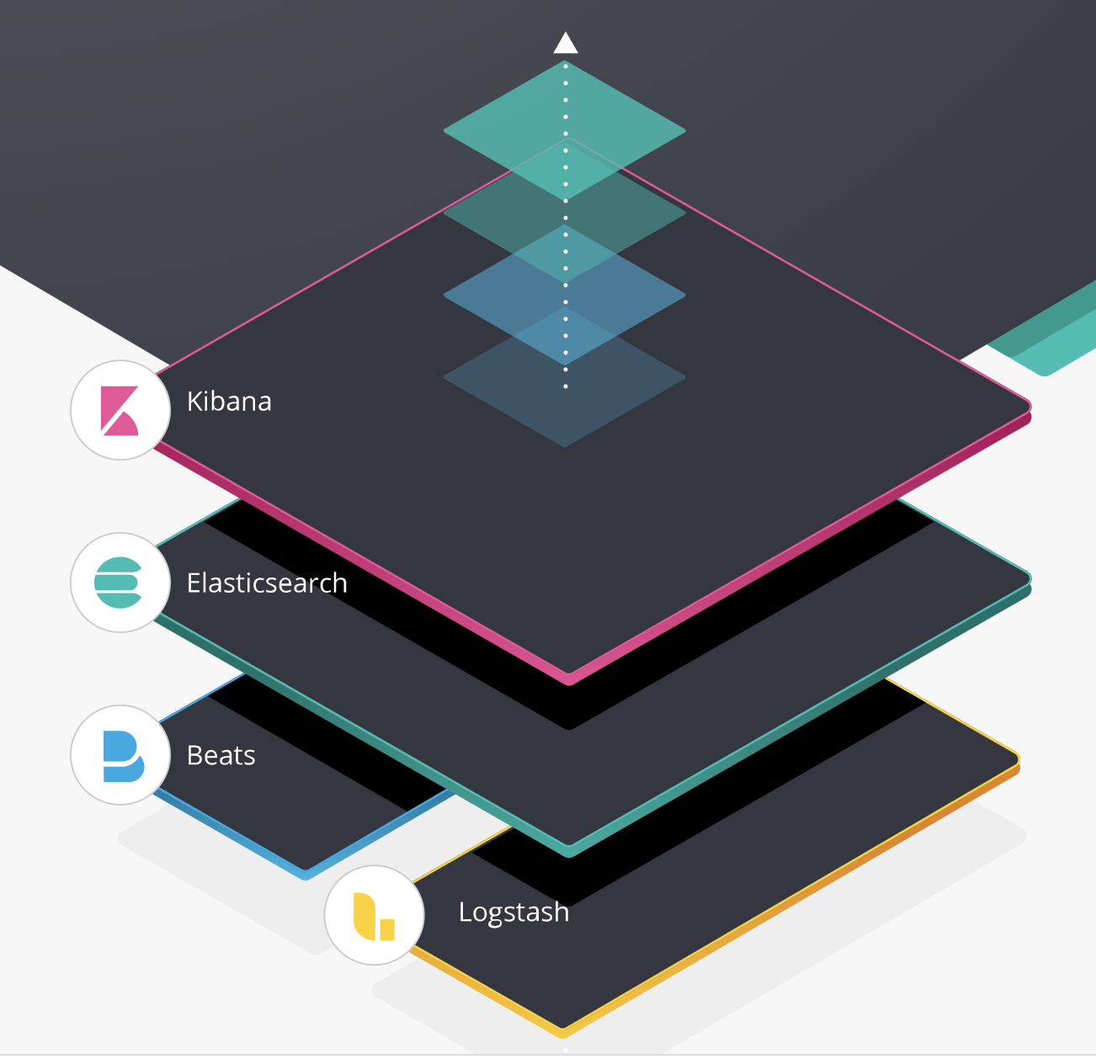
Elastic Stack (Formerly ELK Stack)
Open source from ELASTIC,
Reliably and securely take data from any source, in any format, then search, analyze, and visualize it in real time.
E - Elasticsearch
Heart of the whole operation. The data lives here. (store/Search/Analyze)
L - Logstash
Used collecting logs, data events, transforms
K - Kibana
Analytics and visualization platform, Web interface users the REST API to interact with Elastic Search
visualizing data such as charts, Dashboards, configure change direction and forecasting.
The data is stored in Elastic search itself.
Beats: Data shipper
X-pack: Authorization and Authentication

Slide 5
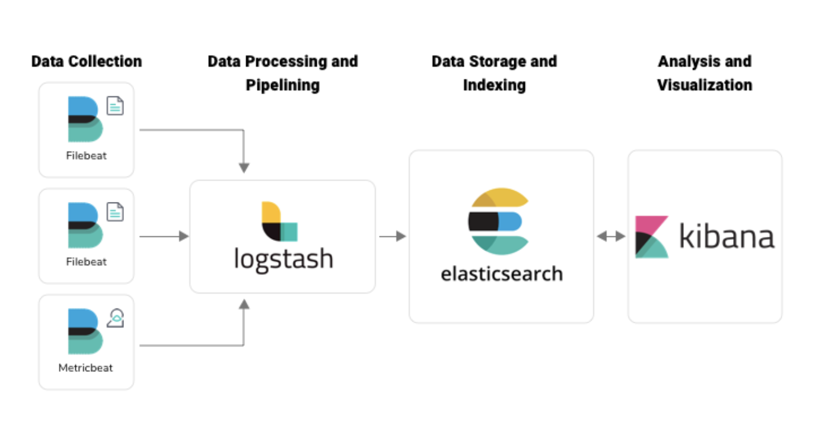
Elastic Stack Architecture

Slide 6

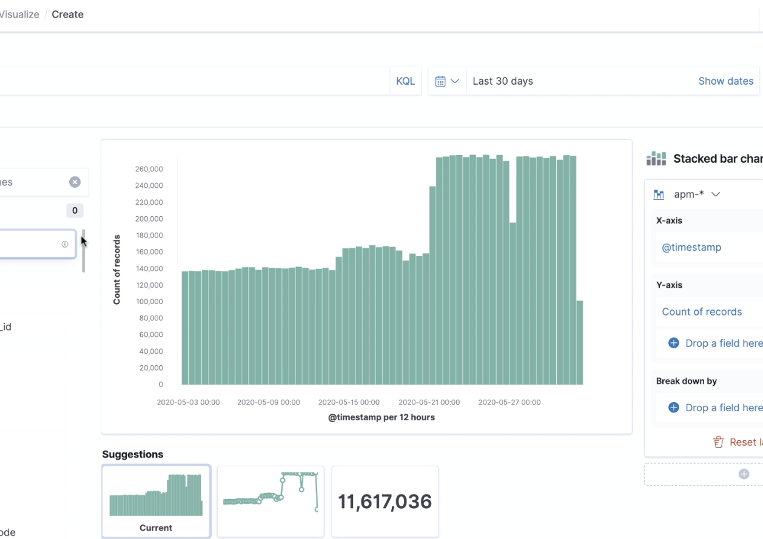
Kibana
Analytics and visualization platform with Key points of interest
The data is stored in Elastic search itself.
Web interface users the REST API to interact with Elastic Search
Dashboards for number of metrics for monitoring/ Performance of servers
Administrators - Dashboards : CPU, Memory usage
Developers : Application Errors/ API Response times

Slide 7

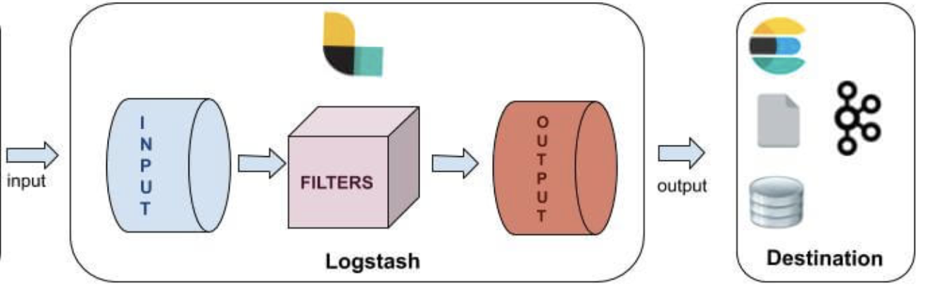
Logstash
Traditionally, Used to process logs from applications , send to Elastic Search, More evolved as generic Tool for data processing pipeline
Data collection, enrichment, and Transformation pipeline
Log stash events can be any data: Structured/unstructured
Input plugins: File, STDIN, Beats, JDBC, Elastic Search, Kafka, http
Filter Plugins: CSV, JDBC, JSNO, XML etc
Output Plugins : Elastic Search, Kafka, S3, File, Stdout, Database (mongo)
Structure of the config file : ex:
input { ……… } filter { ………. } output { ……... }

Slide 8
Data Ingestion
Elastic Beats - Lightweight data shippers
Low resource usage
Used for ingesting logs, metrics, many other things
Logstash - Used for ingesting many things - not just logs
Use to enrich ingested data
Inputs - Data sources include files, logs, http, jdbc, kafka, and on and on
Filters - Process and enrich the data (DNS lookups, Geographic information, custom dictionaries)
Output - Usually to Elasticsearch, but other places as well

Slide 9
Data Ingestion
Application code
Use code to push data into Elasticsearch
Many native client libraries including for Java, Python, etc.
Kibana - Some functionality to put data into Elasticsearch
Any kind of REST client (Postman, curl, etc.)

Slide 10
Query the Elastic Search
Query the documents with proprietary query language called Query DSL. - Verbose
SQL Queries over HTTP alternatively. (Elastic sear ch translates the SQL query to Query DSL format behind)

Slide 11
Indexing/Mapping
Dynamic Mapping - Automatically created by just indexing a document
Elasticsearch guesses everything
All properties are mapped and indexed
Good way to get a base mapping
Explicit Mapping - Usually a better option
You know your data types
You know what data needs to be indexed

Slide 12
Text Analysis
Enables full-text searching
Tokenization - Breaking text into smaller chunks (tokens)
Quick brown fox -> Quick, brown, fox
Normalization - Lowercasing, stemming, synonyms
Quick -> quick
foxes -> fox
leap -> jump
Write custom analyzers
Default analyzer works pretty well for basic full-text search

Slide 13
Data Analysis
Use Kibana!
Web-based UI for Elasticsearch
Search application logs or other data
Visualize data with charts, graphs, tables, and more
Use it for some Elasticsearch management (configure or delete indexes, other settings)

