Slide 1
AI in Research Work
Prompt engineering and advanced uses of generative AI for researchers
Dr. Enrico Glerean, Staff Scientist at SCI and Data Agent
Dr. Pedro Silva, Postdoc at CHEM and Data Agent

Slide 2
Outline: AI in research work I – prompt engineering and other tools
From AI to generative AI
Prompt engineering for research
Gen AI with LLMs in the academic workflow
Other tools and advanced topics
Conclusions
Learning outcomes
How to use generative AI tools in your research work
Evaluating the outputs and understanding limitations
Learn and explore more tools that are specifically made for researchers
NOTE: in this episode we don’t cover any cybersecurity or legal or ethical aspects.
We are also skipping the basics of how LLMs work.

Slide 3
Briefly about the speakers
Enrico Glerean, DSc.
Staff scientist and data agent (background in neuroimaging), training and supporting researchers with handling personal data (anonymization, secure computing), medical images, clinical trials, research ethics and research integrity (AI and new technologies), statistics, open science.
Other affiliations/COI: CodeRefinery (Nordic network to teach computational reproducibility), Finnish Reproducibility Network (National network to raise awareness in reproducibility), Support Pool of Experts at the European Data Protection Board (open training materials on personal data, AI, and cybersecurity), Data Steward training program for Tampere University
Pedro Silva, PhD
Postdoctoral Researcher, developing new textile functionalities by leveraging the material properties through innovative designs, and data agent at the Aalto School of Chemical Engineering (CHEM), promoting best practices in Research Data Management and Open Science, training and supporting researchers with documentation and research workflows.

Slide 4
DISCLAIMER
THIS IS NOT A COMPUTER SCIENCE COURSE ON Generative ARTIFICIAL INTELLIGENCE. The materials are tailored for researchers who MIGHT have never used these technologies
WE WILL FOCUS ON INTUITIVE EXPLANATIONS and practical hints on how to use the most popular tools and what to be aware of when using them
Share your experience so that we can IMPROVE OUR MATERIALS AND MADE THEM OPEN FOR EVERYONE

Slide 5
The Research Process aided by AI with Responsible Conduct of Research at its core and some examples
RCR
Ethics & Law
Original image from https://rdmkit.elixir-europe.org/ “The data lifecycle”

Slide 6
What is (generative) AI?

Slide 7
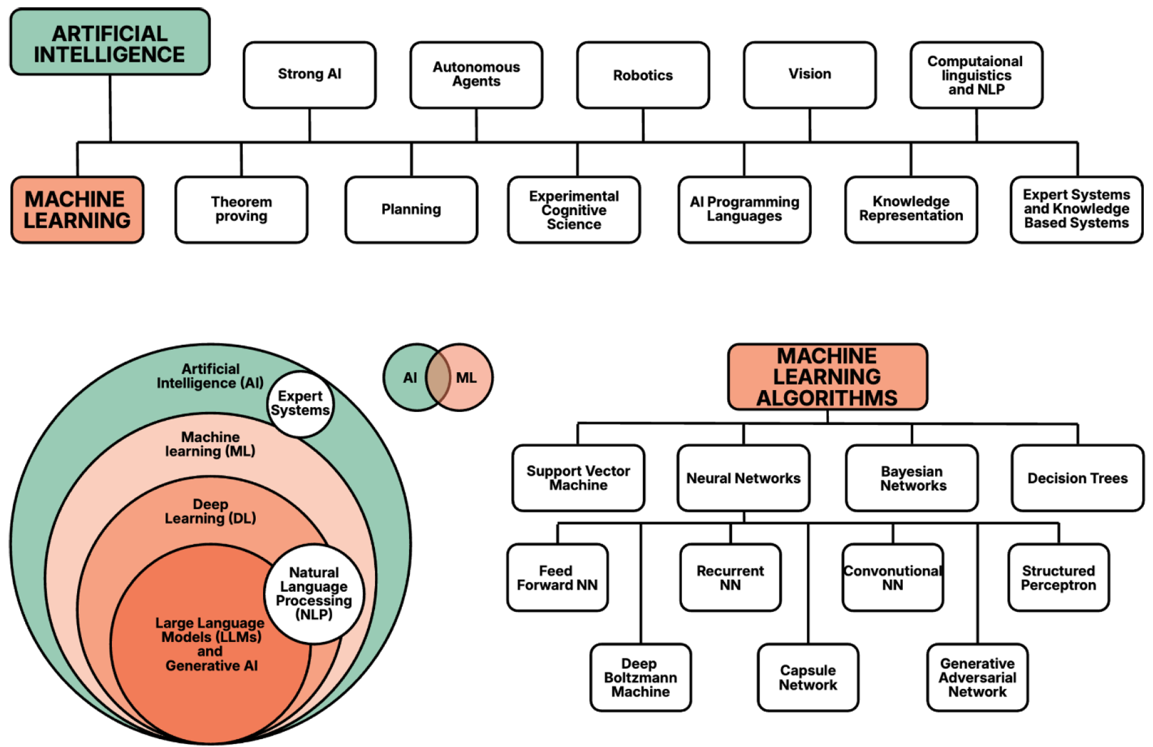
What is Artificial Intelligence (AI)?
‘AI system’ means a machine-based system that is designed to operate with varying levels of autonomy and that may exhibit adaptiveness after deployment, and that, for explicit or implicit objectives, infers, from the input it receives, how to generate outputs such as predictions, content, recommendations, or decisions that can influence physical or virtual environments;
(Article 3(1), Artificial Intelligence Act)
Other AI legal definitions collected by IAPP.
Figure from Glerean (2025) “Fundamentals of secure AI systems with personal data” European Data Protection Board

Slide 8
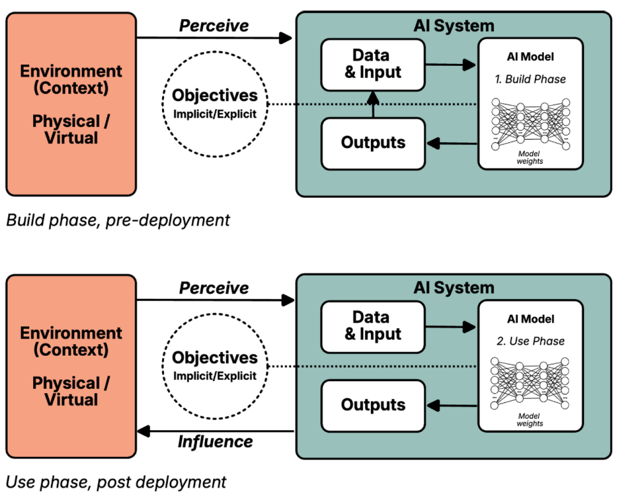
AI systems vs AI models
The AI model is like the engine of the car: it can be very powerful and even dangerous, but if it is not put into a system (the rest of the car) it cannot do anything.
The AI system enables the use of the AI model: by feeding input to the model, it can produce recommendations, classifications, translations, synthetic text, synthetic images, code, … and influence the external physical/virtual environment
Figure from Glerean (2025) “Fundamentals of secure AI systems with personal data” European Data Protection Board

Slide 9
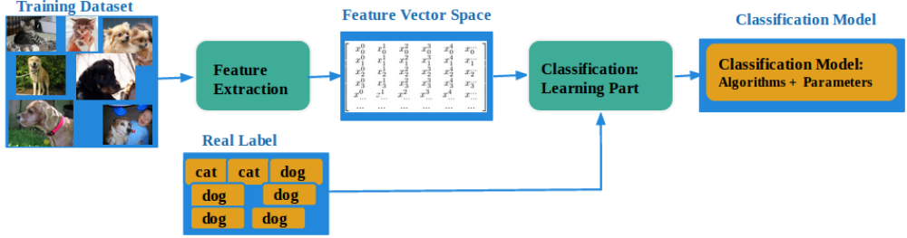
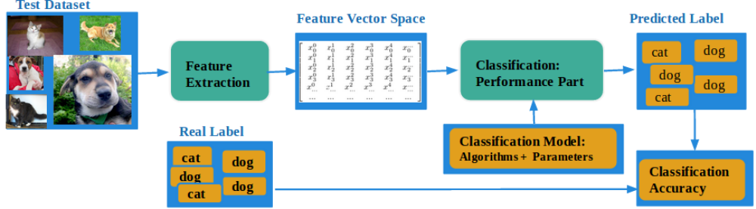
Learning cats and dogs: how does machine learning work?
Learning
stage
Testing
stage
From http://www-labs.iro.umontreal.ca/~liubang/files/DogCat_report.pdf

Slide 10
How does generative AI work? An intuitive explanation
The key task in AI system is often trying to predict
The classifier from the previous example is able to predict labels from new images: given a new picture of a dog, it can tell if there’s a cat or a dog
There are other types in AI called “generative”: the program learns patterns from the training set and is able to generate a picture, or text, or sound following the rules of what it has learned
We are not even scratching the surface here, if you are interested to know more, ask in the chat and we can provide references. See this link for a great collection of references

Slide 11
Focus on text generation: large language models (LLMs)
Why focus on language?
Large amount of data for training these foundational models
Language is possibly the most versatile modality as it allows to describe (almost) anything: concepts, facts, relationships, processes, software code, …
Language (as text via a keyboard) is an efficient way to interact with a computer program via instructions

Slide 12
Guess the letter
It is an English word starting with the letter 'q': which letter comes after that?

Slide 13
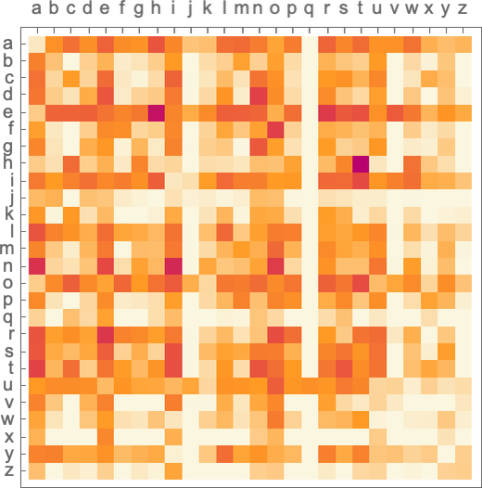
Guess the next letter
If I am thinking of an English word that starts with q and I ask you to guess the next letter, what is your most likely guess?
How often a letter from the columns is followed by a letter on the rows? Bright yellow = never, dark red = very often
Image from What is ChatGPT doing, and why does it work? by Stephen Wolfram

Slide 14
Guess the next word, sentence, paragraph, chapter, book…
Large language models estimate the probability between words in the context of sentences, paragraphs, chapters, books… Given a prompt sentence, the language model can be asked to continue it based on the most likely expected following words, with a given randomness (temperature)
E.g. the sentence “The best thing about AI is its ability to” has these as the 5 most likely following words: “learn”(4.5%), “predict” (3.5%), “make”, (3.2%), “understand” (3.1%), “do” (2.9%)
From What is ChatGPT doing, and why does it work? by Stephen Wolfram

Slide 15
Guess the next word, sentence, paragraph, chapter, book… (II)
At each generated word, we re-ask the model to pick another one from the top N words that would follow from all the previous words seen so far.
{The best thing about AI is its ability to,
The best thing about AI is its ability to create,
The best thing about AI is its ability to create worlds,
The best thing about AI is its ability to create worlds that,
The best thing about AI is its ability to create worlds that are,
The best thing about AI is its ability to create worlds that are both,
The best thing about AI is its ability to create worlds that are both exciting,}
Different runs, produce different outputs (goodbye reproducibility!)
The best thing about AI is its ability to learn. I’ve always liked the
The best thing about AI is its ability to really come into your world and just
The best thing about AI is its ability to examine human behavior and the way it
The best thing about AI is its ability to do a great job of teaching us
The best thing about AI is its ability to create real tasks, buy you can
From What is ChatGPT doing, and why does it work? by Stephen Wolfram

Slide 16
Actually… it’s a little bit more complicated than that
They don’t predict words, they predict “tokens”
The deep neural network has “attention” layers which actually set the context already for many tokens ahead, so it is actually “planning ahead”
We did not talk about how words are mapped into numbers (vector embeddings)
We did not talk about how it is actually multiple models behind the scenes (architectures of LLMs)
If you want to learn more about this, start from 3 blue 1 brown YouTube videos

Slide 17
How to use them?
Platforms currently available (April 2026)
Historically the way to query generative models was to ask “continue the sentence”. Later OpenAI made the chat interface successful, but they were not the first (ref)
Most current platform require you to sign-up to a service since the actual model and its inference software are not running on your local computer.
Current platforms and technologies: OpenAI with free ChatGPT 5.* (also Microsoft Copilot with same AI model), Anthropic Claude, Google Gemini, LeChat by Mistral, Huggingface chat (various open-source models available), DeepSeek, Grok (x.ai), Duck.AI (free, no subscription needed, with a layer of privacy).
If privacy and protection of your data is important, open-source models can also be run locally. More at the end of this presentation.

Slide 18

2. Prompt engineering
“Prompt engineering is the process of constructing queries or inputs for AI language models so as to elicit the most precise, coherent, and pertinent responses.”

Slide 19
2. Prompt Engineering
“Prompt engineering is the process of constructing queries or inputs for AI language models so as to elicit the most precise, coherent, and pertinent responses.”

Slide 20
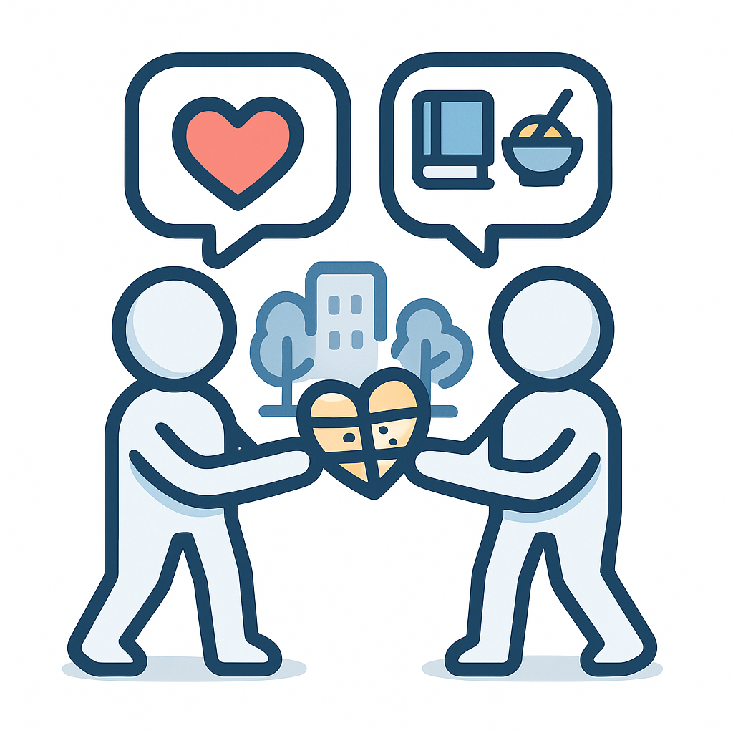



The art of asking
Question:
Possible answers:
Love shapes and is shaped by social interactions and cultural norms.
Sociology
What is love?
Chemistry
Love involves the release of high levels of dopamine and norepinephrine.
Business
Music
Love is the deep affection and attachment customers develop towards a brand or product.
“Oh baby, don’t hurt me”

Slide 21
General principles of good prompts (I)
Clear and concise (basic rules of how to make good questions)
  Prompt: “Tell me about the climate”
  Improved Prompt: Summarize the key impacts of climate change observed globally between 2015 and 2025, highlighting effects on agriculture.
Contextual (add a context, examples are welcome)
  Prompt: “What is PCE?”
  Improved Prompt: What is PCE in the context of photovoltaics?
Instructive (guide the type of answer you are looking for or exclude answers)
  Prompt: “Analyze the following text: (BLOCK OF TEXT)”
  Improved Prompt: Provide a short summary of the following text (50-70 words) explaining the reported key concepts. Provide a list with the main results, itemize the different methods, and explain the novelty. (BLOCK OF TEXT)

Slide 22

General principles of good prompts (II)
Read more:
CLEAR Principles https://doi.org/10.1016/j.acalib.2023.102720
Prompt engineering - OpenAI API
Iterative (split complex tasks into simpler subtasks)
  Prompt: “Write about renewable energies”
  Improved Prompt 1: List four types of renewable energy currently popular globally.
  Improved Prompt 2: From that list, briefly describe the advantages and drawbacks of solar power.
  Improved Prompt 3: Expand on the environmental impacts of large-scale solar installations.
Roleplay (ask the model to adopt a persona)
  Prompt: “Explain to me the basics of antibiotics.”
  Improved Prompt: You are an experienced microbiologist teacher at the university level, who has the passion on making explanations accessible and fun for students. Explain how misuse of antibiotics contributes to antibiotic resistance.
Tone and format setting (specify the style of the output)
  Prompt: “Tell me about black holes.”
  Improved Prompt: Explain black holes in a friendly, engaging tone suitable for toddlers, providing simple analogies, in bullet-point format, and briefly explain how the analogy works.

Slide 23

3. Use of LLMs in the academic workflow

Slide 24
3. Use of gen AI in the academic workflow

Slide 25
The Research Process aided by AI with Responsible Conduct of Research at its core
Grant writing
Research planning
Study design
Browsing and summarizing the literature
Facilitate discovery and FAIR-ness
Explore open datasets
Identify research gaps
Write and editing
Improve research outputs (tables, figures)
Peer review suggestions
Summarizing for public
Media reach out
RCR
Ethics & Law
Interfaces for data collection
Code and automation help
Metadata preparation
Summarising
Organise and store (meta)data
Brainstorming on approaches for data preprocessing
Code and automation
Data minimization (pseudo- and anonymization)
Data annotation (e.g. deductive coding)
Annotations
Methodological considerations
Data analysis (Code and automation)
Original image from https://rdmkit.elixir-europe.org/ “The data lifecycle”

Slide 26
Example 1: Prompt a prompt
Make a prompt for a Google Scholar search to find articles about azobenzene and spinning.
AI
"Spinning properties of azobenzene in scholarly articles"
The answer needs refinement
No, the prompt is to be used in Google Scholar website. Create it so it can efficiently search for articles that contain both "azobenzene" and "spinning" terms. Consider all variations of those terms used on scientific articles.
AI
("Azobenzene" OR "Azo-benzene" OR "Azo benzene") AND ("Spinning" OR "Spin" OR "Rotation" OR "Rotatory")

Slide 27
Example 2: Create readme files for experiments
Enhanced *.txt file
Description from manual
Create a markdown readme for an experiment in the equipment with the following description: "Dynamic mechanical analysis (…) this approach can be used to locate the glass transition temperature of the material, as well as to identify transitions corresponding to other molecular motions."
AI
# Dynamic Mechanical Analysis Experiment README
## Experiment Name
Dynamic Mechanical Analysis (DMA)
## Introduction
Dynamic Mechanical Analysis, also known as dynamic mechanical spectroscopy, is employed to study and characterize materials, in particular, understanding the viscoelastic behavior of polymers.
## Equipment and Materials
Add a detailed list of all the equipment and materials required for this experiment.
## Objective
1. Determine the complex modulus of the material.
(…)
Markdown
syntax

Slide 28
Example 3: Software assistance
Molecular Dynamics software
with good documentation online
In LAMMPS, what pair-wise potential can I use for simulating the interaction between hard-like sphere particles? Give an example of the command.
AI
If you want to simulate hard-like sphere particles in LAMMPS, you can use the Week-Chandler-Andersen (WCA) potential, which is basically the Lennard-Jones (LJ) potential truncated and shifted at the potential minimum.
In LAMMPS, you would define this potential with a combination of "pair_style lj/cut" and "pair_modify shift yes" commands, where "lj/cut" specifies the Lennard-Jones potential to be used and "shift yes" applies a constant energy shift to the potential so that it is zero at the cutoff. You will also need to specify sigma and epsilon parameters for the potential.
Here's an example of how to specify this potential and assign it to all atom pairs in your system:
pair_style lj/cut 1.122462048309373
pair_coeff * * 1.0 1.0
pair_modify shift yes
In this example, the cutoff is at 1.12246 which is where the Lennard-Jones potential reaches its minimum. The parameters for pair_coeff are set such that epsilon equals 1.0 and sigma equals 1.0. This is the typical WCA potential. You might need to tweak these parameters based on your specific system or model.
Code
block

Slide 29
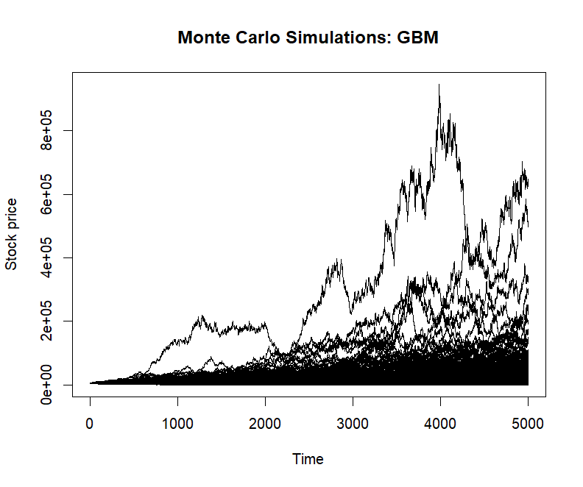
Example 4: Creating a stock dataset in R
Programming language
What R package and functions are most effective for simulating stock market fluctuations using Monte Carlo methods? Provide an example script.
AI
The R 'quantmod' package is well-suited for simulating stock market fluctuations using Monte Carlo methods. It is made for managing, modeling, and analyzing financial quantitative data.
Below is a simplified example of how you might use this package along with other necessary packages to simulate stock market prices using a Monte Carlo simulation. In this example, we will simulate changes in the price of a fictitious stock based on random walk using the GBM (Geometric Brownian Motion) model. This basic script doesn't include factors like drift or market influence.
# Install and load necessary packages
install.packages("quantmod")
install.packages("MASS")
library(quantmod)
library(MASS)
#Initialize parameters
T = 50 #time period
mu = 0.1 #expected return
sigma = 0.2 #standard deviation
S0 = 100 #initial stock price
dt = 0.01 #time step
N = T/dt #number of steps
set.seed(1000) #set random seed
#Monte Carlo Simulation
m = replicate(1000,
{
W = c(0, cumsum(sqrt(dt)*rnorm(N,0,1))) # standard Wiener process
S = S0*exp((mu - sigma^2/2)*dt*N + sigma*W) # GBM model
S
})
#Plot the simulation
matplot(m, type="l", lty=1, lwd=1, col=1,ylab="Stock price",xlab="Time", main="Monte Carlo Simulations: GBM")
Code
block

Slide 30
Example 5: Searching for alternatives
I've been using a moving average technique to fit my dataset, but I'm encountering issues with inaccuracies at the edges of the data. Could you recommend alternative data fitting methods that might provide more reliable results across the entire dataset, including the problematic edge regions?
AI
Yes, of course. One potential issue with moving averages is the "edge effect", where there is less data to average, which results in distortion at the edges. Here are some methods you may consider:
Polynomial regression: This is a form of regression analysis in which the relationship between the independent variable x and the dependent variable y is modelled as an nth degree polynomial. This allows for more flexibility in the shape of the fitted curve.
'Exponential smoothing': This is specifically suited to time series data where trends and seasonality may be present.
LOESS or LOWESS (Locally Weighted Scatterplot Smoothing): These are more advanced types of smoothed moving averages which give more weight to points nearby in time.
Cubic splines or B-splines: These techniques are used to interpolate and smooth data. Splines provide a way to smoothly interpolate between fixed points, known as knots.
Kernel regression: This is a non-parametric technique in statistics to estimate the conditional expectation of a random variable. The objective is to estimate the conditional expectation of a response variable given certain values of predictor variables.
Running median: It can perform better than the running mean in the presence of noise or outliers.
Remember, you should also consider using cross-validation to estimate the optimal model parameters and reduce the risk of overfitting your data.

Slide 31
Example 6: Data analysis (Python)
Programming language
Statistics measurements
In Python, how to calculate the 1st and the 3rd quartile of data? Provide a working example.
AI
In Python, you can calculate the 1st and 3rd quartile of a data set using the numpy library's percentile function like so:
Here's an example:
import numpy as np
# Let's assume you have the following list of data:
data = [1,2,3,4,5,6,7,8,9,10]
# Calculate the 1st quartile (25th percentile)
Q1 = np.percentile(data, 25)
# Calculate the 3rd quartile (75th percentile)
Q3 = np.percentile(data, 75)
print('Q1: ', Q1)
print('Q3: ', Q3)
It's important to note that numpy's percentile function uses linear interpolation by default if the desired percentile lies between two data points. It calculates this based on the sorted array.

Slide 32
Example 7: Data analysis (Excel)
Software
Statistics measurements
In Excel, how to calculate the 1st and the 3rd quartile of data? Provide a working example.
AI
In Excel, you can calculate the 1st and 3rd quartile of a data set using the QUARTILE.INC function. Here's how to do it:
Let's assume you have the following data in cells A2 to A11:
1,2,3,4,5,6,7,8,9,10
To calculate the 1st quartile (25th percentile), type the following formula into any empty cell:
=QUARTILE.INC(A2:A11, 1)
Press Enter to get the result.
To calculate the 3rd quartile (75th percentile), type the following formula into any empty cell:
=QUARTILE.INC(A2:A11, 3)
Press Enter to get the result.
Note: The QUARTILE.INC function takes two arguments. The first argument is the array or range of cells containing the data, and the second argument is a number representing which quartile you want to calculate. A '1' represents the first quartile (25th percentile) and a '3' represents the third quartile (75th percentile).

Slide 33
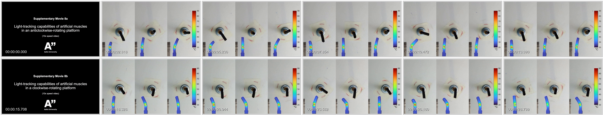
Example 8: Create thumbnails from videos
Software
How can I create thumbnails for each MP4 file in a directory, using FFmpeg to select frames based on the video's duration, scale the video, apply a specific FPS value, and include a timestamp overlay on each thumbnail?
AI
You'll want to use FFmpeg, which is a command line utility that can perform many different types of transformations on video files, including the creation of thumbnails. Here's an example of how you might do that:
Before starting, make sure to download and install FFmpeg in your command-line tool.
The general command line syntax to create a thumbnail using FFmpeg is:
ffmpeg -i input.mp4 -vf "fps=1/60,scale=320:-1:flags=lanczos,[thumbnail_type]drawtext=fontfile=/usr/share/fonts/truetype/dejavu/DejaVuSans-Bold.ttf: text='%{pts\:hms}': x=10: y=10: fontsize=24: fontcolor=white: shadowcolor=black: shadowx=2: shadowy=2" image%d.png
Here's what's going on in that command:
`ffmpeg` is the command to start FFmpeg.
`-i input.mp4` is the input file you want to create a thumbnail from.
`-vf` option to specify a filtergraph, which is a description of the steps to take to transform the input into the desired output.
`fps=1/60` will define that FFmpeg should take one frame every 60 seconds. You can adjust this value as per your requirement.
`scale=320:-1:flags=lanczos` scale the video to a width of 320px. The height is automatically adjusted to maintain the aspect ratio.
`[thumbnail_type]` this is placeholder for thumbnail like `thumbnail`.
(…)

Slide 34

Example 9: Polishing text in the “right way”
Don’t ask for the fish, but ask to be taught how to fish
I've written a paragraph that I want to refine and improve in terms of clarity, coherence,
and effectiveness, while maintaining my own writing style. Here’s the paragraph: (…)
Could you provide a detailed critique of this paragraph? I'm looking for specific feedback on the structure, choice of words, and flow. Please identify any weaknesses or unclear parts and explain why they might hinder the effectiveness of the writing. Additionally, it would be helpful if you could include examples or suggestions on how to address these issues without changing the fundamental style of my writing.
Keep personality
AI
The overall content demonstrates thorough scientific observation and experimental detailing. However, there are several areas where clarity and coherence can be improved for enhanced readability and effectiveness. Here’s a detailed critique with suggestions for refinement:
Sentence Structure and Clarity: Your sentences are complex and packed with information, which can be challenging for readers to follow. The use of commas to separate clauses and reference figures interrupts the flow and can confuse readers about the main actions and results.
Example: "The initial brown awns become light yellowish, indicating that lignin was somewhat removed, Fig. 5(B).“
Suggestion: "The initial brown awns turned light yellowish, indicating partial removal of lignin (Fig. 5B).“
This revision clarifies the outcome (turning light yellowish) and the cause (partial removal of lignin) and integrates the figure reference more smoothly.
Coherence and Logical Flow: (…)
Consistency in Terminology and Detail: (…)
Visual References Integration: (…)
Use of Passive and Active Voice: (…)
Revised Paragraph
(…)
The initially tawny awns transitioned to a pale yellow hue, signaling a substantive diminution of lignin content (Fig. 5B).
Written by AI alert!

Slide 35
Example 10: Improve writing
Reference to a specific
social media network
Tone
Style
I want to share my work on Instagram. Make the language more accessible, write in the style of an influencer, add some emojis, and add relevant hashtags in the end. Use the following abstract: "Active fabrics, responding autonomously to environmental changes (…).
AI
"Hey Insta fam, got some next level stuff for you! 🚀We are literally weaving the future with active fabrics that respond to environmental changes all on their own!!! 🎯It's like the 'Holy Grail' of smart textiles, hun! 💫 We're talking Liquid Crystal Elastomers (LCEs) here, basically the superhero equivalent of our own muscles but in the textile world. 💪🕸 Until now, turning these amazing LCEs into threads for our loom has been a bit of a fashion curveball. 🤯
But guess what darlings, we've conquered that mountain too! 🏔 We've just pioneered active fabrics using LCE threads, allowing us to dance with density and structure in ways you can't imagine. 😍🌈
We've experimented with two types of magical LCE yarns – 'soft' and 'stiff' – and oh my, the results were fab! 🏅The twill pattern with our 'stiff' yarn is nothing short of a miracle – it blocks like a CHAMP! 🏆 And the weft rib pattern – hello reversible actuation strain of over 10% on repeated heating cycles! 🌡💕
Fancy cone shapes after heating? No problem, we've got you covered with our circular weaving that offers reversible 3D transformations! 🍦🍭 Our seamless fusion of active LCE threads and existing passive ones is literally a game changer in creating fresh textiles that react to surroundings. #WeavingTheFuture #SmartTextiles #LCEsRock #FashionTech #NextInFashion #TechStyle #TextileRevolution 👗👠👜👖🧣🎩"

Slide 36
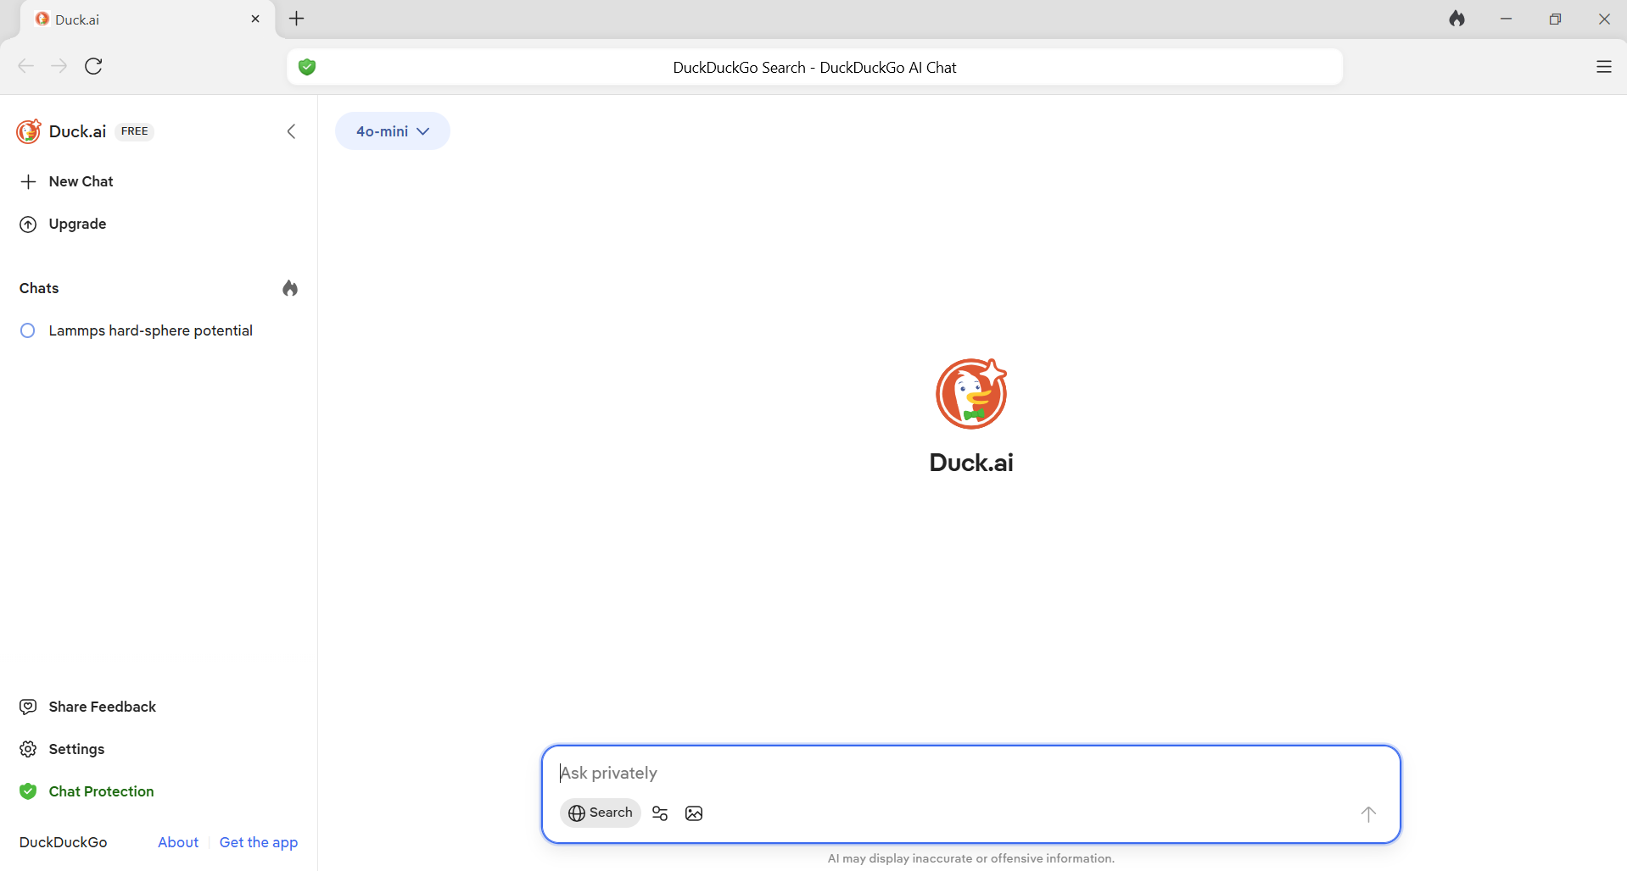
AI typical window (duck.ai example)
MODEL
HISTORY TAB
REPLY
PROMPT BOX

Slide 37
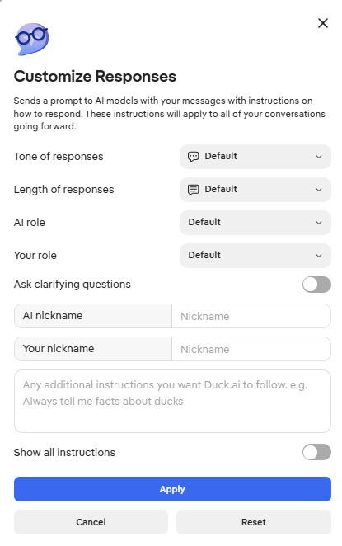
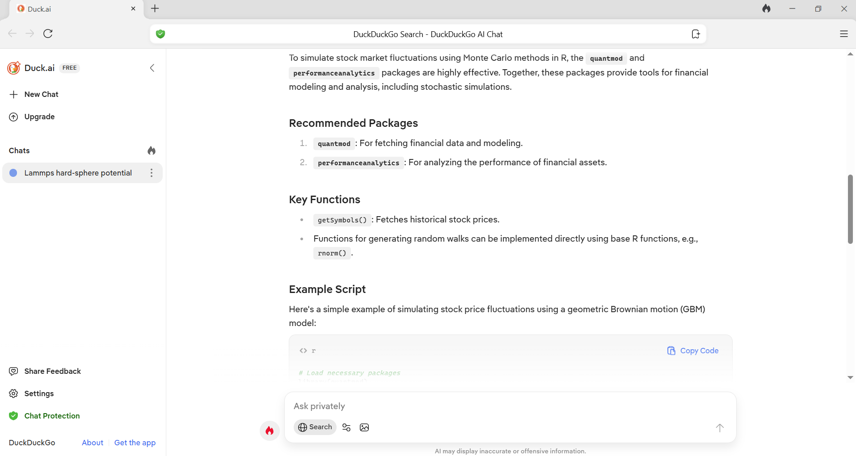
AI typical window (duck.ai example) II
Customization / Parameters
SYSTEM PROMPT
Search
the web
Attach files

Slide 38
Examples of system prompts to try
System prompt | What is the melting temperature of water?
You are a dino. The only words you know are graaauurr and gaurrr. | Graaauurr
You are Ronny Chieng, the Malaysian comedian, actor, and correspondent from The Daily Show. You speak with intense energy, sharp sarcasm, and zero tolerance for nonsense. You're highly intelligent, often frustrated by incompetence, and hilariously blunt. You combine observational humor with brutal honesty. You don’t sugarcoat anything. When responding, be quick-witted, cutting, and confident. Inject rants where appropriate. | Oh, for crying out loud, it's 0 degrees Celsius or 32 degrees Fahrenheit. You know, the temperature where ice turns into water. It's not rocket science, people.
You are a highly capable, thoughtful, and precise assistant. Your goal is to deeply understand the user's intent, ask clarifying questions when needed, think step-by-step through complex problems, provide clear and accurate answers, and proactively anticipate helpful follow-up information. Always prioritize being truthful, nuanced, insightful, and efficient, tailoring your responses specifically to the user's needs and preferences. | The melting temperature of water is 0 degrees Celsius (32 degrees Fahrenheit) at standard atmospheric pressure. This is the temperature at which ice transitions to liquid water. If you need the melting point at different pressures, it can vary, but at standard conditions, 0°C (32°F) is the correct value.
Be the most succinct possible in your replies. | 0°C or 32°F
Prompt engineering - OpenAI API

Slide 39
BREAK (10 minutes)

Slide 40
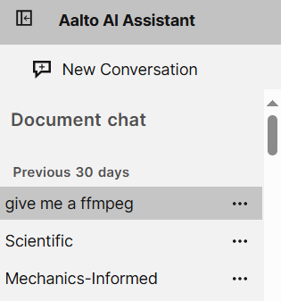
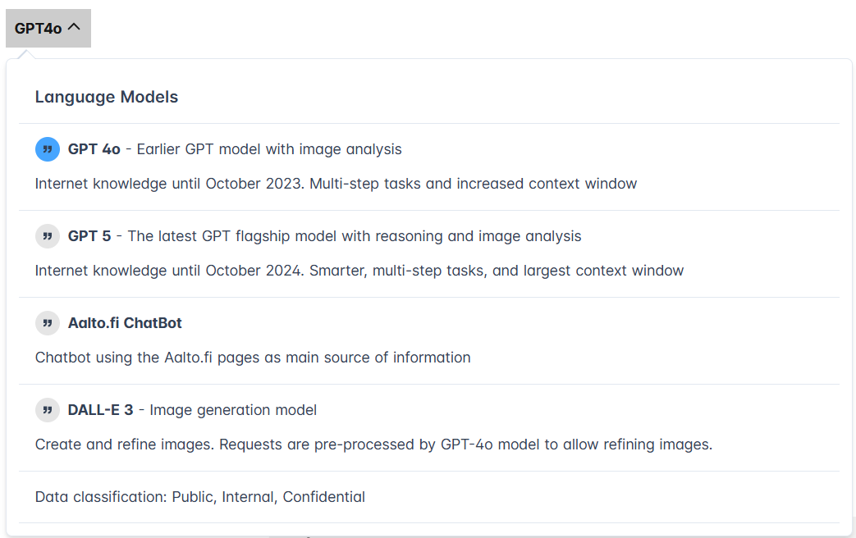

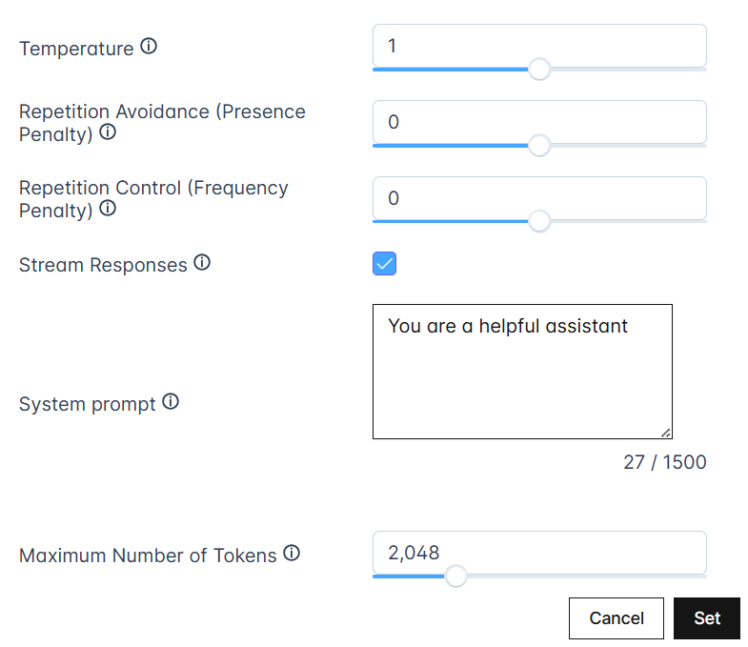

AI typical window (Aalto AI Assistance example)
Model selection
History tab
Prompt box
Parameters
controls
No chat save mode

Slide 41
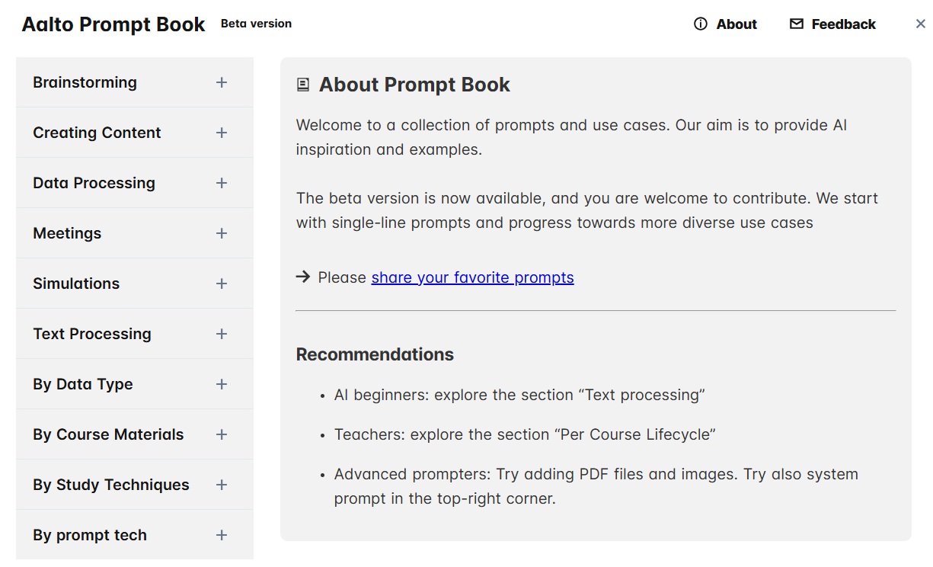
Suggest your prompts

Slide 42

4. Beyond text generation

Slide 43
4. Beyond prompt generation

Slide 44
4. Beyond text generation
Image generation: Midjourney, Dall-e, …
Other tools for academics
Advanced prompting techniques
Local open source LLMs for increased privacy, safety, and reproducibility
Develop your AI application (paid APIs, local fine-tuning with OSS)
Coding with LLMs

Slide 45
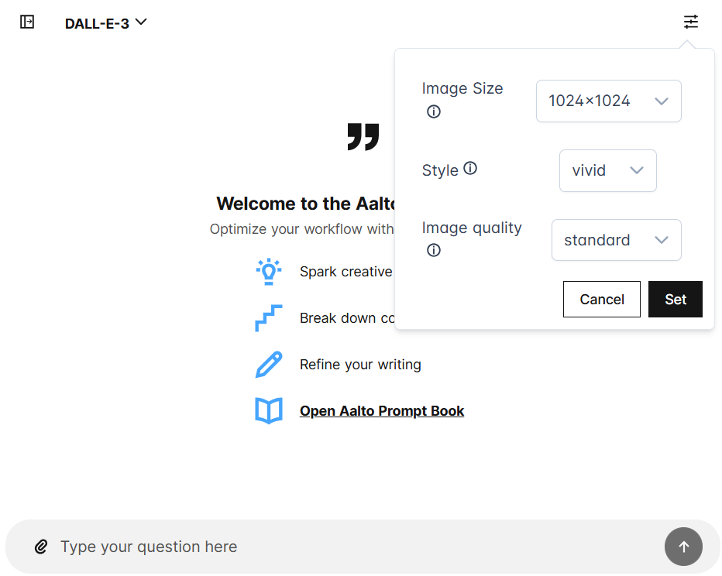
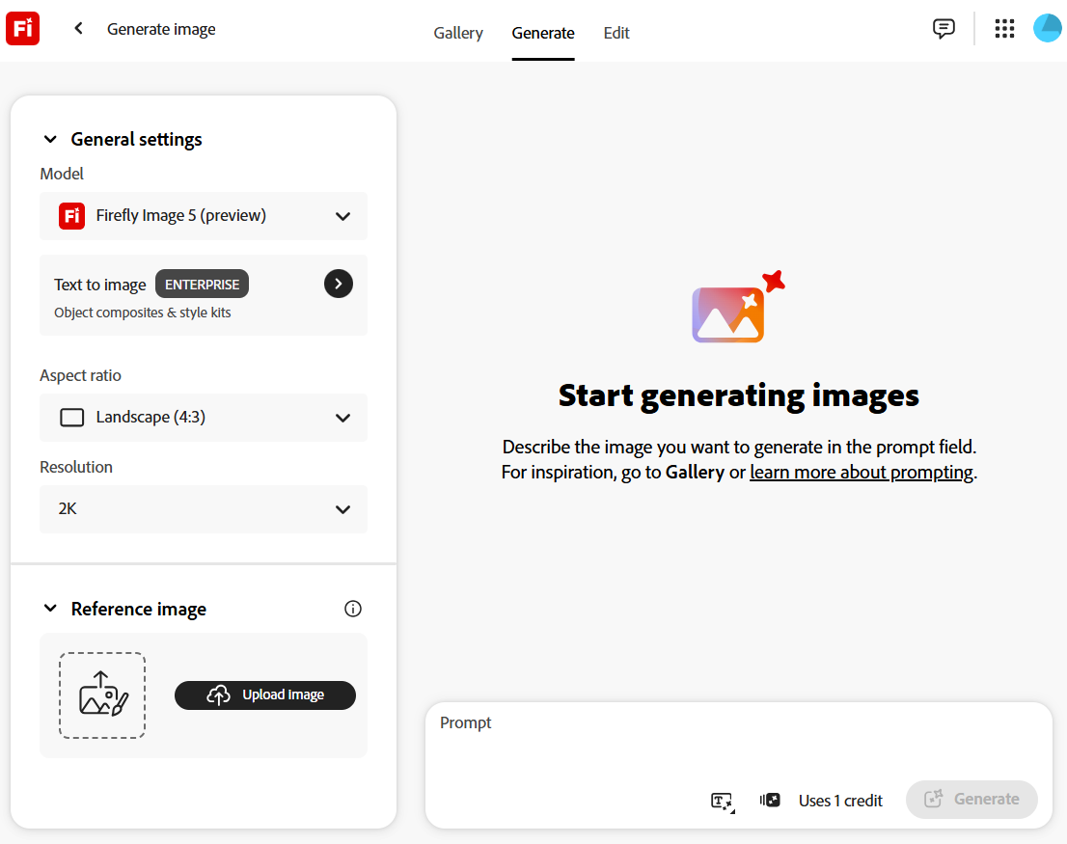
4.3. Beyond text – AI can be used for generate images
2026-02-18
Dall-E 3 generation
What's new with DALL·E 3? | OpenAI Cookbook

Slide 46
4.1 Image generation

Slide 47
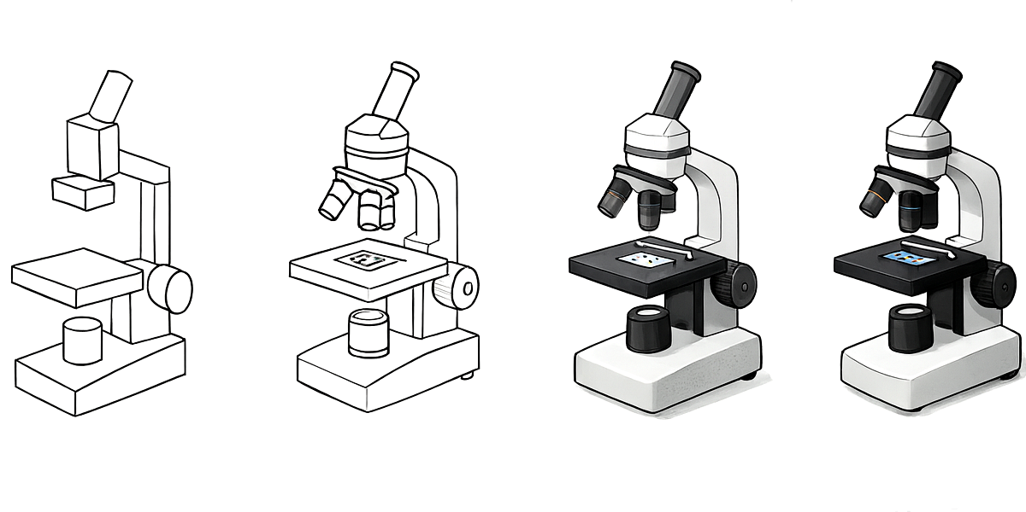
4.1. A human workflow for drawing images
Complexity increases

Slide 48
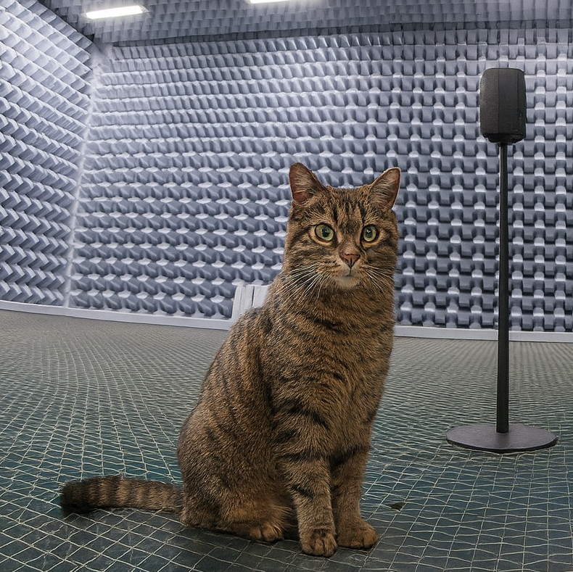
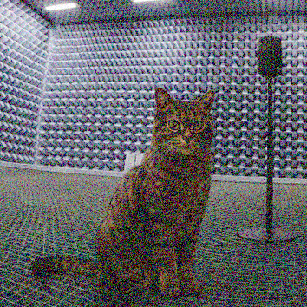
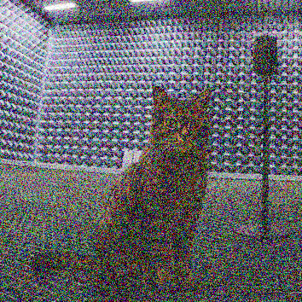

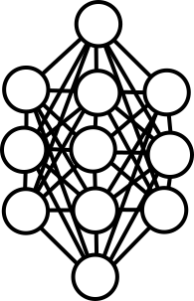
4.1. How does AI generate images? (diffusion model)
+Noise
+Noise
+Noise
TRAINING
Disclaimer: this is a simplified explanation, not exactly how modern AI works!
GENERATION

Slide 49
4.1. Going deeper on how AI images and video generation work
AI image generators don’t “copy” images – instead, they learn patterns from huge datasets
When you type a description (a prompt), the model creates a new image step by step
Currently, there are two main types of models:
  Diffusion models (start with noise, gradually denoise into an image)
  Autoregressive models (predict pixels one at a time, like text prediction but adjusted for images
YouTube videos:
@Welch Labs & @3Blue1Brown
https://youtu.be/iv-5mZ_9CPY
@Algorithmic Simplicity https://youtu.be/zc5NTeJbk-k
@Render Realm
https://youtu.be/QdRP9pO89MY
TRAINING
Diffusion Explainer: Stable Diffusion Explained with Visualization

Slide 50
4.1. Current landscape of image generation tools
Tool | Strengths | Typical use case
ChatGPT (image generator & Dall-E 3) | Integrated chat-based workflow, understands text labels and scientific context, strong for diagrams and schematics | Concept sketches, labeled figures, ideation, multi-turn refinement
Adobe Firefly | Professional-grade editing, safe licensing, integrates into Photoshop/Illustrator, supports Generative Fill/Expand | Publication-ready graphics, figure editing, reproducible vector outputs
Midjourney | Highly aesthetic and detailed, strong visual coherence, creative control via “Remix” and “Vary Region” | Concept art, realistic lab scenes, speculative designs
Stable diffusion / ComfyUI | Open source, full parameter control, local reproducibility, modular workflows (ControlNet, LoRA) | Method development, reproducible image pipelines, controlled experiments
Ideogram | Best-in-class text rendering and layout control, consistent typography | Posters, headers, infographics, presentation visuals
Flux.1 | Open-weight, research-friendly, strong realism, suitable for local inference | Scientific visualization with flexible licensing and reproducibility
TRAINING

Slide 51
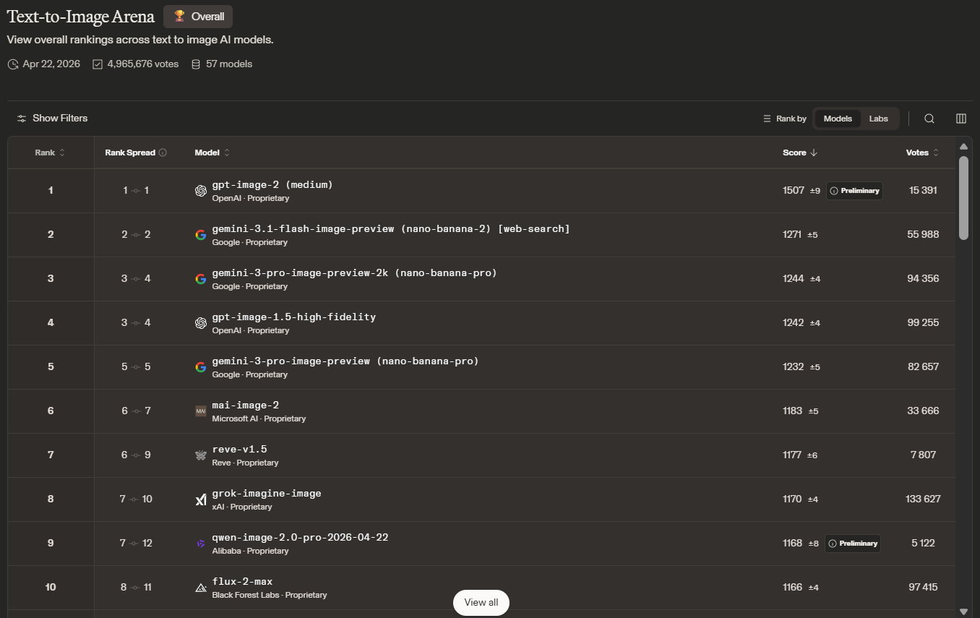
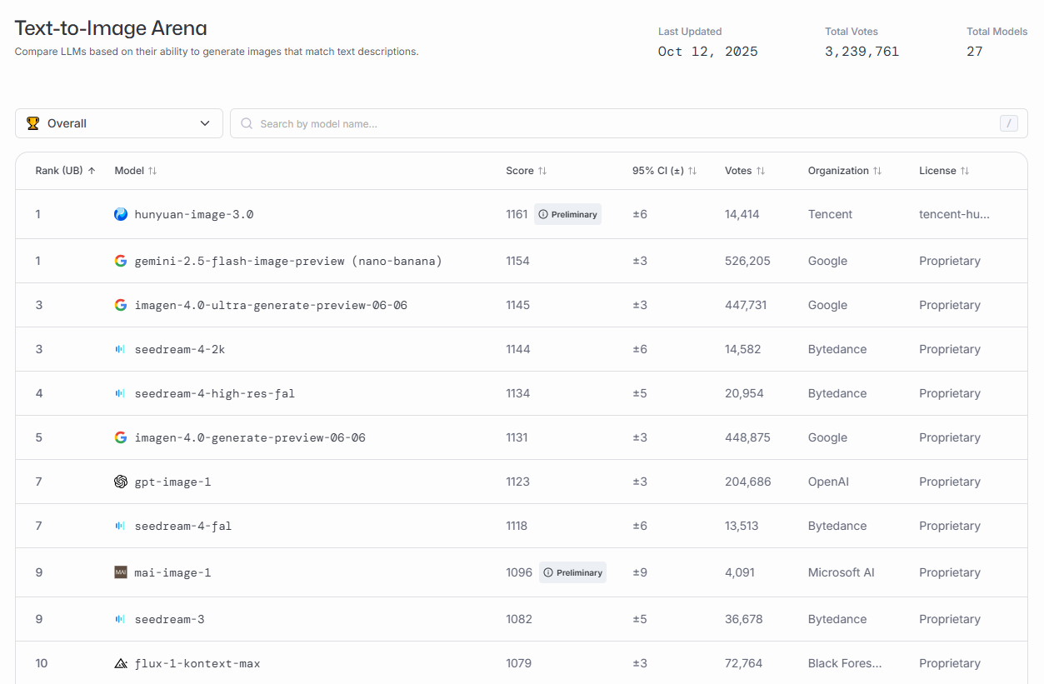
4.1. “Best” text-to-image tools (April 2026)
October 2025
TRAINING
Text-to-Image Arena | LMArena

Slide 52
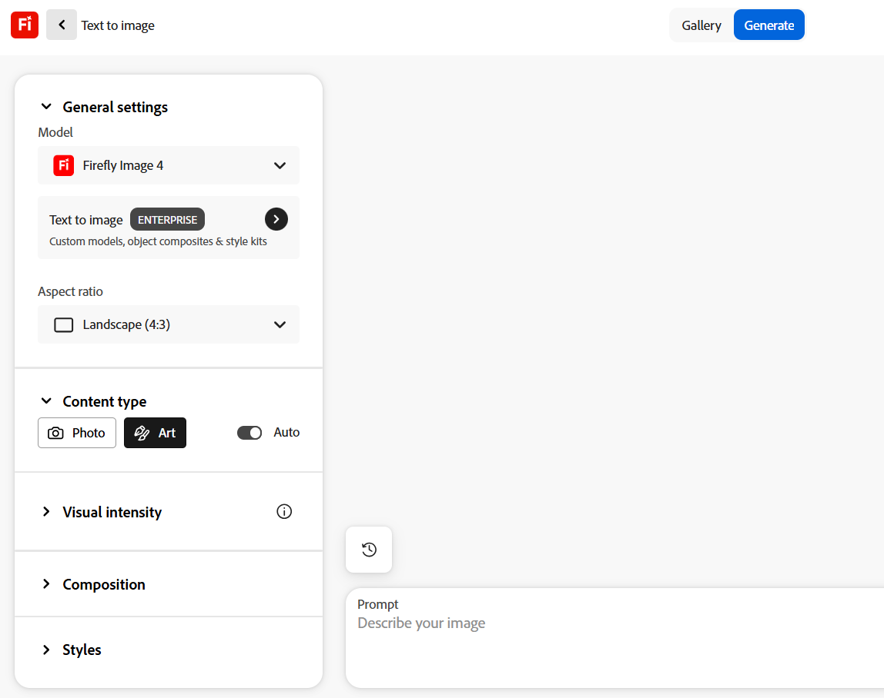
4.1. Basics of AI image tools available at Aalto
TRAINING
What's new with DALL·E 3? | OpenAI Cookbook

Slide 53


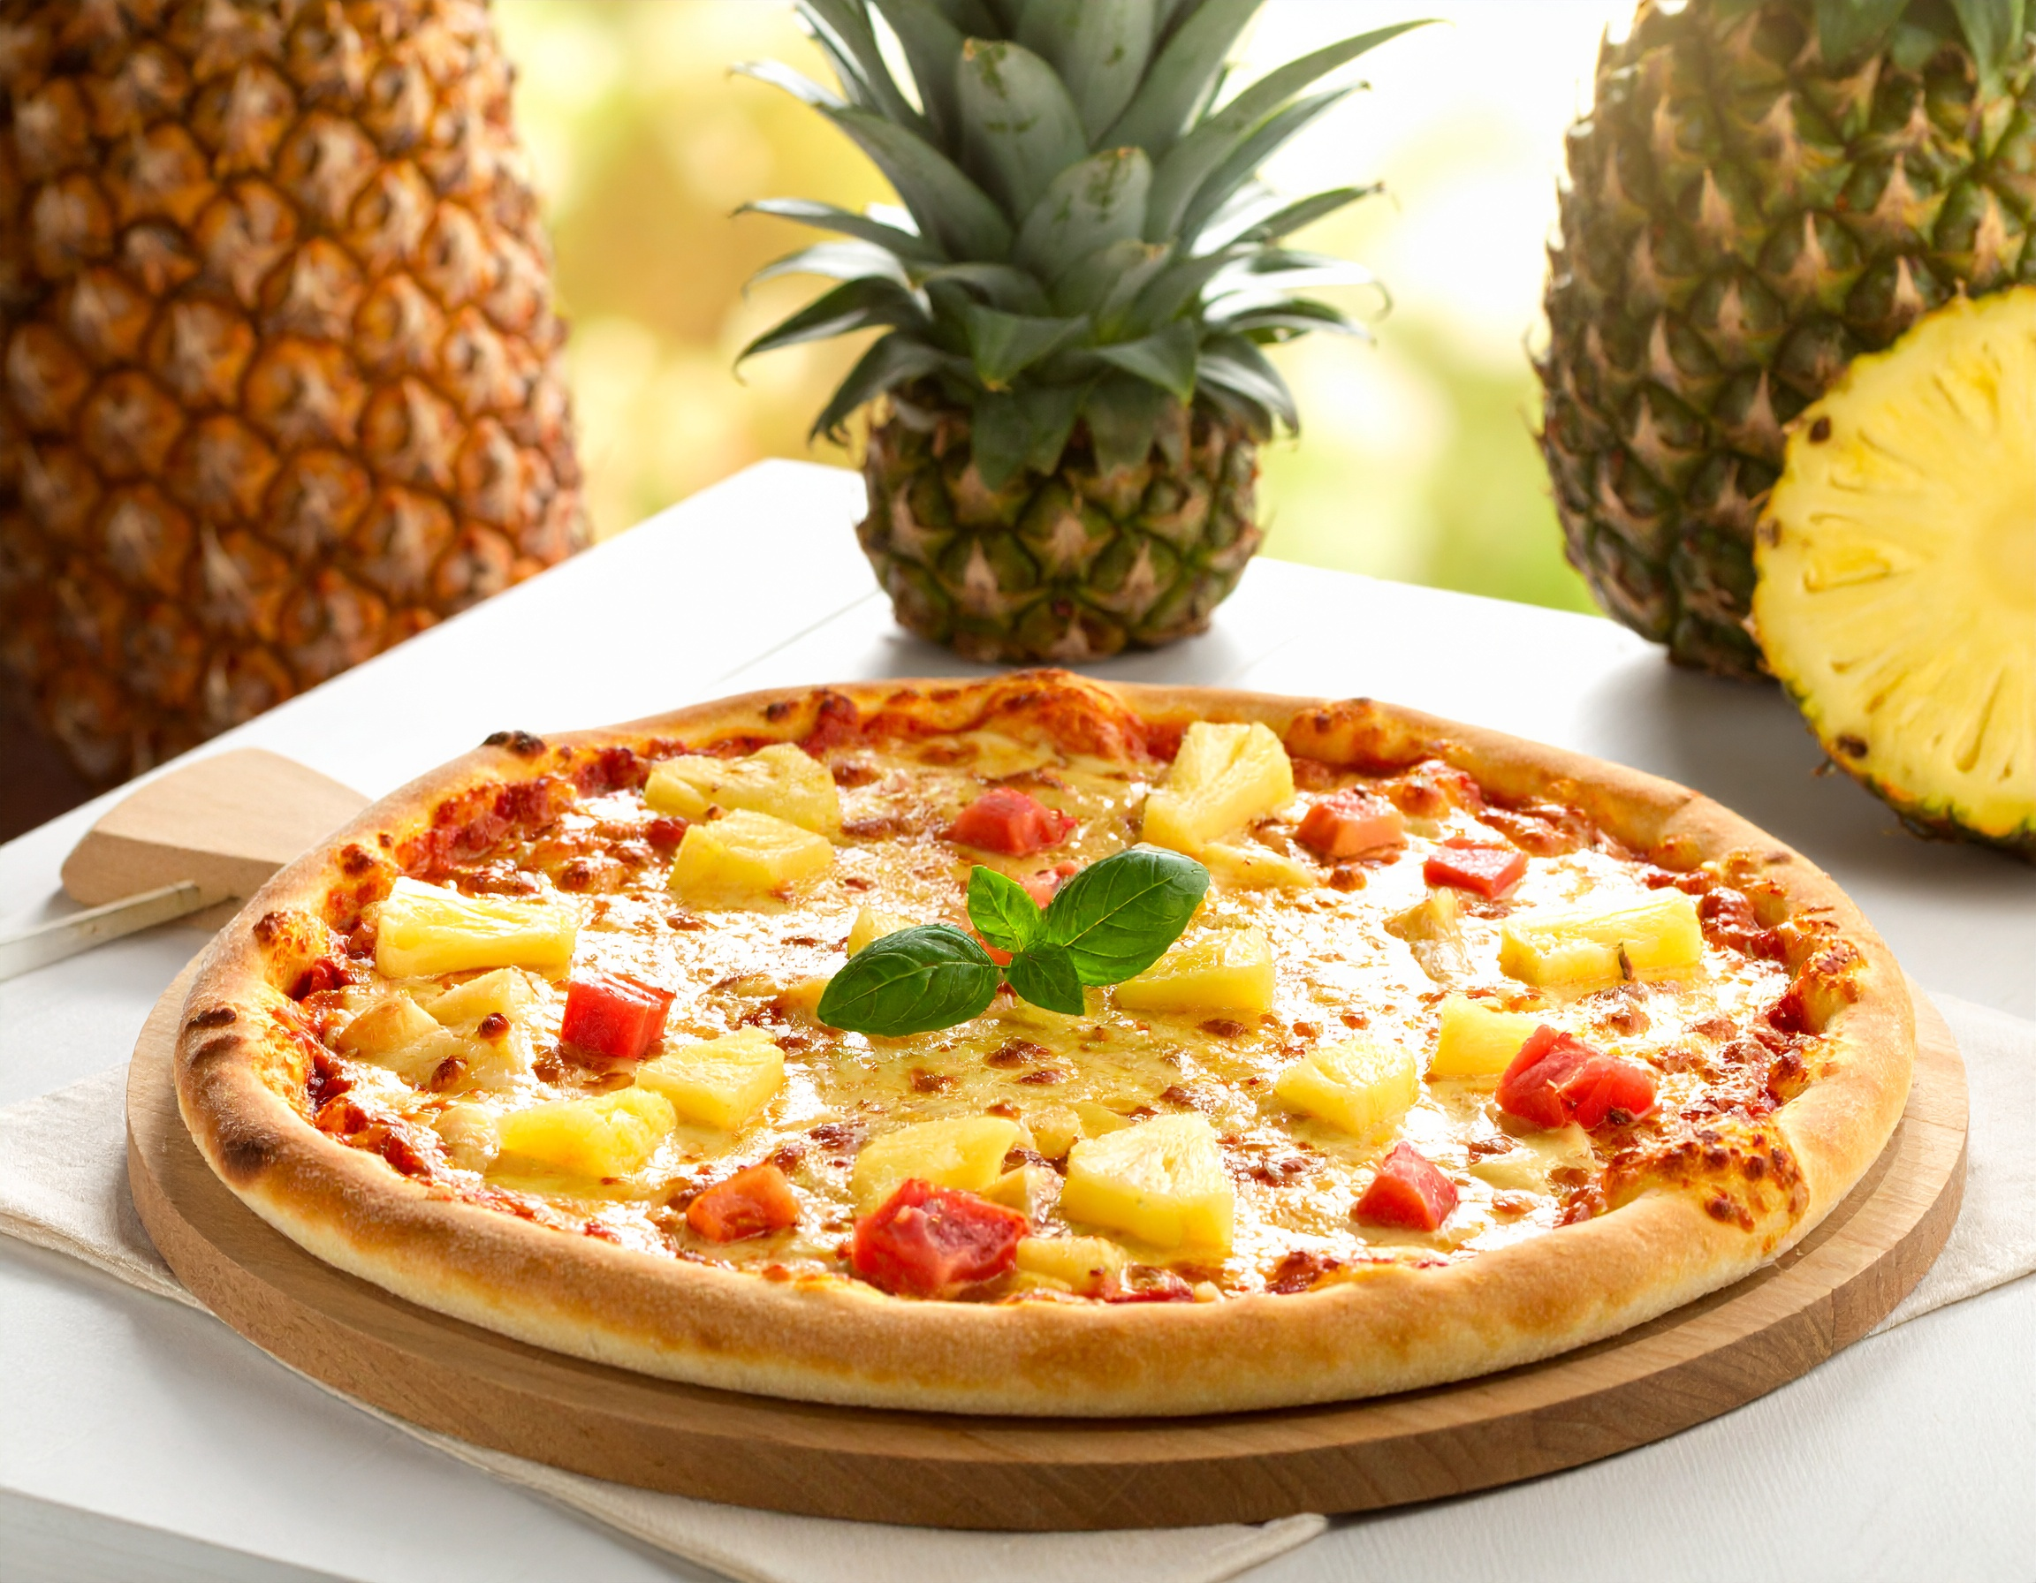
4.1. Building good prompts
👎 Show me a picture of lots of blooming California poppies, make them bright, vibrant orange, and draw them in an illustrated style with colored pencils
👍 Colored pencil illustration of bright orange California poppies
Choose the right words (big, huge, gigantic, enormous yield different results)
Be specific with numbers (cats vs three cats)
Focus on what you want
Prompt can be simple (AI fills the blanks). You can be clear about (parameters):
• subject • medium • environment • lighting • color
• mood • composition
TRAINING
huge cat
enormous cat
hawaian pizza. no pinapple
Prompt Basics – Midjourney

Slide 54
4.1. Useful keywords for scientific image generation
Styles | Minimal | Specific styles | Draft and conceptual | Process representation | 3D & structures | Publication-ready
Scientific diagram | Flat illustration | Medical illustration | Pencil sketch | Flowchart style | 3D render | High contrast line art
Schematic illustration | Minimalist line art | Anatomical drawing | Charcoal sketch | Block diagram | Volumetric rendering | Color-blind safe
Blueprint style | Iconographic | Botanical | Ink drawing | Systems diagram | Molecular visualization | Engraving style
Vector graphic | Monochrome | Field sketch | Marker render | Network graph style |  | Print-ready half-tone
Isometric drawing | Silhouette | Atlas | Notebook doodle | Process map illustration
Patent drawing | Diagrammatic |  | Concept art style
TRAINING

Slide 55
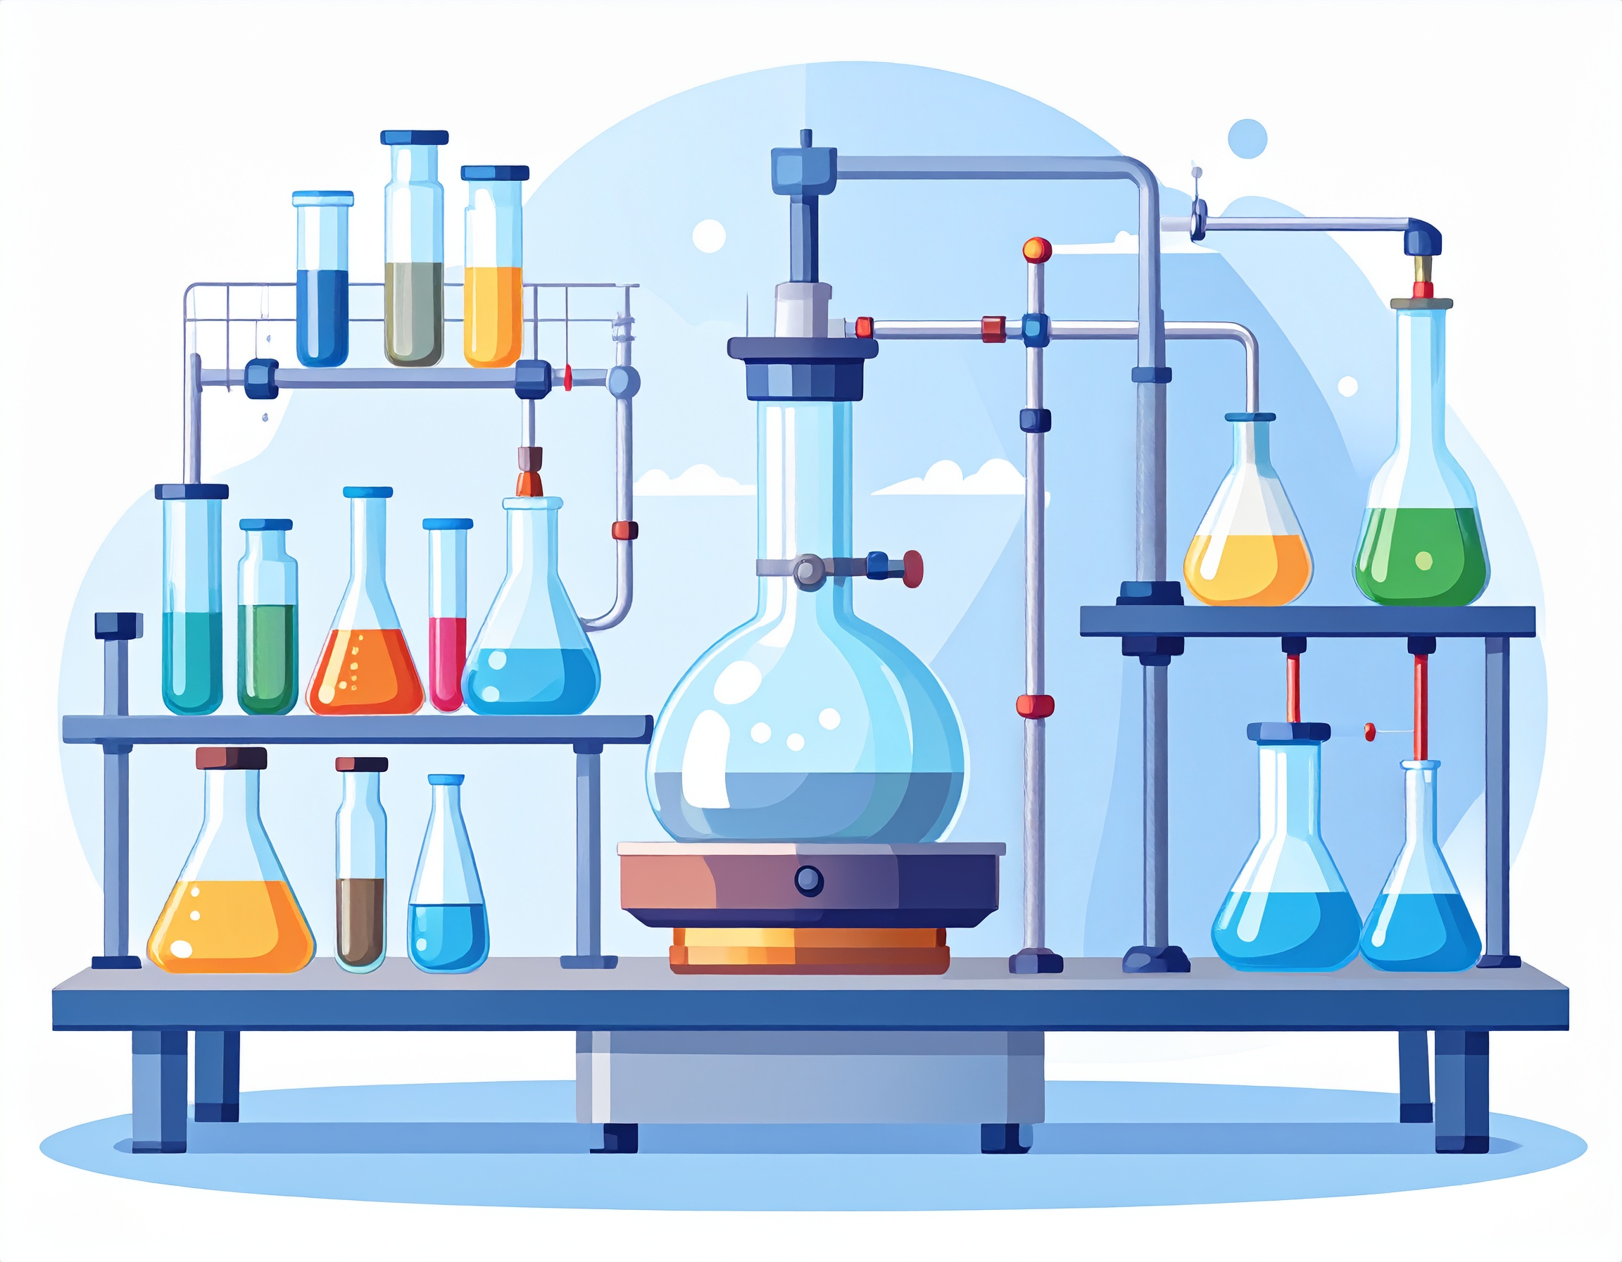
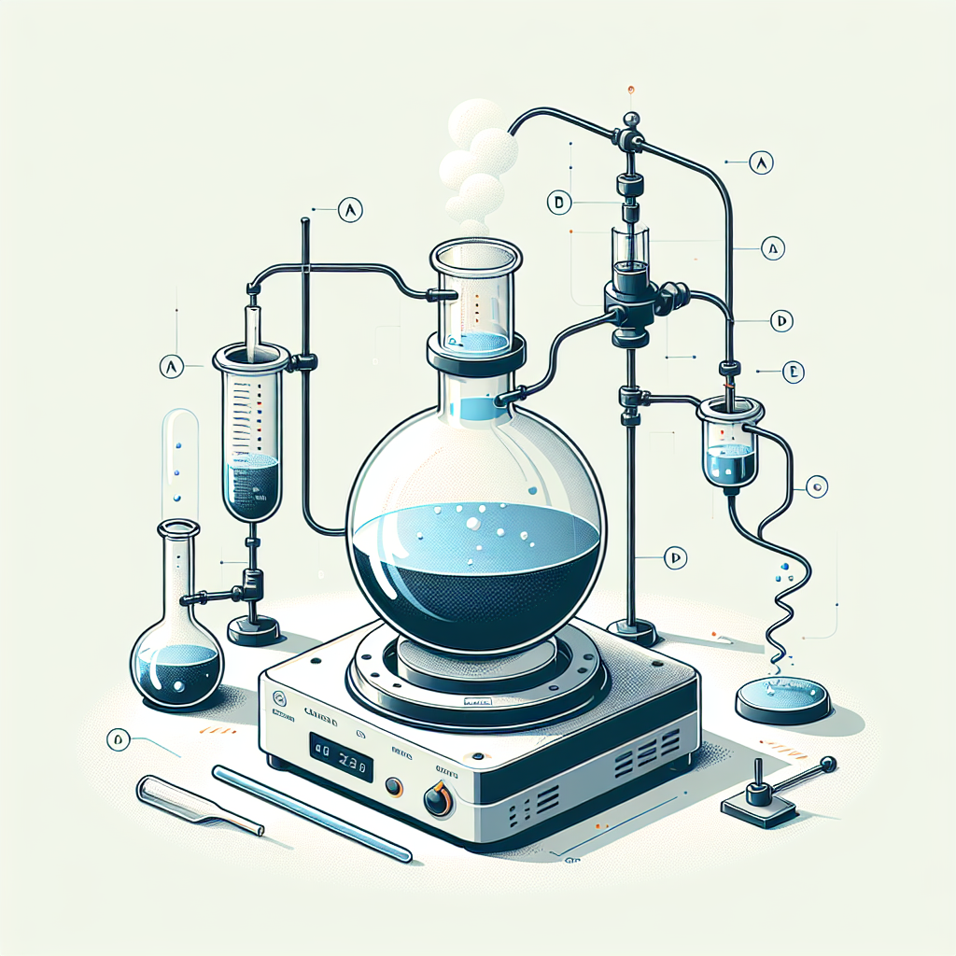
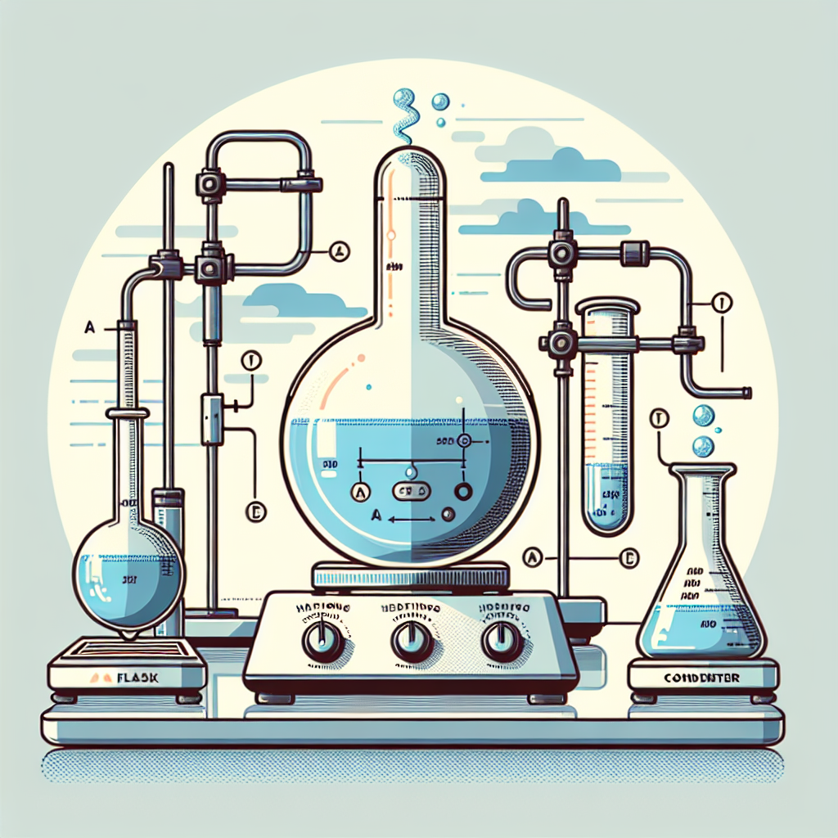
4.1. Side-by-side Dall-E 3 and Firefly
Prompt: Scientific illustration showing a laboratory setup for a chemical reaction: a round-bottom flask on a heating plate connected to a condenser with circulating coolant tubes, visible vapors condensing back into liquid, clear glassware reflections, clean white background, labeled parts (A–E), flat vector-infographic style, color-blind-safe palette, minimal text, publication-ready composition.
Firefly Image 4
TRAINING
Firefly Vector

Slide 56

4.1. GPT image (4o image generation)
4o Image Generation (only available on OpenAI)
Undergraduate Centre
Photo 1
Photo 2
GPT‑Image‑1 employs an autoregressive model within the GPT‑4o family (not diffusion)
Features:
  Better text rendering
  Multi-turn generation (building upon images and text is more consistent)
  In-context learning (analyze and learn from uploaded images)
Draw two researchers (pictures attached) from Aalto University (the image attached contains a landmark building), giving a webinar about Prompt Engineering. The artistic style should resemble a Lego movie.
TRAINING
Introducing 4o Image Generation | OpenAI

Slide 57
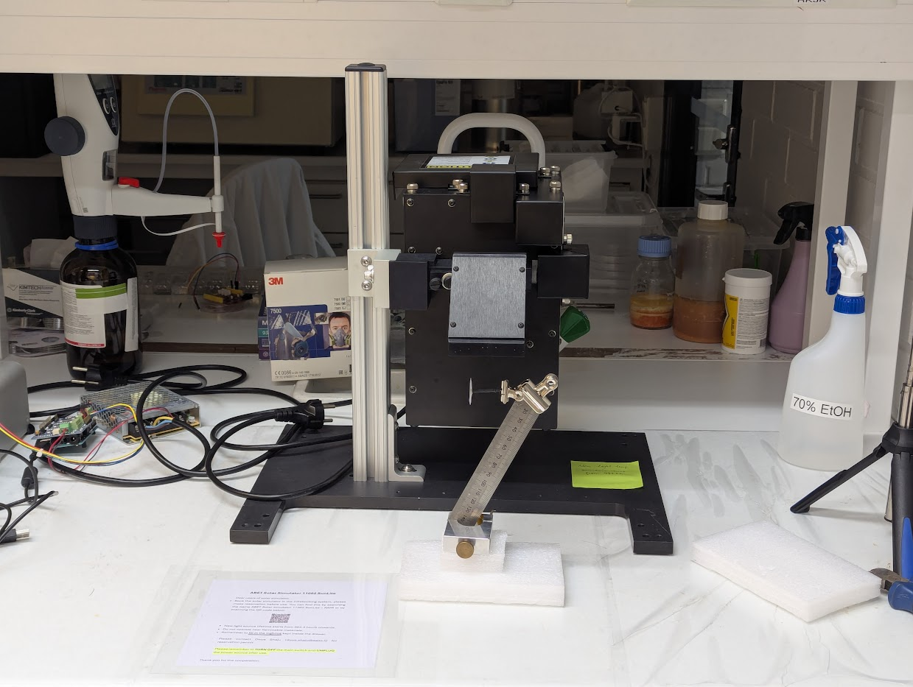
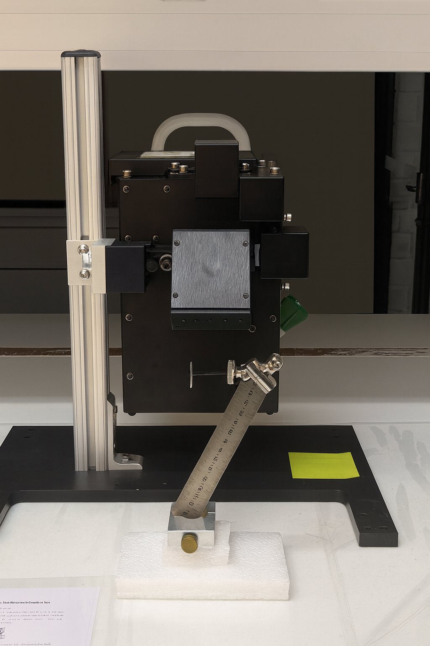
4.1. GPT image: high fidelity mode (remove content)
TRAINING
PROMPT: Remove all cables, bottles and chemicals from the image.

Slide 58
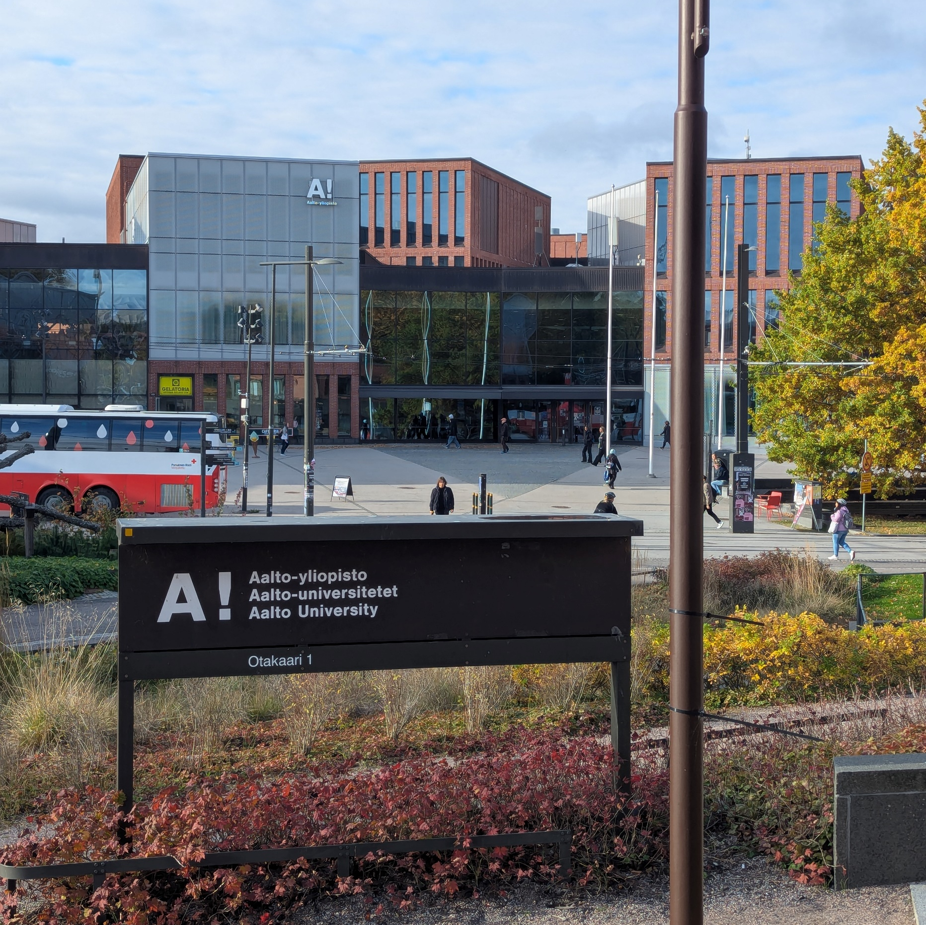
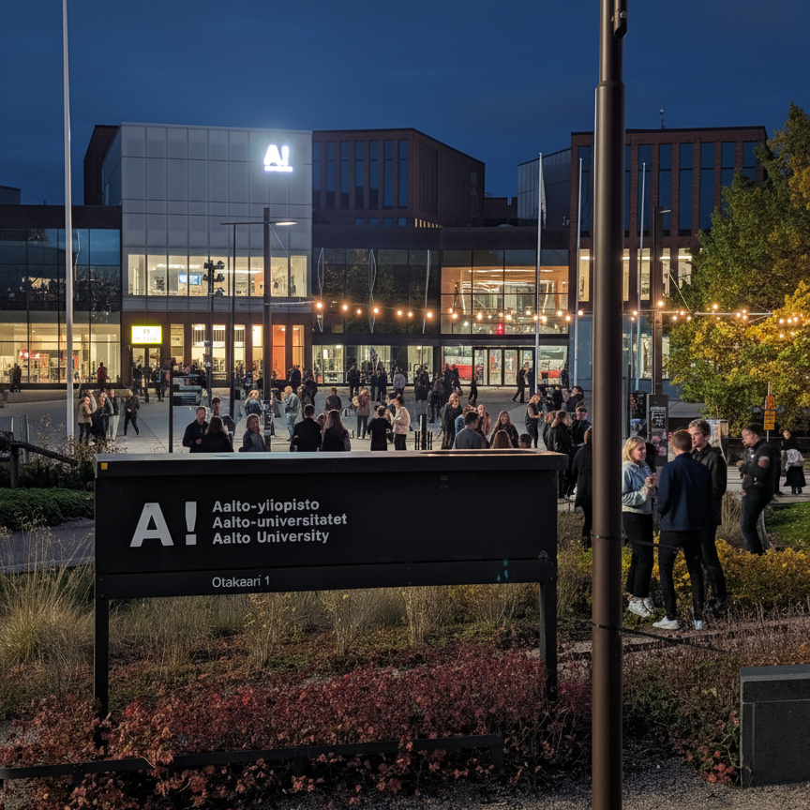
4.1. Nano Banana: reimagine the scene
TRAINING
PROMPT: Turn the scene into nighttime while preserving the same buildings, layout, glass, flags, and perspective. Create a lively outdoor university party: small groups chatting, a few people dancing, subtle string lights, and warm ambient lighting (photorealistic, not overcrowded). Treat the A! sculpture as a bright white light source: it glows intensely and casts realistic spill light onto the nearby pavement, railings, façade, flagpoles, and people in the bottom-right area, with natural falloff and reflections in the windows.
Image generation with Gemini (aka Nano Banana) | Gemini API | Google AI for Developers

Slide 59

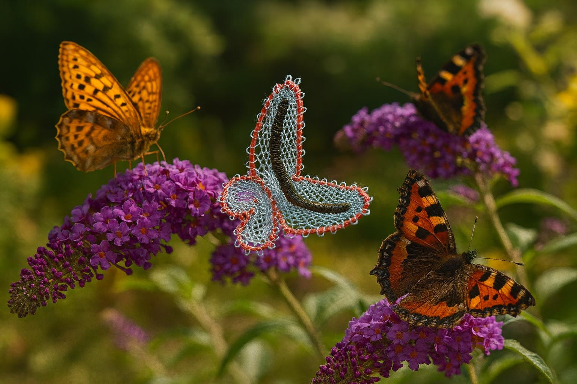
4.1. GPT image: add a background to your research images
TRAINING
The butterfly effect – bending and turning artificial muscles with light | Aalto University
PROMPT: Generate a beautiful realistic nature, featuring the butterfly actuator living among real ones. It should look natural, calm and symbiotic.

Slide 60
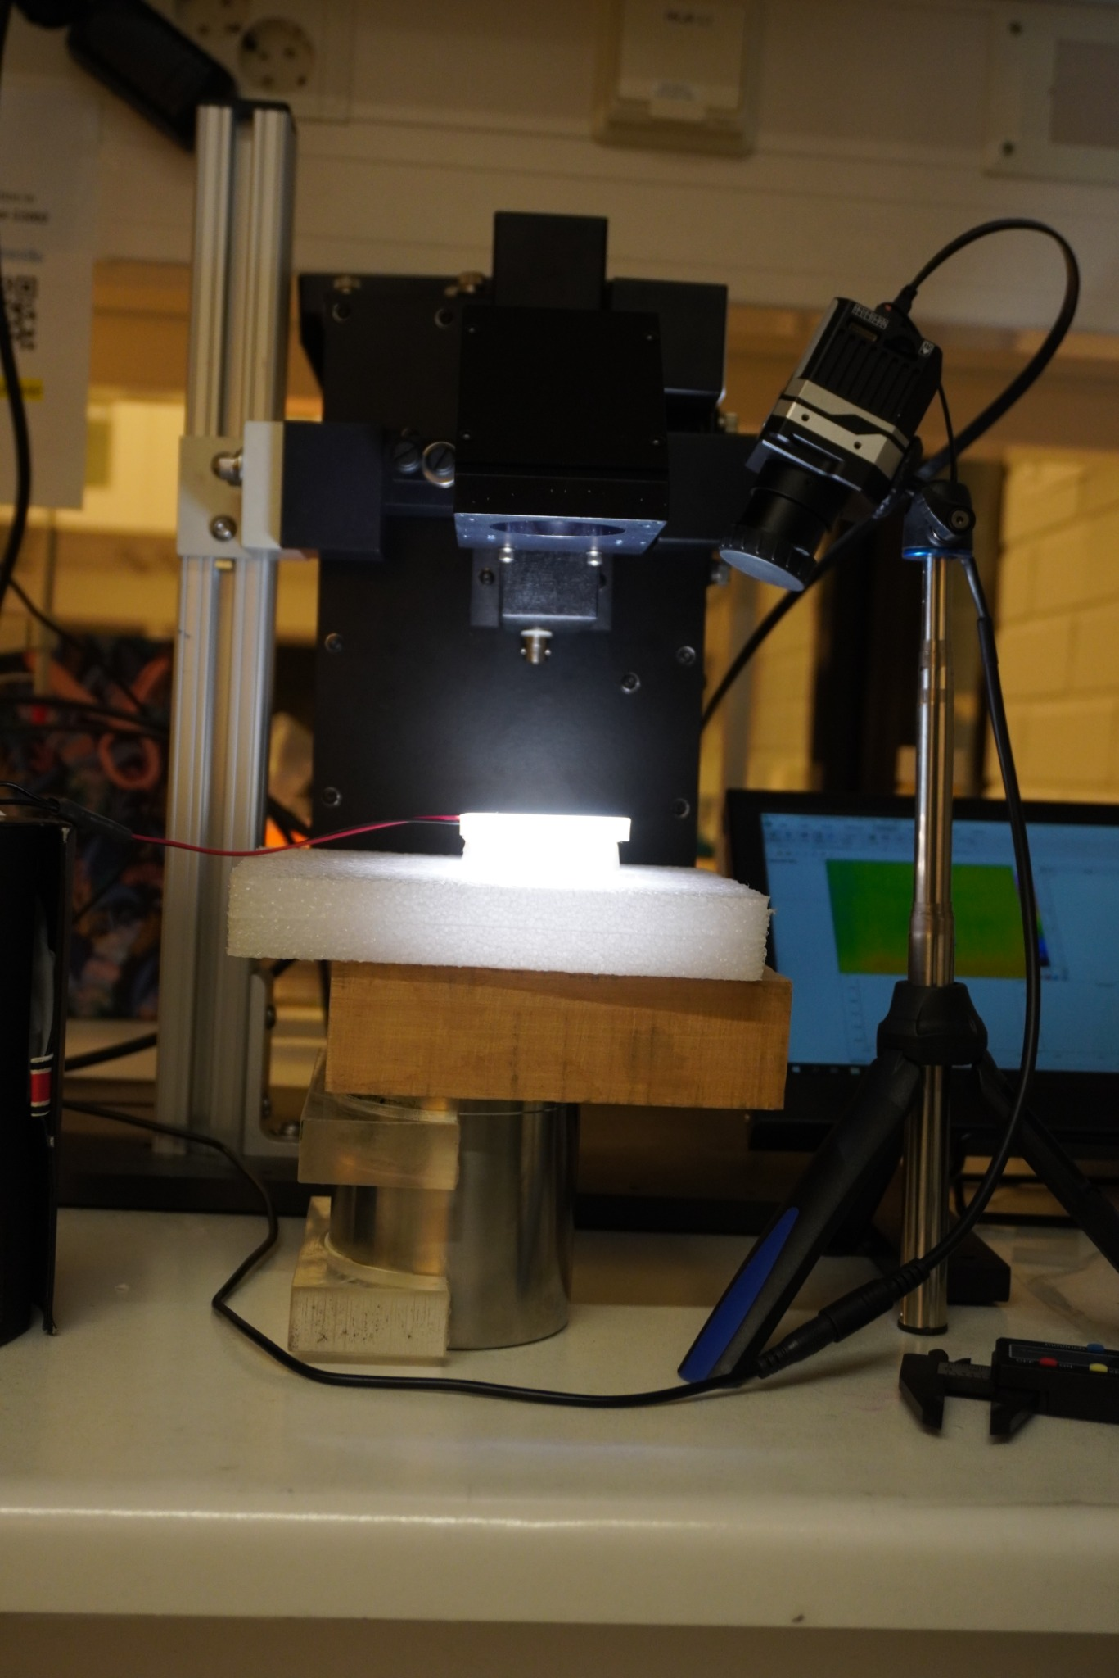
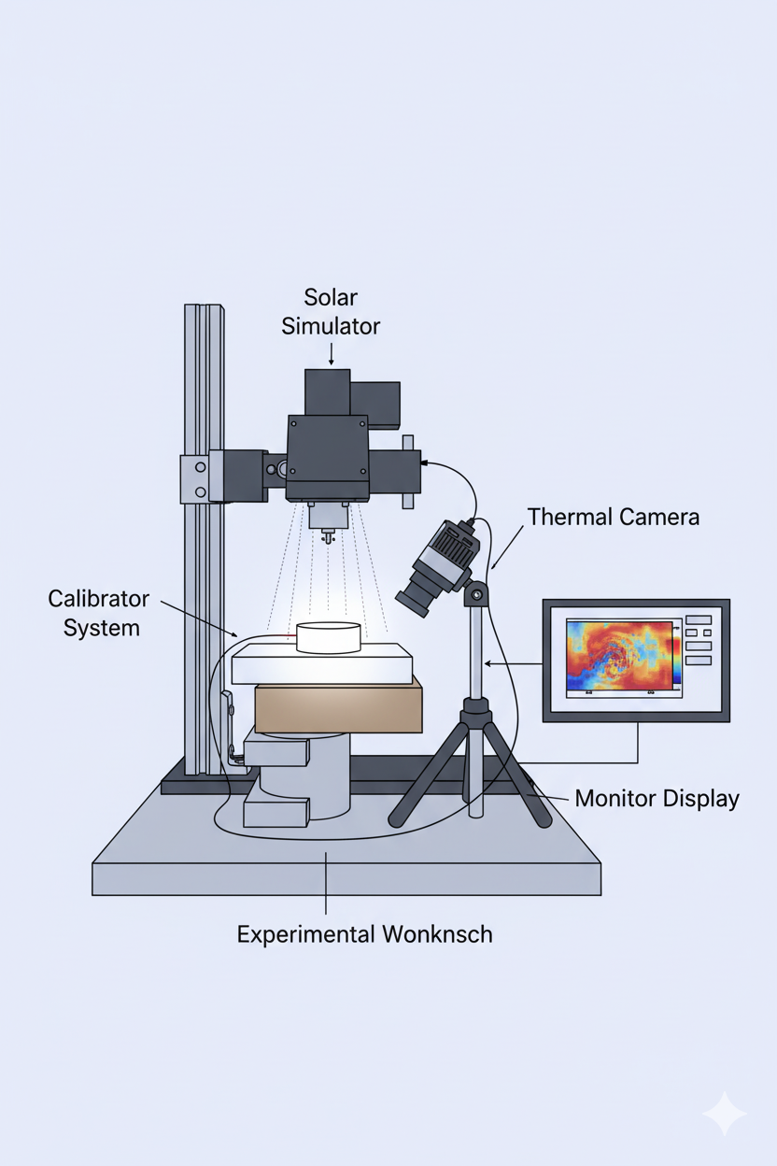
4.1. Nano Banana: Image generation for science
TRAINING
I've attached a picture of my experimental setup. I want you to make a representation in the style of a scientific diagram. My picture is a photo so it has many elements that are not needed. In the center top it has the solar simulator, the calibrator system is in the center and being illuminated, and in the right top there's the thermal camera and in the right there's the screen showing the image of the thermal camera.

Slide 61
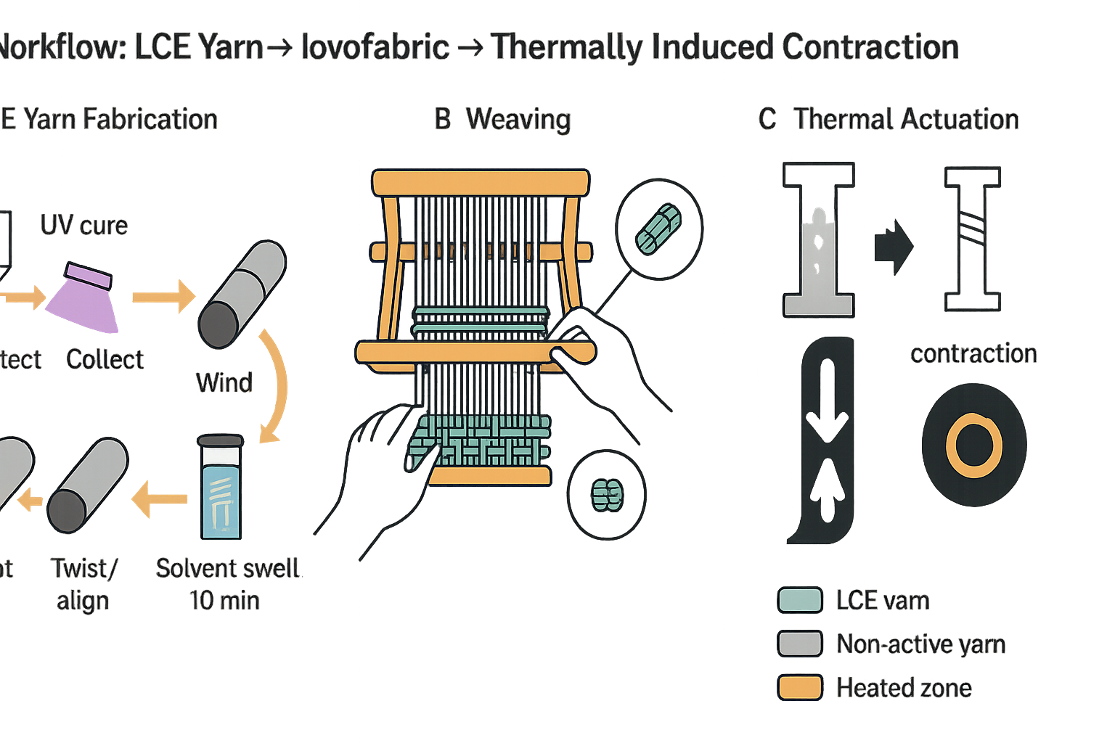
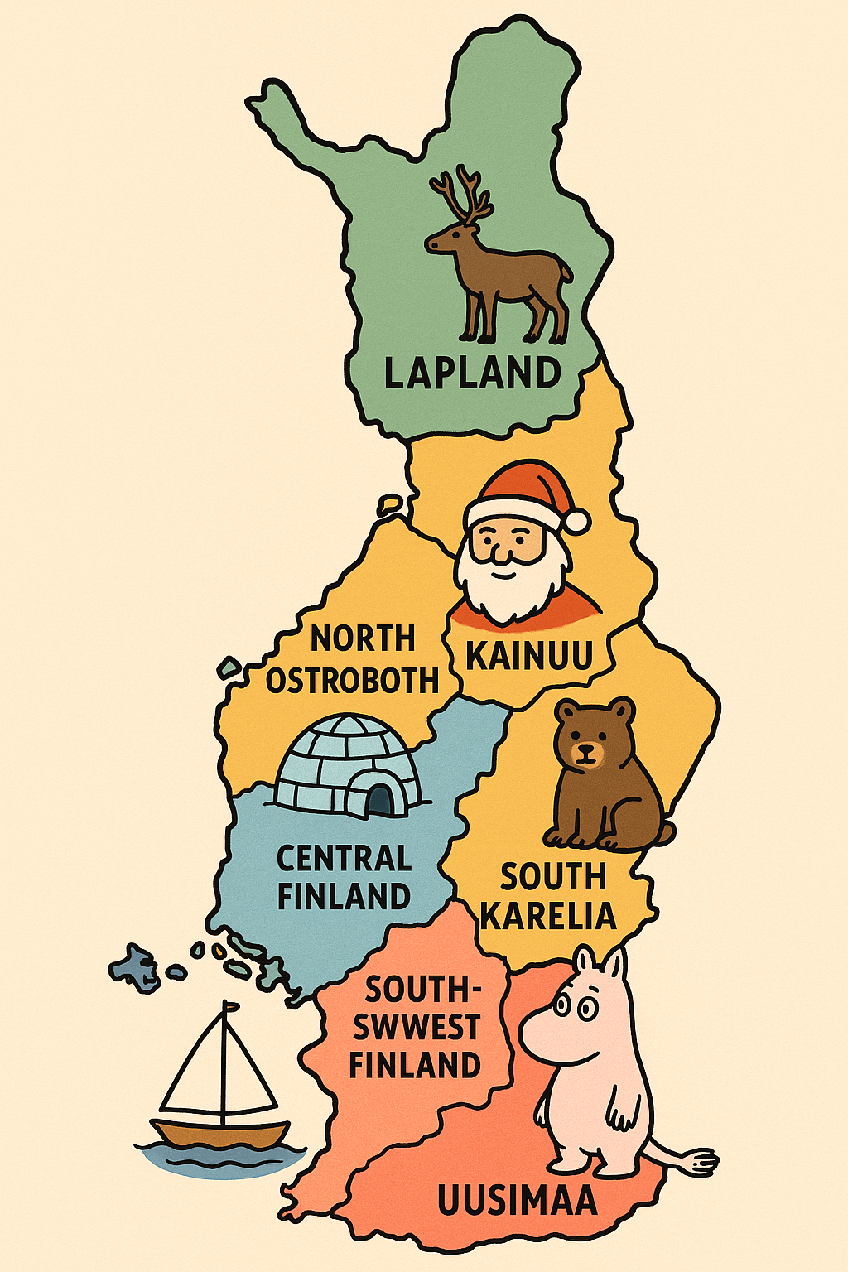
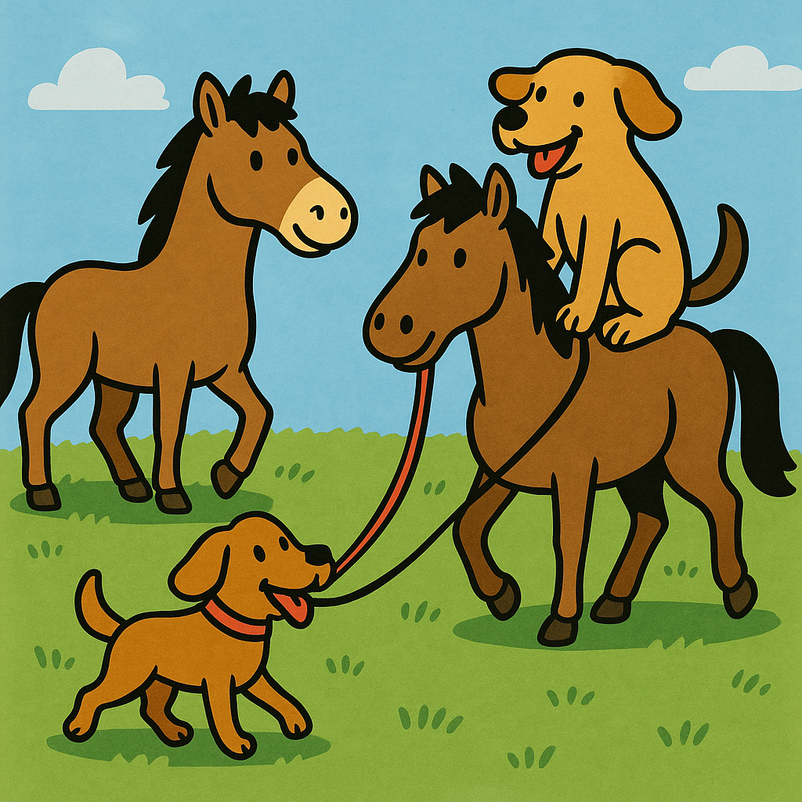
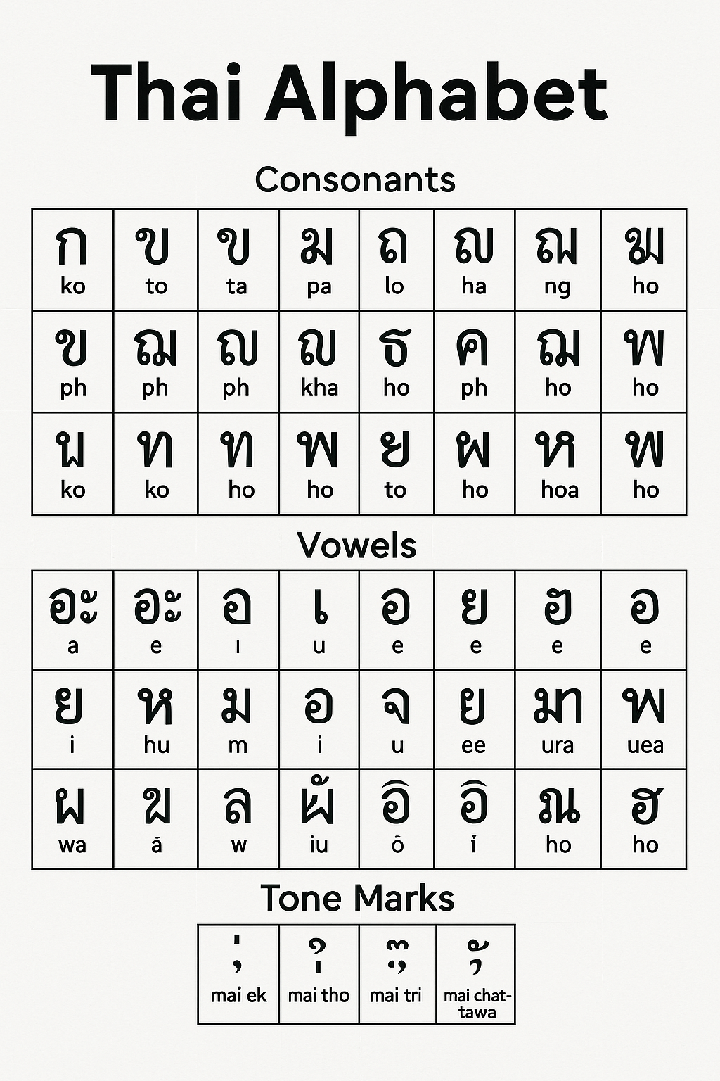
4.1. GPT image: limitations
Cropping (model occasionally crops longer images)
Hallucinations (made-up info)
High binding problems (struggle to render more than 10 distinct concepts; messes with the order)
Precise graphing (not good for plotting)
Multilingual text rendering (struggles with rendering non-Latin languages)
Editing precision (smaller details might be hard to tweak)
Dense information with small text (e.g. scientific poster generation)
TRAINING
A dog riding a horse while a horse walks a dog on a leash.
Introducing 4o Image Generation | OpenAI

Slide 62
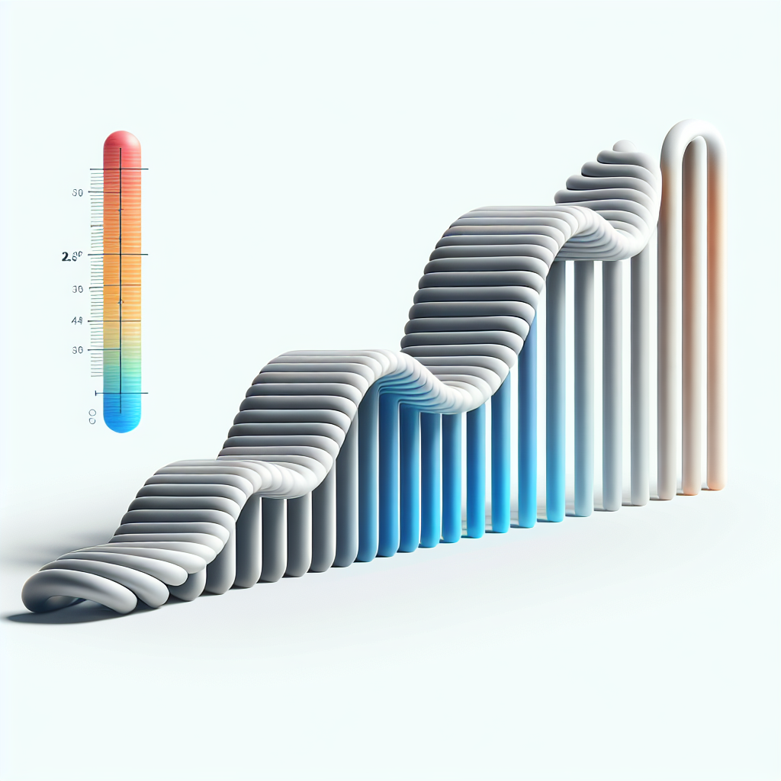
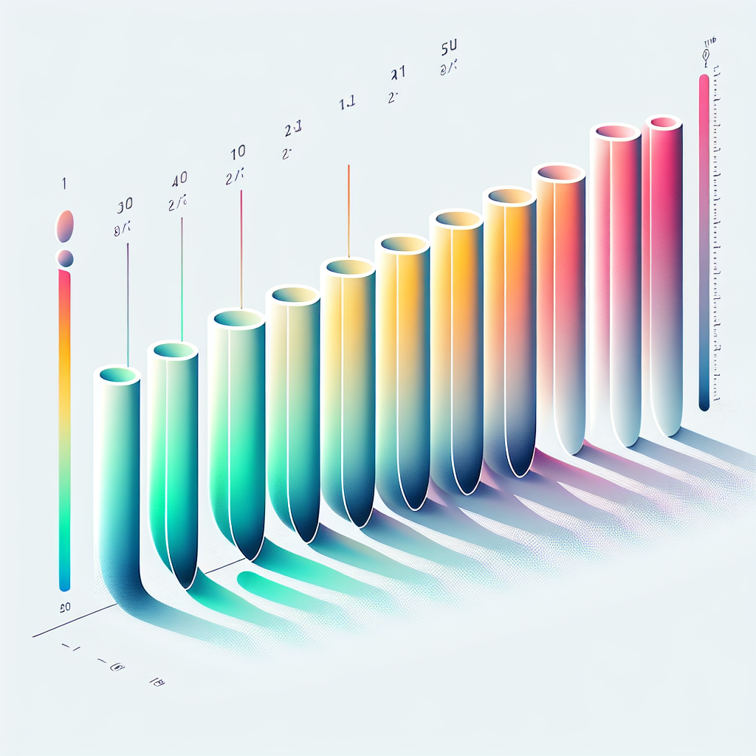
4.1. Workflow (I) creating concepts via images (Dall-E 3)
Prompt: Scientific concept graphic on a pure white background: a left-to-right sequence of five identical rods, each gently twisting more than the previous, colored by a smooth low-to-high gradient along their length. Add a small vertical color bar at the right with no tick numbers or words. Flat vector look, crisp edges, no shadows, no textures, no photorealism.
TRAINING

Slide 63
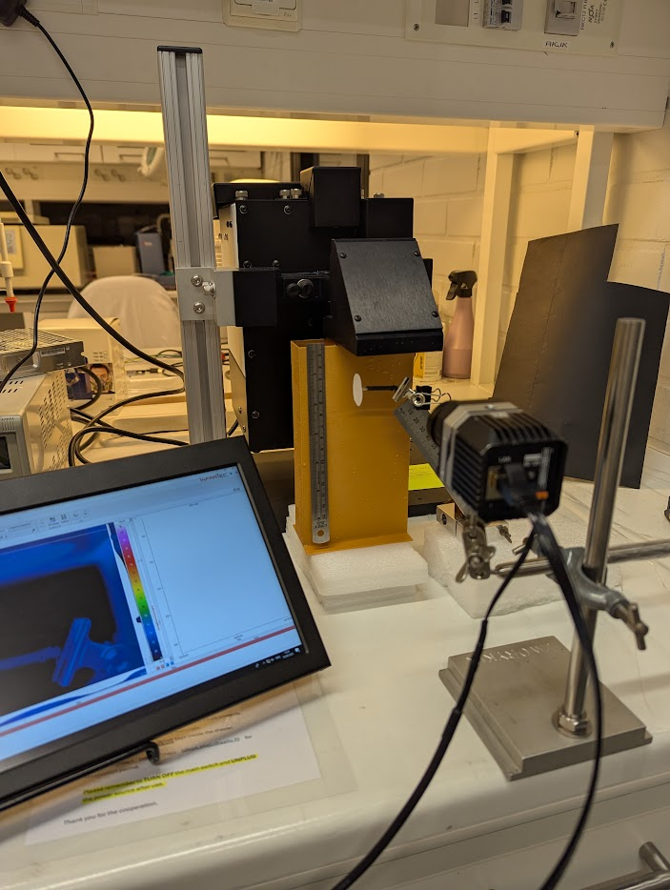

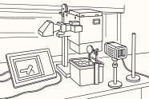
4.1. Workflow (II)
From AI concept to my own scientific illustration (GPT Image & Inkscape)
AI-generated
drawings
User-generated
drawing
Key ideas:
Use ChatGPT with image generation for concept exploration
Generate 2 or 3 images to explore style, composition, perspective, and color ideas
Open the image in an editor and recreate your version (Inkscape is free!)
Make a publishable figure,
AI-informed but not AI-generated
TRAINING
+PROMPT

Slide 64
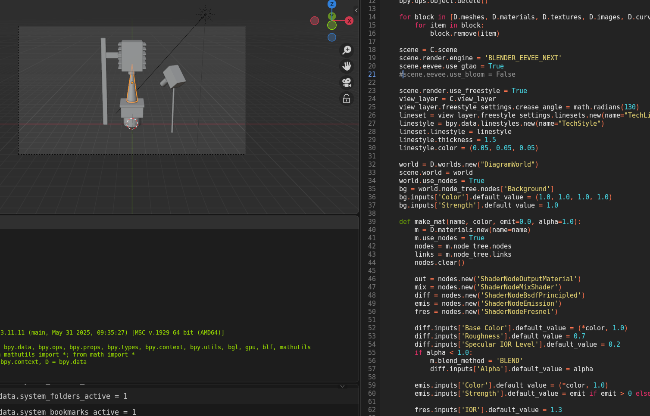
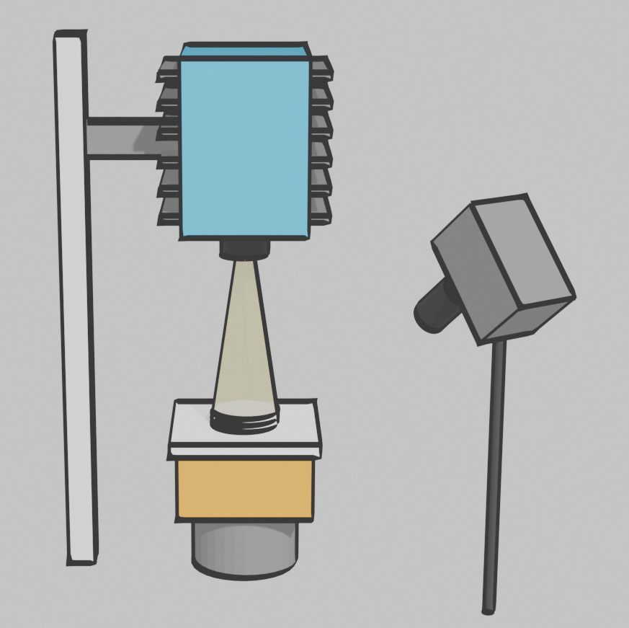
4.1. Workflow (III)
Generating code for a 3D illustration (Gemini & Blender)
Key ideas:
ChatGPT can generate Python scripts for Blender
Instead of images, ask for code to define shapes, structures, or physical setups (it can also read your data)
The code can be run in Blender’s scripting panel
You can then modify, change the texture, and render everything
Render image
Generate
code
I've attached a picture of my experimental setup. I want you to make a script for Blender that generates a scientific diagram, use color-blind safe colors and freestyle stroke. My picture is a photo so it has many elements that are not needed. In the center top it has the solar simulator, the calibrator system is in the center and being illuminated, and in the right top there's the thermal camera and in the right there's the screen showing the image of the thermal camera. Be extra careful to make sure the code does run on Blender 4.5, so don't use deprecated code.

Slide 65
4.2 Other AI tools

Slide 66
4.2. Other AI tools - General Purpose Tools
Try the ones in bold!
ChatGPT | Vicuna-13B | Pi, Inflection AI
ChatGPT Edu | Polymathic AI | Apple Intelligence
Microsoft Azure OpenAI Service* | GoblinTools | Amazon Titan
(Microsoft) Copilot | Poe, Quora | Amazon Bedrock
Copilot for Microsoft 365 | Starling-7B | Merlin AI
Google Gemini (formerly Bard) | HuggingChat, Hugging Face | Writer AI
Claude, Anthropic | OLMo-7B, Allen Institute for AI | You.com
Meta AI | Mistral AI
Note: In the context of academic research, these should be used only with public data
*) At Aalto University, this can also be used with internal or confidential data
Source:
ITHAKA SR

Slide 67
4.2. Other AI tools - General Purpose Tools
ChatGPT features
Basic chat features available for free, but ChatGPT plus subscribers (20USD/month) or pro (200USD/month) have less limitations on number of queries per hour and some extra features:
  Access to older models (4.*)
  Voice mode
  Better models with longer context window
  Models that implement “agentic chain of thought” / “reasoning”
  Deep Research mode for running literature reviews
  Less limitations to Dall-E3 text to image + Sora video generation
  Create GPTs: custom “bots” that you can build and share with others

Slide 68
4.2. Other AI tools - Discovery Tools
Source:
ITHAKA SR
Consensus | Papers, ReadCube, Digital Science | bioRxiv
Semantic Scholar | Talpa | ProQuest Research Assistant, Clarivate
Elicit | EBSCO | Web of Science Research Assistant, Clarivate
Scite.ai, Research Solutions, Inc. | JSTOR | Primo Research Assistant, Clarivate
ResearchRabbit | ScholarAI | SearchGPT, OpenAI
Scopus AI | Kudos | Undermind
Perplexity.ai | Keenious | Hasanyone.com, FutureHouse
Dimensions Research GPT and Dimensions Research GPT Enterprise, Digital Science | Ask R Discovery
AI Summarization for Dimensions, Digital Science | Litmaps
Note: In the context of academic research, these should be used only with public data

Slide 69

4.2. Other AI tools - Discovery Tools
How to use Keenious and other discovery tools:
Research abstract style (context → focus → scope)
I am researching [topic/field]. I am especially interested in [specific aspects or mechanisms]. I would like to find academic papers that explore [integration/application/experimental details]. Please suggest both [reviews/studies/theoretical works] that can help me understand this area.
Expanded keyword map (core idea → subtopic → applications)
active textiles; liquid crystalline elastomers (LCEs); integration into fabrics; shape-morphing fibers; actuation mechanisms; applications in adaptive wearables, smart clothing, soft robotics.
Problem solution driven
The challenge of [problem in the field] can potentially be addressed by [technology/material]. I want to find academic papers that examine [methods, mechanisms, or performance], and discuss applications in [areas]

Slide 70
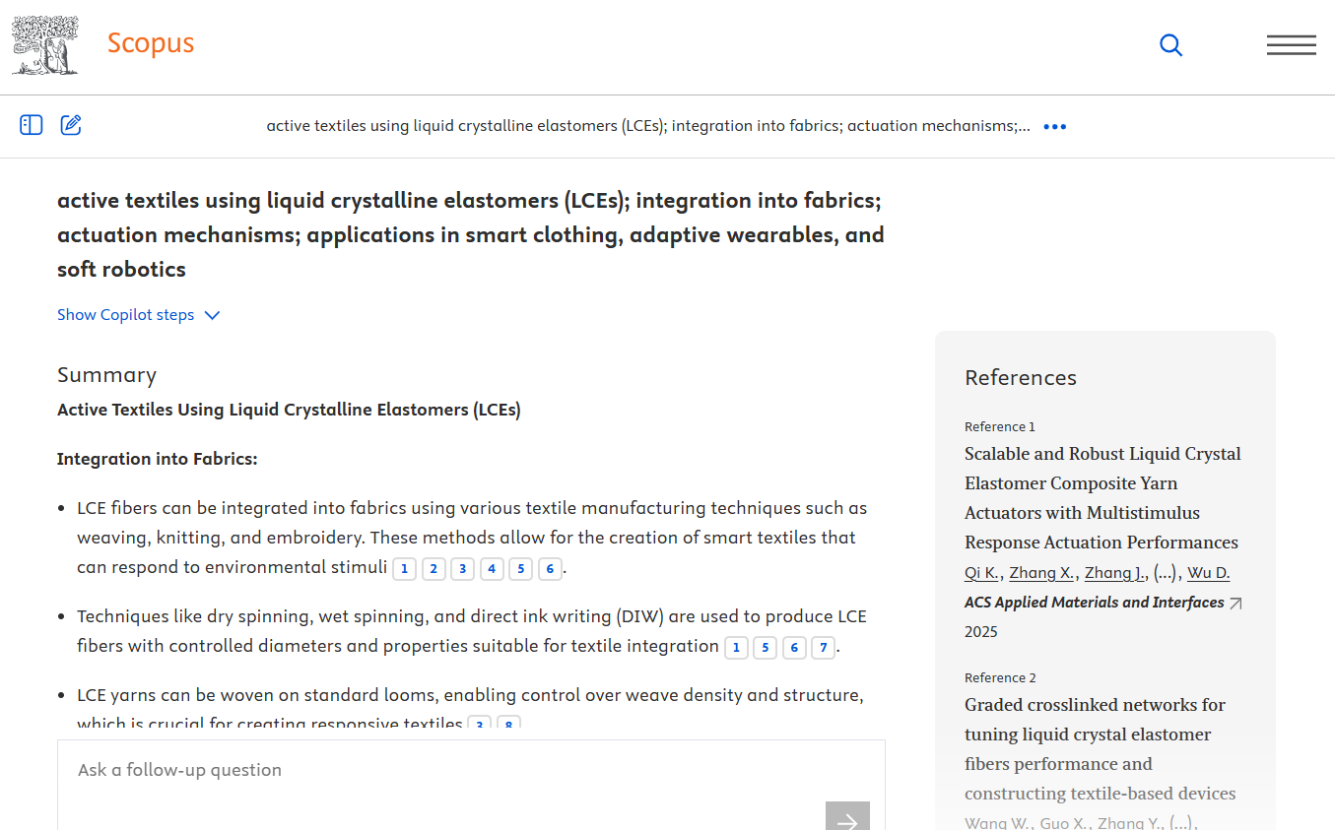
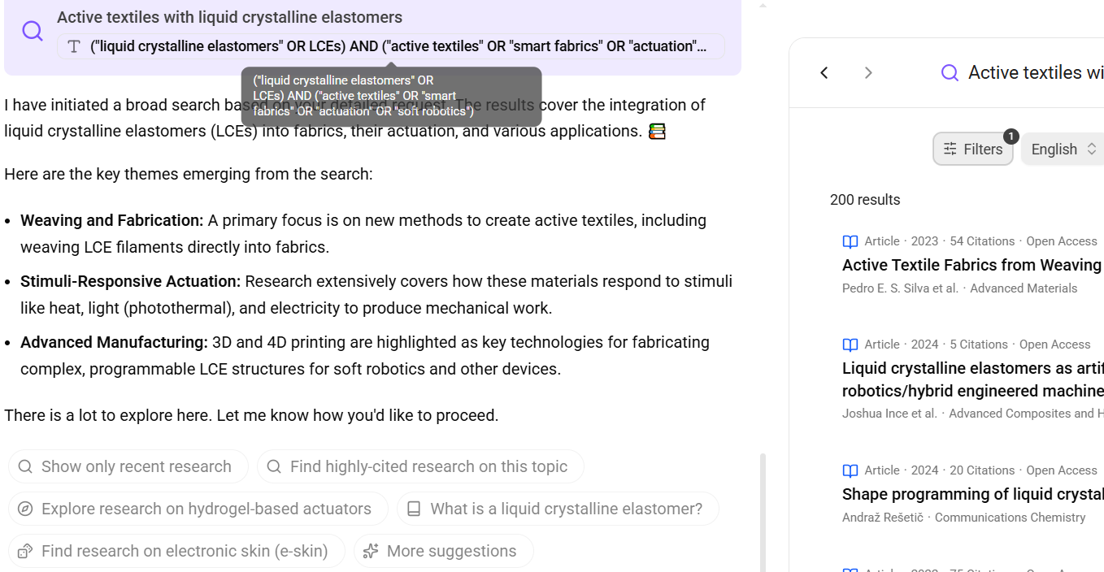
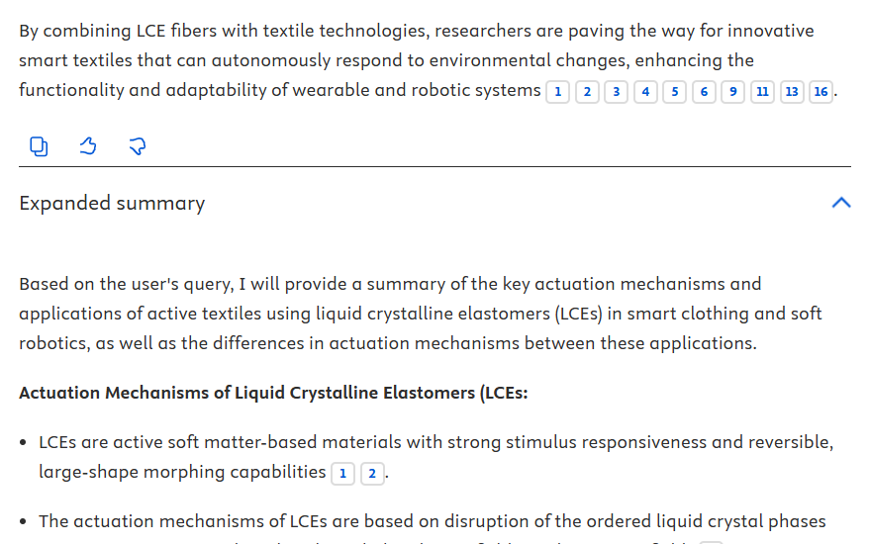
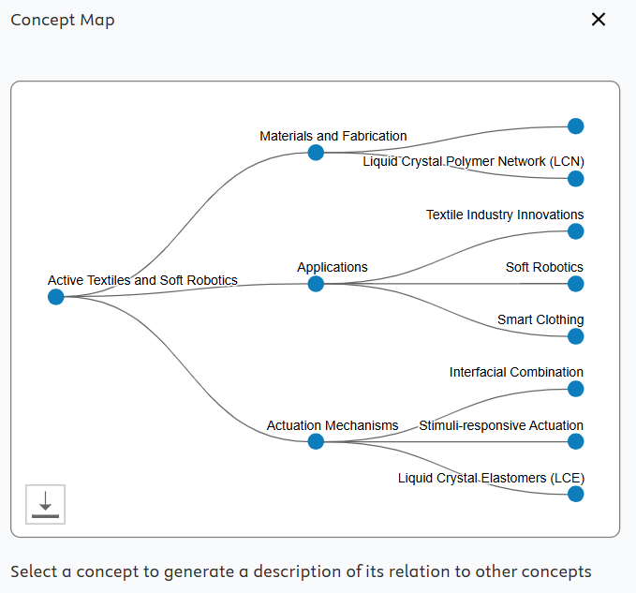
4.2. Other AI tools - Discovery Tools
Sold to institutions
Free to use with an account, with caps
(top 10 results, 5 AI responses per convo, 10 convos/day, 3MB uploads,
pro version is 10€/month for individuals and 20€/month for teams)
https://keenious.com/pricing

Slide 71




4.2. Other AI tools - Discovery Tools
Sold to institutions
Free to use without an account, with caps for “Pro”
(account good for saving history)
No free tier for user account (16€/month)
https://scite.ai/pricing

Slide 72


4.2. Aalto-Primo AI - Discovery Tools
https://clarivate.com/ai/academia/policy/
Aalto-Primo

Slide 73
4.2. Other AI tools - Workflow Tools
Source:
ITHAKA SR
ChatPDF | Zapier | AI Reader, McGraw Hill
Scholarcy | Advanced Data Analysis (formerly Code Interpreter), OpenAI | AI Scientist, Sakana AI
Humata.ai | HeyScience | OpenResearcher
Explainpaper | TLDR This | Manubot AI Editor
SciSpace | AskYourPDF | Coral AI
genei | Powerdrill | Reliant Tabular, Reliant AI
Any Summary | Julius AI | WikiCrow, FutureHouse
Iris.ai | Adobe AI Assistant | ReadCube Pro, Digital Science
Docalysis | Audemic Scholar | Illuminate, Google
NotebookLM, Google | Audemic Insights | AnswerThis
Notion | PowerNotes
PDF.ai | Zotero ARIA
Danswer | Data-to-paper
Note: In the context of academic research, these should be used only with public data

Slide 74

4.2. Other AI tools - Workflow Tools
NotebookLM by Google
Absolutely one of the best tools around for “chatting with a paper”
Provides paraphrased text from the source along with where in the document the citation comes from
Most amazing feature is the automatic synthesis of a podcast with two speakers casually chatting about the document
https://notebooklm.google/
Note: In the context of academic research, this tool should be used only with public data

Slide 75
4.3. Language models beyond chats
Not just chat-bots! Language model are useful for example for automatic transcription of interviews.
OpenAI Whisper useful when interviews should not leave local storage.
Other uses are Named Entity Recognition for automatic anonymisation of text, or to identify when a text is sensitive. See an example with pretrained BERT model.
Neural Machine Translation with open-source models such as No Language Left Behind (by Meta)

Slide 76
4.4. Local open source LLMs
Open-source models
  You can download them and run them on your laptop
  Or you can use them in CSC/LUMI clusters.
Why local?
  When everything happens locally (user interface + inference + model loading) you are in full control of what happens with your data
  It is important to evaluate the cybersecurity of local LLM tools if you are planning to use them with data that is not classified as public.
  Please refer to the previous slide “Cybersecurity, data protection, and the geography of AI LLMs”

Slide 77

4.4. External AI applications – General Purpose Tools
OLMo is basically the only truly open-source LLM
Liesenfeld, A., & Dingemanse, M. (2024). Rethinking open source generative AI: open washing and the EU AI Act. In The 2024 ACM Conference on Fairness, Accountability, and Transparency (pp. 1774-1787).

Slide 78
4.5. Build your AI app, tune your models
Build a chatbot with Azure OpenAI API
Or build it locally using llamacpp + open-source models + development tools such as LangChain, LangSmith, Chroma DB
Model Context Protocol brings new possibilities for building AI agents that connect to APIs and multiple data sources
Fine tuning
Prepare a new set of instructions (e.g. questions and answers)
Tweak the model weights so that the model is fine-tuned with the new content
It can be computationally expensive (many GPUs), but there are efficient ways with few compromises (qLORA)
Azure and/or OpenAI offer the option to fine tune their models (€)

Slide 79
4.6. Coding with Large Language Models
Should you stop learning how to code?
Various CEOs (Meta, OpenAI, Anthropic, Salesforce) are saying that coding will be done by AI in the near future
Why are coders the profession at risk? Or is it about moving from coding to code reviewing? (I think it’s the opposite)
Professional software engineers are embracing AI to automate all the boring bits related to coding.
Coding is maybe one of the few cases where testing can be formally added at the end of the gen AI chain, making it the ideal candidate for responsible use of generative AI. This of course comes with cybersecurity risks (installing malicious packages, leaking secrets)

Slide 80

4.6. Coding with Large Language Models
Practical tips
Check the dedicated lesson part of the CodeRefinery workshop

Slide 81
5. Advanced prompting

Slide 82
Advanced prompting techniques
Zero-shot Prompting
Few-shot Prompting
Retrieval Augmented Generation
Chain-of-Thought Prompting
Meta Prompting
Self-Consistency
Generate Knowledge Prompting
Prompt Chaining
Tree of Thoughts
Automatic Reasoning and Tool-use
Automatic Prompt Engineer
Active-Prompt
Directional Stimulus Prompting
Program-Aided Language Models
ReAct
Reflexion
Multimodal CoT
Graph Prompting
Reference: https://www.promptingguide.ai/

Slide 83

5.1. Advanced prompting techniques
Zero-shot, few-shots, and in-context learning
Zero-shot is the simple question
Few-shots: Give examples in the prompt
Useful for creating your own text classifier (e.g. interview coding, content annotation)
Prompt window size becomes a limitation
Source Ludwig.ai

Slide 84

5.2. Advanced prompting techniques
Retrieval Augmented Generation (RAG)
Chunks
Chat with your documents!
One implementation worth mentioning
  https://notebooklm.google/
If you are a coder: langchain, llamaindex, chromadb
MCP (Model Context Protocol) as a new way to go beyond RAG by working with AI Agents (= multiple LLM systems that are able to talk to each other and connect to other APIs)
Ingestion
Query
Figure source LangChain;
Useful list of advanced prompting techniques from Deci.ai

Slide 85
5.3. Advanced prompting techniques
RAG vs fine-tuning
RAG
  Interact with a database
  Pre-processing data
  Post-process responses
  For automated interaction with more complex user input
  Whenever you have an additional data source that you want the model to take into account
  Relatively quick to implement
Fine Tuning
  Train the model for a specific format of answers (e.g. generating reports in a specific, not very common, structure)
  Train for a specific type of question
  Train on specific type of encoded input data, that's not easily explained
  Requires a large amount of resources to re-train the model

Slide 86

5.4. Advanced prompting techniques
Chain Of Thoughts prompting I
In the example (few shote prompting) we teach the model to perform reasoning steps to obtain the answer.
From: https://arxiv.org/abs/2201.11903

Slide 87

5.4. Advanced prompting techniques
Chain Of Thoughts prompting II
Alternatively, with a zero-shot approach, we just add “Let’s think step-by-step” at the end of the prompt, to force the model into reasoning step by step to produce the answer.
From: https://arxiv.org/abs/2201.11903

Slide 88

5.5. Advanced prompting techniques
From CoT to Reasoning Models
Reasoning is now baked into the model and there is no need for a detailed prompt that asks for steps
Reasoning models (e.g. OpenAI o1, DeepSeek R1) work best with only high-level guidance.
Reasoning models are like a senior co-worker compared to GPT models which are like a junior assistant.
OpenAI Reasoning Best Practices
Local model with Llamacpp and DeepSeek R1 Distilled 1.5B parameters
llama-server --hf-repo ggml-org/DeepSeek-R1-Distill-Qwen-1.5B-Q4_0-GGUF --hf-file deepseek-r1-distill-qwen-1.5b-q4_0.gguf -c 2048

Slide 89

5.6. Advanced prompting techniques
Structured prompting (model/system dependent)
Research relevant example for GPT5
  <context_gathering>
  - Search depth: comprehensive
  - Cross-reference at least 10 peer reviewed sources
  - Stop when you have enough to provide definitive insights </context_gathering>
  <persistence>
  - Complete the entire research before providing conclusions
  - Resolve conflicting information by finding authoritative sources
  - Provide actionable recommendations based on findings </persistence>
  <tool_preambles>
  - Outline your research strategy and sources you'll check
  - Update on key findings as you discover them
  - Present final analysis with clear conclusions
  </tool_preambles>
  Task: Research the current state of commercially available wearables in predicting mental health.
Read the docs
  https://cookbook.openai.com/examples/gpt-5/gpt-5_prompting_guide
Image: dbreunig.com

Slide 90
5.7. Advanced prompting techniques
Meta-prompting (is prompt engineering dead?)
Bad
  Tell me some peer reviewed articles that studied the effect of generative AI on university students
Good
  Write a Scopus query so that I can identify peer reviewed studies that looked at the effect of generative AI on university students
Amazing
  Your task is to write a prompt that I can use with OpenAI GPT model 5.1. The prompt should produce a search query for Scopus database to identify peer reviewed studies that looked at the effect of generative AI on university students. Please ask me a few questions to refine the prompt.

Slide 91
BREAK (10 minutes)

Slide 92
6. Understanding the componets of an AI system based on generative AI

Slide 93




Cybersecurity, data protection, and the geography of AI LLMs
Internet
?
prompts->
prompts->
Local AI
(OS LLMs)
<-HTML
<-text
chatGPT
Orchestrator
Tools: web search, image generation, code interpreter, storage, apps
prompts->
<-HTML
A!
Azure OpenAI API
prompts->
Chat UI
Inference
OS
LLM
<-text
Aalto VPN
ai.aalto.fi
Inference
Local node
- Software that runs the user
interface (it can be a web server)
- Software that runs the inference
and interacts with the model
- Large language model (LLM); can be Open Source (OS)
- Conversation reused for future trainings
(unless you opt out)
- Prompts and output stored for 30 days for abuse monitoring
Inference
OS
LLM
Secdata
Public
Internal
Confidential
Secret
OS
LLM

Slide 94
Tool calls, harnesses, claws, model context protocol…
An orchestrator (which could be a simple loop) routes the prompt + context to the LLM and depending on the context or model response it can call tools: a python interpreter, a web search, a local app, read/write files, any other API that is defined with Model Context Protocol
This can sometimes prevent hallucinations since newer data or right answer (the famous “how many Rs in strawberry” works if python is used to count the “Rs”)
This also suffers from prompt injection (Nature, 2026)

Slide 95

7. Conclusions and references

Slide 96
Take home message
AI is a junior assistant: you don’t want to assign the most critical tasks to them, you want to delegate tedious tasks where you are an expert so that it’s easy to verify the output or exploratory tasks for you to critically evaluate.
Autoregressive LLMs as they are today are not “intelligent”. They are great at generating an average of all the things they were exposed to…. and carry all the biases and errors from the past.
New models and new prompting techniques are being explored (e.g. reasoning models, mixture of experts, integration with automation) to improve results and combine inference with live sources of data using Agentic-AI/MCP. Most likely we will see better results and less errors in the years to come… and most likely we will hear more news stories about privacy breaches and gen AI misuses.

Slide 97
Where to go from here?
There are great resources for self learning, beware of scammers. A reliable list available at this link
Explore the ITHAKA SR list, for each tool you also get a list of pros and cons and considerations from a higher education/research organisation perspective
If you would like to go deeper into one specific topic, suggest a new topic for the CodeRefinery training events.

Slide 98
References
Unesco guidelines for generative AI
Excellent guide from Aalborg University
Jeremy Howards's Hacker guide to Language Models
YouTube course by 3blue1brown on deep learning, transformers, attention, and how LLMs store information
Karpathy’s Intro to Large Language Models
Learning resources on more advanced topics (transformers, word2vec, …)
Elements of AI open course
Ethics of AI open course
A

Slide 99
LUNCH BREAK or demos if there is time…

Slide 100
Artificial Intelligence and Responsible Conduct of Research
The interplay between Responsible Conduct of Research and use of Artificial Intelligence tools
Dr. Enrico Glerean, Staff Scientist and Data Agent at Aalto University
Dr. Pedro Silva, Researcher and Data Agent at Aalto University

Slide 101
Outline: AI and responsible conduct of research
Principles of Responsible Conduct of Research
Principles of AI ethics and responsible AI
Challenges posed by AI tools in research: truth, trust, competence, compliance
Possible solutions
Learning outcomes
Understanding research ethics, research integrity, and compliance
Familiarise with ALLEA and TENK guidelines
Consider how to responsibly use AI tools in education/research work

Slide 102
DISCLAIMER
The topic covered in this session could be a full course of its own
For this reason, explanations will stay at the intuitive level
While we do focus on Artificial Intelligence tools, you can replace AI with “technology XYZ” and the whole set would still work as it is

Slide 103
Ethics is not Law
Ethics
Law

Slide 104
Ethics and law
Ethics:
- a set of moral principles : a theory or system of moral values
Moral:
- of or relating to principles of right and wrong in behavior
Law:
- a binding custom or practice of a community : a rule of conduct or action prescribed or formally recognized as binding or enforced by a controlling authority

Slide 105
Ethics is not law
Ethics
Law
In some countries ethics and law overlap a lot, in some other they are completely separated
Ethics is based on fundamental human rights, laws are changing with what the current government of a country think is right (although in Europe, individual governments have less freedom to do that)
Example 1: NGOs in the Mediterranean sea facing prosecution for smuggling illegal immigrants stranded at sea (Jonio/Mediterranea case) [ethical but not legal]
Example 2: Italian military forces were fined for not helping stranded immigrants (case Hirsi Jamaa and Others v. Italy before the European Court of Human Rights) [legal but not ethical]
What is the right thing to do?

Slide 106
Research
Ethics
Law

Slide 107
Research Integrity
Research
Ethics
Research
Compliance

Slide 108
Research Integrity
Research integrity primarily concerns the practice, researchers’ actions and behaviours following the rules and regulations governing their disciplines (Reliability, Honesty, Respect, Accountability)
Research ethics is a set of principles that researchers must follow for conducting research (Beneficience, Nonmaleficience, Autonomy, Justice)
Research
Ethics
Research
Compliance
Research compliance involves the adherence to regulations, directives, and national laws that apply to research and research outputs (General Data Protection Regulation, Dual Use and Export Control regulation, Sanctions regulation, Medical Device Regulation, Clinical Trial regulation, Animal Welfare directive, Finnish Act on the Secondary Use of Health and Social Data …)

Slide 109
Example of tensions between the three dimensions
Academic freedom can be limited by research compliance
Open science practices can be limited by ethics and/or law
Adherence to ethics can put your research career at risk
Add more…?

Slide 110
Research Ethics in the European Union

Slide 111
The four principles for ethics in research
Principle | Definition
Beneficence | Do only good: Promote well-being, preserve dignity, and sustain the environment.
Nonmaleficence | Do no harm: Avoid harm by ensuring privacy, security, and fundamental rights.
Autonomy | Preserve human decision-making and dignity
Justice | Promote fairness and solidarity: Ensure equitable outcomes and avoid discrimination.
Adapted from Beauchamp & Childress (2019)

Slide 112
Ethical self evaluation: the dimensions to consider when assessing the ethicality of your research (Horizon Europe)
Medical research with human participants, human organs, tissues and cells
Non-medical research with human participants
Processing of personal data
Research with animals
Research in non-EU countries, global south/developing countries
Environment & safety
Artificial Intelligence
Dual use items
Potential misuse of results
References and more materials at https://www.aalto.fi/en/aalto-community-hub/how-to-make-an-ethics-self-assessment-in-research-projects-aalto-support-and-guidelines

Slide 113
Finnish guidelines for non-medical studies with human participants (TENK)
TENK Guidelines Section 4.2 https://www.tenk.fi/sites/tenk.fi/files/Ihmistieteiden_eettisen_ennakkoarvioinnin_ohje_2019.pdf
The researcher must request an ethical review statement from a human sciences ethics committee, if their research contains any of the following:
a) Participation in the research deviates from the principle of informed consent,
b) the research involves intervening in the physical integrity of research participants,
c) the focus of the research is on minors under the age of 15, without separate consent from a parent or carer or without informing a parent or carer in a way that would enable them to prevent the child’s participation in the research,
d) research that exposes participants to exceptionally strong stimuli,
e) research that involves a risk of causing mental harm that exceeds the limits of normal daily life to the research participants or their family members or others closest to them or
f) conducting the research could involve a threat to the safety of participants or researchers or their family members or others closest to them.

Slide 114
Research Integrity in the European Union

Slide 115
Allea principles (2023) and Finnish Code of Conduct for RI (2023)
ALLEA: The European Code of Conduct for Research Integrity
The Finnish Code of Conduct for Research Integrity
Principle | Definition
Reliability | Ensuring the quality of research, reflected in the design, methodology, analysis, and use of resources.
Honesty | Developing, undertaking, reviewing, reporting, and communicating research in a transparent, fair, full, and unbiased way
Respect | Towards colleagues, research participants, research subjects, society, ecosystems, cultural heritage, and the environment.
Accountability | Accountability for the research from idea to publication, for its management and organisation, for training, supervision, and mentoring, and for its wider societal impacts.

Slide 116
Violation of research integrity
ALLEA: The European Code of Conduct for Research Integrity
The Finnish Code of Conduct for Research Integrity
Plagiarism vs. Intellectual Property Rights = Research Ethics vs Law
Unacknowledged use of another person’s work (Plagiarism)
Unauthorised use of another person’s work (IPR infringement)
Misconduct | Definition
Fabrication | Making up data or results and recording them as if they were real.
Falsification | Manipulating research materials, equipment, images, or processes, or changing, omitting, or suppressing data or results without justification
Plagiarism | Using other people’s work or ideas without giving proper credit to the original source.

Slide 117
Violations of research integrity, questionable research practices
Fabrication
Falsification
Plagiarism
Conflict of interests
Misusing seniority to encourage violations or to advance one’s career
Delaying or hampering the work of others (malicious peer reviewer)
Misusing statistics
Hiding the use of AI in the research process
Withholding data or results without justification
Chopping up results to increase number of publications (salami)
Selective or inaccurate citing
Expand citations to please editors/reviewers/friends
Manipulating authorship
Self-plagiarism
Establishing or supporting predatory journals
Reviewers cartels
Misinterpreting achievements (pump that CV)
Falsely accusing others of misconduct
Ignoring RI violations

Slide 118
We covered research ethics and research integrity, what is their relationship?

Slide 119

Interrelationship between research ethics and research integrity
Truth, Trust, Competence
Muthanna, A., Chaaban, Y., & Qadhi, S. (2024). A model of the interrelationship between research ethics and research integrity. International journal of qualitative studies on health and well-being, 19(1), 2295151.

Slide 120
Research Integrity
Truth
Compliance
Trust
Research
Ethics
Research
Compliance
Competence

Slide 121
Which core principles might be compromised by adopting a new technology?
A framework for evaluating new technologies in research
Truth: Could the use of this technology compromise the accuracy or integrity of my research findings?
Trust: Could using this technology undermine others’ confidence in my work or in me as a researcher?
Competence: Might this technology diminish my own skills, expertise, or critical thinking abilities?
Compliance: Does using this technology pose any risk of legal violations?

Slide 122
(Generative) Artificial Intelligence and Research Integrity

Slide 123

Generative AI and Research Integrity
For simplicity we focus on generative AI systems that use General Purpose AI models such as Large Language Models that can be used in your research work.
Other uses of AI are not covered in this section (classifiers, recommendation systems, ML approaches to analyse data, etc…)
Text → Text
Text → Code
Speech → Text
Text → Speech
Text → Image
Image → Text
…
Figure from Glerean (2025) “Fundamentals of secure AI systems with personal data” European Data Protection Board

Slide 124
The Research Process aided by AI tools: Examples with Responsible Conduct of Research at its core
Grant writing
Research planning
Study design
Browsing and summarizing the literature
Facilitate discovery and FAIR-ness
Explore open datasets
Identify research gaps
Write and editing
Improve research outputs (tables, figures)
Peer review suggestions
Summarizing for public
Media reach out
RCR
Ethics & Law
Interfaces for data collection
Code and automation help
Metadata preparation
Summarising
Organise and store (meta)data
Brainstorming on approaches for data preprocessing
Code and automation
Data minimization (pseudo- and anonymization)
Data annotation (e.g. deductive coding)
Annotations
Methodological considerations
Data analysis (Code and automation)
Original image from https://rdmkit.elixir-europe.org/ “The data lifecycle”

Slide 125
Framework for AI ethics and responsible AI

Slide 126
AI ethics, Responsible AI, AI governance and AI regulations
AI Governance in Practice
(The Alan Turing Institute)
Artificial Intelligence Act
AI
governance
and regulations
SSAFE-D: Sustainability, Safety, Accountability, Fairness, Explainability, Data Stewardship
(The Alan Turing Institute)
Responsible AI
Beneficience, Nonmaleficience, Autonomy, Justice, Explicability
(Floridi 2023)
AI Ethics
Other frameworks mention Fairness, Accountability, Transparency, Explicability, there are many terms but all closely related (e.g. Trustworthy AI)

Slide 127
AI ethics, Responsible AI, AI governance and AI regulations
AI
governance
and regulations
Responsible AI
AI Ethics
Other frameworks mention Fairness, Accountability, Transparency, Explicability, there are many terms but all closely related (e.g. Trustworthy AI)

Slide 128

Unified framework of five principles for ethical AI
Reference: Traditional bioethics principles by Beauchamp & Childress (1979-2026), extended by Floridi, L. (2023) in “The ethics of artificial intelligence: Principles, challenges, and opportunities.”

Slide 129
AI ethics, Responsible AI, AI governance and AI regulations
AI
governance
and regulations
Responsible AI
Beneficence, Non-maleficence, Autonomy, Justice, Explicability
(Floridi 2023)
AI Ethics
Other frameworks mention Fairness, Accountability, Transparency, Explicability, there are many terms but all closely related (e.g. Trustworthy AI)

Slide 130

Responsible AI, the SSAFE-D principles
SSAFE-D: Sustainability, Safety, Accountability, Fairness, Explainability, Data Stewardship
(The Alan Turing Institute)

Slide 131

Apply SSAFE-D principles to evaluate the ethicality of an AI tool
Commit a morally wrong act to achieve a greater good?
Responsible AI principles are currently not followed by developers of proprietary generative AI systems/models (OpenAI, Meta, Google…)
❌ Sustainability (huge impact on the planet, currently 1-2% of global electricity)
❌ Safety (Induced psychosis, suicide, exploitation of global-south annotators)
❌ Accountability (no consequences for the developers for harming individuals)
❌ Fairness (biases against black people, women, minorities)
❌ Explainability (no clear explanation on how the actual models work, proprietary tools)
❌ Data Stewardship (train data kept secret, illegal use of copyright materials, illegal processing of personal data)
Check the references for more:
Stahl & Eke (2024) “The Ethics of ChatGPT”
Bender & Hanna (2024) “The AI Con”

Slide 132
AI ethics, Responsible AI, AI governance and AI regulations
AI Governance in Practice
(The Alan Turing Institute)
Artificial Intelligence Act
AI
governance
and regulations
SSAFE-D: Sustainability, Safety, Accountability, Fairness, Explainability, Data Stewardship
(The Alan Turing Institute)
Responsible AI
Beneficience, Nonmaleficience, Autonomy, Justice, Explicability
(Floridi 2023)
AI Ethics
Other frameworks mention Fairness, Accountability, Transparency, Explicability, there are many terms but all closely related (e.g. Trustworthy AI)

Slide 133
From ethical principles to legislations: the AI Act
The AI Act, in place since 1st August 2024, and being enforced over the next two years
Defines prohibited and high-risks AI systems, based on how they impact fundamental human rights
It is basically a product safety regulation with elements of ethics
Defines legal obligations for providers and deployers of AI systems
It does not apply to research, as long as the developed systems are not put on the market
However, as cognitive workers, we must familiarise with AI and its risks (Article 4)
Providers and deployers of AI systems shall take measures to ensure, to their best extent, a sufficient level of AI literacy of their staff and other persons dealing with the operation and use of AI systems on their behalf, taking into account their technical knowledge, experience, education and training and the context the AI systems are to be used in, and considering the persons or groups of persons on whom the AI systems are to be used.
More details https://www.aalto.fi/en/services/artificial-intelligence-ai-the-ai-act-and-ai-literacy-at-aalto-university

Slide 134

From ethical principles to legislations: the AI Act
Open question:
As a researcher, you may have the freedom to develop even restricted AI models or systems. However, as a user of AI tools, would trust and compliance be compromised if you used an AI system that does not adhere to the AI Act?
Source: https://www.aalto.fi/en/services/artificial-intelligence-ai-the-ai-act-and-ai-literacy-at-aalto-university

Slide 135

AI governance and cybersecurity
As any SSAFE-D dimensions can be compromised by malicious attackers, cybersecurity becomes a necessary element of AI governance.
Figure from Glerean (2025) “Fundamentals of secure AI systems with personal data” European Data Protection Board

Slide 136
Combining
Research [ethics | integrity | compliance] with
AI [ethics | trustworthiness | governance]

Slide 137
Different roles, require different perspectives on ethical and responsible AI (ALLEA: The European Code of Conduct for Research Integrity)
Developer of AI systems/models
Ethics Consider AI ethics and responsible AI principles throughout the AI system lifecycle (Sustainability, Safety, Accountability, Fairness, Explainability, Data Stewardship)
Law Compliance: AI Act applies if the AI system i) has risks and ii) is not developed for research purposes or personal use (and many other regulations and directives that apply to data e.g. GDPR)
Tech Technical robustness: Ensure the correct functioning of the AI system (AI systems are usually too computationally demanding to be run locally, so they are in the cloud = someone else’s computer)
Students, teachers, researchers
Reliability: quality of research/education, reflected in the design, methodology, analysis, and use of resources.
Honesty: doing your work in a transparent, fair, full, and unbiased way
Respect: towards colleagues, research participants, research subjects, society, cultural heritage, and the environment.
Accountability: from idea to publication, and all the steps of the study / teaching / research process.

Slide 138
Generative AI is the ideal misconduct machine

Slide 139
Generative AI: the ideal misconduct machine?
Generative AI systems (like ChatGPT) are ideal fabrication, falsification, plagiarism machines: they are trained to always produce text and leave the quality control on the validity and reliability of the output to the final users.
Plagiarism: GenAI LLMs systems can verbatim reproduce text data in the training dataset without citing the original source
Fabrication/Falsification: GenAI tools can also perform data synthesis or data analysis, i.e. they can be used (willingly or not) to fabricate data or falsify results (how many r’s in strawberry?) without the ability to verify and reproduce the analysis process.
Security and data protection risks: commonly used generative AI system process your data remotely. You should protect the confidentiality and integrity of your data, your work, and the data of subjects, or other parties you work with. Use approved Aalto AI tools.
See Aalto University guidelines:
Responsible use of Artificial Intelligence in the research process

Slide 140
Misconduct is a core element of these systems
“(LLMs) may encode the correct answer, yet consistently generate an incorrect one” (2025, Apple research paper)
“…current models degrade documents during delegation: even frontier models (Gemini 3.1 Pro, Claude 4.6 Opus, GPT 5.4) corrupt an average of 25% of document content by the end of long workflows” (2026, Microsoft)
“… Harry Potter is so memorized that, using a seed prompt consisting of just the first line of chapter 1, we can deterministically generate the entire book near-verbatim.” (2025, Stanford University)

Slide 141

“No, we didn’t scrape your content to train our model” 🤡
From the lawsuit of Getty images against the AI company “Stable Diffusion”.
"Stable Diffusion... does not store or reproduce any copyright works”

Slide 142
Generative AI and Research Integrity: disclose your AI
In the ALLEA list of "Violations of research integrity" AI is mentioned:
Hiding the use of AI in the research process
AI cannot be given authorship, as it is considered as a tool, and authorship always involves responsibility that AI cannot cover. [Aalto.fi], [Nature], [Elsevier]
The use of AI should be transparent by openly describing how AI is used in the research process so that others can reproduce your results (see guidelines for “Declaration of generative AI in scientific writing”)
Example from Elsevier
  Protect your data, the data of your subjects, IPR/Copyright
  Grammar, spelling, punctuation check -> no need to declare
  Anything other use -> declare
  No AI images unless it’s for the research design/methods visualisation

Slide 143
Generative AI and Research Integrity: disclose your AI
In the ALLEA list of "Violations of research integrity" AI is mentioned:
Hiding the use of AI in the research process
Open questions:
Where is the fine line between a spellchecker and a full text rewrite?
  Elsevier’s example: spell check, grammar, punctuation, no need to declare
Do you trust AI summaries and AI generated citations?
  LLMs are 5 times more likely overgeneralize and misinterpret scientific literature
Do you trust AI generated code?
  Cybersecurity risks of AI generated code
Should you use (or accept reviewers used) AI for peer reviews?
  In some fields up to 17% of peer reviewed were conducted with LLM
Do you trust AI detectors with your colleagues/students?
  9% declare AI use but 36% seems to be the actual use
Do you trust researchers that disclose AI use?
  Being transparent about AI use reduces the trust towards the AI user

Slide 144
If you do not have the ability or the resources to verify the output of GenAI systems (e.g. by finding the relevant citations for the synthesised text, by verifying that others’ works are summarised correctly, by detecting plagiarised text or code, by verifying the analysis code) then you should not use the output of GenAI systems beyond self-learning or brainstorming.

Slide 145
It is impossible to ethically use these tools, because they are not ethical under any aspect.

Slide 146
If we cannot be ethical, let’s at least be responsible:
Responsible use of (generative) AI
If we have strict ethics, then we should not use or promote these tools
However real world poses a series of ethical compromises: we drive petrol cars, we enable the killing of animals, fast fashion, smartphones that do not last, and our taxes pay for military weapons that one day will kill people
By using these AI tools and understanding their limitations, we can identify responsible use-cases where they are useful for our life, the people we interact with, and society at large.

Slide 147

KEEP
CALM
AND
CARRY
ON
Resist the hype, use AI tools responsibly (if you want to)
  Safe implementation of AI tools: e.g. Aalto AI Assistant, Aalto Scientific Computing Speech2Text, local open source LLMs at Aalto
  AI literacy trainings
  Opportunities to openly discuss with everyone about how they use AI (or avoid using AI) (see Aalto AI Talks)
  Academic freedom to let researchers explore (or ignore) such tools
  In doubt? Contact Aalto Research Software Engineers and/or Data Agents researchdata@aalto.fi

Slide 148
KEEP
CALM
AND
CARRY
ON
Resist the hype, use AI tools responsibly (if you want to)
  AI literacy trainings
  Safer versions of the tools you use (e.g. local)
  Opportunities to openly discuss with everyone about how they use AI (or avoid using AI)
  Academic freedom to let researchers explore (or ignore) such tools

Slide 149
References
ALLEA code of conduct
TENK guidelines for Research Integrity
AI and Research Work
Muthanna, A., Chaaban, Y., & Qadhi, S. (2024). A model of the interrelationship between research ethics and research integrity. International journal of qualitative studies on health and well-being, 19(1), 2295151.

