Slide 1

Analyzing Occupational Wage Gaps Across Maryland
Rin Hwang
DATA 205

Slide 2

Core Research Questions
How does geographic location penalize wages for identical occupations across Maryland’s workforce area, and how do these penalties correlate with local resident demographics?
Which areas pay above or below the statewide baseline for the same work?
How big is the pay difference for identical job titles?
Do frontline service workers take the same percentage wage hit as high earners?
Are wage penalties concentrated in rural labor areas or communities with higher minority populations?

Slide 3

Datasets, Analysis and Modeling
Datasets (2):
“2025 Occupational Employment & Wage Statistics”
  Maryland Department of Labor, Division of Workforce Development and Adult Learning
“Annual Estimates of the Resident Population by Demographic Characteristics for Maryland Jurisdictions”
  Maryland Department of Planning, State Data and Analysis Center
Multiple Linear Regression
  Using location dummy variables to get a numerical penalty
Two-Way ANOVA
  Testing whether wage gaps vary significantly across occupations and locations
Logistic Regression
  Are frontline workers being disproportionally affected by wage gaps?
Notes:
just

Slide 4
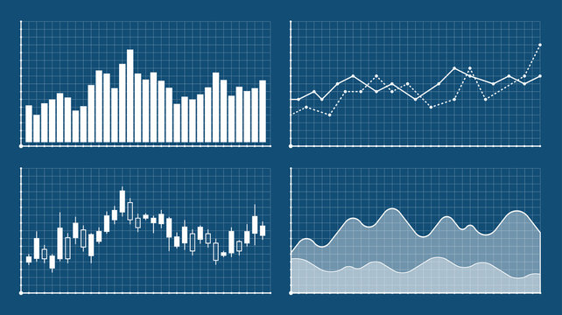
Planned Visuals
Geographic Map of Wage Penalties
  Maryland state map to show severity of wage penalties
  Colored scaled shaded counties (choropleth), the darker the steeper the wage penalty is
Correlations of Demographics Scatterplots
  Equity patterns across communities
  Whether communities with higher minority populations face steeper wage penalties
Boxplots of Penalties
  Wage penalty distributions grouped across occupations
  Is every occupation getting hit with penalties?
  Are there certain occupations that are more stable?

Slide 5
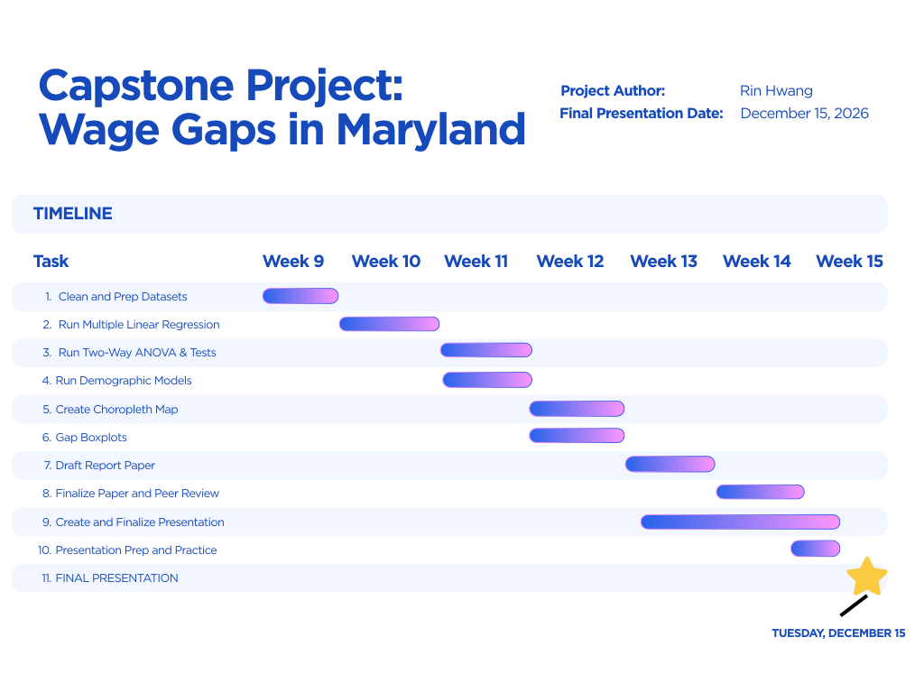

Slide 6

Milestones and Potential Risks
  Project Progression
    Preparing both datasets by cleaning and wrangling
    Start doing modeling: Run regression and ANOVA models to get baseline regional penalties.
    Merge demographic data, run equity models, and finalize visuals
  Risks and Solutions
    Missing data in rural counties
      Solution: Only comparing specific jobs with enough reported data and using broad career fields whenever a local sample gets too small
    Work location ≠ Residence
      People don’t always live in the same county where they work.
      Solution: Grouping the data into the 13 local workforce areas and focusing only on what local employers pay
Notes:
just

Slide 7
Sources
Datasets:
Maryland Department of Labor, Division of Workforce Development and Adult
Learning. (2025). Maryland occupational employment and wage statistics (OEWS). Maryland Department of Labor. https://labor.maryland.gov/lmi/wages/
Maryland Department of Planning, State Data and Analysis Center. (2025). Annual Estimates of the
Resident Population by Demographic Characteristics for Maryland Jurisdictions. State of Maryland. https://planning.maryland.gov/MSDC/SiteAssets/Census_Estimates/Age-Race- Sex/Census_EST_ARS.aspx
Images:
Slide 1 Flag of Maryland: https://en.wikipedia.org/wiki/Flag_of_Maryland
Slide 2 Workers stock image: https://www.istockphoto.com/illustrations/different-occupations
Slide 3 Graphs stock image: https://www.vecteezy.com/free-photos/statistical-analysis
Slide 4 Graphs stock image: https://stock.adobe.com/search?k=graphs
Slide 5 Gantt Chart: Created on Canva using template
Slide 6 Computer stock image: https://www.istockphoto.com/photos/market-research

