Slide 1
Practical SPARQL Benchmarking
Rob Vesse
rvesse@yarcdata.com
@RobVesse
Notes:
Introduce Myself
May want to add a disclaimer here about views/opinions expressed primarily being my personal ones and not those of the company a la DVD extras disclaimers ;-)

Slide 2
Why Benchmark?
Regardless of what technology your solution will be built on (RDBMS, RDF + SPARQL, NoSQL etc) you need to know it performs sufficiently to meet your goals
You need to justify option X over option Y
Business – Price vs Performance
Technical – Does it perform sufficiently?
No guarantee that a standard benchmark accurately models your usage
Notes:
What is says on the slide ;-)

Slide 3
The Standard Benchmarks
Berlin SPARQL Benchmark (BSBM)
Relational style data model
Access pattern simulates replacing a traditional RDBMS with a Triple Store
Lehigh University Benchmark (LUBM)
More typical RDF data model
Stores require reasoning to answer the queries correctly
SPARQL²Bench (SP2B)
Again typical RDF data model
Queries designed to be hard – cross products, filters, etc.
Generates artificially massive unrealistic results
Tests clever optimization and join performance
Notes:
Describe the benchmarks – shown on slides
Discuss deficiencies of each benchmark
BSBM
Relational – not really showing off the capabilities of a SPARQL engine
LUBM
Need for reasoning – implementation thereof can make a huge difference in performance
Forward vs Backward Chaining Reasoning
SP2B
Queries are unrealistic
Focuses on optimization

Slide 4
Problems with Benchmarking
Often no standardized methodology
E.g. only BSBM provides a test harness
Lack of transparency as a result
If I say I’m 10x faster than you is that really true or did I measure differently?
Are the figures you’re comparing with even current?
What actually got measured?
Time to start responding
Time to count all results
Something else?
Even if you run a benchmark does it actually tell you anything useful?
Notes:
Self explanatory slide for the most part
Highlight that just because the store you are interested in is good/bad at a particular benchmark doesn’t tell you whether the store is good/bad for your use case

Slide 5
Query Benchmarker - Overview
Java command line tool (and API) for benchmarking
Designed to be highly configurable
Runs any set of SPARQL queries you can devise against any HTTP based SPARQL endpoint
Run single and multi-threaded benchmarks
Generates a variety of statistics
Methodology
Runs some quick sanity tests to check the provided endpoint is up and working
Optionally runs W warm up runs prior to actual benchmarking
Runs a Query Mix N times
Randomizes query order for each run
Discards outliers (best and worst runs)
Calculates averages, variances and standard deviations over the runs
Generates reports as CSV and XML
Notes:
Describe the methodology in detail
Note that this is based on an amalgamation of the BSBM style and Revelytix SP2B methodologies

Slide 6
Query Benchmarker – Key Statistics
Response Time
Time from when query is issued to when results start being received
Runtime
Time from when query is issued to all results being received and counted
Exact definition may vary according to configuration
Queries per Second
How many times a given query can be executed per second
Query Mixed per Hour
How many times a query mix can be executed per hour
Notes:
Key Point is to cover difference between Response Time and Runtime
Note that this stat can give some interesting information about how stores execute queries – almost instant response time but much longer runtime indicates streaming execution. Long response time with small difference to runtime indicates a batch execution.

Slide 7
Demo
Notes:
Run through a brief demo of the command line tool – make sure to have a running Stardog/Fuseki instance to run against – likely safer to use Fuseki as easier to ensure running and open source so no appearance of bias to a commercial product
Run on SP2B 10k – will complete in reasonable time while I’m talking – suggest using a limited number of runs for demo purposes.
Show the output data (CSV and XML)
Key difference is CSV converts to seconds while XML uses raw nanoseconds
XML is better for post processing
CSV useful for quick import into Spreadsheet tools

Slide 8
Example Results - Configuration
SP2B at 10k, 50k and 250k run with 5 warm-ups and 25 runs
All options left as defaults i.e. full result counting
Runs for 50k and 250k skipped if store was incapable of performing the run in reasonable time
Run on following systems
*nix based stores run on late 2011 Mac Book Pro (quad core, 8GB RAM, SSD)
Java heap space set to 4GB
Windows based stores run on HP Laptop (dual core, 4GB RAM, HDD)
Both low powered systems compared to servers
Benchmarked Stores
Jena TDB 0.9.1
Sesame 2.6.5 (Memory and Native Stores)
Bigdata 1.2 (WORM Store)
Dydra
Virtuoso 6.1.3 (Open Source Edition)
dotNetRDF (In-Memory Store)
Stardog 0.9.4 (In-Memory and Disk Stores)
OWLIM
Notes:
Discuss the setup for the example results – why the stores were chosen?
Ease of availability (open source, runnable on *nix, personal interest etc)
Ensure to highlight YMMV
Disclaimer – Be sure to state that this is just a arbitrarily selected sample of stores and that performance indicated here may not be representative of the true performance of any store. Most importantly Cray/YarcData is not endorsing any specific store.
Again point out the importance of people running their own benchmarks

Slide 9
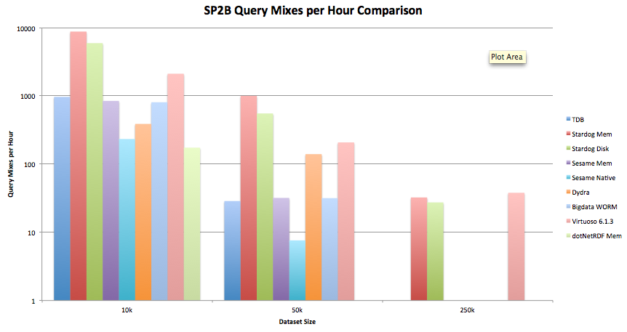
Example Results – QMpH
Notes:
Note how as dataset size increases many stores can’t complete within reasonable time on the machines we used
Logarithmic Scale
Make sure to mention that the fact that many stores did not complete on the 50k and 250k sizes doesn’t mean they are defective, merely that with the machine resources available they couldn’t run in a timely fashion. This leads nicely to the point that it is important to benchmark on the hardware you actually intend to use.

Slide 10
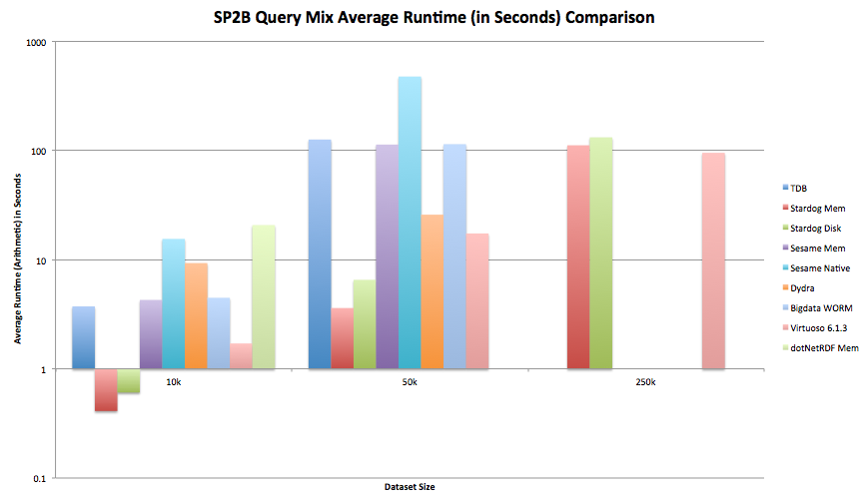
Example Results – Average Mix Runtime
Notes:
Discuss the variation in average runtime – some stores are way ahead of others
Note that some store’s results are heavily influenced by poor performance on certain queries – see next slide
Logarithmic Scale

Slide 11
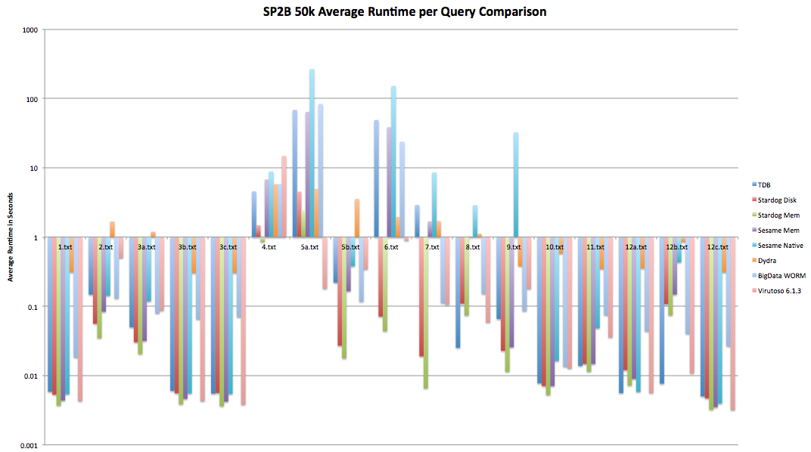
Example Results – Query Runtimes
Notes:
Highlight the variation in performance both between stores and queries. Note how certain queries are just fundamentally hard even with clever optimisation
In-Memory trumps disk for relevant stores in most cases

Slide 12
Code & Example Results
Code Release is management Approved
Currently undergoing Legal and IP Clearance
Should be open sourced shortly under a BSD license
Will be available from https://sourceforge.net/p/sparql-query-bm
Apologies this isn’t yet available at time of writing
Example Results data available from:
https://dl.dropbox.com/u/590790/semtech2012.tar.gz

Slide 13
Go forth and benchmark… Questions?

