Slide 1
The Jena RDF Framework
Konstantinos Tzonas

Slide 2
Contents
What is Jena
Capabilities of Jena
Basic notions
RDF concepts in Jena
Persistence
Ontology management
Reasoning
SPARQL Query processing

Slide 3
What is Jena
Jena is a Java framework for the creation of applications for the Semantic Web
Provides interfaces and classes for the creation and manipulation of RDF repositories
Also provides classes/interfaces for the management of OWL-based ontologies

Slide 4
Capabilities of Jena
RDF API
Reading and writing in RDF/XML, N-Triples
OWL API
In-memory and persistent storage
SPARQL query engine

Slide 5
RDF Concepts
Resources, Properties, Literals, Statements (Triples: <subj pred obj>)
A set of (related) statements constitute an RDF graph
The Jena RDF API contains classes and interfaces for every important aspect of the RDF specification
They can be used in order to construct RDF graphs from scratch, or edit existent graphs
These classes/interfaces reside in the com.hp.hpl.jena.rdf.model package
In Jena, the Model interface is used to represent RDF graphs
Through Model, statements can be obtained/ created/ removed etc

Slide 6
RDF API - Example
// Create an empty model
Model model = ModelFactory.createDefaultModel();
String ns = new String("http://www.example.com/example#");
// Create two Resources
Resource john = model.createResource(ns + "John");
Resource jane = model.createResource(ns + "Jane");
// Create the 'hasBrother' Property declaration
Property hasBrother = model.createProperty(ns, "hasBrother");
// Associate jane to john through 'hasBrother'
jane.addProperty(hasBrother, john);
// Create the 'hasSister' Property declaration
Property hasSister = model.createProperty(ns, "hasSister");
// Associate john and jane through 'hasSister' with a Statement
Statement sisterStmt = model.createStatement(john, hasSister, jane);
model.add(sisterStmt);

Slide 7
Reading/Writing models
RDF Models can be retrieved from external sources (files/databases)
Example of a Model retrieved by a file
// The location of the RDF file is specified
String fileURI = “file:myRDF.rdf”;
// An empty Model is created
Model modelFromFile = ModelFactory.createDefaultModel();
// The Model retrieves the definitions in the RDF file
modelFromFile.read(fileURI);
Example of a Model being written to the stanadard output in RDF/XML
// The destination and RDF dialect are specified
Model.write(System.out, “RDF/XML”)

Slide 8
Reading from databases
The package com.hp.hpl.jena.db is used to provide persistent storage of Jena Models
Accessing a Model in a MySQL DB:
try {
// Load MySQL driver
Class.forName("com.mysql.jdbc.Driver");
}
catch(ClassNotFoundException e) { ... }
// Create a database connection
IDBConnection conn =
new DBConnection("jdbc:mysql://localhost/jenadb", “user”, “pass”, "MySQL");
ModelMaker maker = ModelFactory.createModelRDBMaker(conn);
// Retrieve Model
Model dbModel = maker.openModel(“http://www.example.com/example", true);
// View all the statements in the model as triples
StmtIterator iter = dbModel.listStatements();
while(iter.hasNext()) {
Statement stmt = (Statement)iter.next();
System.out.println(stmt.asTriple().toString());
}

Slide 9
Jena OWL API
OWL is an extension to RDF. This relation is reflected in the Jena framework
  OWL related classes/interfaces extend or use classes/interfaces of the RDF API
Properties → Datatype properties, Object properties, Symmetric, Functional, InverseFunctional…
Resources → Ontology Resources → Classes, Individuals
Subclass-superclass relations (from RDFS)
Equivalency/Disjointness
Constraints on properties (AllValuesFrom, <Min/Max>Cardinality restrictions, etc)
The OWL API of Jena provides classes/interfaces to represent all aspects of the OWL language
These classes/interfaces reside in the com.hp.hpl.jena.ontology package
OntModel is the interface mostly used to manage ontologies

Slide 10
Jena OWL API
OntModel
  Contains ontology statements
  Can be used to retrieve existent resources (Classes, individuals, properties etc) or create new ones
Classes are represented by OntClass
  OntClass methods can be used to view the instances, superclasses, subclasses, restrictions etc of a particular class
OntClass provides methods in order to assert subclass/superclass relations, or class/instance relations
Classes may be just ‘labels’ under which individuals are categorized, but they can be more complex, e.g. described using other class definitions
  UnionClass, IntersectionClass, EnumeratedClass, ComplementClass, Restriction
  The OWL API provides ways to determine whether a class falls on one of the above categories
  OntModel provides methods to construct such complex definitions

Slide 11
Jena OWL API
Properties are represented by OntProperty
  OntProperty provides methods to define the domains and ranges of properties, as well as determine the property type
  DatatypeProperty, ObjectProperty, SymmetricProperty, FunctionalProperty etc
  Subproperty/Superproperty relations can be defined
Properties are defined on their own (i.e., they are not ‘tied’ to certain classes, as happens in frame-like systems)
However, it is often necessary to obtain ‘the properties of a specific class’. This means finding the properties with a domain ‘containing’ the specific class. Jena provides convenience methods for such tasks.

Slide 12
OWL API Example: Classes
// Create an empty ontology model
OntModel ontModel = ModelFactory.createOntologyModel();
String ns = new String(“http://www.example.com/onto1#”);
String baseURI = new String(“http://www.example.com/onto1”);
Ontology onto = ontModel.createOntology(baseURI);
// Create ‘Person’, ‘MalePerson’ and ‘FemalePerson’ classes
OntClass person = ontModel.createClass(ns + "Person");
OntClass malePerson = ontModel.createClass(ns + "MalePerson");
OntClass femalePerson = ontModel.createClass(ns + "FemalePerson");
// FemalePerson and MalePerson are subclasses of Person
person.addSubClass(malePerson);
person.addSubClass(femalePerson);
// FemalePerson and MalePerson are disjoint
malePerson.addDisjointWith(femalePerson);
femalePerson.addDisjointWith(malePerson);

Slide 13
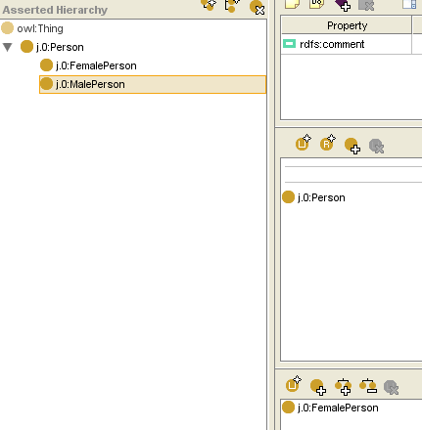
OWL API Example: Classes

Slide 14
OWL API Example: Datatype properties
// Create datatype property 'hasAge'
DatatypeProperty hasAge =
ontModel.createDatatypeProperty(ns + "hasAge");
// 'hasAge' takes integer values, so its range is 'integer'
// Basic datatypes are defined in the ‘vocabulary’ package
hasAge.setDomain(person);
hasAge.setRange(XSD.integer); // com.hp.hpl.jena.vocabulary.XSD
// Create individuals
Individual john = malePerson.createIndividual(ns + "John");
Individual jane = femalePerson.createIndividual(ns + "Jane");
Individual bob = malePerson.createIndividual(ns + "Bob");
// Create statement 'John hasAge 20'
Literal age20 =
ontModel.createTypedLiteral("20", XSDDatatype.XSDint);
Statement johnIs20 =
ontModel.createStatement(john, hasAge, age20);
ontModel.add(johnIs20);

Slide 15
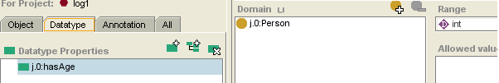
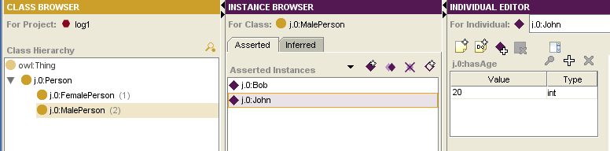
OWL API Example: Datatype properties

Slide 16
OWL API Example: Object properties
// Create object property 'hasSibling'
ObjectProperty hasSibling = ontModel.createObjectProperty(ns + "hasSibling");
// Domain and Range for 'hasSibling' is 'Person'
hasSibling.setDomain(person);
hasSibling.setRange(person);
// Add statement 'John hasSibling Jane‘
// and 'Jane hasSibling John'
Statement siblings1 = ontModel.createStatement(john, hasSibling, jane);
Statement siblings2 = ontModel.createStatement(jane, hasSibling, john);
ontModel.add(siblings1);
ontModel.add(siblings2);

Slide 17
OWL API Example: Property Restrictions
// Create object property ‘hasSpouse’
ObjectProperty hasSpouse = ontModel.createObjectProperty(ns + "hasSpouse");
hasSpouse.setDomain(person);
hasSpouse.setRange(person);
Statement spouse1 = ontModel.createStatement(bob, hasSpouse, jane);
Statement spouse2 = ontModel.createStatement(jane, hasSpouse, bob);
ontModel.add(spouse1);
ontModel.add(spouse2);
// Create an AllValuesFromRestriction on hasSpouse:
// MalePersons hasSpouse only FemalePerson
AllValuesFromRestriction onlyFemalePerson =
ontModel.createAllValuesFromRestriction(null, hasSpouse, femalePerson);
// A MalePerson can have at most one spouse -> MaxCardinalityRestriction
MaxCardinalityRestriction hasSpouseMaxCard =
ontModel.createMaxCardinalityRestriction(null, hasSpouse, 1);
// Constrain MalePerson with the two constraints defined above
malePerson.addSuperClass(onlyFemalePerson);
malePerson.addSuperClass(hasSpouseMaxCard);

Slide 18
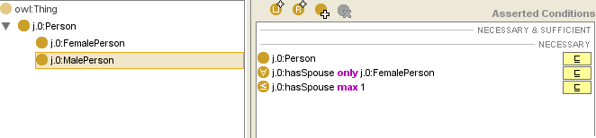
OWL API Example: Property Restrictions

Slide 19
OWL API Example: Defined Classes
// Create class ‘MarriedPerson’
OntClass marriedPerson = ontModel.createClass(ns + "MarriedPerson");
MinCardinalityRestriction mincr =
ontModel.createMinCardinalityRestriction(null, hasSpouse, 1);
// A MarriedPerson ⬄ A Person, AND with at least 1 spouse
// A list must be created, that will hold the Person class
// and the min cardinality restriction
RDFNode[] constraintsArray = { person, mincr };
RDFList constraints = ontModel.createList(constraintsArray);
// The two classes are combined into one intersection class
IntersectionClass ic =
ontModel.createIntersectionClass(null, constraints);
// ‘MarriedPerson’ is declared as an equivalent of the
// intersection class defined above
marriedPerson.setEquivalentClass(ic);

Slide 20
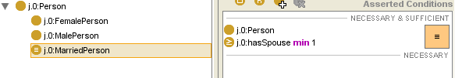
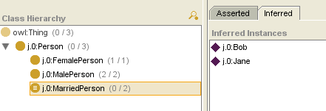
OWL API Example: Defined Classes

Slide 21
Reasoning
Jena is designed so that inference engines can be ‘plugged’ in Models and reason with them
The reasoning subsystem of Jena is found in the com.hp.hpl.jena.reasoner package
  All reasoners must provide implementations of the ‘Reasoner’ Java interface
Jena provides some inference engines, which however have limited reasoning capabilities
  Accessible through the ReasonerRegistry class
Once a Reasoner object is obtained, it must be ‘attached’ to a Model. This is accomplished by modifying the Model specifications

Slide 22
Reasoning
Objects of the OntModelSpec class are used to form model specifications
  Storage scheme
  Inference engine
  Language profile (RDF, OWL-Lite, OWL-DL, OWL Full, DAML)
Jena provides predefined OntModelSpec objects for basic Model types
  e.g. The OntModelSpec.OWL_DL_MEM object is a specification of OWL-DL models, stored in memory, which use no reasoning.
  Reasoner implementations can then be attached, as in the following example:
// PelletReasonerFactory is found in the Pellet API
Reasoner reasoner = PelletReasonerFactory.theInstance().create();
// Obtain standard OWL-DL spec and attach the Pellet reasoner
OntModelSpec ontModelSpec = OntModelSpec.OWL_DL_MEM;
ontModelSpec.setReasoner(reasoner);
// Create ontology model with reasoner support
OntModel ontModel = ModelFactory.createOntologyModel(ontModelSpec, model);

Slide 23
Reasoning
Apart from the reference to a Reasoner object, no further actions are required to enable reasoning
OntModels without reasoning support will answer queries using only the asserted statements, while OntModels with reasoning support will infer additional statements, without any interaction with the programmer
// MarriedPerson has no asserted instances
// However, if an inference engine is used, two of the three
// individuals in the example presented here will be
// recognized as MarriedPersons
OntClass marriedPerson = ontModel.getOntClass(ns + “MarriedPerson”);
ExtendedIterator married = marriedPerson.listInstances();
while(married.hasNext()) {
OntResource mp = (OntResource)married.next();
System.out.println(mp.getURI());
}

Slide 24
SPARQL query processing
Jena uses the ARQ engine for the processing of SPARQL queries
  The ARQ API classes are found in com.hp.hpl.jena.query
Basic classes in ARQ:
  Query: Represents a single SPARQL query.
  Dataset: The knowledge base on which queries are executed (Equivalent to RDF Models)
  QueryFactory: Can be used to generate Query objects from SPARQL strings
  QueryExecution: Provides methods for the execution of queries
  ResultSet: Contains the results obtained from an executed query
  QuerySolution: Represents a row of query results.
    If there are many answers to a query, a ResultSet is returned after the query is executed. The ResultSet contains many QuerySolutions

Slide 25
SPARQL query execution example
// Prepare query string
String queryString =
"PREFIX rdf: <http://www.w3.org/1999/02/22-rdf-syntax-ns#>\n" +
"PREFIX : <http://www.example.com/onto1#>\n" +
"SELECT ?married ?spouse WHERE {" +
"?married rdf:type :MarriedPerson.\n" +
"?married :hasSpouse ?spouse." +
"}";
// Use the ontology model to create a Dataset object
// Note: If no reasoner has been attached to the model, no results
// will be returned (MarriedPerson has no asserted instances)
Dataset dataset = DatasetFactory.create(ontModel);
// Parse query string and create Query object
Query q = QueryFactory.create(queryString);
// Execute query and obtain result set
QueryExecution qexec = QueryExecutionFactory.create(q, dataset);
ResultSet resultSet = qexec.execSelect();

Slide 26
SPARQL query execution example
// Print results
while(resultSet.hasNext()) {
// Each row contains two fields: ‘married’ and ‘spouse’,
// as defined in the query string
QuerySolution row = (QuerySolution)resultSet.next();
RDFNode nextMarried = row.get("married");
System.out.print(nextMarried.toString());
System.out.print(" is married to ");
RDFNode nextSpouse = row.get("spouse");
System.out.println(nextSpouse.toString());
}

Slide 27
Notes
Jena can be used to manage existent ontologies, or create ontologies from scratch
  Regardless of the storage method
  Understanding the triple and/or XML form of ontology documents is required, since some complex concepts like restrictions, RDF lists and defined classes must be created in certain ways (otherwise, inconsistencies may be caused)
Reasoning with existent data in order to obtain inferred knowledge
  Inference engines must provide implementations of a specific Java interface
  For complex ontologies, reasoning may slow down your application, especially if data is inserted or removed regularly from the ontology
  It is important to know when an inference engine is actually needed

Slide 28
End of presentation

