Slide 1
Jena Examples
Expert
Family Tree

Slide 2
Expert
C:\Jena\Tutorial\expert
(expert folder in Tutorial.zip)

Slide 3
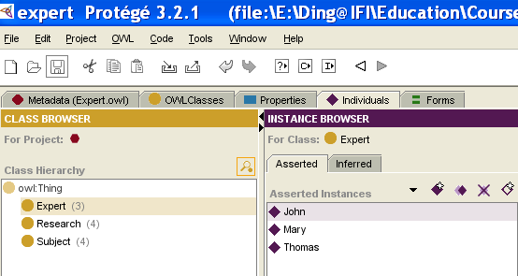
Expert
Using Protege to build up expert.owl:
  Three classes: Expert, Research, Subject
  Properties: hasResearch: expert can have many researches; research is associated with many subjects
  Create some instances.
  Output this ontology as expert.owl (for example: C:\Jena\Tutorial\expert\expert.owl)

Slide 4
ontologyDB
Introduce some methods to handle store, read ontology in/from persistent database (here takes MySQL as example):
  connectDB
  createDBModelFromFile
  getModelFromDB
  getModelSpec

Slide 5
ontologyDB
import java.util.*;
import com.hp.hpl.jena.db.*;
import com.hp.hpl.jena.ontology.*;
import com.hp.hpl.jena.rdf.model.*;
public class ontologyDB {
/* link database */
public static IDBConnection connectDB(String DB_URL, String DB_USER, String DB_PASSWD, String DB_NAME) {
return new DBConnection(DB_URL, DB_USER, DB_PASSWD, DB_NAME);}
/* Read ontology from filesystem and store it into database */
public static OntModel createDBModelFromFile(IDBConnection con, String name, String filePath) {
ModelMaker maker = ModelFactory.createModelRDBMaker(con);
Model base = maker.createModel(name);
OntModel newmodel = ModelFactory.createOntologyModel( getModelSpec(maker), base );
newmodel.read(filePath);
return newmodel; }

Slide 6
ontologyDB
/* Get ontology from database */
public static OntModel getModelFromDB(IDBConnection con, String name) {
ModelMaker maker = ModelFactory.createModelRDBMaker(con);
Model base = maker.getModel(name);
OntModel newmodel = ModelFactory.createOntologyModel( getModelSpec(maker), base);
return newmodel; }
public static OntModelSpec getModelSpec(ModelMaker maker) {
OntModelSpec spec = new OntModelSpec(OntModelSpec.OWL_MEM);
spec.setImportModelMaker(maker);
return spec;}
}
C:\Jena\Tutorial\expert\ontologyDB.java

Slide 7
Main.java
Store expert.owl into MySQL database,
Read expert.owl from MySQL database,
List the classes of expert.owl

Slide 8
import java.io.*;
import java.util.*;
import com.hp.hpl.jena.ontology.*;
import com.hp.hpl.jena.rdf.model.ModelMaker;
import com.hp.hpl.jena.util.FileManager;
import com.hp.hpl.jena.util.*;
import com.hp.hpl.jena.db.*;
public class Main {
public static final String DB_URL = "jdbc:mysql://localhost/expert";
public static final String DB_USER = "root";
public static final String DB_PASSWD = "111";
public static final String DB = "MySQL";
public static final String DB_DRIVER = "com.mysql.jdbc.Driver";
public static void main (String args[]) {
try {
Class.forName("com.mysql.jdbc.Driver");
} catch (ClassNotFoundException e) {
e.printStackTrace(); }
String filePath = "file:///C:/Jena/Tutorial/expert/expert.owl";
IDBConnection con = ontologyDB.connectDB(DB_URL,DB_USER, DB_PASSWD, DB);
System.out.println(con);
ontologyDB.createDBModelFromFile(con, "expert", filePath);
OntModel model = ontologyDB.getModelFromDB(con, "expert");
for (Iterator i = model.listClasses(); i.hasNext();) {
OntClass c = (OntClass) i.next();
System.out.println(c.getLocalName()); }
}
}
C:\Jena\Tutorial\expert\Main.java

Slide 9
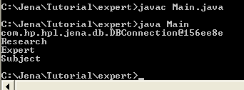
Expert
Open MySQL
  Mysql>mysql –uroot –p111
Create expert database in MySQL
  Mysql>create database expert;
Parse ontologyDB.java and Main.java
Run Main.java
Notes:
Make sure all classes are owl classes because OWL_MEM:
<owl:Class rdf:ID="Research"/>
<owl:Class rdf:ID="Expert"/>
<owl:Class rdf:ID="Subject"/>
Notes:
OntModelSpec OWL_MEM, then in expert.owl, three classes should use owl:class; otherwise, it will not list the classes here.
<owl:Class rdf:ID="Research"/>
<owl:Class rdf:ID="Expert"/>
<owl:Class rdf:ID="Subject"/>

Slide 10
Expert - Class
Main.java
  Not using method to output class of the ontology
Main1.java
  Using defined SimpleReadOntology method to output class of the ontology
public static void SimpleReadOntology(OntModel model) {
for (Iterator i = model.listClasses(); i.hasNext();) {
OntClass c = (OntClass) i.next();
System.out.println(c.getLocalName());
}
}

Slide 11
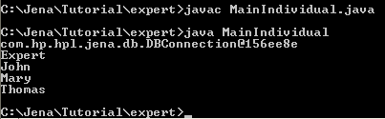
Expert - individual
MainIndividual.java
  C:\Jena\Tutorial\expert\MainIndividual.java, defined prix is default namespace from expert.owl, using getInstance method.
  But you have to compile ontologyDB.java, as all the Main* files are calling the methods defined in ontologyDB.class
public static void getInstance(OntModel model){
String prix = "http://www.owl-ontologies.com/Expert.owl#";
/*get Expert class from the onotlogy*/
OntClass expert = model.getOntClass(prix + "Expert");
//print out the name of the Expert class
System.out.println(expert.getLocalName());
//get instances of the Expert class
Iterator it = expert.listInstances();
//print out the instances of the Expert class
while(it.hasNext()){
Individual oi = (Individual)it.next();
System.out.println(oi.getLocalName());
}
}

Slide 12
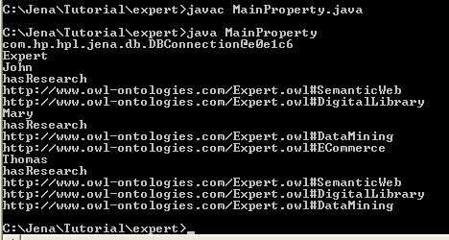
Expert - property
MainProperty.java
  C:\Jena\Tutorial\expert\MainProperty.java
  Using getProperty method
  Compile ontologyDB.java first

Slide 13
Expert – getProperty method
public static void getProperty(OntModel model) {
String NS = "http://www.owl-ontologies.com/Expert.owl#";
/* get the Expert class */
OntClass expert = model.getOntClass(NS + "Expert");
// print out the name of the Expert class
System.out.println(expert.getLocalName());
// get the instances of the Expert class
Iterator it = expert.listInstances();
// print out the instances of the Expert class
while (it.hasNext()) {
Individual oi = (Individual) it.next();
System.out.println(oi.getLocalName());
//get the properties of the instances of the Expert class
for (Iterator ipp = expert.listDeclaredProperties(); ipp.hasNext();) {
OntProperty p = (OntProperty) ipp.next();
//print out property name and its values
System.out.println( p.getLocalName());
for (Iterator ivv = oi.listPropertyValues(p); ivv.hasNext();) {
String valuename = ivv.next().toString();
System.out.println(valuename); } }
}
}

Slide 14
Query Expert
Using SPARQL and Jena Reasoner
Add familiar_with property (domain: Expert, range: Subject) to expert.owl.
  There is no instance for this property.
  We will use reasoner to find its inferred instances
Query: list the experts and their familiar_with subjects.
Setting up rules for the reasoner:
  ExpertA hasResearch ResearchB, ResearchB is associated with SubjectC → ExpertA is familiar_with SubjectC
Using Sparql to query ExpertX (is familir_with) SubjectY
  Select ?expert ?subject
  Where { ?expert faimilar_with ?subject }

Slide 15
MainQuery.java
import com.hp.hpl.jena.ontology.*;
import com.hp.hpl.jena.rdf.model.*;
import com.hp.hpl.jena.util.*;
import com.hp.hpl.jena.query.* ;
import com.hp.hpl.jena.sparql.*;
import com.hp.hpl.jena.reasoner.*;
import com.hp.hpl.jena.reasoner.rulesys.*;
import com.hp.hpl.jena.db.*;
public class MainQuery {
public static final String DB_URL = "jdbc:mysql://localhost/expert";
public static final String DB_USER = "root";
public static final String DB_PASSWD = "111";
public static final String DB = "MySQL";
public static final String DB_DRIVER = "com.mysql.jdbc.Driver";
public static void main (String args[]) {
try {
Class.forName("com.mysql.jdbc.Driver");
} catch (ClassNotFoundException e) {
e.printStackTrace(); }
String filePath = "file:///C:/Jena/Tutorial/expert/expert.owl";
IDBConnection con = ontologyDB.connectDB(DB_URL,DB_USER, DB_PASSWD, DB);
System.out.println(con);
ontologyDB.createDBModelFromFile(con, "expert", filePath);
OntModel model = ontologyDB.getModelFromDB(con, "expert");
searchOnto(model); }

Slide 16
MainQuery.java
public static void searchOnto(OntModel model){
/*Setting up rules*/
String rule = "[rule1:(?x http://www.owl-ontologies.com/Expert.owl#hasResearch ?y) " +
"(?y http://www.owl-ontologies.com/Expert.owl#associate ?z) " +
"->(?x http://www.owl-ontologies.com/Expert.owl#familiar_with ?z)]";
/*query String*/
String queryString = "PREFIX Expert:<http://www.owl-ontologies.com/Expert.owl#> " +
"SELECT ?expert ?subject " +
"WHERE {?expert Expert:familiar_with ?subject} ";
/*set up reasoner*/
Reasoner reasoner2 = new GenericRuleReasoner(Rule.parseRules(rule));
InfModel inf = ModelFactory.createInfModel(reasoner2, model);
Query query = QueryFactory.create(queryString);
QueryExecution qe = QueryExecutionFactory.create(query, inf);
ResultSet results = qe.execSelect();
/*output result*/
ResultSetFormatter.out(System.out, results, query);
qe.close(); }
}
C:C:\Jena\Tutorial\expert\MainQuery.java

Slide 17
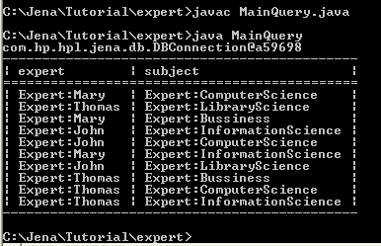
Query Expert
MainQuery.java
  C:\Jena\Tutorial\expert\MainQuery.java
  Using searchOnto method
  Compile ontologyDB.java first

Slide 18
Family Tree
C:\Jena\Tutorial\familytree
(familytree folder under Tutorial.zip)

Slide 19
Family Tree
The example shows:
  How to create and populate RDF models
  How to persist them to a database,
  How to query them programmatically using SPARQL query language
  How to show Jena reasoning capabilities which can be used to infer knowledge about models from an ontology
URL: http://www-128.ibm.com/developerworks/xml/library/j-jena/

Slide 20
Creating a simple RDF model
Create a model from scratch and add RDF statements to it.
Create a model to represent the relationships in a family using different relationship types, such as siblingOf, spouseOf, parentOf, childOf (more details about relationship ontology: http://vocab.org/relationship/)
Define family members using URIs from a made-up namespace: http://family/. It is useful to declare them as Java constants.

Slide 21
Family Tree
…
adam + dotty
beth + chuck
edward
fan + greg
harriet

Slide 22
Creating a simple RDF model
import java.util.*;
import java.io.*;
import com.hp.hpl.jena.rdf.model.*;
import com.hp.hpl.jena.util.FileManager;
//A small family tree held in a Jena Model
public class FamilyModel {
// Namespace declarations
static final String familyUri = "http://family/";
static final String relationshipUri = "http://purl.org/vocab/relationship/";
public static void main(String args[]) {
// Create an empty Model
Model model = ModelFactory.createDefaultModel(); . . .
//set namespace
Resource NAMESPACE = model.createResource( relationshipUri );
model.setNsPrefix( "rela", relationshipUri);
// Create the types of Property we need to describe relationships in the model
Property childOf = model.createProperty(relationshipUri,"childOf"); . . .
// Create resources representing the people in our model
Resource adam = model.createResource(familyUri+"adam");. . .

Slide 23
Creating a simple RDF model
// Add properties to describing the relationships between them
adam.addProperty(siblingOf,beth); . . .
// Statements can also be directly created ...
Statement statement1 = model.createStatement(edward,childOf,adam); . . .
// ... then added to the model:
model.add(statement1); . . .
// Arrays of Statements can also be added to a Model:
Statement statements[] = new Statement[5];
statements[0] = model.createStatement(fran,childOf,adam); . . .
// A List of Statements can also be added
List list = new ArrayList(); . . .
list.add(model.createStatement(greg,spouseOf,fran)); . . .
model.add(list);
model.write(System.out, "RDF/XML-ABBREV");
}
}
C:\Jena\Tutorial\familytree\FamilyModel.java

Slide 24
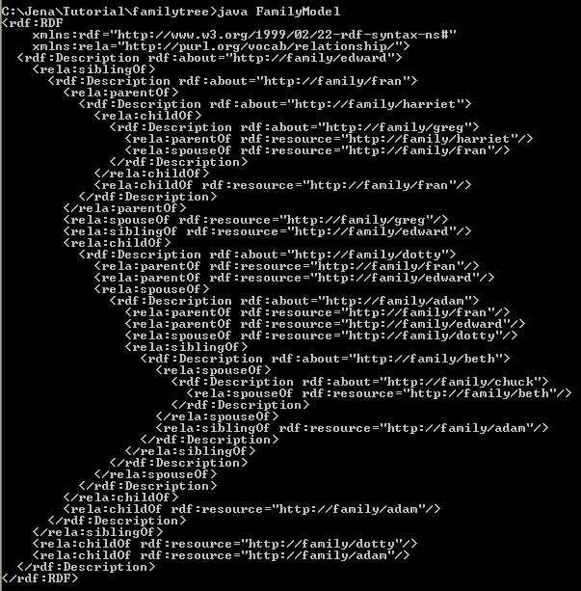
Creating a simple RDF model
Store FamilyModel.java in C:\Jena\Tutorial\familytree
Compile and Run

Slide 25
Store this RDF model in file
Store the RDF model in to C:\Jena\Tutorial\familytree\family.rdf
Add following codes to FamilyModel.java
try{
File file=new File("C:\\Jena\\Tutorial\\familytree\\family.rdf");
FileOutputStream f1=new FileOutputStream(file);
RDFWriter d = model.getWriter("RDF/XML-ABBREV");
d.write(model,f1,null);
}catch(Exception e) {}
C:\Jena\Tutorial\familytree\FamilyModel01.java

Slide 26
Query family tree - listStatement
Query : Show me who has which-kind-of relation with whom.
  listStatement (Subject s, Property p, RDFNode o)
import com.hp.hpl.jena.rdf.model.*;
import com.hp.hpl.jena.util.FileManager;
import com.hp.hpl.jena.vocabulary.*;
import java.io.*;
public class FamilyQuery {
static final String inputFileName = "family.rdf";
public static void main (String args[]) {
// create an empty model
Model model = ModelFactory.createDefaultModel();
// use the FileManager to find the input file
InputStream in = FileManager.get().open(inputFileName);
if (in == null) {
throw new IllegalArgumentException( "File: " + inputFileName + " not found"); }
model.read( in, "");
//query the statement:subject, property and object
StmtIterator iter = model.listStatements(null, null, (RDFNode) null);
if (iter.hasNext()) {System.out.println("They are:");
while (iter.hasNext()) {System.out.println(" " + iter.nextStatement()); }
} else {System.out.println("They are not in the database"); }
}
}
C:\Jena\Tutorial\familytree\FamilyQuery.java

Slide 27
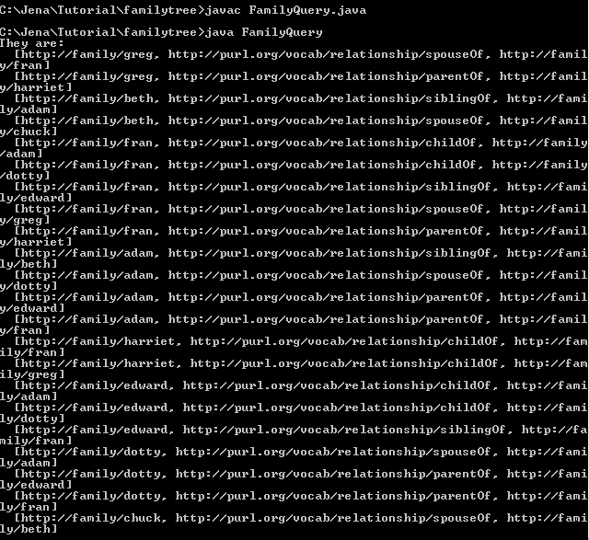
Run FamilyQuery.java

Slide 28
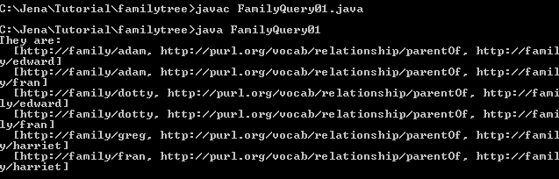
Query family tree - listStatement
Query01: show me who are the parent of whom
  listStatements(null, model.getProperty("http://purl.org/vocab/relationship/parentOf"), (RDFNode) null)
  C:\Jena\Tutorial\familytree\FamilyQuery01.java

Slide 29
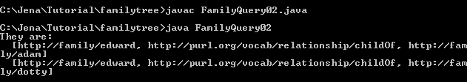
Query family tree - listStatement
Query02: who are parent of edward
  model.listStatements(model.getResource("http://family/edward"), model.getProperty("http://purl.org/vocab/relationship/childOf"), (RDFNode) null)
  C:\Jena\Tutorial\familytree\FamilyQuery02.java

Slide 30
Query family tree - Sparql
Find grandparent?
import com.hp.hpl.jena.rdf.model.*;
import com.hp.hpl.jena.util.FileManager;
import com.hp.hpl.jena.query.* ;
import com.hp.hpl.jena.sparql.*;
import java.io.*;
public class FamilyQuery03 {
static final String inputFileName = "family.rdf";
public static void main (String args[]) {
// create an empty model
Model model = ModelFactory.createDefaultModel();
// use the FileManager to find the input file
InputStream in = FileManager.get().open(inputFileName);
if (in == null) {
throw new IllegalArgumentException( "File: " + inputFileName + " not found"); }
model.read( in, "");

Slide 31
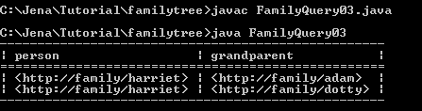
Query family tree - Sparql
String queryString = "PREFIX rela: <http://purl.org/vocab/relationship/> " +
"SELECT ?person ?grandparent " +
"WHERE {" +
" ?grandparent rela:parentOf ?y . " +
" ?y rela:parentOf ?person . " +
" }";
Query query = QueryFactory.create(queryString);
// Execute the query and obtain results
QueryExecution qe = QueryExecutionFactory.create(query, model);
ResultSet results = qe.execSelect();
// Output query results
ResultSetFormatter.out(System.out, results, query);
// Important - free up resources used running the query
qe.close();
}
}
C:\Jena\Tutorial\familytree\FamilyQuery03.java

Slide 32
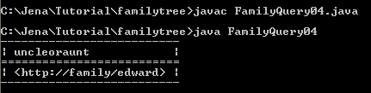
Query family tree - Sparql
Who is uncle of harriet?
C:\Jena\Tutorial\familytree\FamilyQuery04.java
String queryString =
"PREFIX rela: <http://purl.org/vocab/relationship/> " +
"SELECT ?uncleoraunt " +
"WHERE {" +
" <http://family/harriet> rela:childOf ?x . " +
" ?x rela:siblingOf ?uncleoraunt . " +
" }";

Slide 33
Reasoning family tree
Who are niece or nephew of edwar?
import java.io.*;
import java.util.Iterator;
import com.hp.hpl.jena.util.*;
import com.hp.hpl.jena.rdf.model.*;
import com.hp.hpl.jena.reasoner.*;
import com.hp.hpl.jena.reasoner.rulesys.*;
public class FamilyReason {
private static String fname = "family.rdf";
private static String NS = "http://family/";
public static void main(String args[]) {
Model rawData = FileManager.get().loadModel(fname);
String rules = "[r1: (?x http://purl.org/vocab/relationship/siblingOf ?y), (?y http://purl.org/vocab/relationship/parentOf ?z)" + "-> (?x uncleorauntOf ?z)]";
Reasoner reasoner = new GenericRuleReasoner(Rule.parseRules(rules));
InfModel inf = ModelFactory.createInfModel(reasoner, rawData);
Resource A = inf.getResource(NS + "edward");
System.out.println("A * * =>");
Iterator list = inf.listStatements(A, null, (RDFNode)null);
while (list.hasNext()) {
System.out.println(" - " + list.next()); }
}
}
C:\Jena\Tutorial\familytree\FamilyReason.java

Slide 34
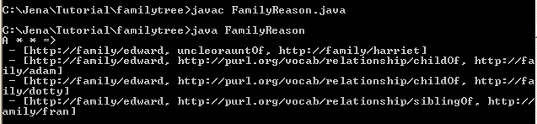
Reasoning family tree

Slide 35
Reasoning family tree
Using FamilyModel02.java to delete some statements (siblingOf, childOf, spouseOf,…) and store it in N-Triple in family1.nt.
Who are the children of dotty?
Using generic rule reasoning
Using sparql to query
C:\Jena\Tutorial\familytree\FamilyReason01.java

Slide 36
FamilyReason01.java
import java.io.*;
import java.util.Iterator;
import com.hp.hpl.jena.util.*;
import com.hp.hpl.jena.rdf.model.*;
import com.hp.hpl.jena.reasoner.*;
import com.hp.hpl.jena.reasoner.rulesys.*;
import com.hp.hpl.jena.query.* ;
import com.hp.hpl.jena.sparql.*;
public class FamilyReason01 {
private static String fname = "family1.nt";
public static void main(String args[]) {
Model rawData = FileManager.get().loadModel(fname);
//setting up rules
String rules = "[r1: (?x http://purl.org/vocab/relationship/parentOf ?y), (?x http://purl.org/vocab/relationship/spouseOf ?z)" +
"-> (?z http://purl.org/vocab/relationship/parentOf ?y)]";

Slide 37
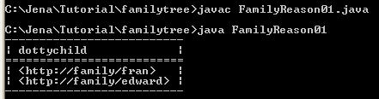
FamilyReason01.java
/*query String*/
String queryString = "SELECT ?dottychild " +
"WHERE { <http://family/dotty> <http://purl.org/vocab/relationship/parentOf> ?dottychild} ";
Reasoner reasoner = new GenericRuleReasoner(Rule.parseRules(rules));
InfModel inf = ModelFactory.createInfModel(reasoner, rawData);
Query query = QueryFactory.create(queryString);
QueryExecution qe = QueryExecutionFactory.create(query, inf);
ResultSet results = qe.execSelect();
/*output result*/
ResultSetFormatter.out(System.out, results, query);
qe.close();
}
}
C:\Jena\Tutorial\familytree\FamilyReason01.java

Slide 38
Reasoning family tree
Using multiple rules to do complex reasoning.
Dataset: C:\Jena\Tutorial\familytree\family2.nt
<http://family/harriet> <http://purl.org/vocab/relationship/childOf> <http://family/fran> .
<http://family/fran> <http://purl.org/vocab/relationship/spouseOf> <http://family/greg> .
<http://family/fran> <http://purl.org/vocab/relationship/childOf> <http://family/adam> .
<http://family/adam> <http://purl.org/vocab/relationship/spouseOf> <http://family/dotty> .
<http://family/adam> <http://purl.org/vocab/relationship/siblingOf> <http://family/beth> .
<http://family/beth> <http://purl.org/vocab/relationship/spouseOf> <http://family/chuck> .
<http://family/edward> <http://purl.org/vocab/relationship/siblingOf> <http://family/fran> .
<http://family/edward> <http://purl.org/vocab/relationship/childOf> <http://family/adam> .

Slide 39
FamilyReason02.java
Multiple rules:
  R1: ?x parentOf ?y, ?y parentOf ?z ->?x grandparentOf ?z
  R2: ?x parentOf ?y, ?x spouseOf ?z ->?z parentOf ?y
  R3: ?x childOf ?y -> ?y parentOf ?x
Query: who can be grandparents?

Slide 40
FamilyReason02.java
import java.io.*;
import java.util.Iterator;
import com.hp.hpl.jena.util.*;
import com.hp.hpl.jena.rdf.model.*;
import com.hp.hpl.jena.reasoner.*;
import com.hp.hpl.jena.reasoner.rulesys.*;
import com.hp.hpl.jena.query.* ;
import com.hp.hpl.jena.sparql.*;
public class FamilyReason02 {
private static String fname = "family2.nt";
public static void main(String args[]) {
Model rawData = FileManager.get().loadModel(fname);
//setting up rules
String rules = "[r1: (?x http://purl.org/vocab/relationship/parentOf ?y),
(?y http://purl.org/vocab/relationship/parentOf ?z)" +
"-> (?x grandparentOf ?z)]" +
"[r2: (?x http://purl.org/vocab/relationship/parentOf ?y),
(?x http://purl.org/vocab/relationship/spouseOf ?z)" +
"-> (?z http://purl.org/vocab/relationship/parentOf ?y)]" +
"[r3: (?x http://purl.org/vocab/relationship/childOf ?y)" +
"-> (?y http://purl.org/vocab/relationship/parentOf ?x)]";

Slide 41
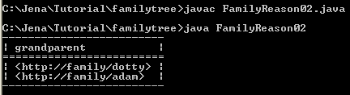
FamilyReason02.java
/*query String*/
String queryString = "SELECT ?grandparent " +
"WHERE { ?grandparent <http://purl.org/vocab/relationship/parentOf> ?x ." +
" ?x <http://purl.org/vocab/relationship/parentOf> ?y . } ";
Reasoner reasoner = new GenericRuleReasoner(Rule.parseRules(rules));
InfModel inf = ModelFactory.createInfModel(reasoner, rawData);
Query query = QueryFactory.create(queryString);
QueryExecution qe = QueryExecutionFactory.create(query, inf);
ResultSet results = qe.execSelect();
/*output result*/
ResultSetFormatter.out(System.out, results, query);
qe.close();
}
}
C:\Jena\Tutorial\familytree\FamilyReason02.java

Slide 42
Summary
Practicing these examples
Be able to create your own examples

