Slide 1
Layout of the Detail in GPU Techniques
The OpenGL Pipeline
Vertex and Fragment Shaders

Slide 2
The OpenGL Pipeline
Modelview Transform
Lighting
Perspective Transform
Rasterization
Texturing

Slide 3
The OpenGL Pipeline with Shaders
Vertex Shader
Rasterize + Interpolate
Fragment Shader

Slide 4
The OpenGL Pipeline with Shaders
Vertex Shader
Small programs that run on the graphics card
Rasterize + Interpolate
Fragment Shader

Slide 5
The OpenGL Pipeline with Shaders
Vertices with:
Colors
Texture coords
Normals
Vertex Shader
Rasterize + Interpolate
Fragment Shader

Slide 6
The OpenGL Pipeline with Shaders
Vertex Shader
Transformed Vertices with:
(Anything you want here, eg normals, colors, texture coords)
Texture Memory
Rasterize + Interpolate
Fragment Shader

Slide 7
The OpenGL Pipeline with Shaders
Vertex Shader
Rasterize + Interpolate
Fragments with:
(Interpolated values from previous stage)
Fragment Shader

Slide 8
The OpenGL Pipeline with Shaders
Vertex Shader
Texture Memory
Rasterize + Interpolate
Fragment Shader
Fragments with:
Colors

Slide 9
Examples (Vertex Shader)
How many times are the fragment and vertex shaders executed on this scene

Slide 10
Examples (Vertex Shader)
Vertex shader runs once per vertex

Slide 11
Examples (Fragment Shader)
Vertex shader runs once per vertex
Fragment shader runs once per pixel

Slide 12
Examples
Vertex Shader
void main_vp(
float4 pos : POSITION,
out float4 oPos : POSITION,
uniform float4x4 worldViewProjMatrix
){
oPos = mul(worldViewProjMatrix, pos);
}
Fragment Shader
void main_fp(
float4 pos : POSITION,
out float4 col : COLOR
){
col = float4(0, 1, 0, 1);
}

Slide 13
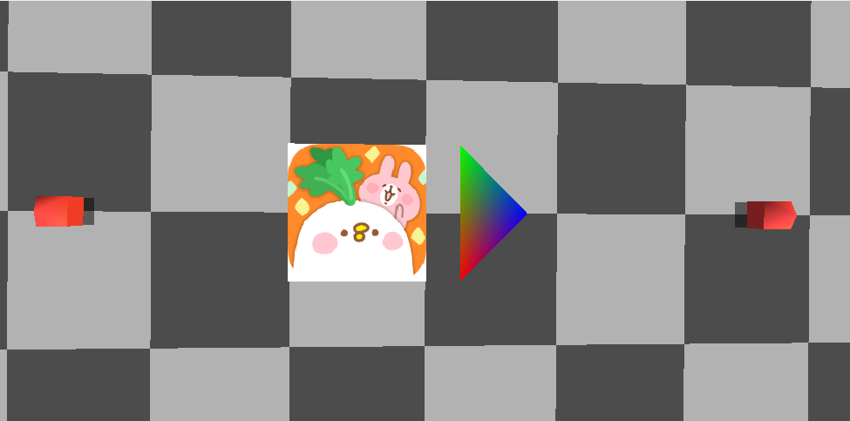
Shader Examples

Slide 14
Program、VBO、VAO
Program: 儲存shader的容器(vertex shader fragment shader)
VBO: 顯卡儲存空間的一塊暫存區
VAO: 紀錄渲染對象的完整資訊

Slide 15
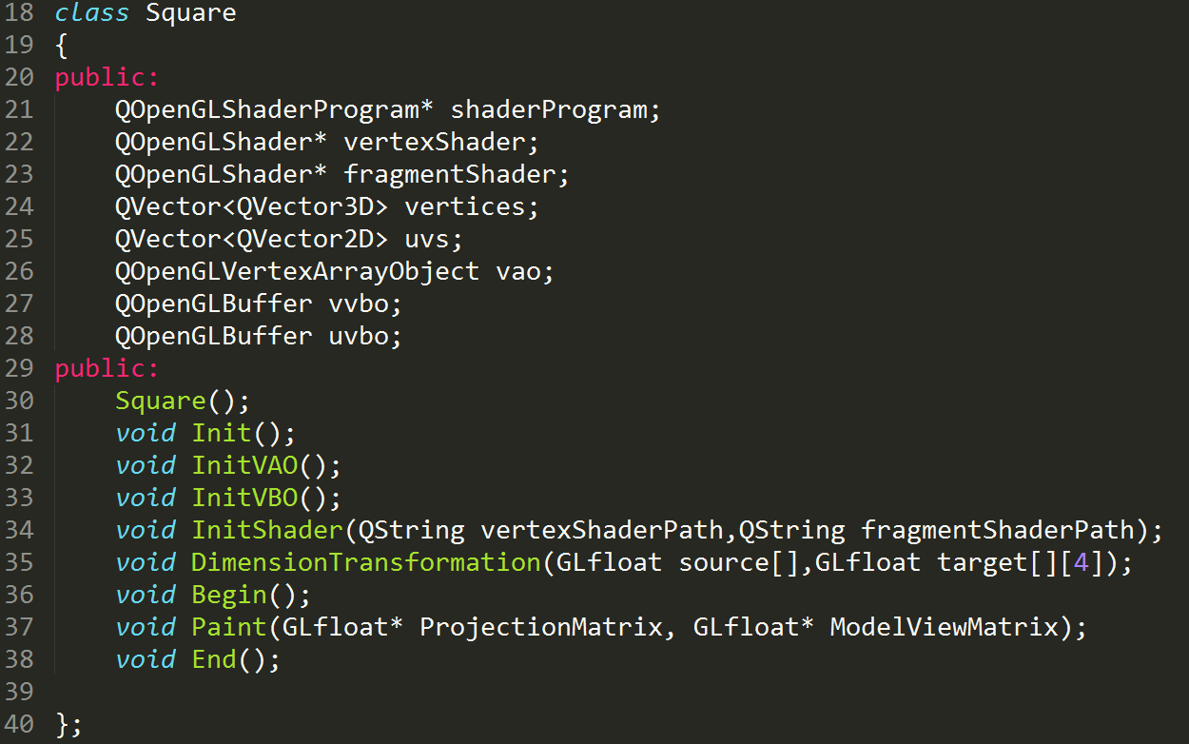
Square.h

Slide 16
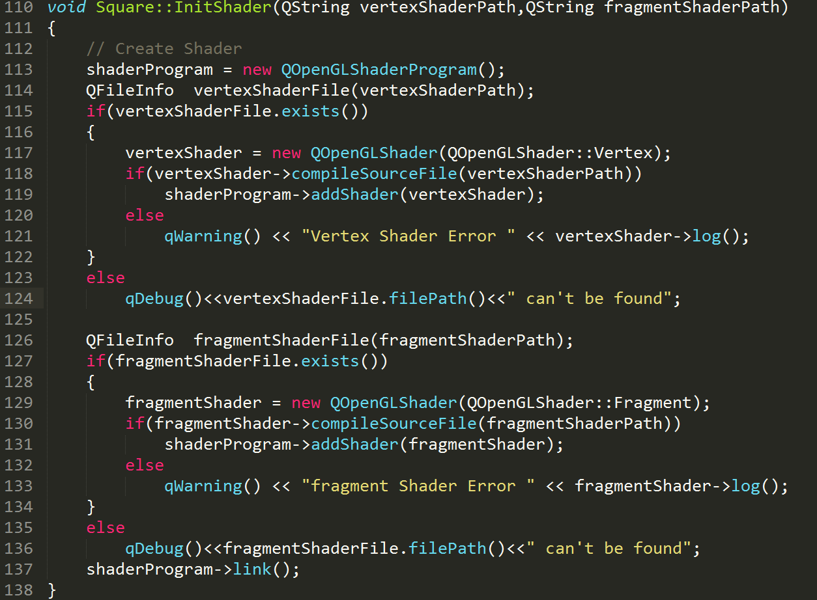
InitShader
Vertex shader
Fragment shader

Slide 17
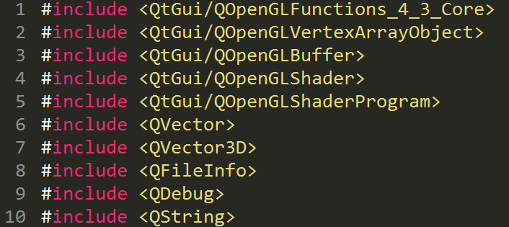
Include files

Slide 18
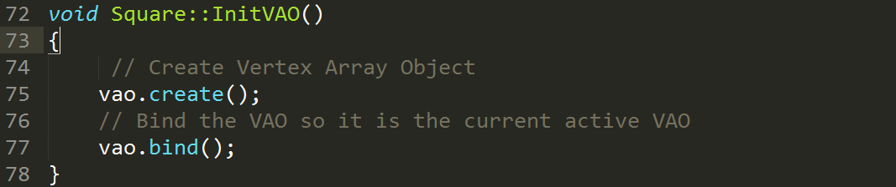
InitVAO

Slide 19
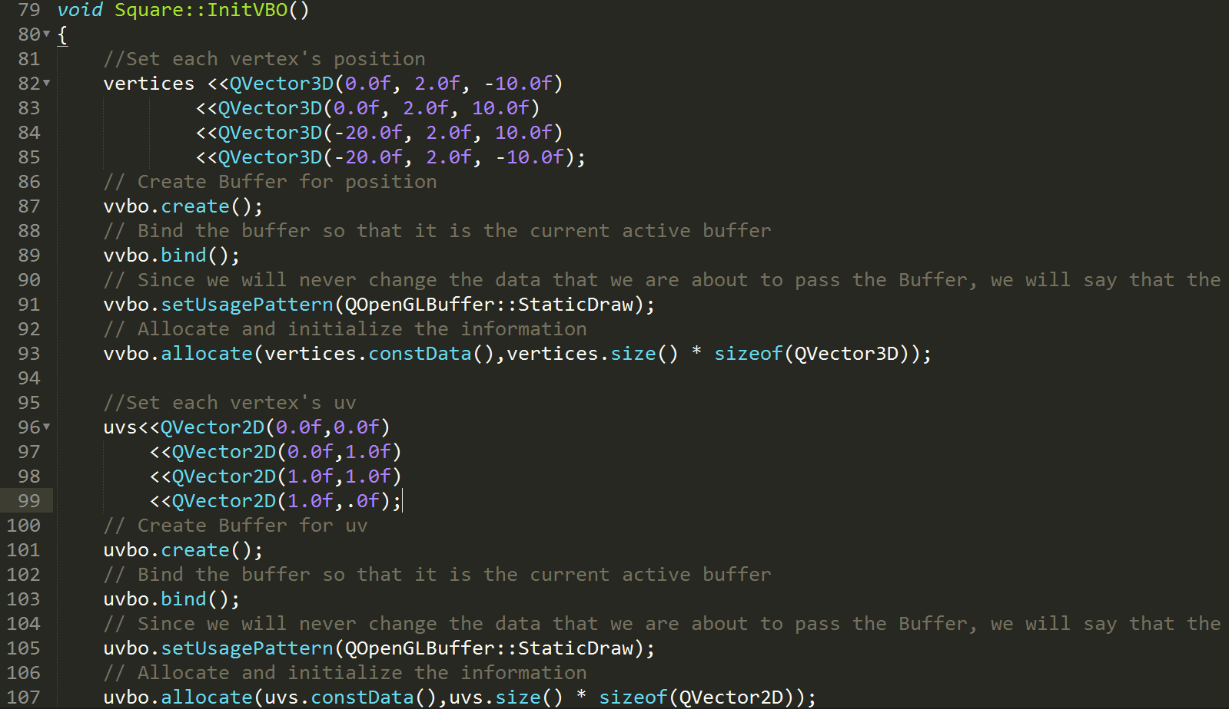
InitVBO

Slide 20
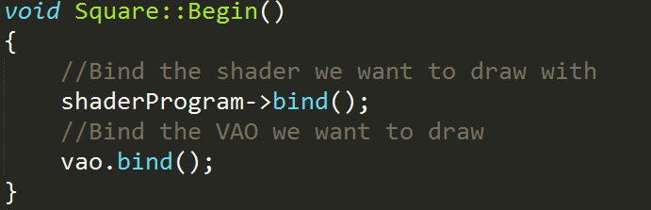
Render Begin

Slide 21
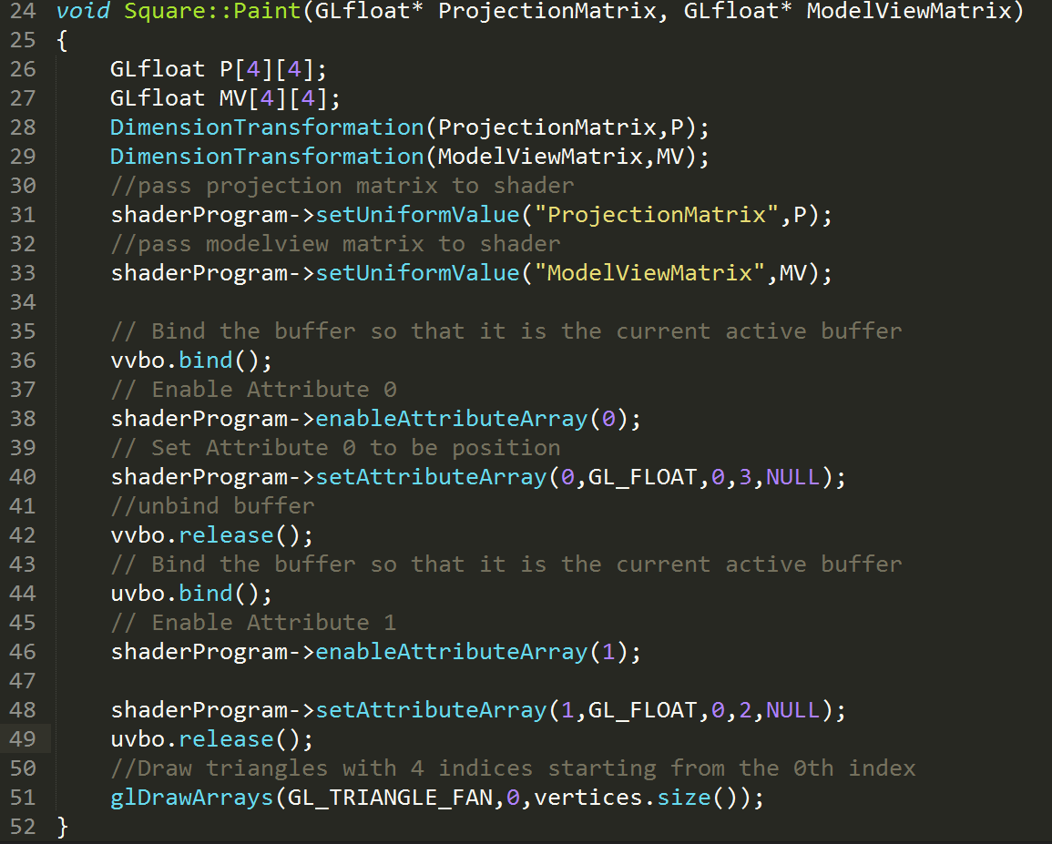
Render

Slide 22
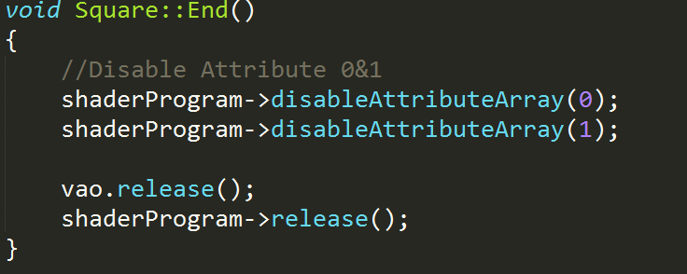
Render End

Slide 23
Render End

Slide 24
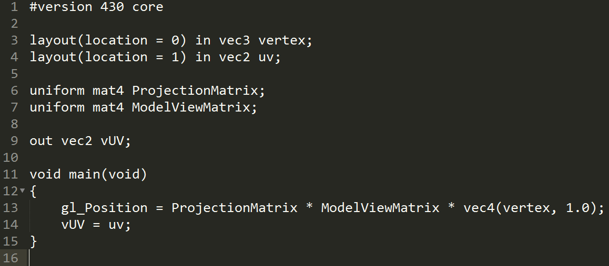
Square.vs

Slide 25
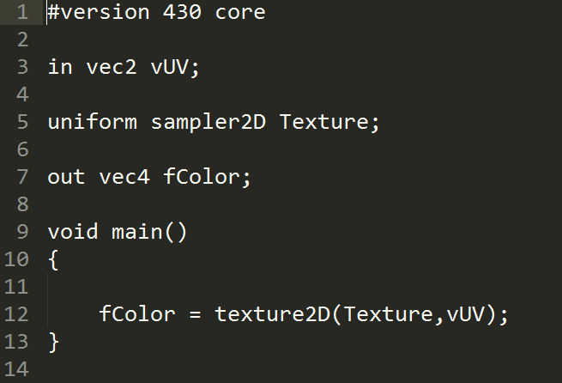
Square.fs

Slide 26
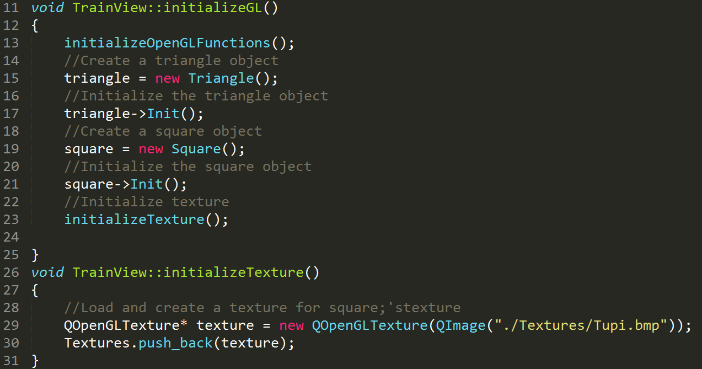
Initialization in Trainview

Slide 27
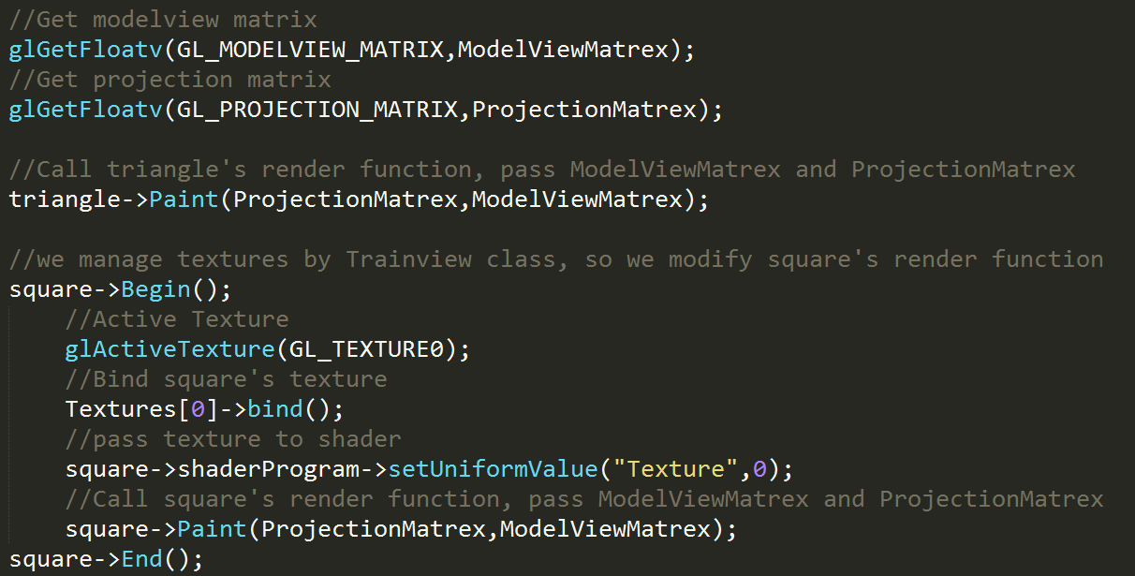
Paint in Trainview

Slide 28
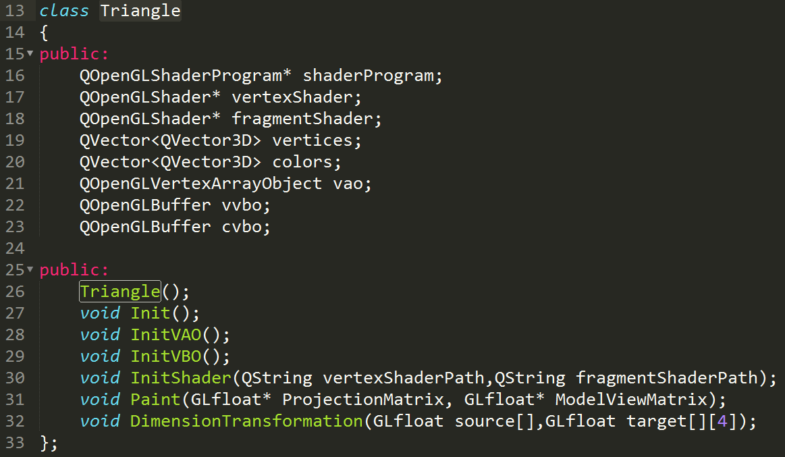
Triangle.h

Slide 29
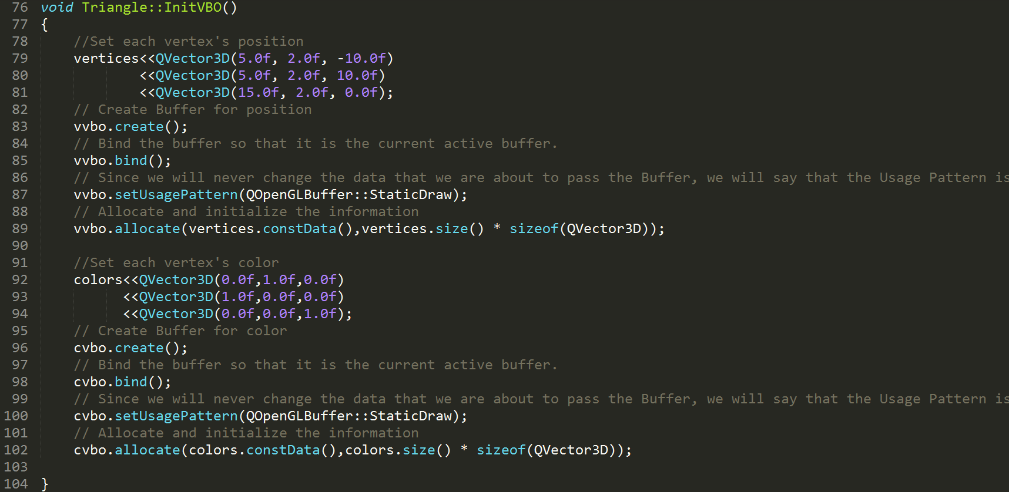
InitVBO

Slide 30
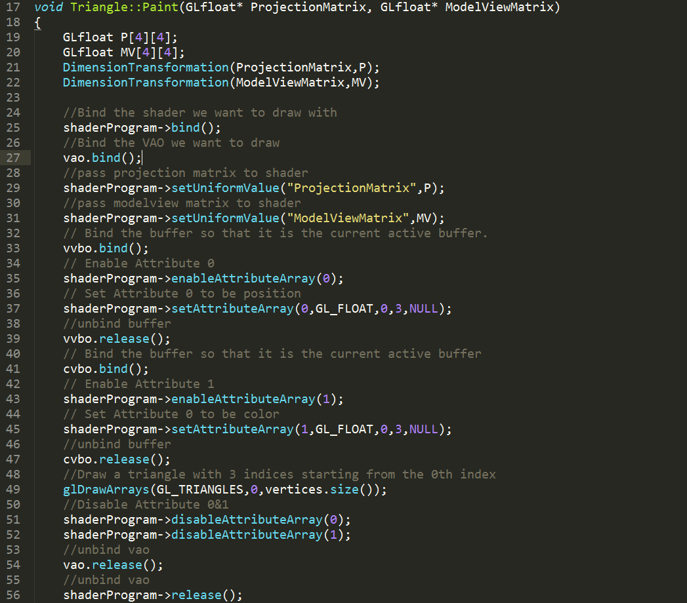
Render

Slide 31
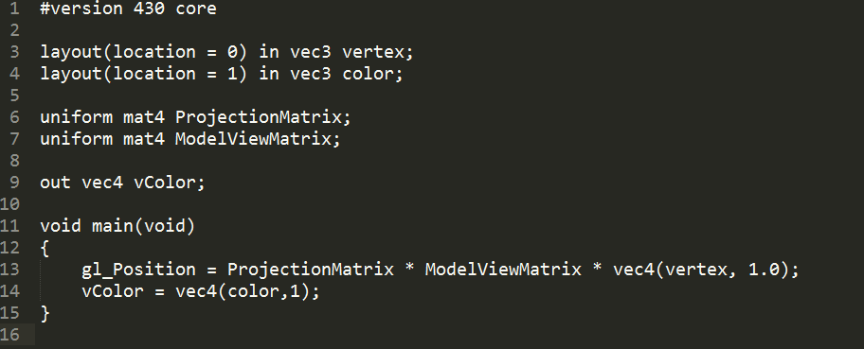
Traingle.vs

Slide 32
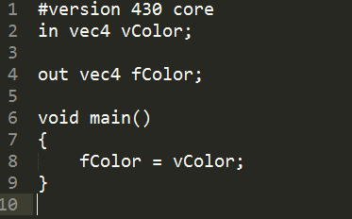
Traingle.fs

