Slide 1

PSI 1
Przemyslaw Lewandowski 221477

Slide 2
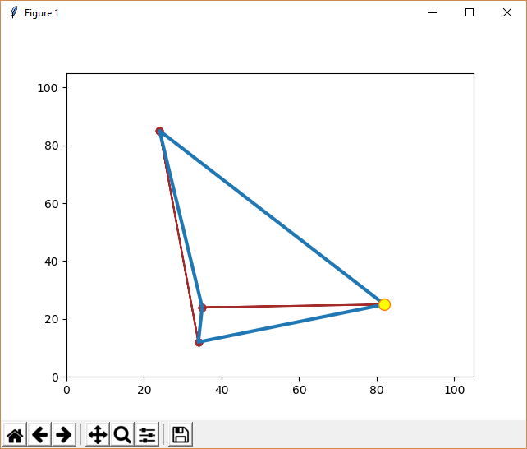
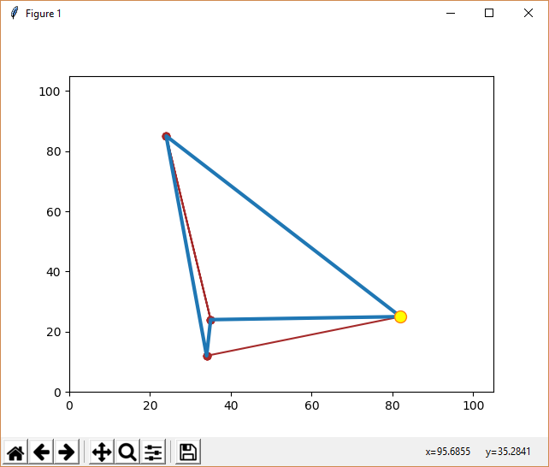
Główna różnica pomiędzy metodami
Brute force
Nearest-neighbour

Slide 3
Porównanie wyników
Cities no. |  | 4 | 5 | 6 | 7 | 8 | 9 | 10 | 11 | 12
Brute Force | Time | 0.0002611200445644876 | 0.000972458832632974 | 0.0046677341299599575 | 0.035822256780331824 | 0.28631488619774054 | 2.5289575302754184 | 24.41164090225338 | 273.418308850058 | x
 | Distance | 173.323 | 250.351 | 293.280 | 262.643 | 257.734 | 302.107 | 263.894 | 350.605 | x
Nearest-neighbour | Time | 0.00019319469963852143 | 0.00018534403163204794 | 0.0003037867185129335 | 0.0004164267377368344 | 0.0005447680929737131 | 0.0006881281174404563 | 0.0008676694814155894 | 0.0010222935077877082 | x
 | Distance | 183.243 | 257.790 | 304.356 | 262.644 | 258.489 | 312.801 | 291.933 | 365.698 | x
100 x 100

Slide 4
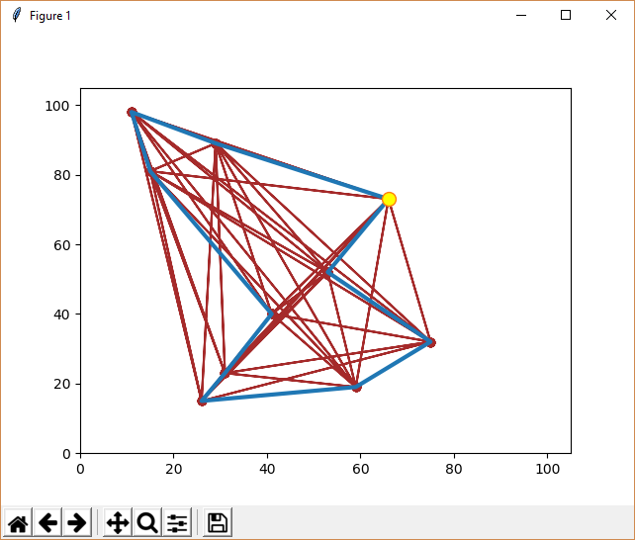
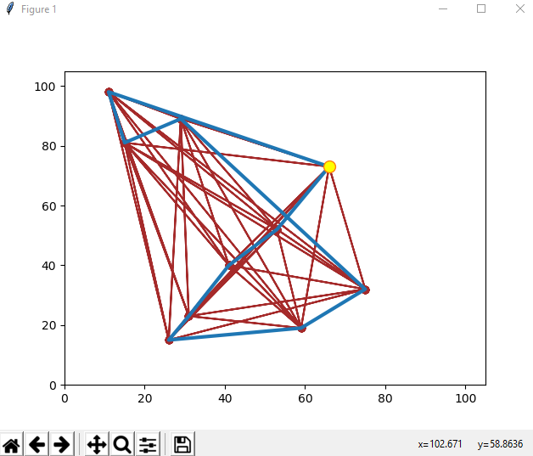
10 miast - porównanie
10
24.41164090225338
263.894
10
0.0008676694814155894
291.933

Slide 5
Cities no. | Brute Force |  | Nearest-neighbour
 | Time | Distance | Time | Distance | Time Difference | Distance Difference
4 | 0,00026112 | 173,323 | 0,000193195 | 183,243 | 6,79253E-05 | 9,92
5 | 0,000972459 | 250,351 | 0,000185344 | 257,79 | 0,000787115 | 7,439
6 | 0,004667734 | 293,28 | 0,000303787 | 304,356 | 0,004363947 | 11,076
7 | 0,035822257 | 262,643 | 0,000416427 | 262,644 | 0,03540583 | 0,001
8 | 0,286314886 | 257,734 | 0,000544768 | 258,489 | 0,285770118 | 0,755
9 | 2,52895753 | 302,107 | 0,000688128 | 312,801 | 2,528269402 | 10,694
10 | 24,4116409 | 263,894 | 0,000867669 | 291,933 | 24,41077323 | 28,039
11 | 273,4183089 | 350,605 | 0,001022294 | 365,698 | 273,4172866 | 15,093
12 | x | x | x | x | x | x

