Slide 1
Python password manager

Slide 2

Features
-Before logging in
-Add users
-Log in
-Exit
-After logging in the user can handle their own information
-Add services
-Delete services
-View all services, but not their passwords
-Get service passwords
-Delete their user
-Log out
-Exit

Slide 3
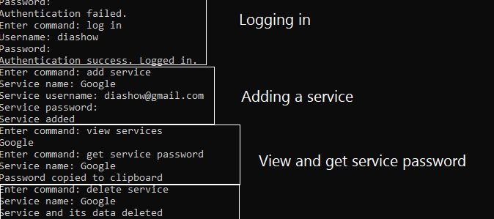
Example 1

Slide 4
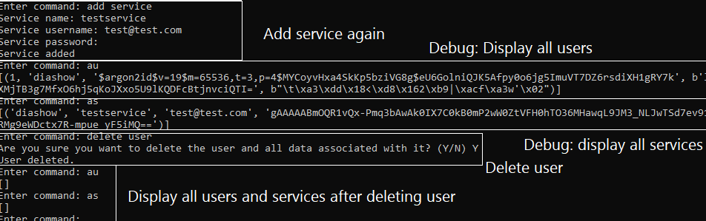
Example 2

Slide 5
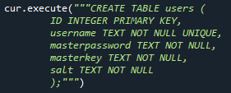
What’s in the database? How do they relate to each other? 1/2
Created using SQlite3
In the users table:
Username can be (almost) anything
Password can be (almost) anything and will be hashed
Master key is used for encrypting and decrypting
service passwords. Master key is derived from
password’s hash + salt.

Slide 6

What’s in the database? How do they relate to each other? 2/2
Master user is same as previous users tables username
Service name is the name of the service
Service user is the username of the service
Service password is the password for the service. Service password is encrypted and decrypted with the previously generated master key.

Slide 7

Master password and salt
Password can be generated randomly utilizing secrets and string library
Secrets is endorsed by Open Worldwide Application Security Project (OWASP)
Hashed using Argon2id
Salt is generated using os.urandom(16) to generate 128 bits of random data. This length is recommended by National Institute of Standards and Technology (NIST). Urandom is used in secrets which is endorsed by OWASP.

Slide 8
Argon2id
Argon2 is a hashing algorithm that won the Password Hashing Competition in 2015.
It was designed by Alex Biryukov, Daniel Dinu, and Dmitry Khovratovich.
Some use cases for it are hashing passwords and deriving keys.
Recommended by OWASP
Example of Argon2id hash (digest)

Slide 9
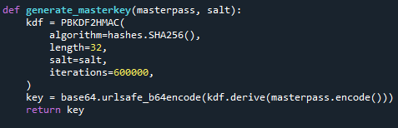
Master key
Generated from password and salt using PKDF2HMAC with the recommendations/parameters provided by OWASP.
Used for encrypting and decrypting service passwords
Components needed to create it stored in the database, but not the key itself
Key could be given to user in another format such as a file, but they could compromise it themselves

Slide 10

PKDF2HMAC
PKDF2 stands for Password-Based Key Derivation Function 2
HMAC means it utilizes a hash-based message authentication code. HMAC is used for verifying the integrity and authenticity of the message (or in this case a password).
Recommended by OWASP and NIST

Slide 11
Encryption/Decryption
Done using fernet with the master key

Slide 12
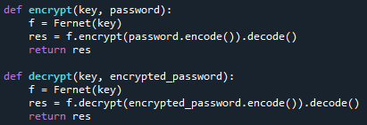
Fernet
Python library used for symmetric encryption.
Fernet utilizes AES 128 in CBC mode for encryption and decryption. (https://github.com/fernet/spec/blob/master/Spec.md)
Fernet can be used to generate a key, or passwords can be used to derive a key.

Slide 13

Questions? Comments? Thoughts?

