Slide 1
Soft-Error-Analysis

Slide 2
Overview
Introduction: Soft-Errors & Soft-Error Analysis
Detect Soft-Errors
Verify protection Logic (main part)
  input format, algorithms, output format, ..
First results
Conclusion / future work

Slide 3
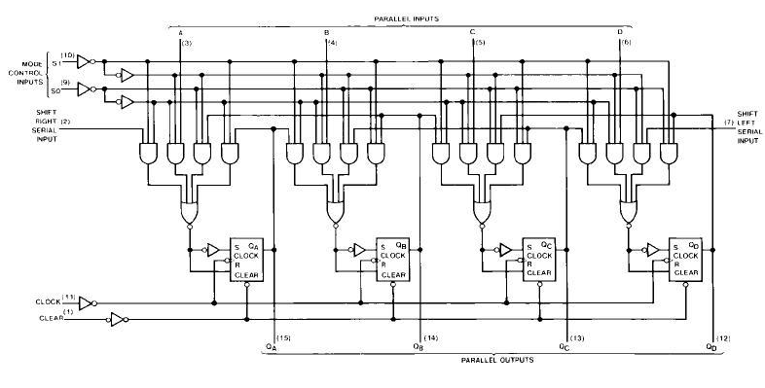
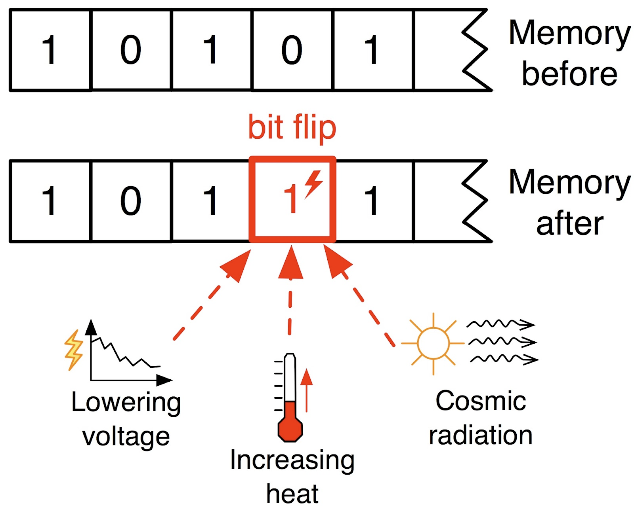
Soft Errors
Boolean circuits: inputs, AND gates, latches, outputs
Components (latches, AND gates) can have soft-errors
  flip truth value
  Single fault assumption (only one component flips)

Slide 4

Soft-Error-Analysis
Circuits to detect soft-errors aka protection Circuit:
  Alarm output: true, when flip has an effect on the value of the outputs
Main goal of my work: create Tool that tests the soft-error-detection for completeness (semi-formally ;-):
  Report definitely vulnerable and potentially protected circuits
Simplified view:
alarm circ
alarm output
Sequential
circuit
Inputs
Outputs
openSEA

Slide 5
How to detect Soft-Errors?
L1
L2
Inputs
...
...
Outputs
...
Ln

Slide 6
How to detect Soft-Errors:
→ add redundancy! New Tool: AddParityTool
L1
⊕
Inputs
L2
...
...
Outputs
...
⊕
Alarm Output
Ln
Le1
⊕
⊕
⊕

Slide 7
How to detect Soft-Errors:
AddparityTool:
Input:
  Circuit to protect (in AIGER format)
  Percentage of latches to protect
  New latch per how many existing latches (k)
    Relevant for critical circuit depth
Output:
  Protected circuit
  With new output: alarm
  Contains k extra latch(es)
Alarm Output

Slide 8

Is the protection-circuit correct ... ?
... or is there some scenario where a latch can be flipped without recognizing that?
which latches are definitely vulnerable?
which are potentially protected?
?
in
?
out
?

Slide 9

Is the protection-circuit correct ... ?
... or is there some scenario where a latch can be flipped without recognizing that?
which latches are definitely vulnerable?
which are potentially protected?
The openSEA (tool) can help you with these questions!
  open Soft-Error-Analysis – a tool to verify protection circuits (working title)

Slide 10
openSEA
Input: arbitrary circuit with protection logic (alarm output)
Output: List of definitely vulnerable latches
highly modular, extensible and configurable
several algorithms, modes, options, optimizations, ...
Vulnerabilities:
L1, L334, …,
L9985
AIGER circuit
BackEnd:
SimulationBased
[TestCase(s)]
SymbTime
[Error-Traces]:
Latch 1:
- flip L1 at i=5
- error at i=9
- input vectors
i0: 0101
i1: 1010
...
Options
SymbTimeLocation
Lingeling
miniSAT
PicoSAT
openSEA

Slide 11
Input and Output Format
Input Format:
  circuit with protection logic
  TestCase(s) consisting of a vector of input values
time | Input 0 | Input 1
ts 0 | 1 | 1
ts 1 | 0 | 1
ts 2 | 1 | 0

Slide 12
Input and Output Format
Output Format:
  List of definitely vulnerable Latches
  Optional: ErrorTraces for each vulnerable Latch (to stdout or to file)
    When happens the flip, when has it an effect on the output, what were the necessary inputs?
L3
L42
L1337
L3:
Flip at ts 10
Wrong output at ts 13
time | Input 0 | Input 1
ts 0 | 1 | 1
ts 1 | 0 | 1
ts 2 | 1 | 0

Slide 13
BackEnd: SimulationBasedAnalysis
Execute correct simulation with the provided TestCase (vector of input-vectors)
  store the resulting output vectors
Compare with all possible faulty simulations
for each latch:
  for each time-step: flip truth value of latch ( = timestep i )
    vulnerable, if output value is different in this or in a future-time-step ( = timestep j )
Implementational Details:
Implemented AIGER circuit simulator for that

Slide 14
BackEnd: SymbTimeAnalysis (1)
Idea: make point in time where a latch value is flipped symbolic, call SAT-Solver
Do for each latch:
Convert circuit to a CNF transition relation (Tseitin transformation)
Unroll transition relation for each timestep in the TestCase
  replace input variables with concrete input values from TestCase
  append modified copy each iteration, previous state to next state
  add clause(s) saying that the output has changed
  call SAT solver
timestep 0:
timestep 1:
timestep n:
L(0)
L(1)
0
1
replaced
Latch-output
0
1
replaced
Latch-output
0
1
...
f0
f1
fn

Slide 15
BackEnd: SymbTimeAnalysis (2)
assignment: ¬f0, f1, ¬f2, .. , ¬fn
If SATISFIABLE:
  current latch is vulnerable
  SAT assignment: read point in time where a flip creates an error (f variable)
timestep 0:
timestep 1:
timestep n:
L(0)
L(1)
0
1
replaced
Latch-output
0
1
replaced
Latch-output
...
Implementational Details:
Incremental SAT solving
mode: don't copy whole transition-relation, build CNF on-the-fly
f0
f1

Slide 16
BackEnd: SymbTimeLocationAnalysis (1)
Idea: make point in time AND the latch to flip symbolic
timestep 0:
...
timestep n:
L1
(0)
L1
(n)
Latch 1:
0
1
0
1
...
replaced
Latch-output
0
1
0
1
replaced
Latch-output
f0
c1
fn
c1
...
...
...
...
Lm
(0)
Lm
(n)
Latch m:
0
1
0
1
replaced
Latch-output
...
0
1
0
1
replaced
Latch-output
f0
cm
fn
cm

Slide 17
BackEnd: SymbTimeLocationAnalysis (2)
If SATISFIABLE:
  Found vulnerability
  SAT assignment:
    c3: Latch 3 is flipped
    f1: it is flipped in timestep 1
assignment: ¬f0, f1, ¬f2, .. , ¬fn, ¬c1, ¬c2, c3, .., ¬cm

Slide 18
BackEnd: SymbTimeLocationAnalysis (3)
Unroll transition relation for each timestep in the TestCase:
  append modified copy each iteration, previous state to next state
  replace input variables with concrete input values from TestCase
  clause(s) saying that output has changed

Slide 19
Extension: TestCase with free Input-Values
allows TestCases to have undefined input-variables
For SymbTimeAnalysis and SymbTimeLocationAnalysis
Not (easily and efficiently) possible for SimulationBasedAnalysis
SAT-solver chooses the values for inputs to force an error
Example TestCase with free inputs & Example Error-Trace
time | Input 0 | Input 1
ts 0 | 1 | 1
ts 1 | 1 | ?
ts 2 | ? | 0
L3:
flip at ts 10
Wrong output at ts 13
time | Input 0 | Input 1
ts 0 | 1 | 1
ts 1 | 1 | 1
ts 2 | 0 | 0
…
…

Slide 20
Extension: TestCase with free Input-Values
Get the best of both worlds:
  Discrete input values when possible (faster!)
  Variable input values when necessary (flexible)
This makes OpenSEA a full model-checker!
  With detailed feedback for the hardware designer where the bug is
time | Input 0 | Input 1
ts 0 | ? | ?
ts 1 | ? | ?
ts 2 | ? | ?
L3:
flip at ts 10
Wrong output at ts 13
time | Input 0 | Input 1
ts 0 | 1 | 0
ts 1 | 0 | 1
ts 2 | 0 | 1
…
…

Slide 21
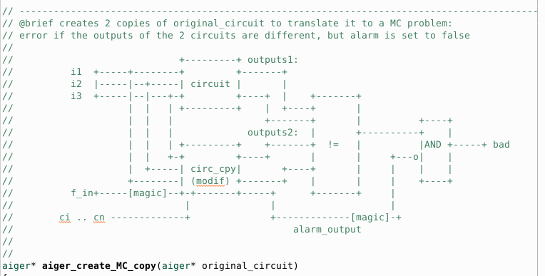
What else have I done?
Convert circuit with protection logic to a model-checking problem (standalone tool):

Slide 22
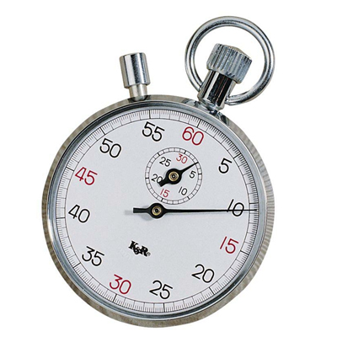

What else have I done?
Start running some benchmarks on the developed
algorithms with several modes, optimizations, etc., on problem-
instances

Slide 23
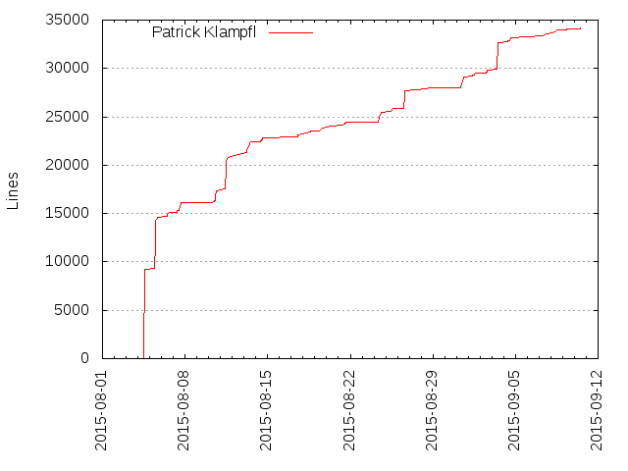
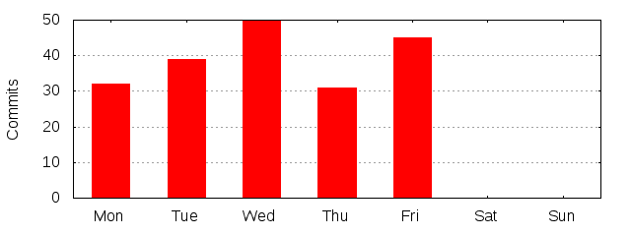
What else have I done?
A lot of coding

Slide 24

What else have I done?
drinking Coffee ;-)

Slide 25

Conclusion
AddParityTool: adds simple parity computation to protect a circuit
Create configurable SEA Tool: openSEA
Implement Soft-Error-Analysis Algorithms:
  Simulation-Based Analysis
  SAT-Based: Symbolic Time
  SAT-Based: Symbolic Time + symbolic Location
Optimizations, Free Inputs extension
Implement pure Model-Checking Approach as well
First Benchmarks

Slide 26

Future Work
more benchmarking
quantitative analysis: how likely is each vulnerability
Check other components for vulnerabilities:
  Besides of latches, AND gates could be flipped as well
Detect false alarms
Model an environment and add exceptions:
  output might not be relevant at each timestep
… and lots of other things you can think of

Slide 27

Questions?
Thank you for your attention!

