Slide 1
Soft-Error Analysis

Slide 2
Overview
Introduction:
  Soft-Errors
  Protection Logic
  Classification of components
Techniques:
  simulation vs. formal vs. semi-formal
Algorithms (application of the techniques for classification)
Benchmark Results

Slide 3
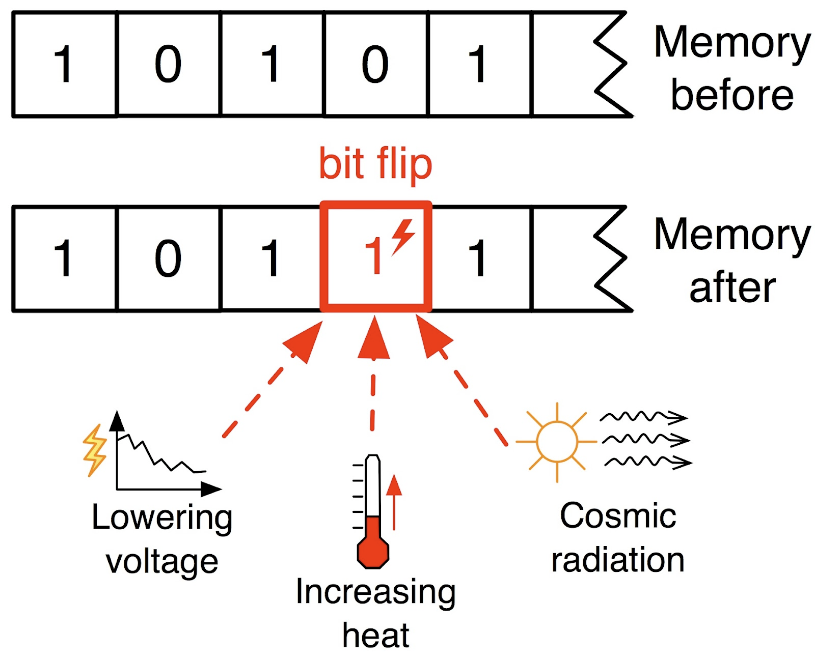
Soft Errors / Faults
Sequential Boolean Circuits: inputs, AND gates, latches, outputs
Components (latches, AND gates) can suffer from faults
  flip truth value
Single fault assumption

Slide 4
Protection Logic
Special part of a circuit for reliability
Detect faults or correct faults
Examples: Triple Modular Redundancy (TMR), parity-checks, ...

Slide 5
How to correct errors: TMR Example
Example: triple modular redundancy
Con: > 200% overhead in power consumption and area!
f(in)
in
a
f(in)
majority gate
b
out
f(in)
c

Slide 6
How to detect errors?
L1
L2
Inputs
...
...
Outputs
...
Ln

Slide 7
How to detect errors:
→ add redundancy.
L1
⊕
Inputs
L2
...
...
Outputs
...
⊕
Alarm Output
Ln
Le1
⊕
⊕
⊕

Slide 8
Errors in protection logic
vulnerable latches
  Faults that corrupt primary outputs
  → soft error escaped
false positives
  Unnecessarily reported faults
no alarm raised
flip
output
different
somewhere:
alarm raised
flip
outputs OK

Slide 9
Techniques for Component Classification
Formal methods
  Complete
  Slow, bad scalability
Simulation
  Not Complete
  Fast, good scalability
Semi-Formal methods
  Flexible
Scalability
Completeness
All Inputs Fixed | Some Inputs Open | All Inputs Open
Simulation |  | Formal (MC)
Semi-Formal

Slide 10
Detecting vulnerable latches
Formal method: (Bounded) Model Checking
Simulation
Semi-formal methods
no alarm raised
flip
output
different

Slide 11



Formal: Model Checking Approach
Circuit
Output1
Input
Alarm
E (“soft error
escaped”)
State
clock
Copy
Output2
Input
Alarm
State
clock
clock

Slide 12
Simulation (1/2)
Test case provides input values for the circuit:
(1) Execute correct simulation
(2) Execute faulty simulations
  Induce faults
  Compare output values with correct simulation
01101000110
10101100111
…
for all latches l in L:
for all time steps i=1 to len(t):
// check if soft error injected at
// latch l in step i of test case t
// escapes (now or in future steps)

Slide 13
Simulation (2/2)
Not complete! (only concrete test cases)
But: might already find some vulnerable latches / false positives
Fast for a single test case
Not suited for verification

Slide 14
Semi-Formal approach
Sequential Equivalence Checking
SAT-based: symbolically encode the circuit as a formula
test case-based: Input values from test cases, can be concrete or open
point in time AND component to flip symbolic
011??01000110
101??01100111
…
for all latches l in L:
for all time steps i=1 to len(t):
Flip latch
//check ...

Slide 15
Convert circuit to CNF formula (for SAT-solver)
Circuit can be converted to a transition relation formula T(x,i,o,x’)
    talks about inputs, outputs, current- and next state
Execution of circuit: T(x₀,i₀,o₀,x₁) ∧ T(x₁,i₁,o₁,x₂) ∧ … ∧ T(x_{n},i_{n},o_{n},x_{n+1})
0:
1:
n:
01 …….... 0
1? ……..... ?
…
?? ……….. ?
time step 0:
time step 1:
time step n:
I ₀
i₁
i₁
I ₁
I _{n}
Initial state x₀
...
T(x₀,i₀,o₀,x₁)
T(x₁,i₁,o₁,x₂)
T(x_{n},i_{n},o_{n},x_{n+1})
...
...
O₀
i₁
i₁
o₁
o_{n}

Slide 16
Semi-Formal Algorithm
Sequential Equivalence Checking: compare fault-free and faulty circuit
SAT-based: symbolically encode the execution of both circuits as a formula:
  fault-free: T(x₀,i₀,o₀,x₁) ∧ T(x₁,i₁,o₁,x₂) ∧ … ∧ T(x_{n},i_{n},o_{n},x_{n+1})
  faulty: T(f₀, c, x’₀,i₀,o’₀,x’₁) ∧ T(f₁, c, x’₁,i₁,o’₁,x’₂) ∧ … ∧ T(f_{n}, c, x’_{n},i_{n},o’_{n},x’_{n+1})
  c defines which latch should be flipped, f defines the point in time when it should be flipped
test case-based: Input values i from test cases, can be concrete or open
011??01000110
101??01100111
…

Slide 17
  SAT-query to find vulnerable components
If SATISFIABLE:
    c3: Latch 3 is flipped
    f1: it is flipped in time step 1
    Output wrong in step i (at query time)
for all time steps i=1 to len(t):
“Dear SAT solver, can you produce a wrong output at step i without
alarm raised by flipping any latch in some earlier step?”
assignment: ¬f0, f1, ¬f2, .. , ¬fn, ¬c1, ¬c2, c3, .., ¬cm
…

Slide 18
Detecting definitely protected latches
must hold in any state!
Definitely protected → not vulnerable
Not definitely protected → ??? (maybe protected, maybe vulnerable..)

Slide 19
Detecting definitely protected latches
Check property using a SAT-solver
k-step protection of a latch:
A fault in any state (an over-approximation of all states) ...
a) … either gets masked out within at most k time steps
( and does not affect any outputs)
b) … or an alarm is raised within at most k time steps
( and does not affect any outputs before)

Slide 20
False Positives
Problem: impossible to compare outputs forever
  undecidable
Solution: search for situations where the state is repaired within finite time
  Incomplete: might not find all false positives
somewhere:
alarm raised
outputs OK (forever?!)
flip
somewhere:
alarm raised
outputs OK
flip
state normal again

Slide 21
Detecting false-positives
Formal method: (Bounded) Model Checking
Simulation
Semi-formal methods
somewhere:
alarm raised
outputs OK
flip
state normal again

Slide 22
  SAT query to find false positives
Find situations where
  bit flip raises an alarm, does not corrupt outputs, and state recovers from bitflip
for all time steps i=1 to len(test-case):
“Dear SAT solver, can you find a false positive by flipping
any latch in any previous time step?”
If SATISFIABLE: false positive found
    c3: Latch 3 has to be flipped
    f1: it has to be flipped in time step 1
    state ok again in step i (at query time)
assignment: ¬f0, f1, ¬f2, .. , ¬fn, ¬c1, ¬c2, c3, .., ¬cm

Slide 23
Summary
Properties to check
  Search for vulnerable components
  Prove that component is definitely protected
  Find situations for false positives
Techniques for checking:
Scalability
Completeness
All Inputs Fixed | Some Inputs Open | All Inputs Open
Simulation |  | Formal (MC)
Semi-Formal

Slide 24
Results – simulation vs semi-formal (1/2)
Simulation vs semi-formal (point in time and component to flip are symbolic variables)
3 concrete test cases, each 15 time steps long
Search for vulnerable latches
011010001110
101011010111
…

Slide 25
Results – simulation vs semi-formal (2/2)
3 test cases, each 15 time steps long, containing some open input values
Search for vulnerable latches
>5 open inputs: semi-formal faster, < 5: simulation faster, ~5: about the same
011??01000110
10101??110111
…

Slide 26

Conclusion
Open inputs: Semi-formal algorithms scale significantly better than simulation
Concrete Inputs: Simulation is fastest
Reducing input space: better than MC
011??01000110
10101??110111
…

Slide 27
Thank you for your attention!
Questions?

Slide 28
formal vs semi-formal method
All inputs open (MC and semi-formal) vs. all inputs concrete (semi-formal)
Search for vulnerable latches
Semi-formal method and BMC about the same performance with all inputs open
Semi-formal can be faster by setting (some) inputs to concrete values
???????????????
???????????????
…
011010001110
101011010111
…

Slide 29
OpenSEA
Input: arbitrary circuit with protection logic (alarm output)
Output: List of definitely vulnerable latches
AIGER circuit
C++
[TestCase(s)]
BackEnd:
Vulnerabilities:
L1, L334, …,
L9985
011??01000110
101??01100111
…
BackEnd 1
BackEnd 2
BackEnd 3
[Error-Traces]:
Latch 1:
- flip L1 at i=5
- error at i=9
- input vectors
i0: 0101
i1: 1010
...
Options
Lingeling
miniSAT
CUDD
openSEA

Slide 30
Simulation (3/3)
Simulation-based solution: Details
// Step 1: fault-free simulation
for all test cases t in T:
s := initial state
for all time steps i=1 to len(t):
correctState[t][i] := s
s,o := sim1step(s,t[i])
correctOutput[t][i] := o
// Step 2: simulation with faults:
for all latches l in L:
for all test cases t in T:
for all time steps i=1 to len(t):
s := correctState[i]
s := s with L flipped
for all time steps j=i to len(t):
if(s == correctState[t][j])
continue with next step i
s,o,c := simu1step(s,t[i])
if(alarm)
continue with next step i
if(o != correctOutput[t][j])
print “Latch L is vulnerable”
continue with next latch l

Slide 31
Semi-Formal approach
SAT-based: symbolically encode the circuit as a formula
test case-based: Input values from test cases, can be concrete or open
2 variants:
  A) point in time to flip symbolic:
  B) point in time AND component to flip symbolic
011??01000110
101??01100111
…
for all test cases t in T:
for all latches l in L:
for all time steps i=1 to len(t):
// check ...
for all test cases t in T:
for all latches l in L:
for all time steps i=1 to len(t):
// check ...

Slide 32
  A) point in time to flip symbolic:
for all test cases t in T:
for all latches l in L:
for all time steps i=1 to len(t):
// check ...
If SATISFIABLE:
  Flip L in step 1 to produce corrupt outputs
timestep 0:
timestep 1:
L(0)
L(1)
0
1
replaced
Latch-output
0
1
replaced
Latch-output
0
1
f0
f1
fn
assignment: ¬f0, f1, ¬f2, .. , ¬fn

Slide 33
Environment Models
Output values might be irrelevant
  e.g. if data on bus is not ready
Some input combinations might not be allowed
  SAT-solver choices for input values can
  be restricted

Slide 34
Results – Length of Test Cases

Slide 35

Vulnerable Latches:
Alarm
NO
Input
Output
Given: circuit
Next
State
State
clock
time

Slide 36

Vulnerable Latches:
Alarm
NO
Input
Output
Given: circuit
Find situation..
  where Latch can be flipped ...
Next
State
State
clock
no alarm raised
flip
time

Slide 37

Vulnerable Latches:
Alarm
NO
Input
Output
Given: circuit
Find situation..
  where Latch can be flipped ...
  such that outputs are wrong
  without raising an alarm before
Next
State
State
clock
no alarm raised
flip
output
different
time

