Slide 1
Soft-Error-Analysis

Slide 2


Overview
Previously … [recap]
  Introduction: Soft-Errors & Soft-Error Analysis
  Detect Soft-Errors
  Verify Protection Logic (vulnerabilities)
Latest work:
  Verify Protection Logic (false positives)
  Environment Models
  Benchmark Results
Conclusion
Internship
Summer '15
Master-Project

Slide 3
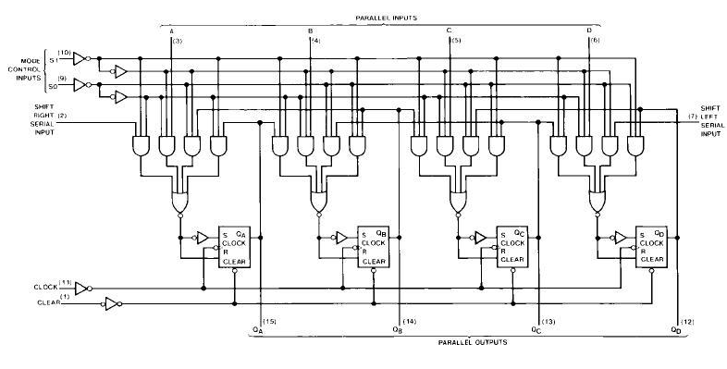
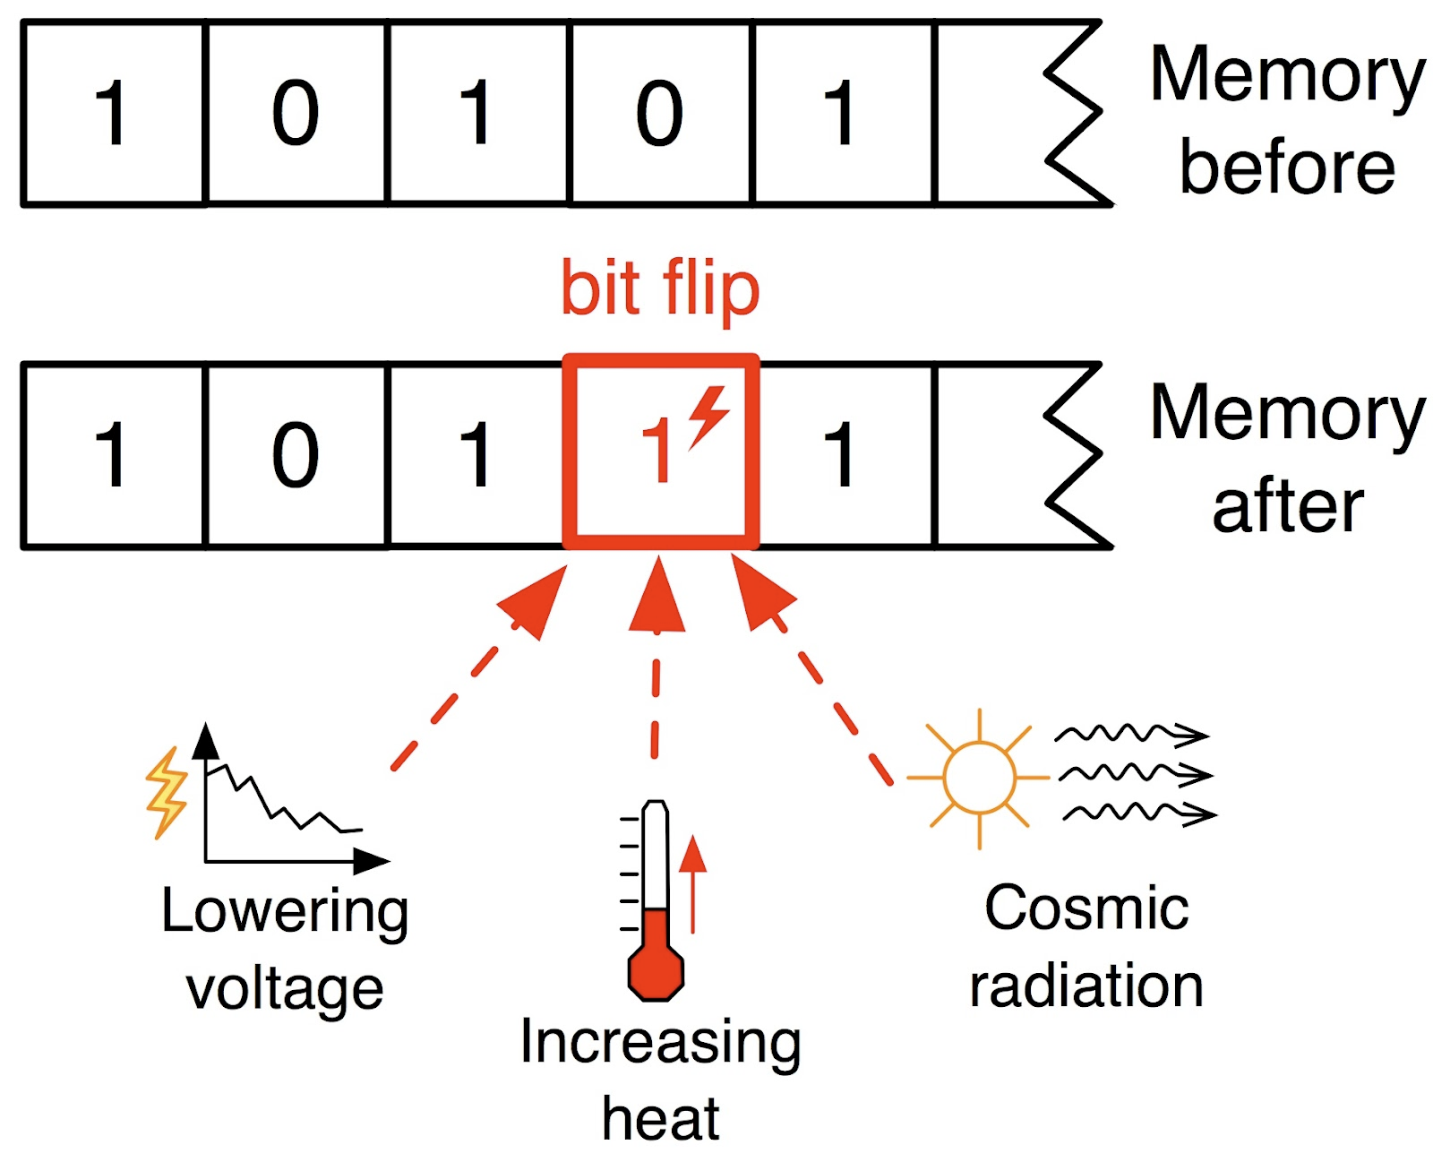
Soft Errors
Boolean circuits: inputs, AND gates, latches, outputs
Components (latches, AND gates) can have soft-errors
  flip truth value

Slide 4
How to detect Soft-Errors?
L1
L2
Inputs
...
...
Outputs
...
Ln

Slide 5
How to detect Soft-Errors:
→ add redundancy. Tool: AddParityTool
L1
⊕
Inputs
L2
...
...
Outputs
...
⊕
Alarm Output
Ln
Le1
⊕
⊕
⊕

Slide 6

Q: Is the protection-circuit correct ... ?
Given: Circuit
Find Vulnerabilities:
  Latches that can be flipped (once)
  such that output changes (at some point in the future)
  but no alarm raised (up to that point)
?
?
?
no alarm raised
flip
output
different

Slide 7



Model Checking Approach
Tool: AlarmToMC
Circuit
Output1
Input
Next
State
Alarm
E (“soft error
escaped”)
State
clock
Copy
Output2
Input
Next
State
Alarm
State
clock
clock

Slide 8
Model Checking Approach
Pro:
  Exact: Valid for all possible input combinations
Contra:
  Bad scalability

Slide 9
Model Checking Approach
Pro:
  Exact: Valid for all possible input combinations
Contra:
  Bad scalability
Idea: Instead of all possible Input combinations, use concrete input vectors

Slide 10
openSEA
Input: arbitrary circuit with protection logic (alarm output)
Output: List of definitely vulnerable latches
AIGER circuit
C++
[TestCase(s)]
BackEnd:
Vulnerabilities:
L1, L334, …,
L9985
011??01000110
101??01100111
…
BackEnd 1
BackEnd 2
BackEnd 3
[Error-Traces]:
Latch 1:
- flip L1 at i=5
- error at i=9
- input vectors
i0: 0101
i1: 1010
...
Options
Lingeling
miniSAT
PicoSAT
openSEA

Slide 11
BackEnds
Simulation – based: (SIM)
  Execute correct simulation with the provided TestCase
  Compare with all possible faulty simulations
Symbolic Time Analysis: (STA)
  Point in time when to flip a latch is symbolic
Symbolic Time + Symbolic Location (STLA)
  Point in Time + Latch to flip is component

Slide 12
Latest Work
False Positives
Environment Models
Benchmark Results

Slide 13
False Positives
Vulnerabilities are false negatives: a soft error happens, but is not detected
  Alarm should have been raised
False Positive: Alarm is true, but the soft-error has no effect
  Alarm raised gratuitously
no alarm raised
flip
output
different
somewhere: alarm= 1
outputs OK
flip
state normal again

Slide 14
False Positives
Implemented similar to Algorithms for false-negatives:
  Symbolic Time Analysis (STA)
  Symbolic Time Symbolic Location Analysis (STLA)
somewhere: alarm= 1
outputs OK
flip
state normal again

Slide 15
Environment Models
Output values might be irrelevant
  e.g. if data on bus is not ready
Some input combinations might not be allowed
  SAT-solver choices for input values can
  be restricted

Slide 16
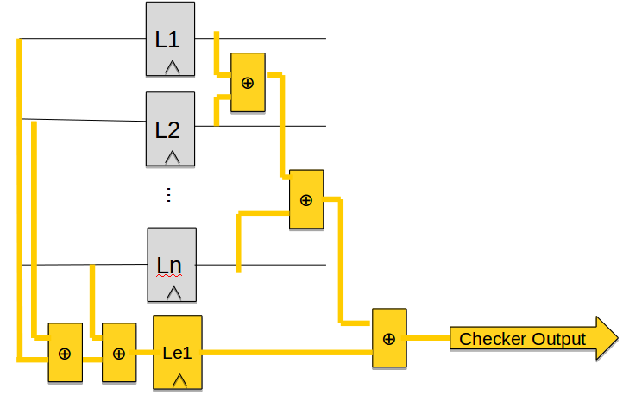
Benchmark Results – Setup for Experiments
IWLS 2002 and IWL 2005 [1] circuits converted to AIGER format
Add protection (AddParityTool)
  only parity
  Parameters:
    Percentage of latches to protect
    Number of latches to protect with 1 new latch
Test Inputs: created randomly
                [1] http://www.eecs.berkeley.edu/~alanmi/benchmarks/
011??01000110
101??01100111
…

Slide 17
Results – All Algorithms

Slide 18
Results – Length of Test Cases

Slide 19
Optimization: Unsatisfiable Cores

Slide 20
Number of unspecified input values

Slide 21
Model Checking Results

Slide 22

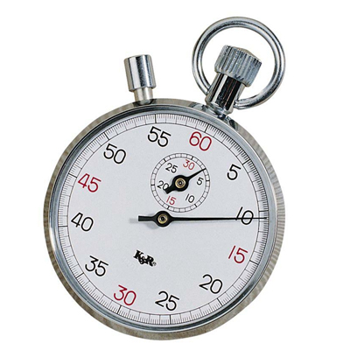
Conclusion
Extended openSEA
  False Positives Algorithms
    Symbolic Time
    Symbolic Time + symbolic Location
  Environment Models
Benchmarking results
  Free inputs: sym. Algorithms (STLA) scale significantly better than simulation
  Concrete Inputs: Simulation is fastest
  Reducing input space: better than MC
  UNSAT cores might speed up longer test cases
Scalability
Completeness
All Inputs Fixed | Some Inputs Open | All Inputs Open
Simulation |  | Model Checking
Our Approach

