Slide 1

MIPS32 RISC V 6 Stage pipelined processor
Aniketh Reddimi
Vamshi Kashyap Dabbiru

Slide 2
Introduction – MIPS 32
32 - 32 bit GPIO‘s R0 - R31 ( temporary storage)
R0 = 0 always
PC = Program Counter (points to the next instruction in memory to be fetched)
PC increments every time when a new instruction comesin
Very few addressing modes (register , immediate , register indexed etc)
Only load and store can access memory
Every word has unique address

Slide 3
RISC V
Reduced Instruction Set Computer
It consists of Three types of Instructions
R type Instructions
I type Instructions
J type Instructions
It consistes different instructions like Memory instructions, immediate oparand, jump instructions and Arithmatic Instructions

Slide 4
R type Instructions
It follows a pirticular format
Opcode - Ins[31:26]
Source Register Rs – Ins[25:21]
Source Register Rt – Ins[20:16]
Destination Register Rd – Ins[15:11]
Shift amount Shamt – Ins[10:6]
Function functn – Ins[5:0]

Slide 5
I type Instructions
Contains an Immediate oparand
To add, substract or work directly on the Immediate
Opcode - Ins[31:26]
Source register Rs – Ins[25:21]
Destination register Rt- Ins[20:16]
Immediate – Ins[15:0]

Slide 6
J type Instructions
Jumps the Instructions when ever needed or when a condition is satisfied
Opcode –Ins[31:26]
26 bit jump adress – Ins[25:0]

Slide 7
Pipelining
Output to one stage is the input to the other stage
One instructions goes into the first stage as soon as other goes to second and so on
No stage will be idle (without any instruction)
This optimises the Throughput very much
Pipelining of MIPS processor consists of 5 Stages

Slide 8
IF - Stage
Instruction Fetch Stage
Fetches the Instruction from Instruction Memory
Then it goes to the ID stage
PC is used to fetch the instructions one by one
PC increments each time a new instructions comes

Slide 9
ID - Stage
Decodes the Instruction
Opcode is determinde by Decoding the Instruction
It Specifies what it needs to do to the Operands
This decoded info will be pushed to Search Operands in the Next stage.

Slide 10
CO Stage:
It Calculates the Operands
Effective Address of each Operand is estimated
This is also called as Read Register Stage (RR)
Operans will be located

Slide 11
FO - Stage
Fetches the Operands
All operands reside in a big Data Memory
Data cache is used
Saves time
Eases the Operation

Slide 12
EI - Stage
Executes Instructions
Operands will be processed by the ALU
Actual Indicated Operations are performed
More Power
High Processing Speed

Slide 13
WB - Stage
Write Back Stage
Results are transferred into Data memory
Updates the Registers with New Information
Flags the Registers which are updated.

Slide 14
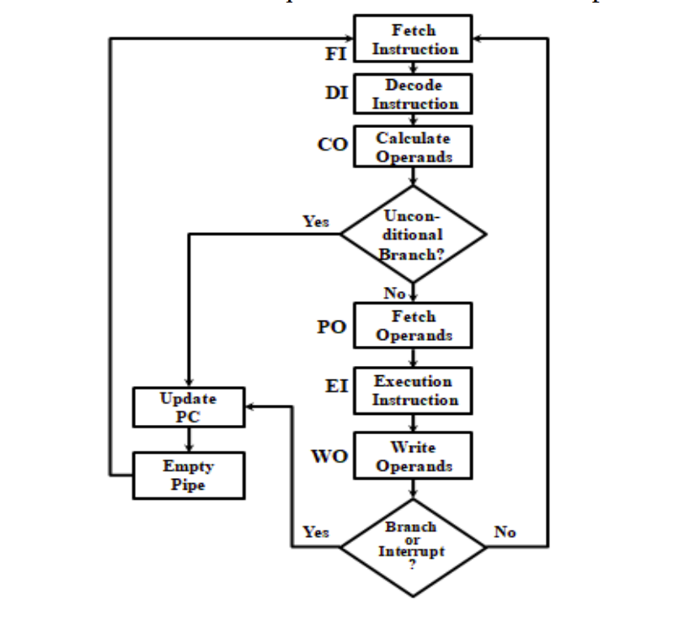
Pipeline Flow

Slide 15
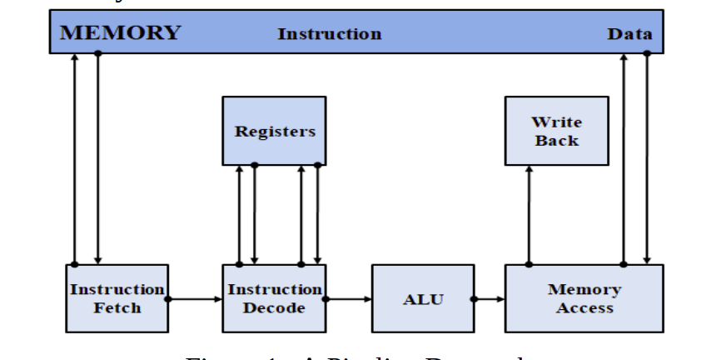
Pipeline DataPath

Slide 16
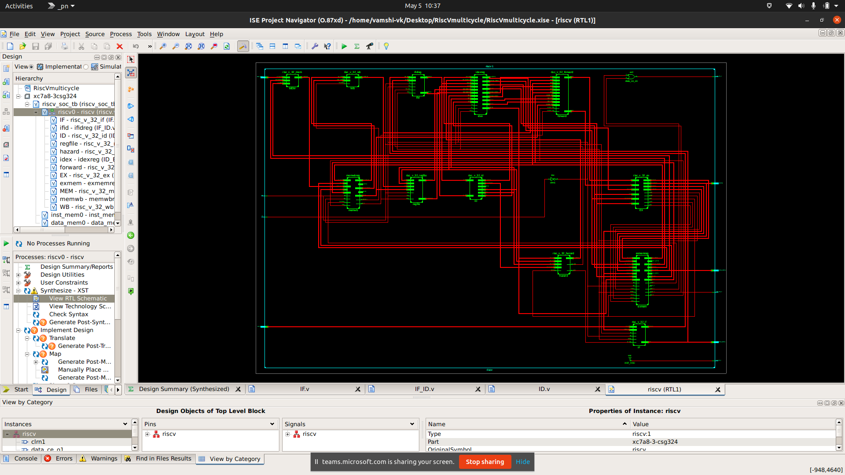
RTL Schematic

Slide 17
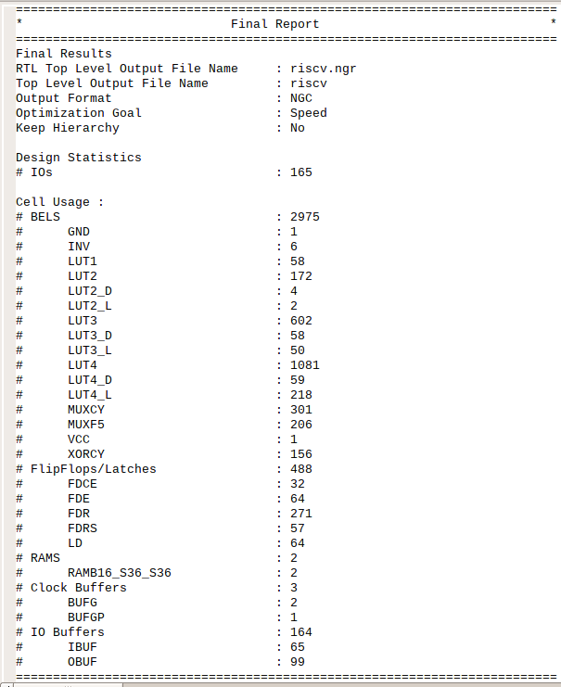
Synthesis Report

Slide 18
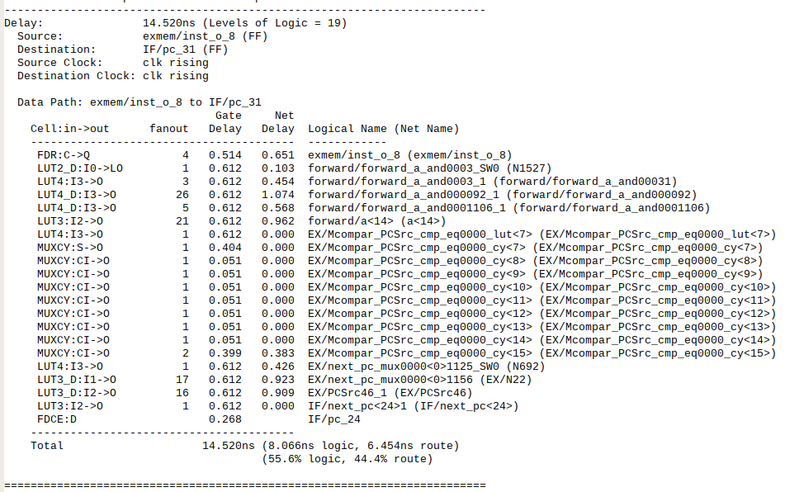
Delay

Slide 19
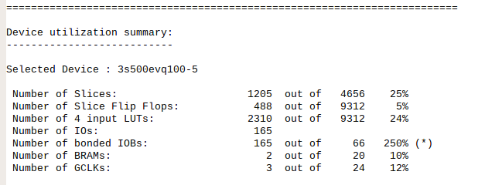
Device Utilization

Slide 20
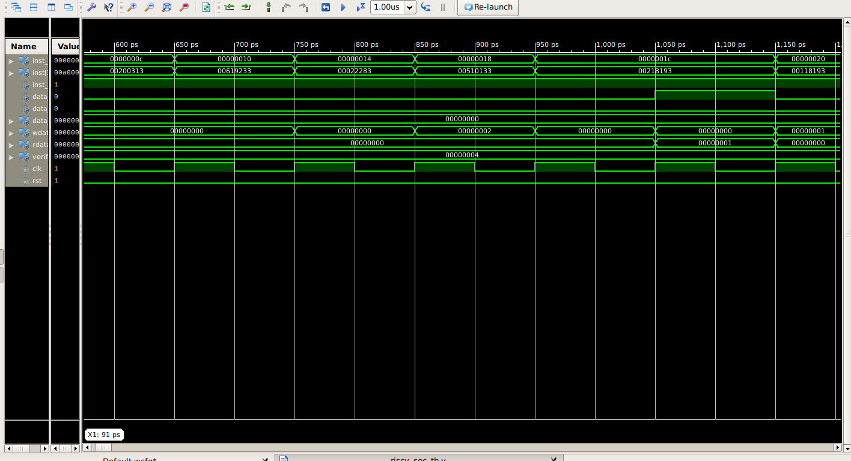
Timing Diagram

Slide 21

Thank YOU

