Slide 1

Flu and Weather
How is flu related to weather?

Slide 2
Motivation
Are the spikes of COVID-19 related to weather events?
COVID-19 data too new
Flu (Influenza) and COVID-19 both are respiratory illnesses
Flu historic data

Slide 3
Questions
Why are there seasons when ILIs are more noticeable?
Are ILIs cause by the change in weather or weather events?
What variables represent weather events better?

Slide 4
Limitations
Flu data not available on its own. Found as Influenza Like Illnesses (ILI)
ILI data per state not per city
Weather data per day
Data presented only in CSV format

Slide 5
Sources
ILI data from the Centers for Disease Control and Prevention (CDC) which in turn belongs to the World Health Organization (WHO)
Weather data provided by The Weather Company

Slide 6
Cities and Time period
Data period: 2010– 2018
Cities and States:
Phoenix, AZ | New York, NY
Los Angeles, CA | Philadelphia, PA
Denver, CO | Houston, TX
Atlanta, GA | Seattle, WA
Chicago, IL
Weather variables:
Temperature
Precipitation

Slide 7
Data Cleanup
Weather data already clean but not in the same time-frame as the ILI data
Resampling daily data to weekly
Replacing of null data
Removing columns of irrelevant data

Slide 8
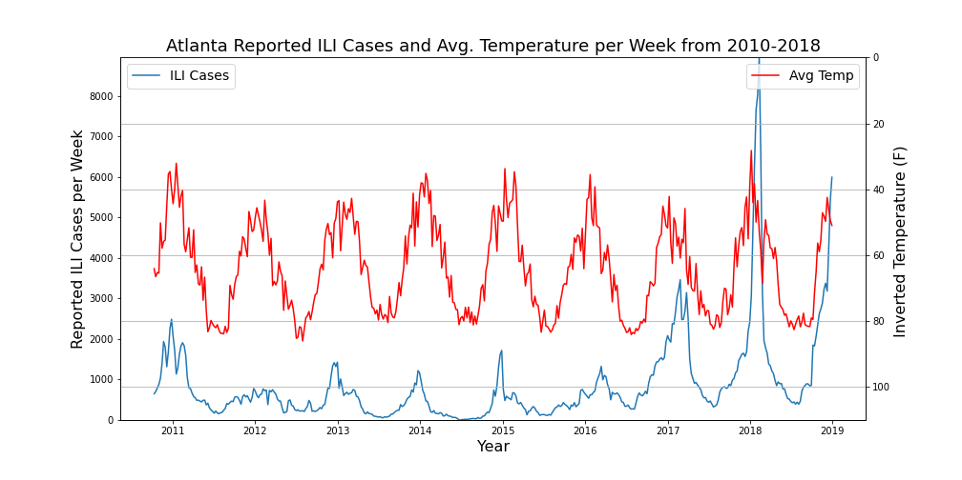
Data Analysis
Same time-frame
Compare ILI cases vs temperature and precipitation data
Create line plots, scatter plots and regression lines to allow better visualization of correlation between ILI cases and the weather variables

Slide 9
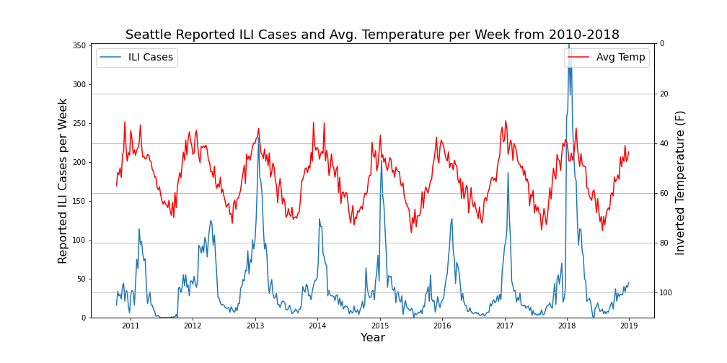
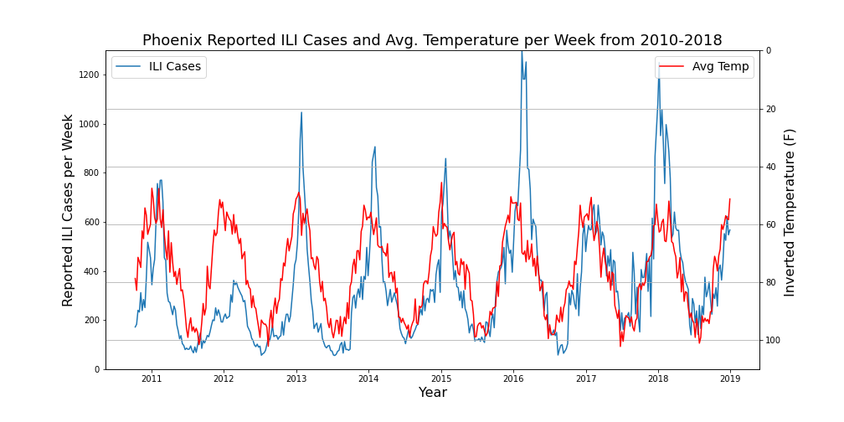
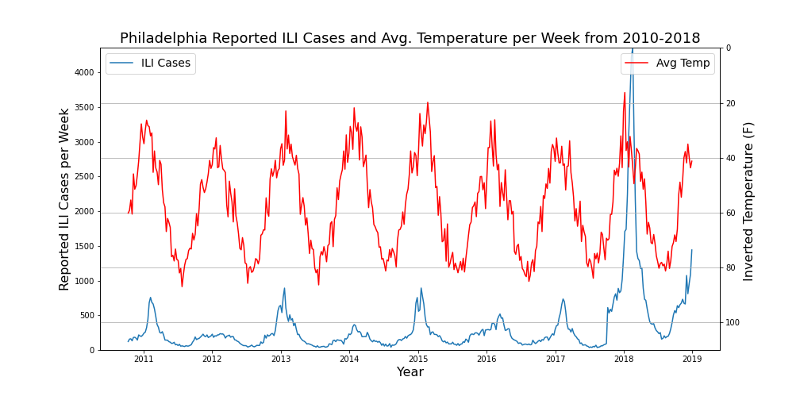
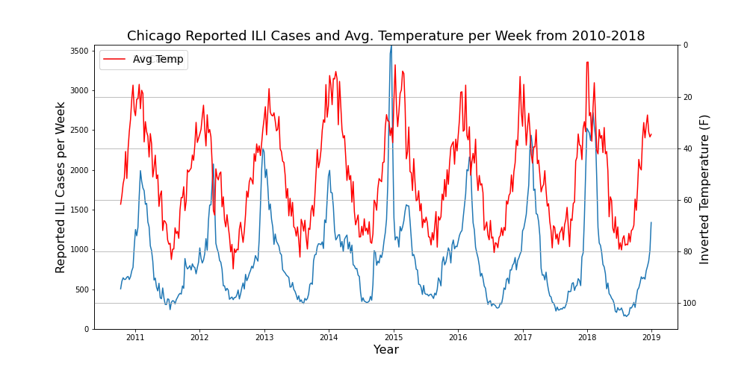

Slide 10
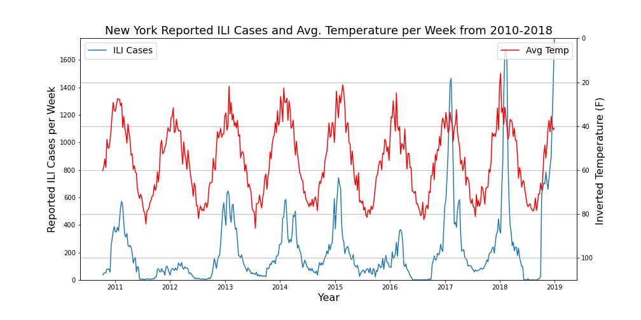
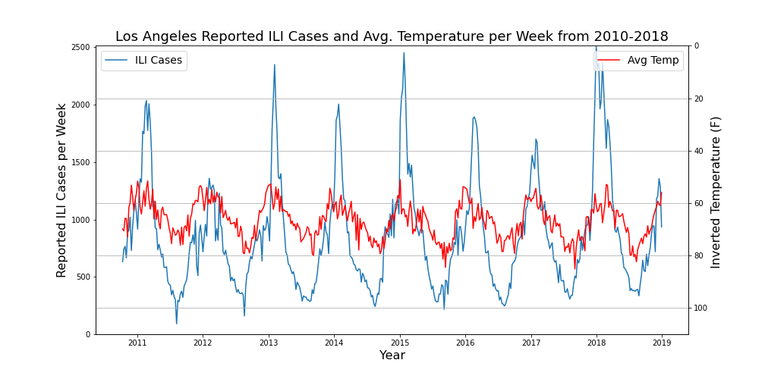
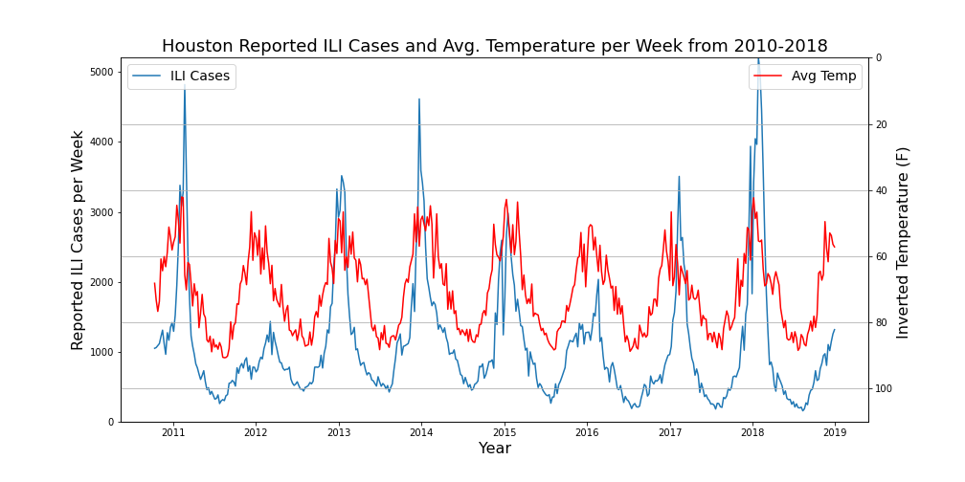
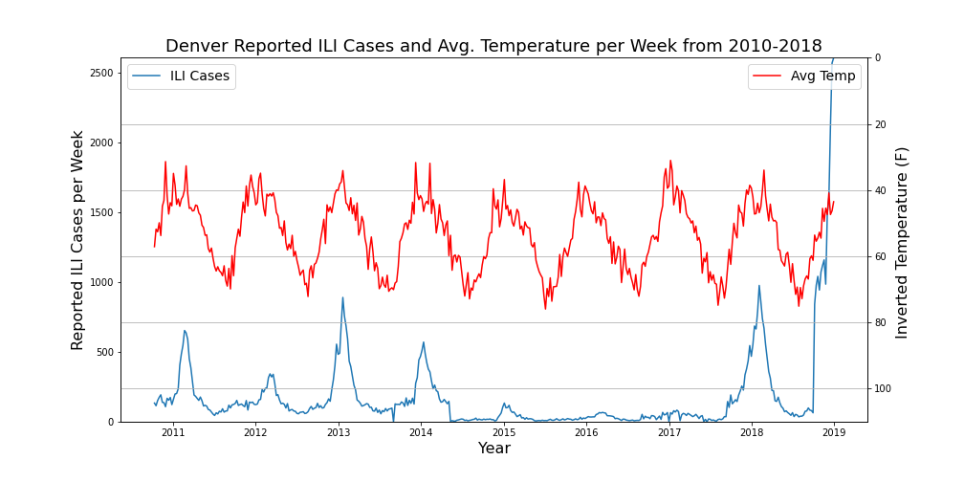

Slide 11
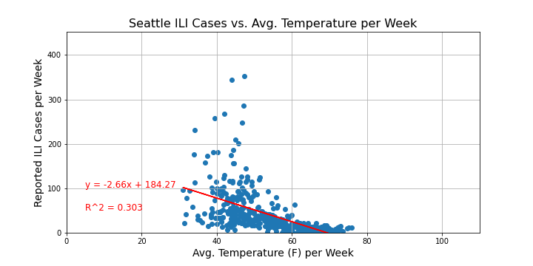
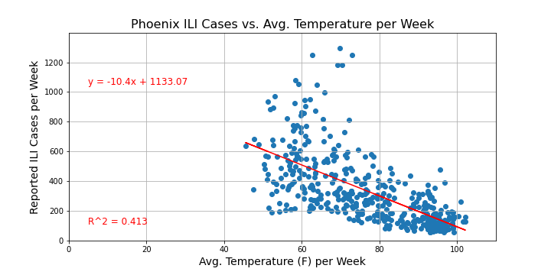
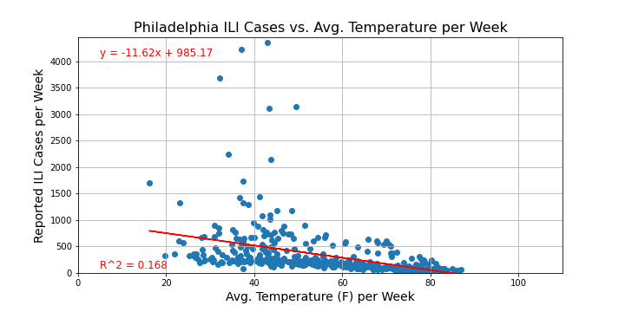
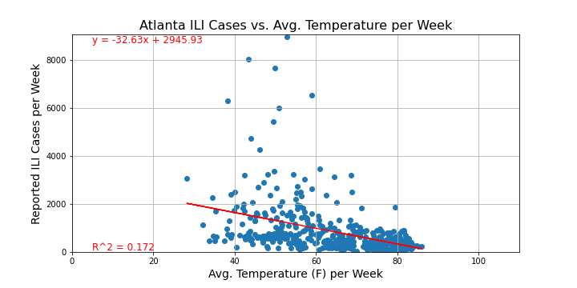

Slide 12
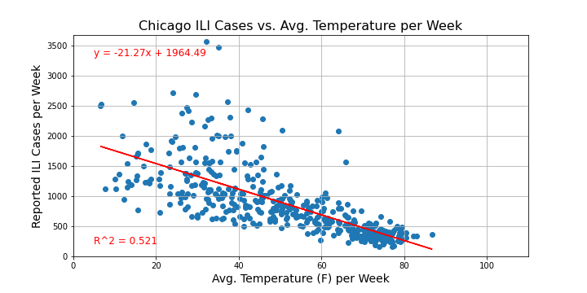
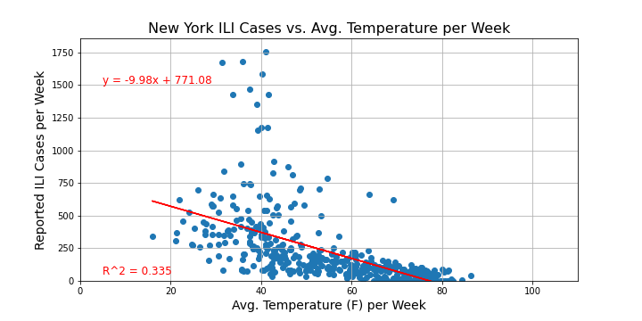
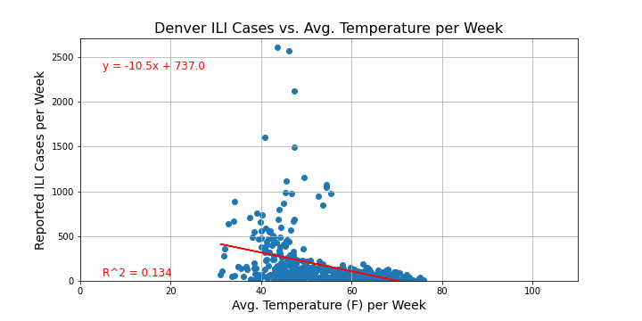
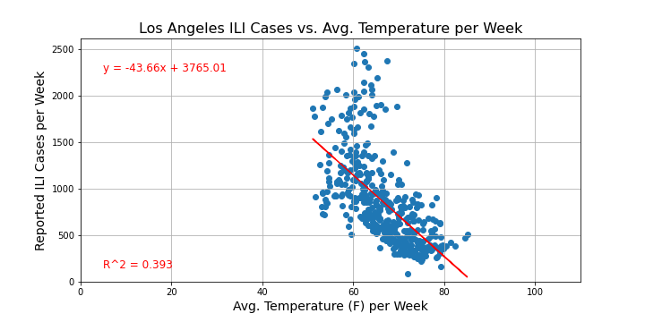
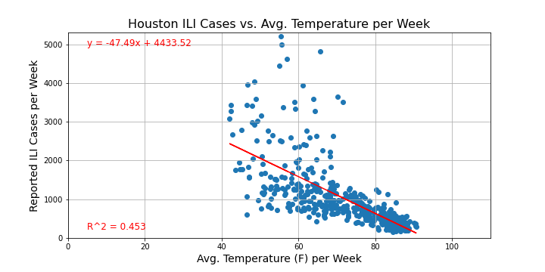

Slide 14
Conclusion
Why does temperature affect ILIs?
Negative correlation between temperature and ILI spikes
Why does precipitation show no effect on ILIs spikes?
No correlation
Other factors weather variables affect spikes of ILIs: humidity, altitude, wind ?

