Slide 1



Jesús Parra García
Alejandro Benito Marcos
Adrián Tendero García

Slide 2
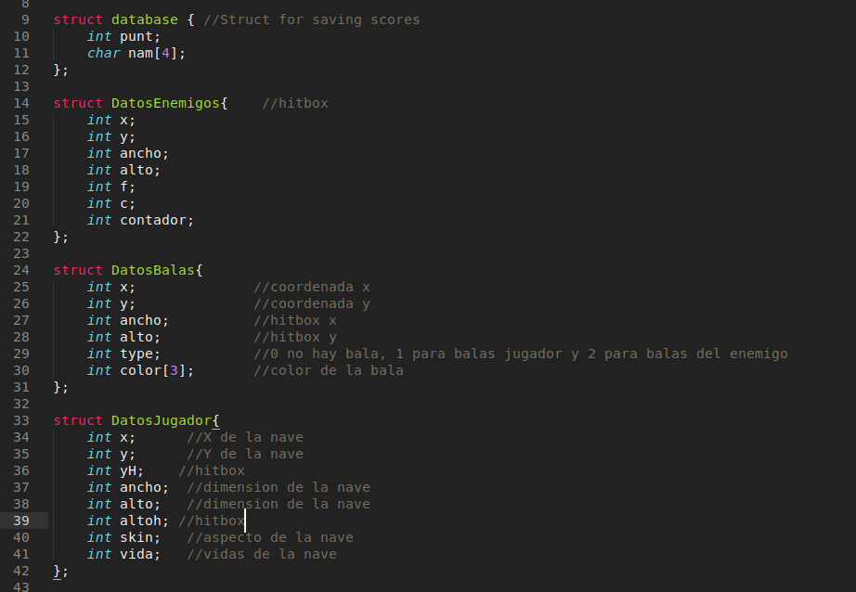
· The structs

Slide 3

· Main Menu

Slide 4
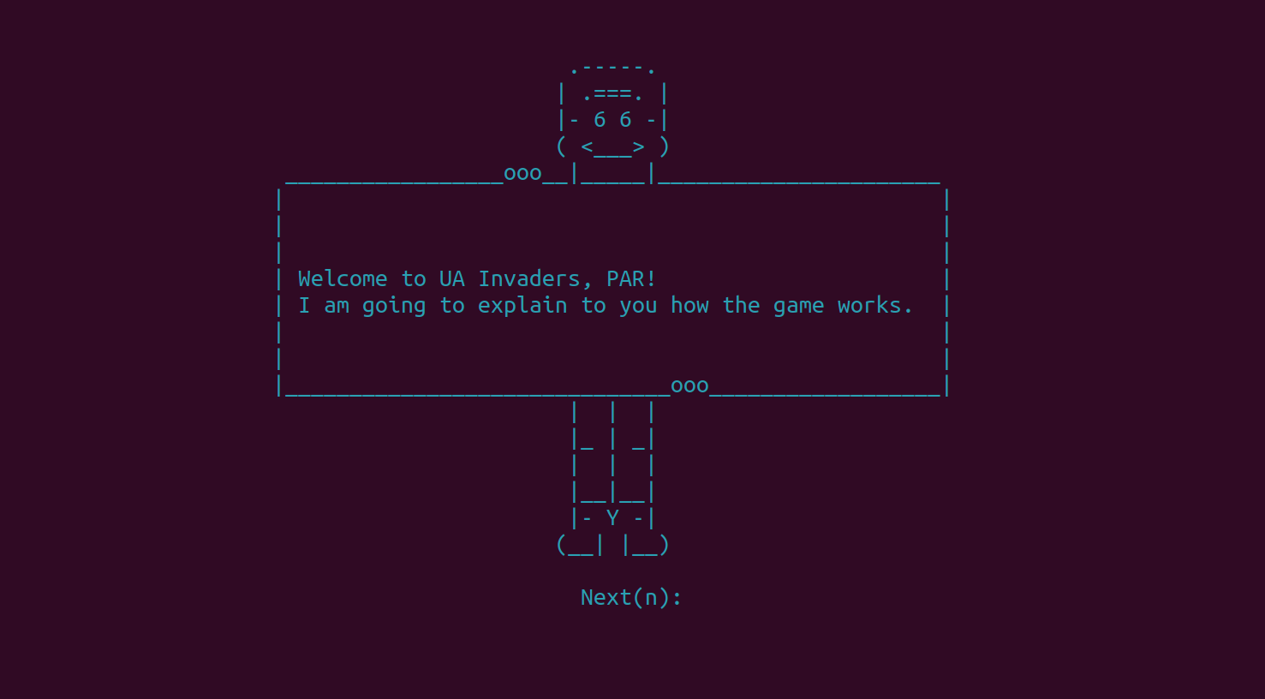
· Instructions

Slide 5
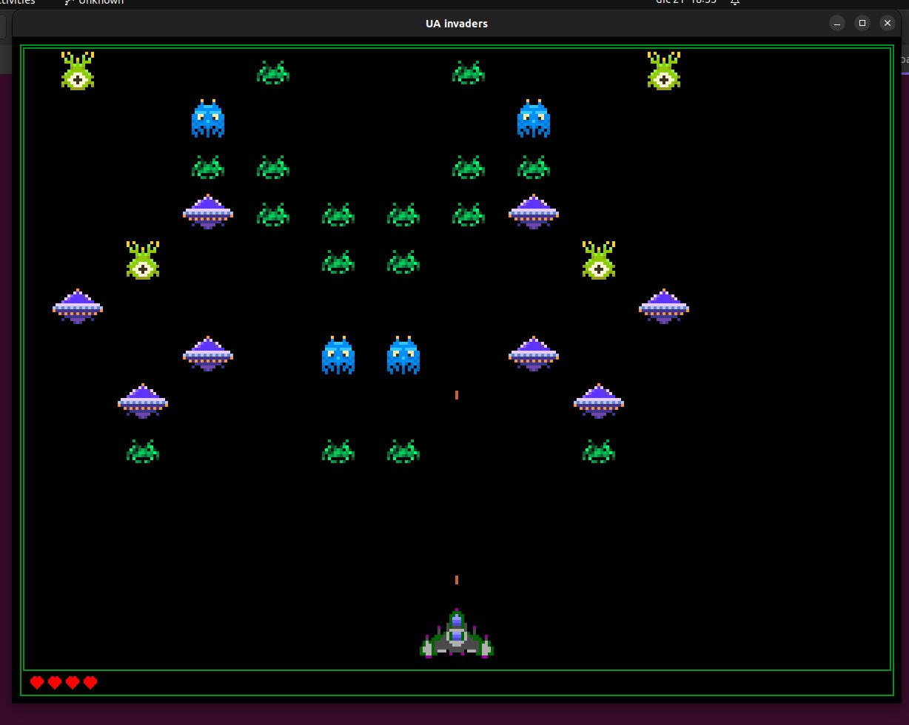
· Gameplay

Slide 6
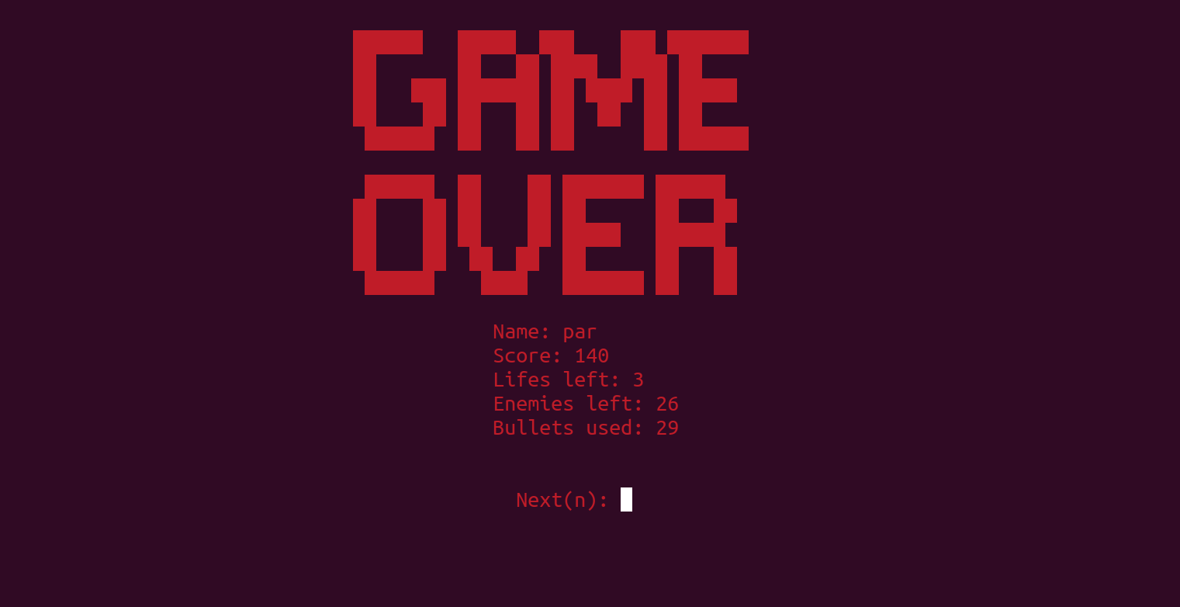

· Stats

Slide 7
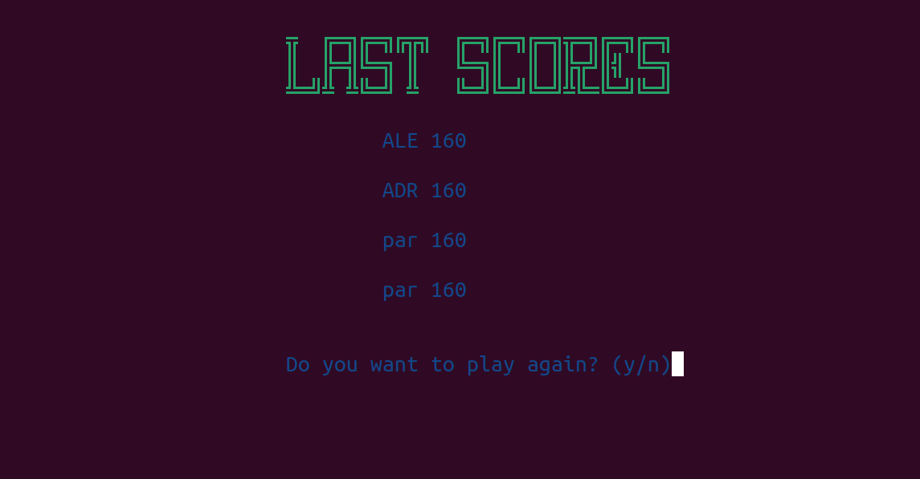
· Scores

Slide 8
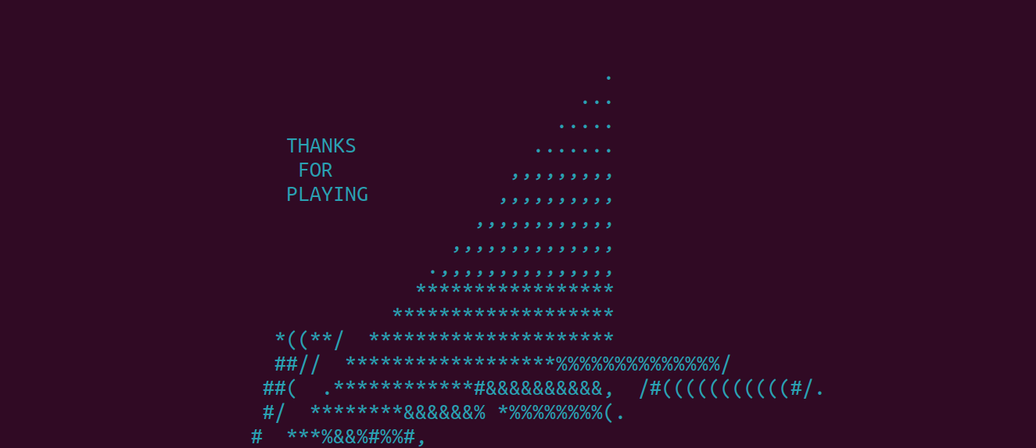
· THE END

