Slide 1
Multimodal Argumentative Fallacy Detection and Classification on Political Debates
PIP-4004 UNIVERSITY PROJECT
Review-2
Batch Number: CSE_CST_CAP_08
Under the Supervision of,
Dr. Sandeep Albert
Assistant Professor
School of Computer Science and Engineering
Presidency University
20211CST0067 | WARALE AVINASH KALYAN
20211CST0059 | SIDDHARTH PAGARIA
20211CST0076 | CHAITRA V
20211CST0085 | SPOORTHI HG
Roll Number | Student Name
Name of the Program: B.Tech Computer Science & Technology(AI&ML)
Name of the HoD: Dr. Saira Banu Atham
Name of the Program Project Coordinator: Dr. H M Manjula(AP)
Name of the School Project Coordinators: Dr. Abdul Khadar A

Slide 2
Content
Abstract
Literature survey
Objective and existing drawbacks
Proposed Method and Architecture
Timeline of the Project
References

Slide 3
Problem Statement Number: N/A
Organization: The 12th Workshop on Argument Mining
Category : Software
Problem Description:
Political debates often include misleading arguments, called fallacies, that can confuse people. Most tools for detecting fallacies focus only on text, but debates also involve tone of voice, facial expressions, and gestures. This project aims to build an AI system that detects and classifies fallacies using text, audio, and video. By analyzing speech, expressions, and words, the system will identify misleading arguments. The main challenges include understanding context, speaking styles, and debate formats. This project will help journalists, researchers, and the public recognize false arguments, promoting more informed discussions and reducing misinformation.

Slide 4
Abstract
Argumentative fallacies in political debates can mislead audiences and distort public discourse. Identifying and classifying these fallacies is a challenging task, particularly when integrating multimodal data sources such as text and audio. Traditional text-based approaches are often insufficient in capturing the nuances of spoken arguments, including tone, emphasis, and delivery style.
Leveraging Artificial Intelligence (AI) and Machine Learning (ML) for multimodal argument analysis can enhance fallacy detection by combining textual and paralinguistic features. The MM-ArgFallacy2025 shared task introduces a dataset derived from U.S. presidential debates (1960–2020), providing labeled instances of argumentative fallacies across multiple categories. Participants can explore text-only, audio-only, and combined text-audio approaches to develop robust classification models.
However, achieving high accuracy in multimodal fallacy detection requires overcoming challenges such as noisy audio data, speaker variations, and dataset limitations. This task aims to advance research in multimodal argument mining by fostering innovative AI-driven methods. The presentation will discuss key methodologies, dataset details, and evaluation criteria while emphasizing the significance of responsible AI use in political discourse analysis.

Slide 5
Literature Survey
Argumentative fallacies have long been a critical area of research in argumentation theory, particularly in political discourse. Fallacies are often used in debates to mislead, manipulate, or persuade audiences unfairly. With the rise of Natural Language Processing (NLP) and machine learning techniques, researchers have developed computational methods for detecting and classifying fallacies, especially in multimodal settings where textual, acoustic, and visual cues contribute to argumentative persuasion.
Argumentative Fallacy Classification in Political DebatesThe classification of argumentative fallacies is a fundamental challenge in argument mining. Goffredo et al. (2022) developed a dataset of U.S. presidential campaign debates, annotating six major fallacy categories: ad hominem, appeal to authority, appeal to emotion, false cause, slippery slope, and slogans . Their approach utilized transformer-based models, particularly Longformer, for identifying fallacies while integrating argument components (evidence, claim) and relations (support, attack). The study demonstrated that leveraging argumentative structures significantly improved fallacy classification performance .Other contributions in this domain include Habernal et al. (2018), who created an annotated dataset from the “Change My View” subreddit for detecting ad hominem fallacies. Their work emphasized the role of contextual cues in fallacy detection . Similarly, Sahai et al. (2021) curated a dataset of fallacious arguments from Reddit using Wikipedia-based fallacy keywords and examined their overlap with propaganda techniques .Key Findings in Text-Based Fallacy Detection
1. Transformer-based architectures (e.g., BERT, RoBERTa, Longformer) have shown superior performance in fallacy classification
2. Argumentation features, such as argument components and relations, enhance classification accuracy .

Slide 6
Literature Survey
3. Fallacies such as appeal to emotion and slogans rely on persuasive language, making semantic and sentiment-based approaches essential
The Role of Multimodal Analysis in Fallacy Detection, while most studies have focused on textual analysis, recent advancements highlight the importance of multimodal approaches. Mancini et al. (2024) proposed the first multimodal dataset (MM-USED-fallacy) that integrates text and audio for fallacy classification . Their experiments confirmed that incorporating paralinguistic features (e.g., speech rhythm, intonation, stress) significantly improves classification performance.
Mocking tones and accent-based stereotypes are linked to ad hominem attacks .This study introduced a multimodal classification model, combining RoBERTa for text encoding and Wav2Vec/CLAP for audio encoding, achieving higher F1-scores than uni-modal approaches .Key Findings in Multimodal Fallacy Detection
1. Audio cues such as intonation, stress, and speech rhythm help distinguish appeal to emotion and ad hominem fallacies .
2. Multimodal fusion techniques improve detection accuracy over text-only methods .
3. Data scarcity in certain fallacy types (e.g., slogans) remains a challenge, requiring larger multimodal datasets

Slide 7
Objective
To develop and evaluate AI-driven multimodal models for detecting and classifying argumentative fallacies in political debates, integrating textual and audio features for improved accuracy and robustness. The task aims to:
Enhance Fallacy Detection – Identify whether a given statement contains an argumentative fallacy using AI-powered analysis of text and speech.
Improve Multimodal Understanding – Leverage both textual and paralinguistic features to capture tone, emphasis, and delivery style for better fallacy classification.
Automate Argument Analysis – Develop machine learning models that classify fallacies into predefined categories without manual intervention.
Optimize Dataset Utilization – Utilize the MM-USED-fallacy dataset and additional resources to train more effective classification models.

Slide 8
Existing Drawbacks
At the moment, there is no functional model available for this project.
Low accuracy of pre-trained models
Less data available

Slide 9
Proposed Methodology
Multimodal Data Integration – Combine textual and audio inputs from political debates to improve argumentative fallacy detection and classification.
Text & Speech-Based Feature Extraction – Utilize Natural Language Processing (NLP) for text analysis and Speech Processing techniques to extract tone, pitch, and other paralinguistic cues.
Multimodal Fusion Model – Develop deep learning models that integrate textual and audio modalities to enhance classification accuracy.
Context-Aware Classification – Incorporate previous debate utterances to improve the contextual understanding of arguments and their logical consistency.
Fallacy Type Categorization – Implement supervised learning models to classify detected fallacies into predefined categories based on linguistic and prosodic patterns.
Model Training & Optimization – Fine-tune large language models and speech analysis networks on the MM-USED-fallacy dataset for robust performance across diverse debate settings.
This methodology ensures an advanced AI-driven approach to detecting argumentative fallacies by leveraging both textual and audio signals.

Slide 10
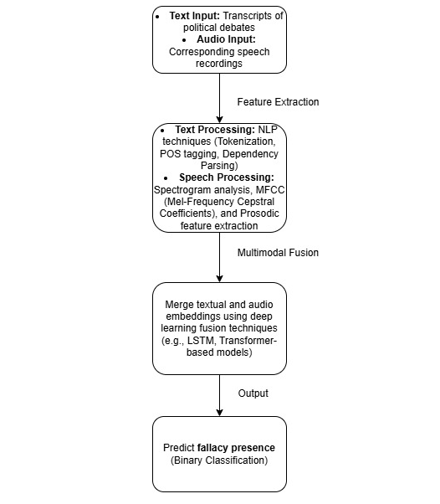
Architecture

Slide 11
Github Link
The Github link provided should have public access permission.
Github Link :- https://github.com/p4rz1v4l26/MM-ArgFallacy2025

Slide 12
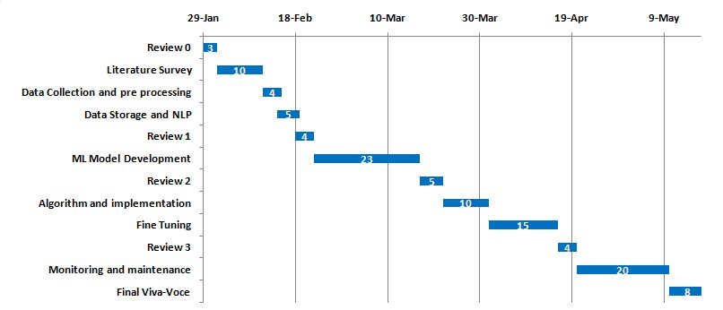
Timeline of the Project (Gantt Chart)

Slide 13
References (IEEE Paper format)
M. Goffredo et al., “Fallacious argument classification in political debates,” Proc. of IJCAI 2022, pp. 4148–4154, 2022. https://doi.org/10.24963/ijcai.2022/575
S. Haddadan et al., “Yes, we can! Mining arguments in 50 years of US presidential campaign debates,” Proc. of ACL 2019, pp. 4701–4711, 2019. https://aclanthology.org/P19-1463.pdf
M. Mancini et al., “MM-USED-fallacy: A multimodal dataset for argument fallacy detection,” Proc. of EACL 2024, pp. 159–165, 2024. https://aclanthology.org/2024.eacl-short.16.pdf
M. Mancini et al., “MM-USED: A dataset for multimodal argument mining,” Proc. of ArgMining 2022, pp. 135–146, 2022. https://aclanthology.org/2022.argmining-1.15.pdf
M. Lippi and P. Torroni, “Argument mining from speech: Detecting claims in political debates,” Proc. of AAAI 2016, pp. 2979–2985, 2016. https://ojs.aaai.org/index.php/AAAI/article/view/10384
P. Mestre et al., “M-Arg: A multimodal argument mining dataset,” Proc. of ArgMining 2021, pp. 77–88, 2021. https://aclanthology.org/2021.argmining-1.8.pdf

Slide 14


