Slide 1
E-Learning Website
- By Technocrats

Slide 2

What Is e-learning
E-learning is the use of technology to enhance learning and teaching
This initiative is to improve the quality of learning
It is the platform to provide efficient learning materials.
It is the new approach to learning where the learner has control over what , when and where he/she learns .
Focus on learner
- Designing , developing , delivering and accessing.

Slide 3
Concept OF E-LEARNING
In our rapid changing world we find it difficult to overcome the learning challenges and the possible achievements.
To bridge this gap , the concept such as E-learning has become the part of effective education.

Slide 4
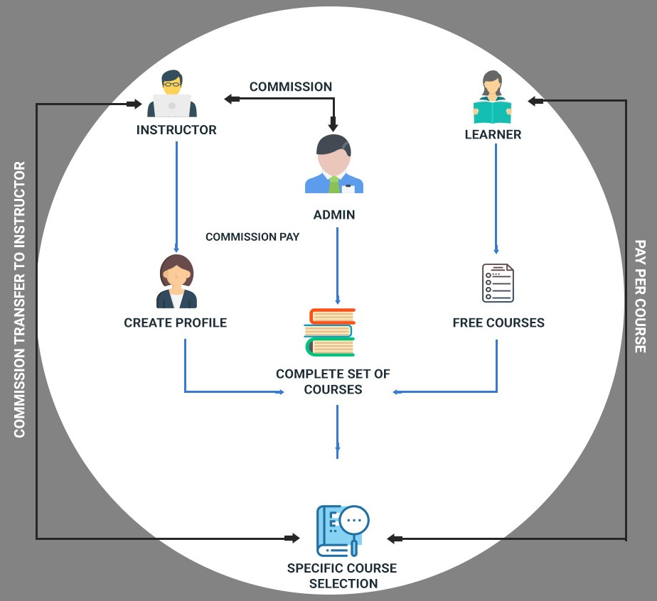
Learning model
Model consists of 4 factors :
Instructor
Learning Material
Learner
Tools

Slide 5

Instructor
Instructor are teachers who work in an internet environment.
They build new concepts of working in time and space.
They find new learning resources as they interact with information, materials and ideas with their students and colleagues.

Slide 6
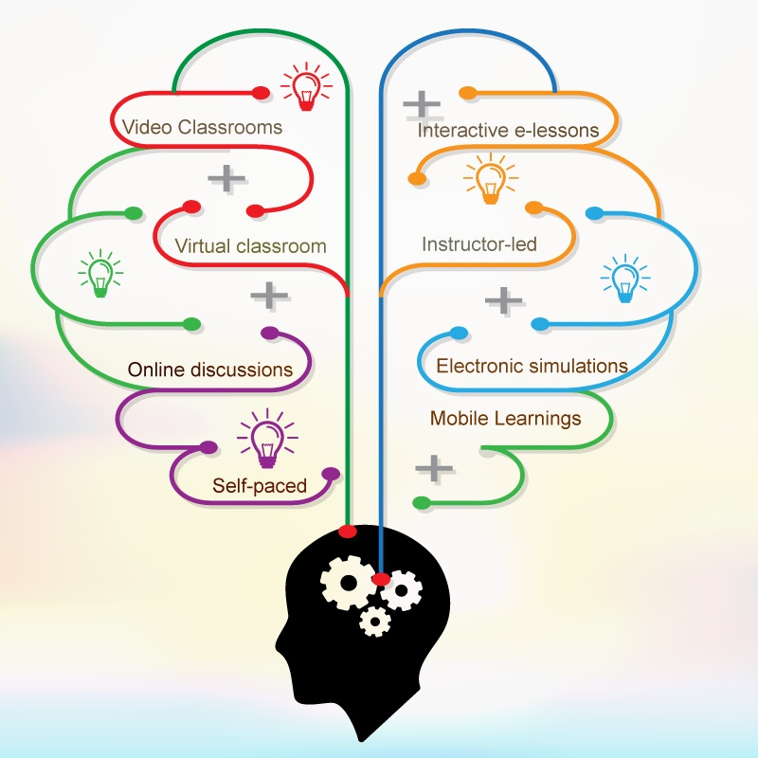
LEARNERS MATERIAL
Learners prefer to pay for eLearning content which they find simple, relevant, and informative.
Therefore, eLearning content development encourages the learners to finish the chapters completely.

Slide 7

LEARNER
Self Directed
Self motivated
Self regulating
Lifelong Learning

Slide 8
E-Learning Tools
Every teacher and student should have an e-mail account
Communicate with students
Communicate with parents
Create a paperless enviroment
Simple but effective
Effiecient and cost effective

Slide 9
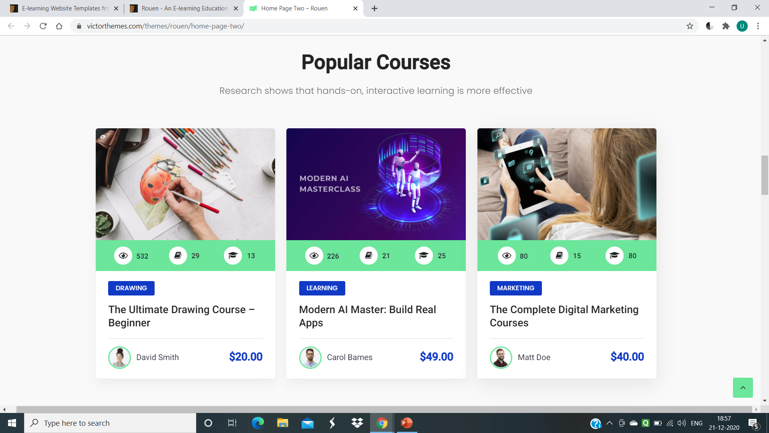
Features
With the help of this feature , you can learn the needed lessons as per your needs .
Our quality curriculum is designed with top-tier industry partners, not academics so you learn the skills.
Research shows that hands-on, interactive learning is more effective.

Slide 10

Quizzes
A quiz is an essential and beneficial component of an eLearning course. It contributes to elevating the overall effectiveness of a course by increasing engagement level and heightening retention.

Slide 11
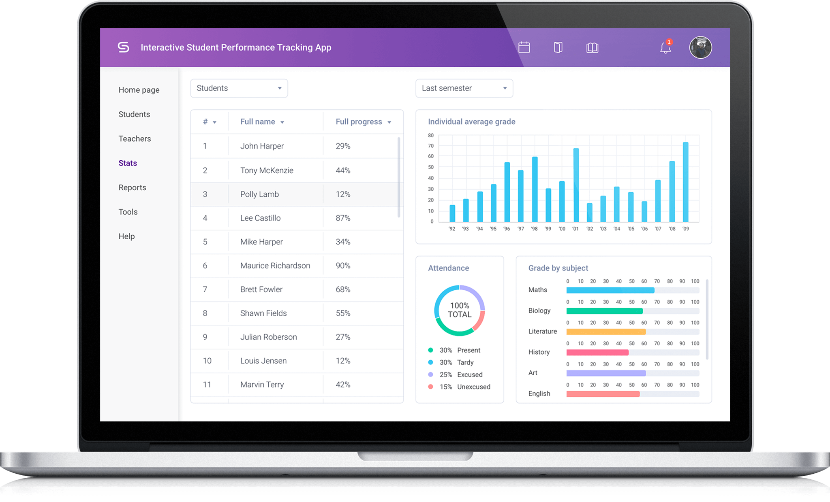
Performance analysis
An analysis of a student's performance should be provided periodically.
The performance should be based on various parameters, such as the completion of chapters, the ability to understand concepts with respect to time, project work, and scores on quizzes.

Slide 12

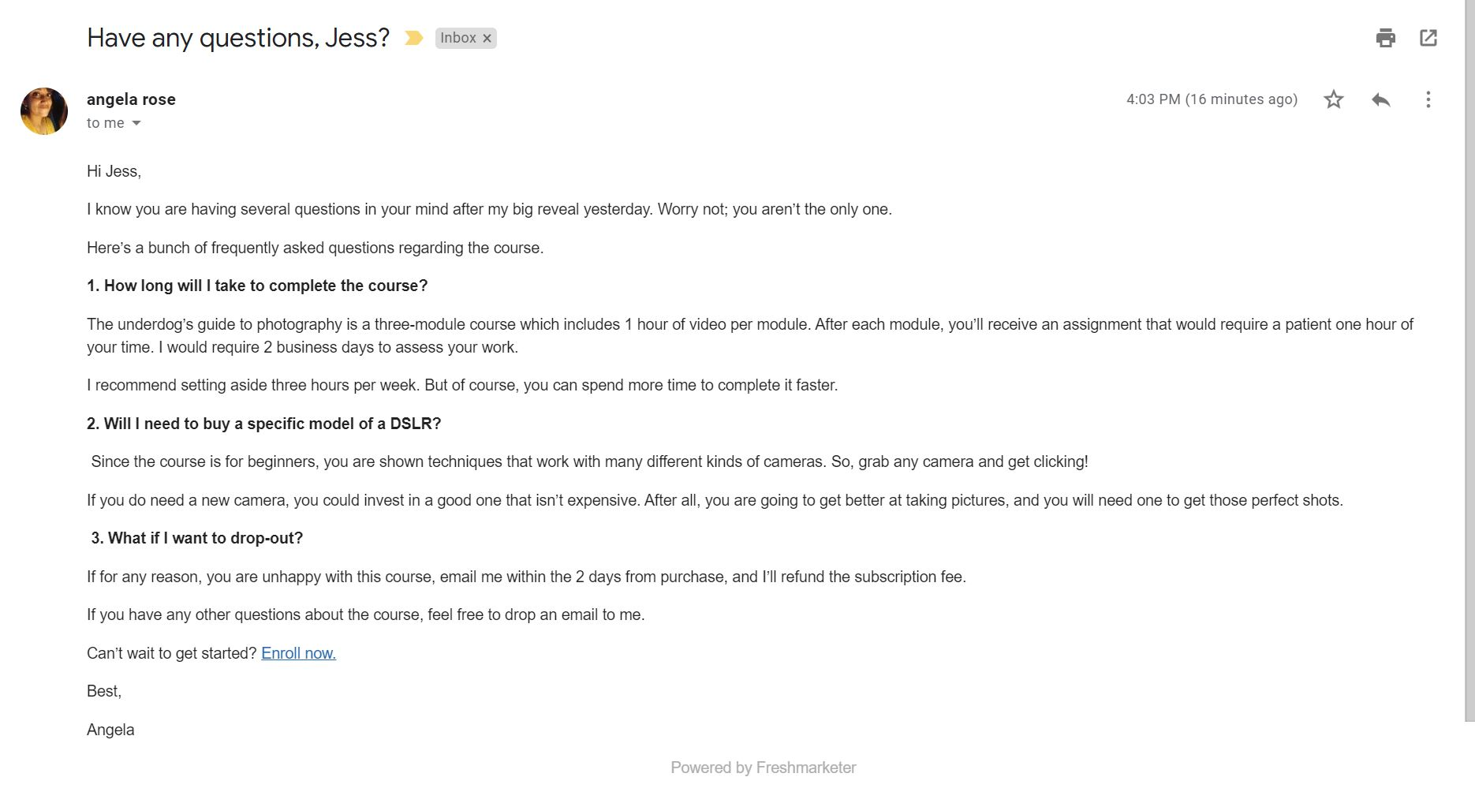
Communication
A two way communication between the instructor and E-learners using Online Forum as well as E-mail .
Collaborating learning with group discussion and Community Participation.

Slide 13
"We need to bring learning to people instead of people to learning."
- Elliot Masie

