Slide 1

Flipkart
Growing the number of reviews on the platform
By Bhoomi Parikh

Slide 2







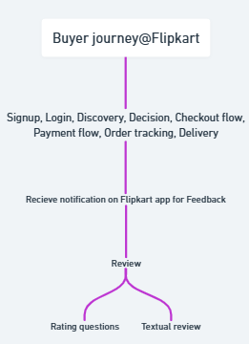
Product and Problem Overview
The Problem Space
Define Goal: Turn the post-purchase experience into a moment of delight and trust-building Assumption: We have infinite tech bandwidth. We are solving for mobile-first users.
E-commerce Marketplace
$33B Valuation
$6.74B Revenue
450M+ buyers
What is a user review?
2.5M orders/day
1.4 M sellers
A user review is an evaluation of a product or service written by someone who has purchased and used it.
Powering India's Digital Commerce
Business model - Marketplace
User Journey
- Flipkart is a platform connecting buyers and sellers across India.
- Sellers list their products on the platform, and Flipkart takes a commission on each sale — this is Flipkart’s primary revenue stream.
- Flipkart does not hold inventory — this model enables a wide product range without the complexities of inventory management.

Slide 3
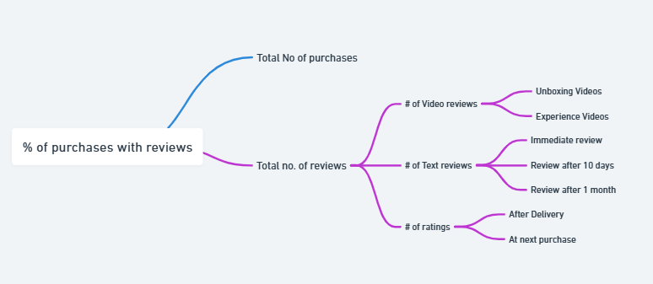
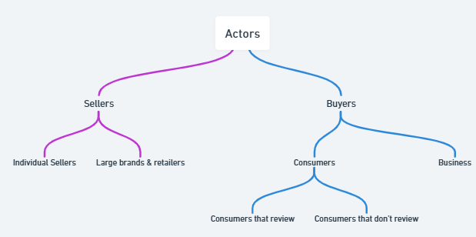
KPI Tree
Actors/Stakeholders in the System
Why are User Reviews Important?
Problems Faced by Users
Product Outcomes
1. Build trust & credibility
2. Boost conversions on product pages
3. Feedback loop for sellers & Flipkart
4. Improve product visibility (SEO/ranking)
5. Enable rich content (photos, videos)
Delivery delays & poor tracking
Confusing returns/refund flow
Robotic or slow support
No human touch post-payment
Review prompts come too late or are ignored
1. More reviews
2. Higher conversions
3. Stronger trust
4. Fewer support tickets
5. Better product visibiity

Slide 4
Who are the users facing this problem?
Insights from users
Young working adults (21–35) in Tier 1 & Tier 2 cities
Shop regularly on Flipkart using mobile apps
Spend hours daily on social media (YouTube, Instagram)
Prioritize speed, convenience, and trusted peer opinions
Don’t revisit the app post-delivery unless there’s a problem
Needs & Goals
Clear, easy review process
Motivation or reason to share feedback
Confidence that their input matters
6 out of 10 users said: “I forget to leave a review unless I get reminded”
4 out of 5 prefer giving feedback on WhatsApp or via notification
Majority find photo/video-based reviews more credible than text
Review forms feel long and repetitive
Secondary Research
What is the TRUE problem
Review content (especially short videos) increases buyer trust
Most users open WhatsApp more often than any shopping app
Incentivized actions (points, badges) increase review rates significantly
Users lack motivation to write reviews — no clear value or reward
Flipkart’s review flow has friction and poor visibility
Users don’t return to the app once the product is delivered

Slide 5
Use visits Flipkart
Value from Users
🎁 Incentives for leaving helpful reviews
🔍 Easier comparison between products
🧠 Informed decisions through real buyer experiences
🕒 Saves time and reduces product return risks
🌟 Builds credibility and trust
🚀 Boosts product discoverability in searches
💬 Gains direct customer feedback for improvements
💸 Drives higher sales and lower return rates
A user discovers the review while searching
Users looks at review & buys a product
Search engine index the review
User reviews the product
Why solve this now?
📈 India's e-commerce sector is booming, forecasted to grow steadily by 2027
🛒 Amazon India is accelerating — Flipkart must innovate to stay competitive
📢 Meesho is capturing huge rural markets, pushing Flipkart to strengthen loyalty among existing users

Slide 6
SmartPrompt
QuickSnap Review
Review Rewards Hub
What is it?
What is it?
What is it?
SmartPrompt sends users a simple, smart notification or WhatsApp message after product delivery, nudging them to leave a quick review.
QuickSnap allows users to upload a quick photo or 15-second video of the product instead of typing long reviews.
A gamified rewards dashboard where users can track their earned Flipkart Coins, badges, or vouchers for writing helpful reviews.
How it solves the problem
How it solves the problem
How it solves the problem?
Saves time and appeals to mobile-first users
Makes reviews more engaging and credible for future shoppers
Incentivizes users to leave more thoughtful reviews
Creates a habit of participation after every purchase
Reaches users at the right moment (when satisfaction is high)
Reduces forgetfulness and friction to submit reviews
Solutions
Reach
Frequency of usage
Impact on Users
Time spent for a review
Impact on business
# reviews
Confidence
(Assurance)
Score
Smart Prompt
5
5
4
4
18
QuikSnap Review
4
4
4
4
15
Review Rewards Hub
3
3
3
3
14

Slide 7
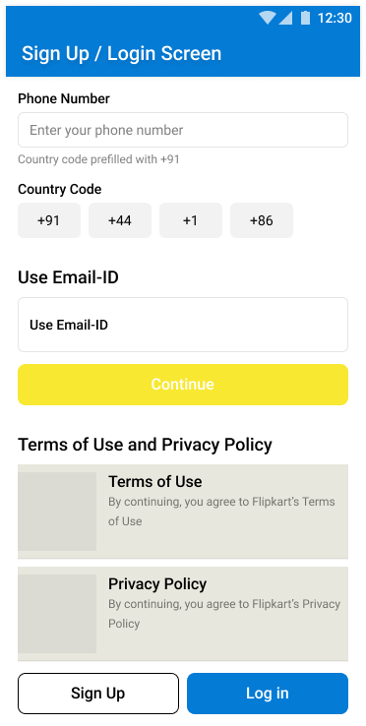
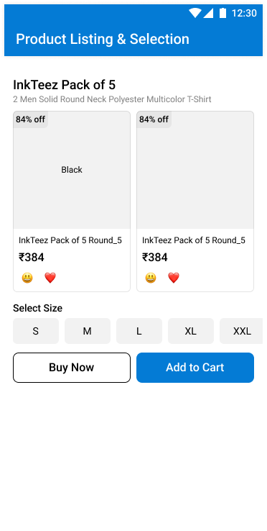
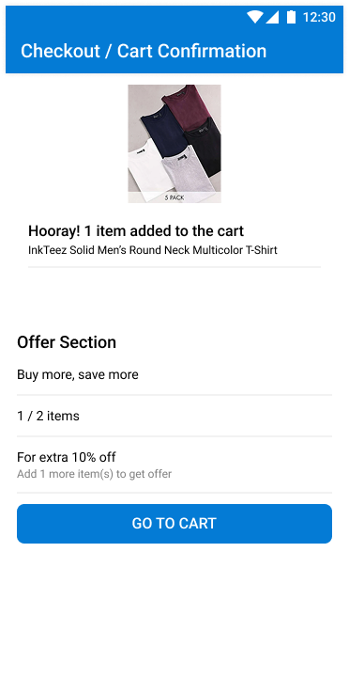

UI Mockups
UI Mockups

Slide 8
Metrics: How would you measure the success of the solution?
North Star Metric: Number of reviews generated
Type | Metric | Goal
 | - # of users receiving review prompts - Open Rate of review invites
 | - # of first-time reviewers using SmartPrompt - % of reviews submitted through WhatsApp vs App
 | - Avg. # of reviews submitted per user - Avg. # of images/videos attached per review
Awareness
Measure feature reach
- Click-through Rate (CTR) on Review Prompt
Activation
Measure action taken
Adoption
Measure adoption
Engagement
Measure user activity
Retention
- % of users submitting reviews more than once
Measure long-term use
Satisfaction
- User Satisfaction Score on Review Flow (CSAT)
Measure long-term use

Slide 9
Pitfalls and Mitigations - Why could the solution fail ?
Pitfalls
Mitigation
01
Personalized timing (send after successful delivery)
Clear value in the message ("Review and earn Flipkart Coins")
Low engagement with SmartPrompt notifications
02
AI-based spam/fraud detection
Manual moderation for flagged reviews
Fake or low-quality reviews submitted
03
Resistance from users uncomfortable with WhatsApp
Allow choice between WhatsApp, app, or email review prompts
Clear opt-in consent
04
Reward system abuse (fake reviews for coins)
Set minimum quality standards for reward eligibility
Random audits of rewarded reviews
Future Scope
Long term Vision
Expand to All Product Categories
Currently focused on high-value items — later extend SmartPrompt to categories like fashion, home essentials, etc.
Enable Video Reviews at Scale
Build lightweight in-app tools for easy 30-second video submissions, even on low-end devices.
AI-Powered Smart Review Sorting
Use AI to surface the most helpful, authentic, and recent reviews automatically for every product page.
Social Sharing Integration Let users easily share their review videos or experiences to Instagram, WhatsApp Status, etc., driving organic brand visibility.
Become the Most Trusted Review Platform in India Turn Flipkart's post-purchase experience into a competitive advantage where reviews are not just a checkbox but a powerful trust-building engine.

