Slide 1

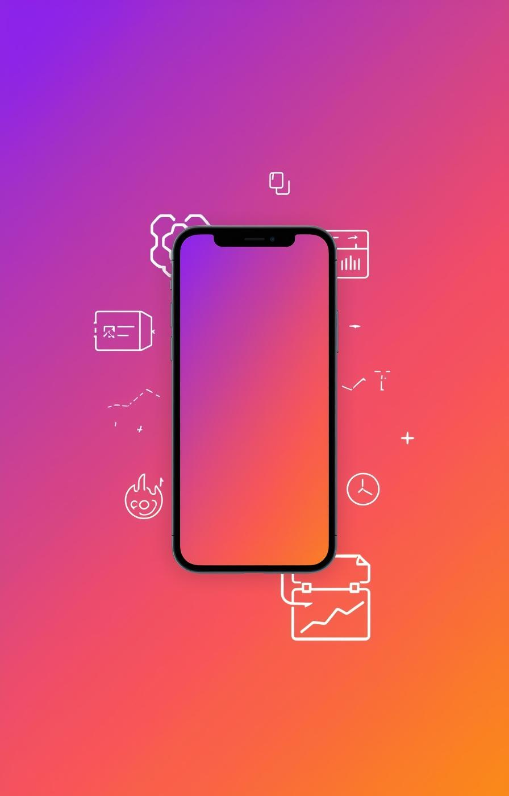

Instagram

Slide 2
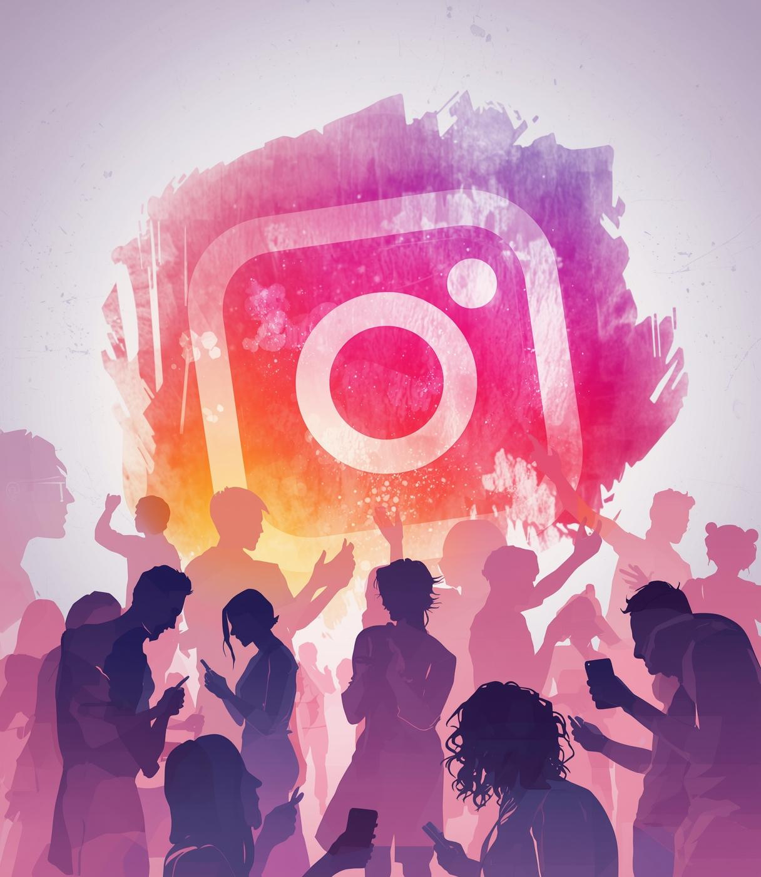
Exploring Instagram Personas
User Personas Unveiled

Slide 3
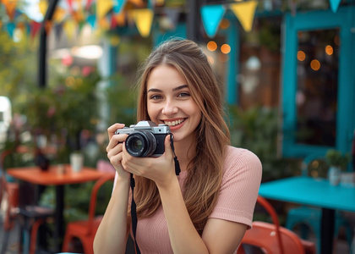
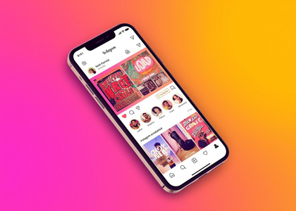
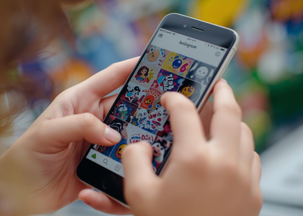
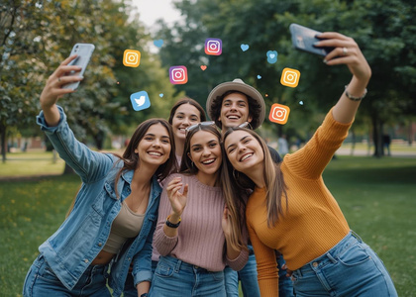
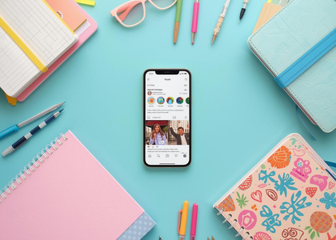
Mia Rodriguez: The Social Storyteller
Mia Rodriguez, 22, college student (Communications major), lives in Austin, TX. Loves digital storytelling, campus events, and photography. Shares snippets of daily life, travels, and food adventures with friends and a growing audience.
Goals and Aspirations
Behaviors and Interactions
Challenges Faced
Usage Context
Building Community
  Engage her followers with creative reels and stories
  Build a personal brand for media internships
  Stay up to date with friends and trending content
  Frequently shares multimedia content (stories, reels)
  Interacts via polls, Q&A, and reacts to friends' posts
  Follows and interacts with local creators
  Overwhelmed by sponsored posts/ads
  Algorithm hides content from close friends
  Limited editing tools on mobile
  Uses the app during short breaks, after class, and at night
  Active both as a content creator and consumer
  Mobile-first; rarely uses browser version
Through her lively posts and stories, Mia aims to connect with like-minded individuals, fostering a sense of community and shared experiences within her online network.

Slide 4

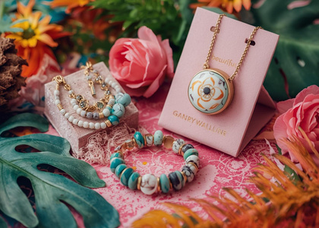
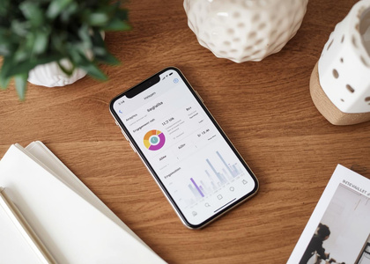

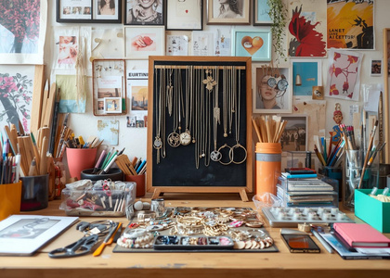
Instagram User Persona: Priya Patel
Priya Patel, 34, owns an eco-friendly jewelry brand in Chicago. Started using Instagram for personal use, now leverages it for business growth, customer service, and community-building.
Engaging Customers through Instagram
Efficient Management Practices
Challenges in Campaign Tracking
Optimizing Business Hours
Integrating E-Commerce Tools
  Schedules regular posts and stories for new releases
  Uses Instagram analytics to track engagement
  Responds to direct messages and customer comments
  Difficult to track campaign performance
  Managing multiple DMs and comments is time-consuming
  Algorithm changes affect reach unpredictably
  Active during business hours and evenings
  Uses both mobile and desktop interfaces
  Relies on integration with e-commerce tools
Utilizing e-commerce tool integrations, Priya effectively converts Instagram engagement into sales, streamlining her business operations for growth and success.
  Attract new customers with product posts and reels
  Efficiently manage brand messaging and promotions
  Receive feedback and interact with buyers directly

Slide 5

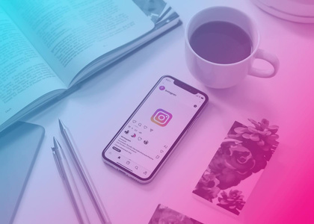
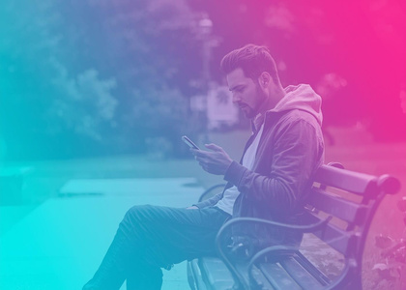
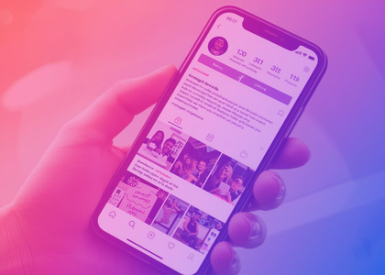

Ron : The Casual Browser
Ron Johnson, 48, high school teacher in Seattle. Enjoys keeping up with friends, sports, and news. Prefers passive browsing and minimal engagement.
Goals and Behaviors of Ron
Challenges in Ron's Experience
Context of Use
Content Preferences
Desired User Experience
  Stay connected with family and old friends
  Discover news, hobbies, and memes passively
  Avoid information overload and time-wasting
  Feels lost with frequent app feature updates
  Gets distracted by endless scrolling
  Finds suggested content less relevant
  Feels lost with frequent app feature updates
  Gets distracted by endless scrolling
  Finds suggested content less relevant
  Uses Instagram mainly on mobile, in short sessions
  Seeks a relaxed, low-effort experience
  Not interested in creating or posting content
Ultimately, Ron seeks a relaxed browsing atmosphere that does not demand much effort, allowing him to enjoy social media at his own pace.

Slide 6
Instagram User Experience Redesign
Feature Enhancements

Slide 7
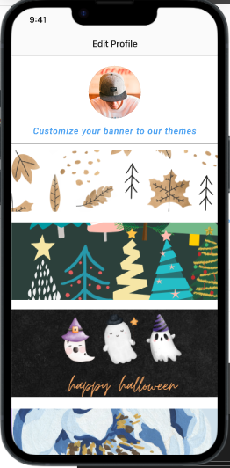
Enhancement 1: Customizable Themes
Located in: Profile Settings → Customize Your Banner
Premium Themes (Subscription Required)
PROBLEM: Instagram lacks personalization options, making the app feel generic.
SOLUTION: Customizable themes allow users to personalize their homepage aesthetics.
KEY BENEFITS
- Enhanced Personalization
- Improved User Experience (Dark Mode)
- Revenue Opportunity

Slide 8
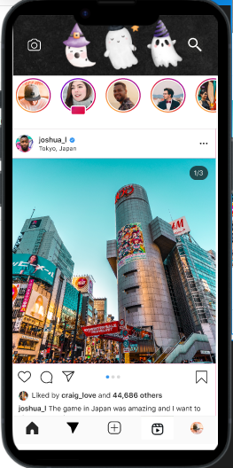
Enhancement 2: Navigation Redesign
Optimizing Icon Placement for Better User Flow
PROBLEM
Search icon in bottom bar: Requires uncomfortable thumb stretch on larger phones
Messages in top bar: Occupies premium space despite being secondary action
Poor ergonomics: Most-used features aren't optimally placed
SOLUTION
Swap Search and Messages icons to align with natural usage patterns and ergonomic thumb zones.
KEY BENEFITS
Improved Ergonomics Bottom navigation optimized for one-handeduse
Faster Search Access Top bar placement enables quick discovery
Messaging Convenience Bottom placement makes DMs easier to reach

Slide 9
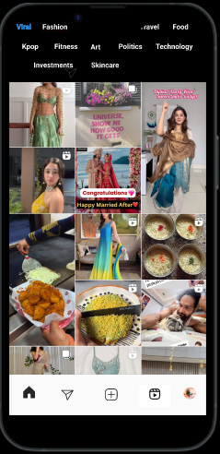
Enhancement 3: Swipe Gesture Redesign
Streamlined Navigation: Swipe Right to Feed
PROBLEM
Instagram's swipe-right gesture currently opens Messages, disrupting users who are actively browsing content. This creates friction when accidentally triggered while scrolling through posts.
SOLUTION
Redirect the swipe-right gesture from Messages to Feed, allowing users to seamlessly navigate between different content views without leaving the browsing experience.
KEY BENEFITS
Seamless Browsing Flow
Behavior-Aligned Navigation
Reduced User Frustration

Slide 10
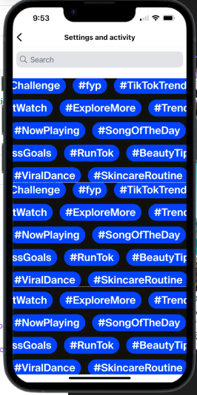
Enhancement 4: Customizable Feed
Personalized Content Discovery with Keyword Filters
PROBLEM
Instagram's algorithm shows content based solely on past engagement, giving users no control over what appears in their feed. Users feel confused and overwhelmed, unable to prioritize specific topics or discover diverse content beyond what they've previously liked.
SOLUTION
Keyword-based feed customization (Settings → Choose Your Feed) allows users to select topics of interest. Selected keywords appear as filterable pills at the top of the feed, enabling one-tap content filtering by topic.
KEY BENEFITS
User Control & Personalization
Instant Content Filtering
Reduced Content Clutter

Slide 11
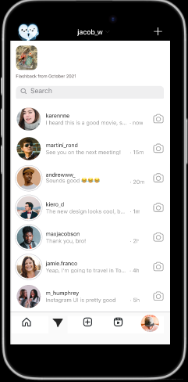
Enhancement 5: Memories Feature
Relive Your Instagram Journey with Automatic Memories
PROBLEM
Instagram has no built-in way to rediscover old content. Users must manually scroll through their entire profile to find past posts, making nostalgic moments difficult to revisit and reshare.
SOLUTION
Automatic Memories feature on the Messages page surfaces posts and stories from 1-2 years ago, allowing users to relive, reshare, and download nostalgic content effortlessly.
KEY BENEFITS
Past moments surface automatically without manual scrolling
One tap to share memories to Story with date stickers
Save memories directly to device for safekeeping

Slide 12
Exploring Instagram User Stories
User Stories
Unveiled

Slide 13
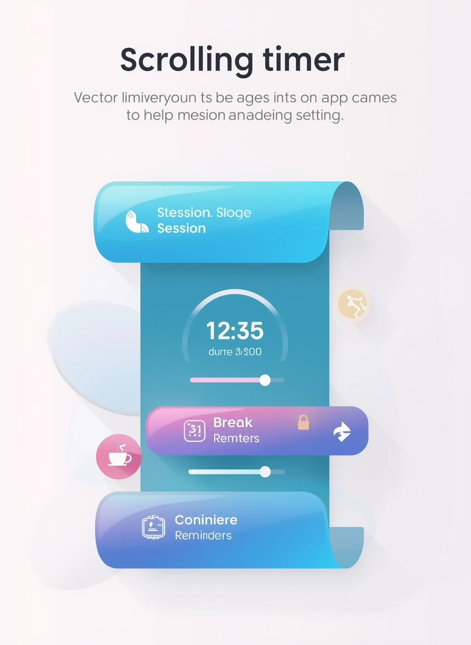
Streamlined Search
Focused Social Connection
Persona: Mia Rodriguez (The Social Storyteller)
User Story: As Mia, I want the search bar to be readily available on the main feed so that I can instantly look up trends, local creators, and content without interrupting my browsing flow.
Benefit: This allows for quicker content discovery and engagement, helping her build her personal brand and stay up-to-date efficiently.
Acceptance Criteria:
1. The search bar is placed at the top of the primary feed, above the Stories tray.
2. Tapping the search bar opens the full search interface directly.
3. The change does not remove any existing navigation elements from the bottom bar.
Persona: Ron Johnson (The Casual Browser)
User Story: As Ron, I want my messages and friend activity grouped on a dedicated
screen, replacing the shopping tab, so that I can focus on connecting with friends without
commercial distractions.
Benefit: This creates a less distracting, more intentional browsing atmosphere that aligns
with his goal of avoiding information overload.
Acceptance Criteria:
1. The second tab in the bottom navigation is re-labeled and re-skinned to "Chats."
2. Tapping the "Chats" tab reveals a unified view of direct messages and friend
activity/notifications.
3. The shopping tab is removed from the main bottom navigation bar.

Slide 14
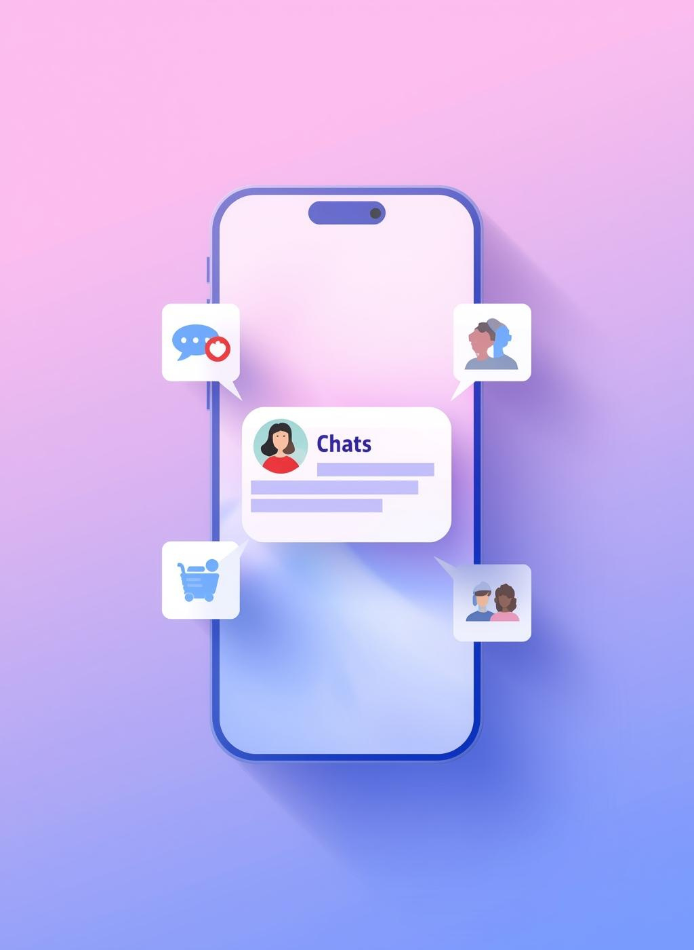
Mindful Scrolling Aid
Persona: Ron Johnson (The Casual Browser)
User Story: As Ron, I want to set a scrolling timer with break reminders so that I can consciously manage my time on the app and prevent unintentional, endless scrolling.
Benefit: This promotes a relaxed, low-effort experience by helping him avoid time-wasting and maintain control over his social media usage.
  Acceptance Criteria:
1. A "Scrolling Timer" menu is added within the main Settings page.
2. The user can set a session duration (e.g., 15, 30, 45 minutes).
3. Upon timer expiration, a gentle, non-dismissible full-screen reminder appears,
encouraging the user to take a break.
Automated Post Organization
Persona: Mia Rodriguez (The Social Storyteller)
User Story: As Mia, I want my saved posts to be automatically organized into thematic
folders using AI so that I can quickly find inspiration for my content (e.g., travel, food,
outfits) without manual sorting.
  Benefit: This saves time and enhances her ability to curate content for her personal
brand, making her content creation process more efficient.
  Acceptance Criteria:
  A new "Auto-categorize" feature is introduced in the "Saved Posts" section.
2. The AI automatically generates and populates folders based on the content of
saved posts (e.g., "Travel Inspiration," "Food Ideas").
3. The user can review, rename, and move posts between these auto-
generated folders.

Slide 15
Direct Sales from Stories
Persona: Priya Patel (The Business Owner)
User Story: As Priva, I want to add purchasable product stickers to my stories so that I can convert viewer engagement into direct sales without requiring them to visit a
separate website.
  Benefit: This streamlines the purchasing process, improves sales conversion from
marketing efforts, and helps track the direct ROI of story campaigns.
  Acceptance Criteria:
  A "Product" sticker is available in the sticker tray when creating a story.
Selecting the sticker allows me to link a specific item from my connected e-commerce catalog.
2. Viewers can tap the sticker to see product details and complete the checkout
process within the Instagram app.

Slide 16

Appendix:A Day in the Life
Morning Engagement
Evening Reflection
Midday Check-in
Afternoon Scroll
👩‍🎓 Mia Rodriguez – The Social Storyteller (College Student, 22, Austin, TX)
Goal: Build community and express creativity through stories and reels.
Tone: Energetic, spontaneous, and socially connected.
Timeline:
  7:30 AM ☀️ – Checks Instagram stories while getting ready for class; replies to friends’ DMs.
  10:00 AM 📸 – Captures campus moments or coffee snaps for her story.
  1:00 PM 🎓 – Scrolls through trending reels during lunch; saves ideas for future posts.
  4:00 PM 💬 – Engages with polls and Q&As from friends and local creators.
  6:30 PM 🌇 – Edits and uploads a reel using mobile tools; experiments with filters.
  9:00 PM 🌙 – Reviews engagement metrics and responds to comments before bed.
Extra Educational Insight:
Mia’s day reflects the dual role of student and micro-influencer, showing how social media habits intertwine with identity-building and peer engagement — a key concept in digital communication studies.
👩‍💼 Priya Patel – The Entrepreneurial Creator (Small Business Owner, 34, Chicago)
Goal: Use Instagram to grow her eco-friendly jewelry brand and connect with customers.
Tone: Strategic, data-driven, and customer-focused.
Timeline:
  8:00 AM ☕ – Reviews overnight engagement and analytics reports.
  10:00 AM 💻 – Schedules product posts and stories for the day.
  12:30 PM 💬 – Responds to customer DMs and comments during lunch.
  3:00 PM 📊 – Tracks campaign performance and adjusts hashtags or captions.
  6:00 PM 🛍️ – Collaborates with influencers or posts behind-the-scenes content.
  9:00 PM 🌙 – Reflects on daily engagement and plans next day’s content strategy.
Extra Educational Insight:
Priya’s schedule demonstrates how small business owners integrate social media marketing into daily operations, balancing brand storytelling, analytics, and customer engagement — ideal for discussions on digital entrepreneurship.
👨‍🏫 Ron Johnson – The Casual Browser (High School Teacher, 48, Seattle)
Goal: Stay connected with friends and enjoy light entertainment without information overload.
Tone: Relaxed, reflective, and minimalistic.
Timeline:
  6:30 AM ☕ – Scrolls through news and sports highlights before work.
  12:00 PM 🍴 – Checks memes and family updates during lunch break.
  4:00 PM 🚌 – Passively browses suggested posts on commute home.
  7:00 PM 📱 – Watches short reels or reads comments on favorite hobby pages.
  9:30 PM 🌙 – Logs off early to avoid endless scrolling and screen fatigue.
Extra Educational Insight:
Ron’s day highlights passive consumption patterns and the impact of algorithmic design on user attention, offering a valuable lens for studying digital well-being and user experience design.

