Slide 1
eDocLite
Harish Annavajjala
Jay Nagle
Vraj Parikh
Rohit Patil
Yash Ketkar

Slide 2
Build Plan
Semester is divided into total of 5 sprints.
First sprint is for 3 weeks and we are in the last week of first sprint

Slide 3
Tasks Completed
Exploring the project on github
Added test frameworks Karma and Mocha and also tested them using simple tests
Setting up Webpack and setting it up to use Babel for transpiling React,ES2015 and ES 2016
Executed the tests by “npm test”
Able to lint the project by “ESLint”
Setup codeclimate to check linting rules on check into master

Slide 4
Tasks Completed (cont.)
Setup Travis-CI continuous integration service.
Added badges for codeclimate and Travis-CI to github README
Documentation using esDocs
Use PhantomJS as browser for running tests.

Slide 5
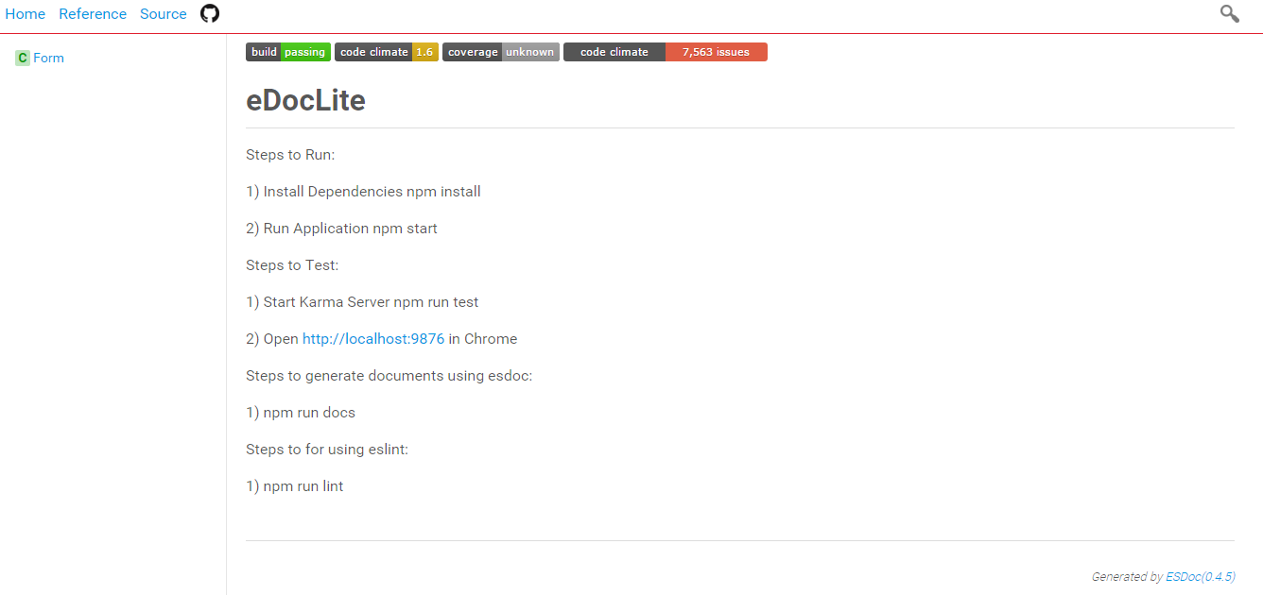
Github Badges

Slide 6
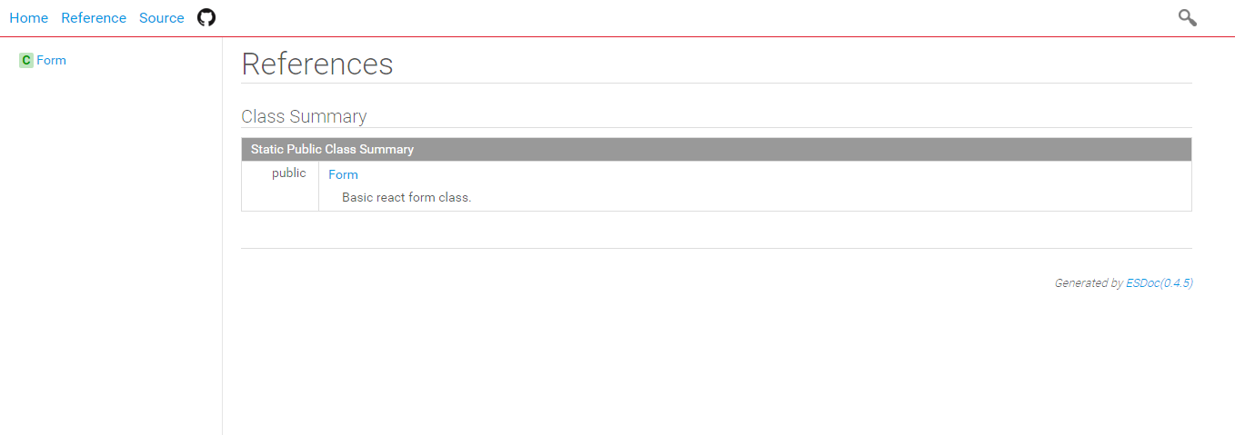
esDocs Documentation

Slide 7
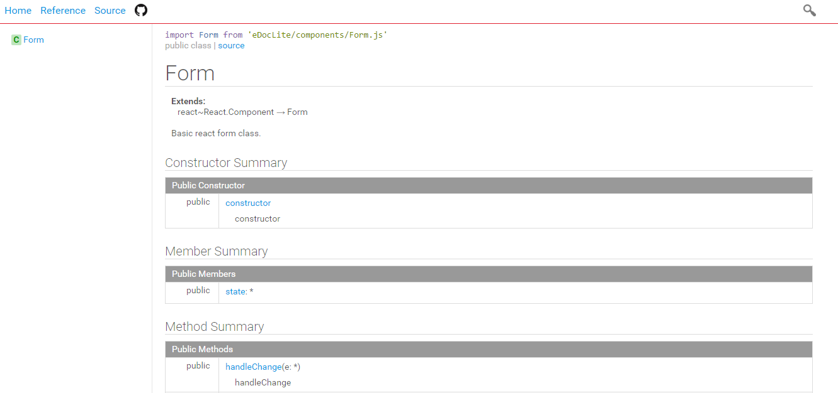
esDocs Documentation

Slide 8
Team Work
Helped each other with issues faced during setting up of build environment
Divided tasks for front end and back end on basis of modules.
We pushed code to different branches in git which were reviewed by other team members.

Slide 9
Tools
NodeJS
ReactJS
Webpack
Babel
Git
Travis-CI
Karma
Mocha
Slack
CodeClimate

Slide 10
Thank You

