Slide 1
eDocLite
Harish Annavajjala
Jay Nagle
Rohit Patil
Vraj Parikh
Yash Ketkar

Slide 2
Build Plan
We have divided the Semester into 5 Sprints
Completion of Sprint 1
Setting up of Build Environment
Start of Sprint 2
Create a forms using React

Slide 3
Milestone 1: Tasks Completed
Start Working on an Issue.
Create a feature branch
Publish feature branch to central repository
Write Tests
Add a Test Runner (Karma)
Add a Testing Framework (Mocha)
Add a simple test which generates test output
Use PhantomJS as browser for running tests.

Slide 4
Milestone 1: Tasks Completed
Implement Code
Setup Webpack
Setup webpack to use Babel for transpiling React,ES2015 and ES2016
Read about ES2015/ES2016
Setup webpack to do LESS preprocessing
Add Bootstrap and React-Bootstrap to the project
Add dev server to serve assets

Slide 5
Milestone 1: Tasks Completed
Run Tests
Tests are executed using “npm test”
Setup Travis CI to run tests on check in to master
Setup Travis CI to run tests on push to feature branch
Setup code coverage reports using Isparta
Setup Travis CI to build coverage report in format for Code Climate
Add badge for Code Climate test coverage to Github README
Setup Travis CI to report failed builds to Slack

Slide 6
Milestone 1: Tasks Completed
Check Quality
Run “npm run lint” to lint the project with ESLint
Setup code Climate to check linting rules on check in to master
Setup Code Climate to check linting rules on push to feature branch
Add badge to Code GPA for Github README
Document Code
Code is documented with JSDoc standards
Run “npm run docs” to prepare documentation and output the overall coverage of documentation using ESDoc
Add badge for documentation coverage to Github README

Slide 7
Milestone 1: Tasks Completed
Finish Story
Submit pull request
Travis CI reports build status on pull request
Setup Github to report pull requests and comments to Slack

Slide 8
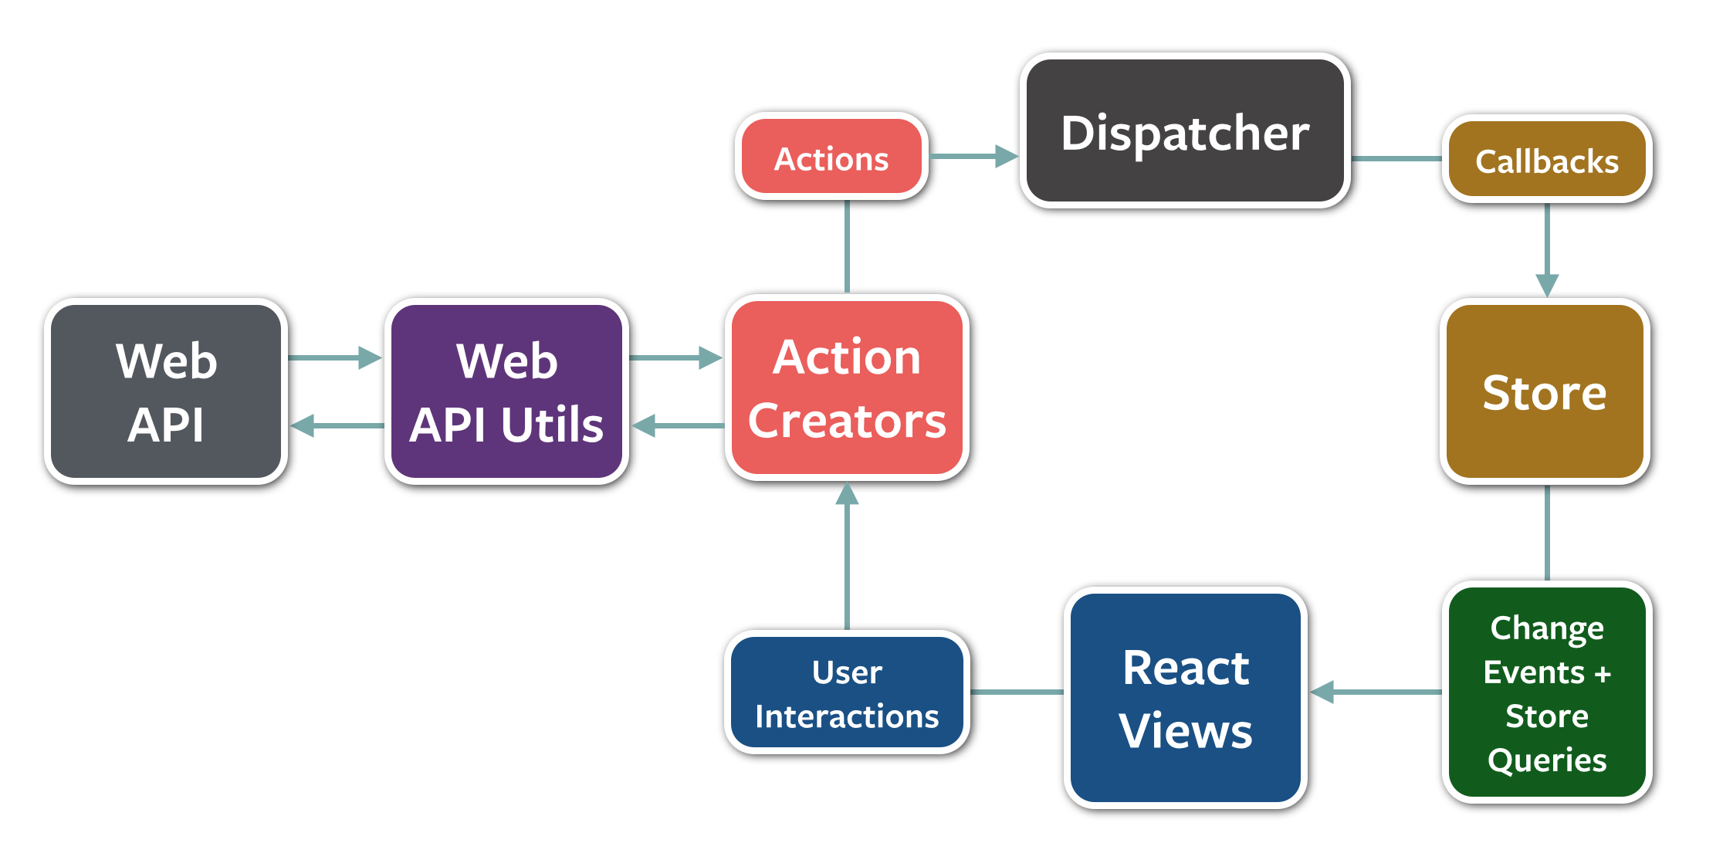
New Tools - Redux
Redux is a predictable state container for JavaScript apps.

Slide 9

Project Statistics Comparison (Vs Last Week)

Slide 10
Milestone 2
Understand Redux
We will be using the approach, as the one used for Game Maker
Created Brick Breaker
Created Game Maker
Similarly we aim to do the following
Create Forms/To-Do List using React and Redux
Create a Form Builder

Slide 11
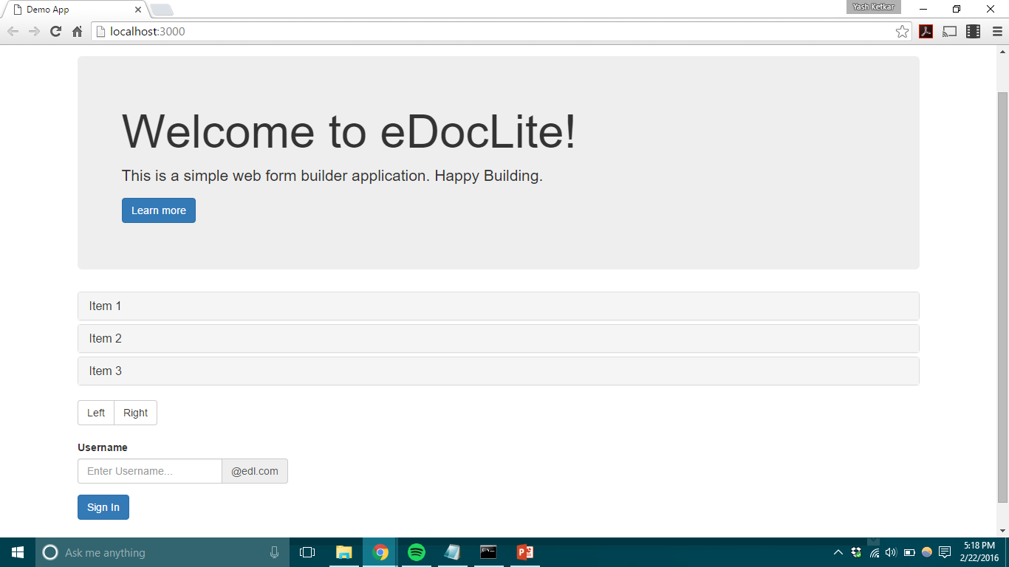

Slide 12
Team Work
Helped each other with issues faced during setting up of build environment
Divided tasks for front end and back end on basis of modules.
We pushed code to different branches in git which were reviewed by other team members.

Slide 13
Tools
NodeJS
ReactJS
Webpack
Babel
Git
Flux
Redux
Travis-CI
Karma
Mocha
Slack
CodeClimate

Slide 14
Thank You!

