Slide 1
eDocLite
Harish Annavajjala
Jay Nagle
Rohit Patil
Vraj Parikh
Yash Ketkar

Slide 2
Build Plan
We have divided the Semester into 5 Sprints
Sprint 1 - Completed
Setting up of robust Build Environment
Sprint 2 - Completed
Created forms using React and Redux.
Sprint 3 - Completed
Completed drag and drop in form builder.
Able to access the editable properties.
Sprint 4 – Completed
Finished customizing the properties of components.
Explored exporting user created form to JSX.

Slide 3
Milestone 4 : Completed
Refined edit component functionality.
Added more customization to form elements.
Explored exporting user created form as JSX.
Bug fixes.

Slide 4
Future Milestones
Ability to align form elements
Build a sample form given by the client
Complete exporting user created form as JSX.

Slide 5
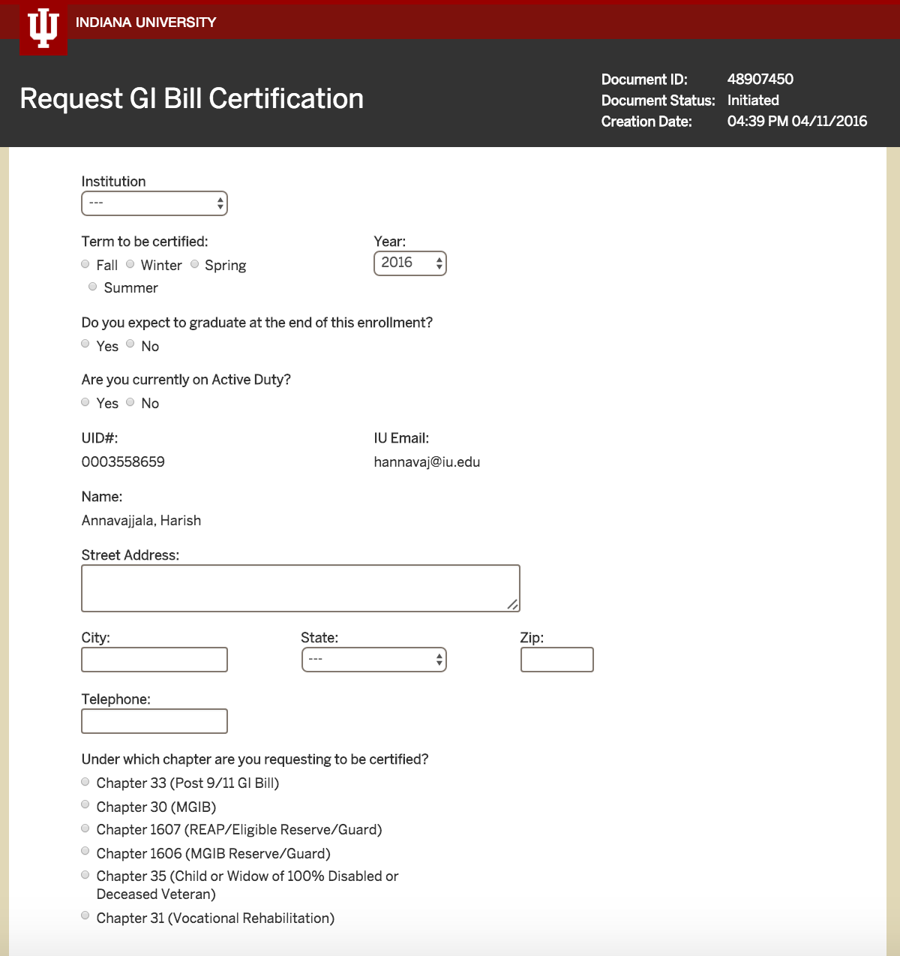

Slide 6
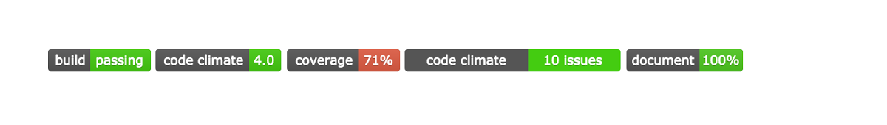
Project Statistics Comparison (Vs Last Week)

Slide 7
Team Work
Pair programming and peer reviewing
Frequent Group Meetings

Slide 8
Tools
NodeJS
ReactJS
Webpack
Babel
Git
Flux
Redux
Travis-CI
Karma
Mocha
Slack
CodeClimate

Slide 9
Demo
https://vimeo.com/162439534

Slide 10
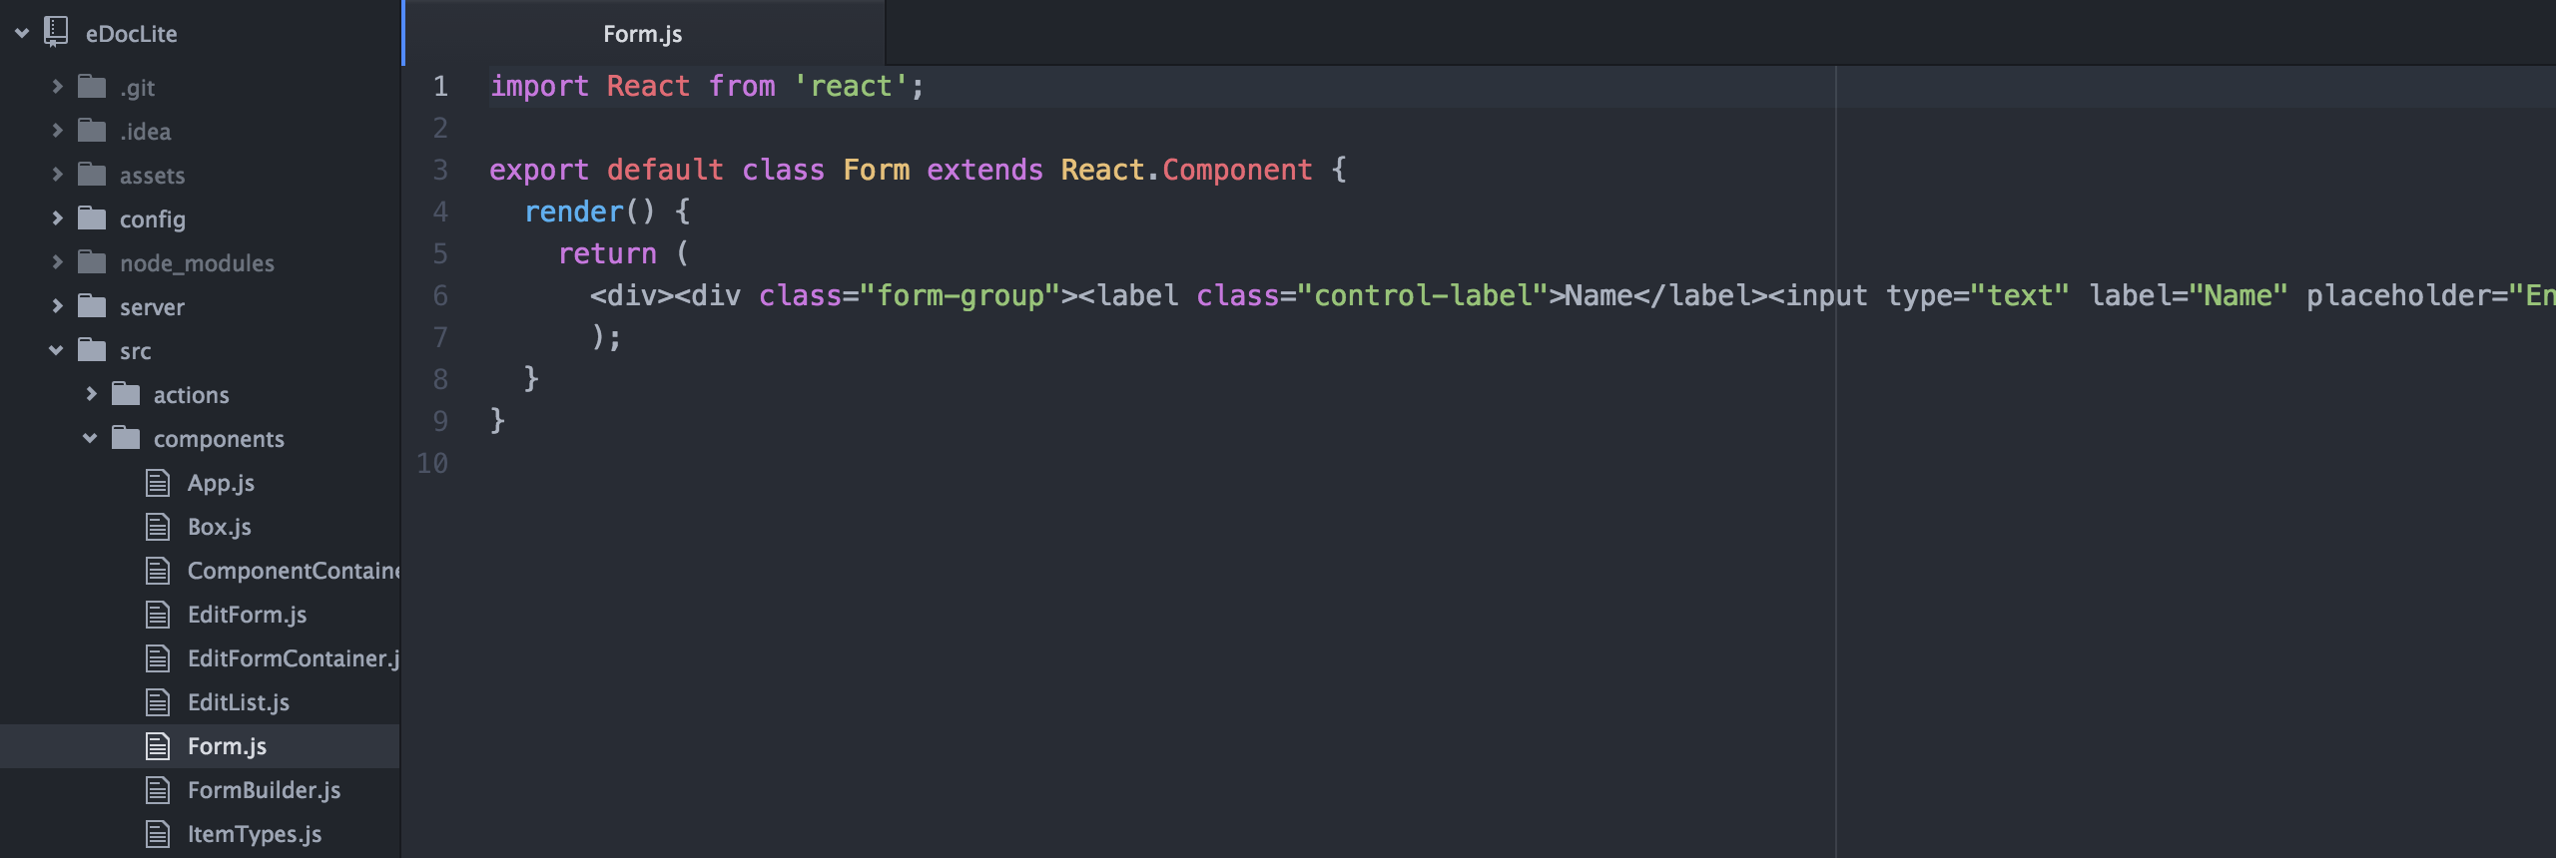
Exported Form

Slide 11
Thank You!

