Slide 1
eDocLite
Harish Annavajjala
Jay Nagle
Rohit Patil
Vraj Parikh
Yash Ketkar

Slide 2
Build Plan
We have divided the Semester into 5 Sprints
Sprint 1 - Completed
Setting up of robust Build Environment
Sprint 2 - Completed
Created forms using React and Redux.
Sprint 3 - Completed
Completed drag and drop in form builder.
Able to access the editable properties.
Sprint 4 – In progress
Finish customizing the properties of components.
Integrate all the modules.

Slide 3
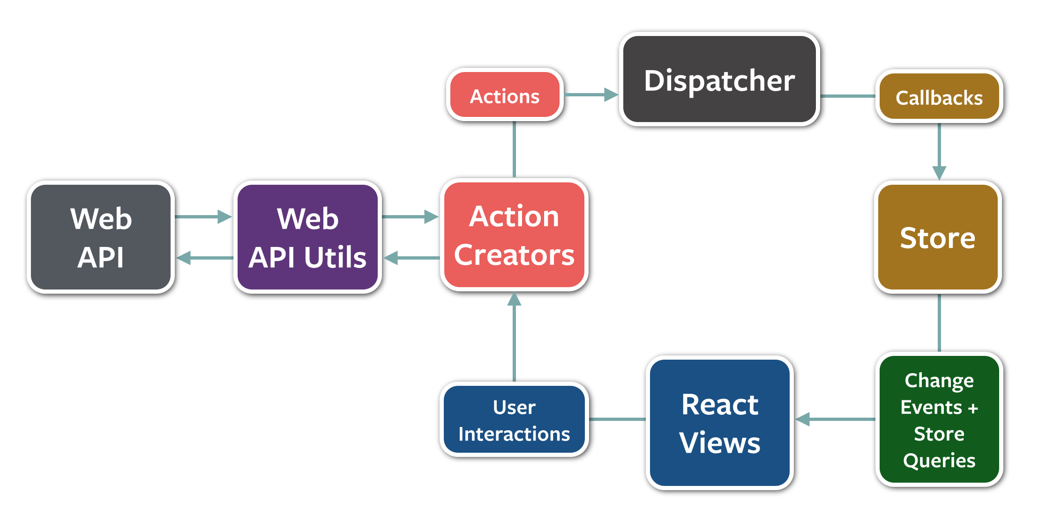
Redux
Redux is a predictable state container for JavaScript apps..

Slide 4
Milestone 3 : Completed
Achieved drag and drop functionality.
Ability to create custom forms using toolbox of draggable components.
Able to fetch and view the properties of dragged components.

Slide 5
Future Milestones
Able to completely edit properties of form elements.
Further customization of existing toolbox.
Able to save the created forms.

Slide 6
Project Statistics Comparison (Vs Last Week)

Slide 7
Team Work
Pair programming and peer reviewing.

Slide 8
Tools
NodeJS
ReactJS
Webpack
Babel
Git
Flux
Redux
Travis-CI
Karma
Mocha
Slack
CodeClimate

Slide 9
Demo
Demo

Slide 10
Thank You!

