Slide 1
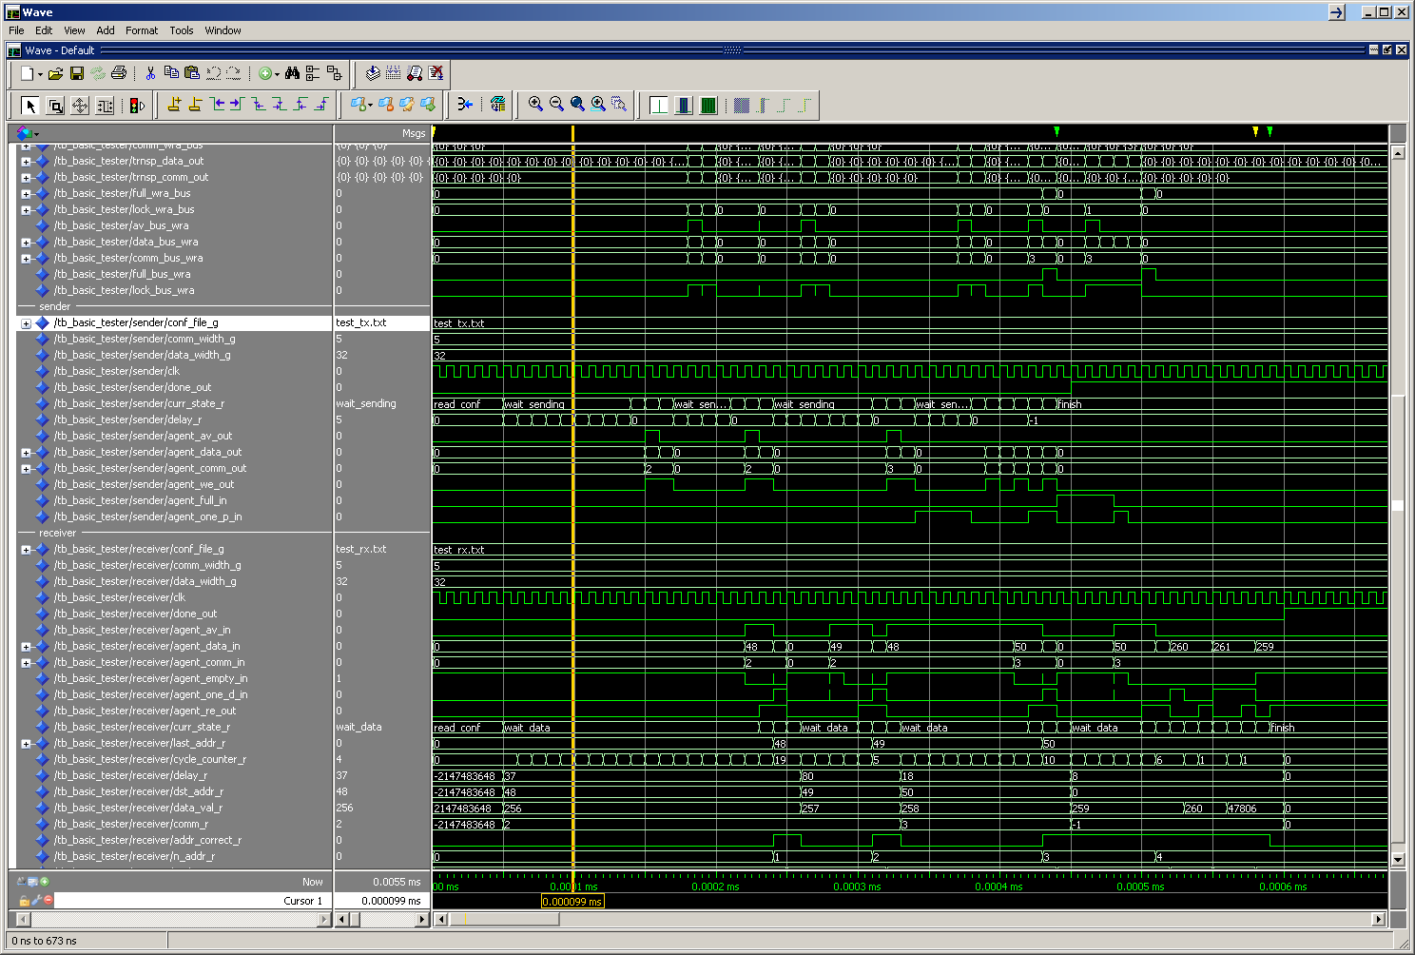
VSIM 1> vsim –novopt work.tb_basic_tester
VSIM 2> do tb_basic_tester.do
VSIM 3> run 600 ns
Example by Erno Salminen, 2012-01-31
1. Tx waits 10 cycles before first transer
5. All sent
2. First addr+data sent
3. 2nd send
6. All received
4. 1st received

