Slide 1
HIBI_PE_DMA Example

Slide 2
HIBI bus operation

Slide 3
HIBI burst transfer (streaming)
A burst transfer consist of bus command and destination address followed by data (one or more data words)
Sending IP is responsible of setting all these
Sender address is not transmitted
receiver does not know where data is coming from
sender information must be included in data payload OR agreed at design time which IP-blocks send data to which
IP block
HIBI wrapper
HIBI wrapper
IP block
[HIBI bus command]
[Destination address]
IP
Tx FIFO
[HIBI bus command]
[Data]
Rx FIFO
IP
…

Slide 4
HIBI random access transfer (normal transfer)
Normal transfer consist of bus command, destination address and data sent in parallel every clock cycle
Sending IP is responsible of setting all these
Sender address is not transmitted
receiver does not know where data is coming from
sender information included in data payload OR agreed at design time which IP-blocks exchange data
IP block
HIBI wrapper
HIBI wrapper
IP block
[HIBI bus command]
[Destination address]
[Data]
IP
Tx FIFO
[HIBI bus command]
[destination address]
Rx FIFO
IP
[Data]
…

Slide 5
HIBI addresses
All wrappers have unique addresses in HIBI bus address space
IP block address space is transparent (same as HIBI address space) or opaque (independent)
HIBI address space
IP’s local address space
HIBI wrapper
HIBI wrapper
IP block
Registers for configuration
Offset(s) +
[IP-block base address]
HIBI transmission
Registers
for IP-block
Offset(s) +
[IP-block base address]
IP-block registers and memory locations
e.g. 0x00000 -
0xfffff
HIBI transmission

Slide 6
HIBI channel
This is used in a HIBI_PE_DMA controller, not in normal HIBI wrapper
HIBI channel is an address in HIBI address space through which data is transmitted
Rx buffers are organized as channels
Only memory space limits how many buffers (channels) exists at the same time
Channels have implicit meanings that must be agreed
Who (what IP-block or CPU) sends data to which channel, since otherwise the sender is not known (HIBI does not send sender ID in transfers)
Possible explicit meaning of channel like ”DCT transform Q-parameter”
HIBI address space
IP’s local address space
HIBI wrapper
HIBI wrapper / HIBI PE DMA
IP block
Channel 3
Register A
[IP-block base address L ]
HIBI transmission
[IP-block base address K] + 3
0x00001
Channel 2
Buffer A
[IP-block base address N ]
HIBI transmission
[IP-block base address K] + 2
0x00002 -
0x000ff
Channel 1
Buffer B
HIBI transmission
[IP-block base address K] + 1
0x00100 -
0x00110

Slide 7
Example
Following example assumes the system below
A data transfer between two IP-blocks (CPUs)
Data buffering takes place in dual-port RAM that both CPU and DMA controller can access at the same time
cpu0
dma_buf_0
(=DPRAM)
HIBI segment
instr.memory
(on/off-chip)
hibi_pe_
dma_0
HIBI wrapper
HIBI bus
cpu1
dma_buf_1
(=DPRAM)
instr.memory
(on/off-chip)
hibi_pe_
dma_1
HIBI wrapper

Slide 8
Sending a packet (fixed size transfer)
CPU reserves buffer space from dual-port memory
CPU copies/writes data to dual-port memory
CPU configures DMA transfer
Size of transfer and destination IP-block’s HIBI address (not the local CPU address)
DMA reads data from dual-port memory and sends the data to the configured HIBI address
CPU’s local address space
Global (HIBI) address space not accessible directly by CPU programs
Data memory
(on/off-chip)
CPU
Dual-port
RAM
1
1
instr.memory
(on/off-chip)
2
HIBI PE
DMA
3
HIBI wrapper
HIBI bus

Slide 9
Receiving a packet (fixed size transfer)
CPU reserves buffer space from dual-port memory
CPU configures DMA
Size of transfer and HIBI address in which data is received
DMA copies the incoming data to DPRAM
DMA interrupts CPU when a configured number of words have been received
CPU knows that data is ready in dual-port memory and uses it/copies to its data memory
(DMA can wait for many incoming transfers at the same time)
CPU’s local address space
Global (HIBI) address space not accessible directly by CPU programs
Data memory
(on/off-chip)
CPU
dual-port
RAM
5
5
4
instr.memory
(on/off-chip)
HIBI PE
DMA
2
3
HIBI wrapper
HIBI bus

Slide 10
Receiving ad-hoc data
CPU has not yet configured any DMA transfers
DMA receives address that doesn’t match any channel
DMA interrupts CPU
CPU reads interrupt causeand incoming transfer’s address. Reserves buffer and configures a new channel for it
DMA writes transfer to buffer
DMA interrupts CPU when transfer is ready
CPU reads the data
Nios
dual-port RAM
(on-chip)
1
7
3
instr.memory
(on/off-chip)
4
5
2
HIBI_
PE_DMA
HIBI wrapper
6
HIBI bus

Slide 11
Receiving streaming data (continuous, no packet borders)
CPU reserves buffer space from dual-port memory
CPU configures DMA
Size of transfer and HIBI address in which data is received
DMA copies the incoming data to DPRAM
DMA interrupts CPU when buffer gets full or when incoming data stream stops
CPU reads whole buffer and acknowledges to DMA
Streaming continues as in 3.
Data memory
(on/off-chip)
CPU
dual-port
RAM
5
4
instr.memory
(on/off-chip)
HIBI PE
DMA
2
3
HIBI wrapper
HIBI bus

Slide 12
Notes about HIBI transfers
HIBI is a low-level transfer mechanism
SW side must know other IP-blocks’ HIBI addresses and HIBI bus commands to transfer data
Not reasonable for user applications to know these low-level details
We hide these details by SW platform macros and functions

Slide 13
HIBI PE DMA block diagram (when used with NIOS)
PE (Processing Element)
Avalon interrupt
DMA configuration interface
PE memory port
Avalon master
Avalon master
Avalon slave
Dualport
RAM
DPRAM ports
Avalon slave
Avalon slave
Avalon master
Avalon master
DMA configuration interface
HIBI PE DMA
Memorywrite, read
DMA configuration registers
Avalon interrupt
DMA configuration parameters
HIBI IP interface
HIBI Tx
HIBI Rx
HIBI Tx
HIBI Rx
HIBI wrapper

Slide 14
Hardware dependent SW

Slide 15
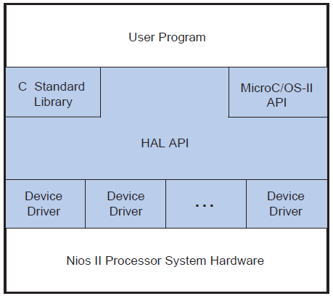
SW platform for NIOS and uC/OS-II RTOS
NIOS processor
Application SW
SW abstraction (API)
SW platform
Hardware abstraction
Dualport
On-chip RAM
HW platform
HIBI_PE_DMA controller

Slide 16
Hardware dependent software
General term that refers to such SW that directly manipulates HW
HdSW belongs to HAL (Hardware Abstraction Layer)
Hardware platform topmost layer and SW platform lowest layer communication
Physical interrupt lines, registers and memory locations are accessed by HdSW
Transmitting data
Configuring

Slide 17
Step by step from HW to SW
Physical structure of IP-blocks (at IP-block design time)
Registers, interrupts, memory locations, special status and control signals
Generic values are fixed for each instantiated IP-block (at HW integration time)
Base addresses, register widths, …
System specific SW configuration files are provided for the physical addresses (e.g. headers)
Physical addresses are given names/symbols
Low-level macros are provided to handle the registers at word/bit level
Add primitive behavior of handling the HW registers
May add control and protection against lowest level protocol violations
Basic operation is register read/write
Functions
Hide the low-level register access
Provide system independent but device specific protocol to send/receive/configure/get status
Without operating system, these can be used directly from applications
OS dependent APIs
HAL (hardware abstraction layer) API
Standardized, system and device independent functions to access the device
E.g. Unix char and block devices (fopen, fcose, …)
Add control for interrupt services and mutual exclusion
OS independent APIs
Standardized APIs, but do not depend on OS
E.g. MCAPI, MPI, OpenCL

Slide 18
Example SoC hardware
Two separate NIOS subsystems designed with SoPC builder
NIOS subsystems and HIBI network instantantiated in Quartus
nios_2x_soc.vhd
nios_sram_subsystem.vhd
cpu0
dma_buf_0
(=DPRAM)
hibi_2x_r4_segment.vhd
HIBI segment
instr.memory
(on/off-chip)
hibi_pe_
dma_0
HIBI wrapper
HIBI bus
nios_sdram_subsystem.vhd
cpu1
dma_buf_1
(=DPRAM)
instr.memory
(on/off-chip)
hibi_pe_
dma_1
HIBI wrapper

Slide 19
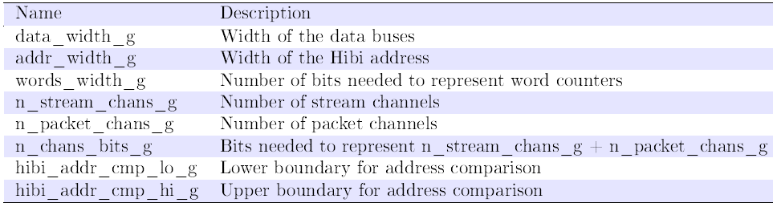
1. Hardware generics (VHDL)
HW implementation time generics that can not be changed at run time
Word length, address range (on HIBI addr space)
Channel
Seen from HIBI, each channel have own HIBI address to receive data from other IP-blocks
Seen from CPU, each channel is a buffer in dual port memory
Bits for words_width_g tells the maximum packet size in a buffer, e.g. 8 bits means max 256 words in the buffer
CPU MEMORY
CPU
Dualport
RAM
HIBI PE DMA
HIBI wrapper

Slide 20
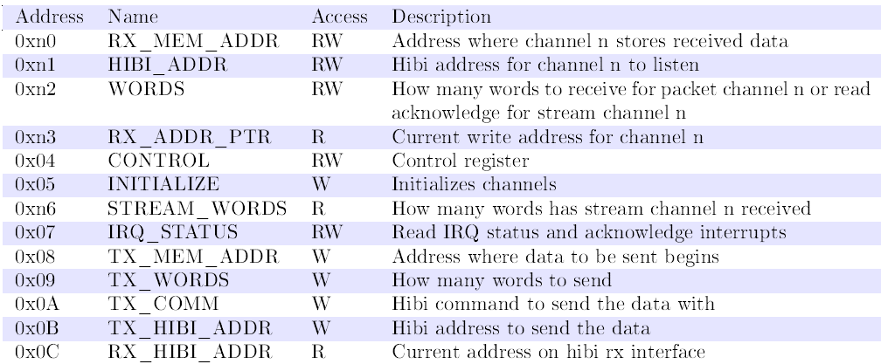
2. Registers (VHDL)
CPU MEMORY
CPU
Dualport
RAM
Note: number of implemented registers depends on generics (n channels means 5n + 8 registers in total)
Register addresses are in CPUs address space (not HIBI)
Purpose: Initialization, DMA configuration, status, transfer control for CPU, transfer control for HIBI bus
HIBI PE DMA
HIBI wrapper

Slide 21
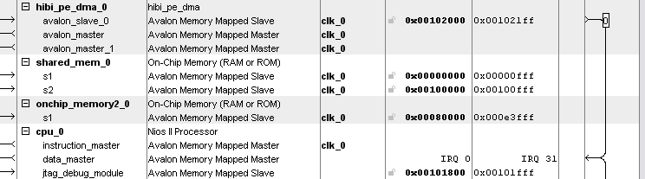
3. System and instance specific values (VHDL)
NIOS subsystem address space
SoPC builder project stores address information (.sopc XML file)
Altera tools automatically generate system.h for SW
HIBI address space
Project file .bdf (if defined in Quartus) OR the top-level VHDL file including all wrappers
User must manually write .h for SW (Kactus2 will do this automatically in the future versions)
CPU MEMORY
CPU
Dualport
RAM
HIBI PE DMA
HIBI wrapper

Slide 22
HW file dependencies (VHDL)
Note: this is not complete, just example
Criteria for modules and dependencies: think how to use layers to help reuse and portability
File | Dependency | Description / what defined
nios_2x_soc.vhd |  | Top level VHDL for the complete system (2 NIOS subsystems and HIBI bus
hibi_2x_r4_segment.vhd |  | Instantiates and connects HIBI wrappers. Defines physical system specific HIBI addresses
nios_sram_subsystem.vhd |  | Generated in SoPC and instantiates NIOS, HIBI PE DMA, local mem and peripherals
hibi_pe_dma.vhd |  | DMA component top VHDL
hpd_tx_control.vhd |  | Transmission control module
hpd_rx_and_conf.vhd |  | Reception and general control module
hpd_rx_stream_chan.vhd |  | Streaming transfer cahnnel module
hpd_rx_packet_chan.vhd |  | Receiver component for known packet size
hibi_pe_dma_hw.tcl | ./hpd_rx_channel.vhd ./hpd_rx_and_conf.vhd ./hibi_pe_dma.vhd ./hpd_rx_stream.vhd | Creates a SoPC/QSys component that has 2x avalon master, 1x avalon slave, 1x IRQ out and 1x HIBI R1 IP side bus

Slide 23
Typical SW layers
Application SW
Applications
Standard APIs
SW abstraction (API)
Standard device classes
SW platform
Functions to access specific devices
Macros to access registers
Hardware abstraction
HIBI addresses:
all HIBI wrappers
NIOS sram subsystem addresses:
HIBI_PE_DMA registers,
Local memory, etc.
NIOS sdram subsystem addresses:
HIBI_PE_DMA registers,
Local memory, etc.
HW platform

Slide 24
4. HW defining SW files
File | Depen-dency | Description / what defined | NIOS specific | HIBI specific | HPD specific
nios_2x_soc.vhd |  | VHDL file defining physical HIBI addresses | - | x
nios_2x_soc.h |  | Header file defining all system specific HIBI register and memory addresses | - | x | x
nios_1x_subsys.sopcinfo |  | Defines SoPC project specific addresses. Note in this example we have one NIOS per SoPC | x | - | -
system.h |  | Processor subsystem specific address definitions (SoPC generated defines for NIOS address spaces) | x | - | -
sys/alt_irq.h |  | Defines NIOS specific interrupt service routines | x | - | x
Both HIBI and NIOS subsystems have separate header files
Arrows show from where header gets its content
Altera generates headers automatically, HIBI-related headers must be created manually (automatically if Kactus2 and IP-XACT generators are used)
Note: only examples, not complete listing of files

Slide 25
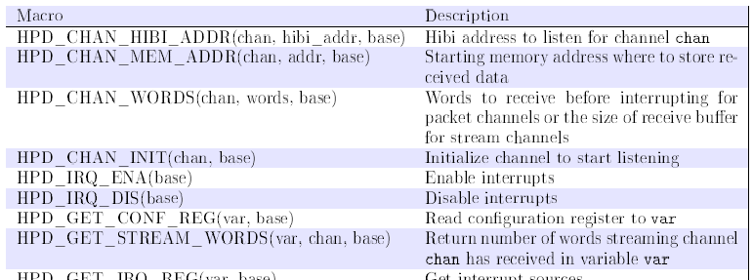
5. Macros
Macros for HIBI PE DMA
Expects physical addressess are named and defined in a header file
Note: only register access (R and W), not any protocol

Slide 26
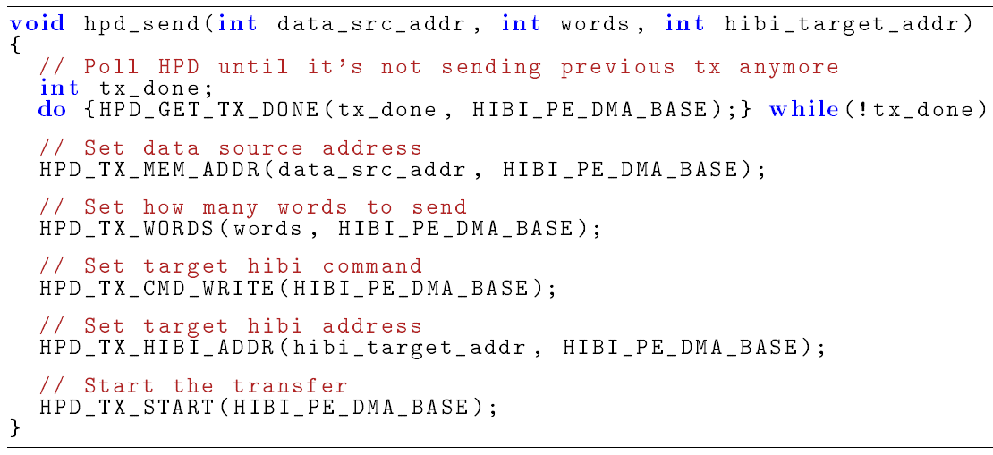
6. Functions – Send (example)
Send data from dual-port memory buffer to another CPU via HIBI
Note: added low-level protocol, still includes HIBI-specific things like HIBI bus command

Slide 27
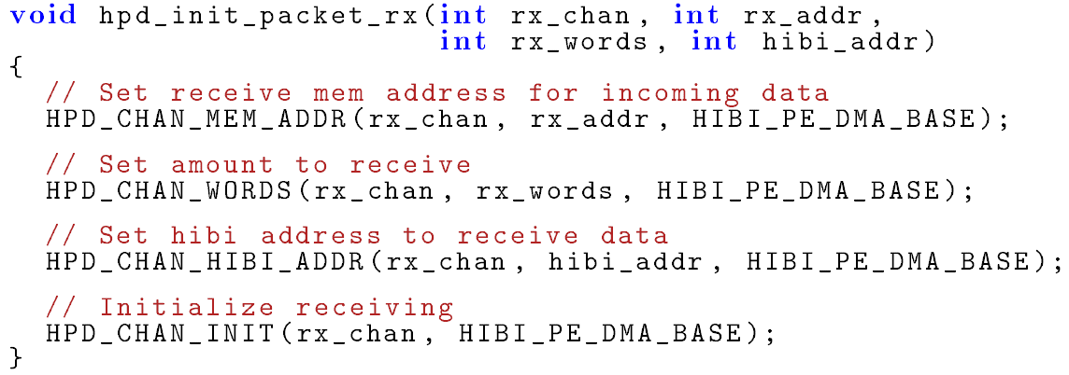
Functions – Initilaize receive (example)
Initializes packet reception from HIBI to dual-port memory buffer

Slide 28
Hardware abstraction layer
The HAL application programming interface (API) provides a standard (POSIX-like) interface to the hardware
HAL is also called BSP (Board Support Package)
The HAL provides a variety of generic device classes
character-mode
file subsystem
Ethernet
timestamp and system timers
direct memory access (DMA)
flash memory
Note: device sharing (exclusion) and execution control (e.g. interrupts) can be implemented on HAL or OS level

Slide 29
7. Drivers (for NIOS HAL)
Workflow overview:
Define registers
system.h, <component_name>_regs.h
Write the driver code
Typically uses macros and functions
Decide polling/interrupting mode
Decide mutual exclusion
Decide blocking/non-blocking
Define device class (if standard)
Publish driver to NIOS HAL
A TCL script specifying how to add the driver to NIOS
Register the driver
Include to initialization code
Note: this is your task in execrsise 4!

Slide 30
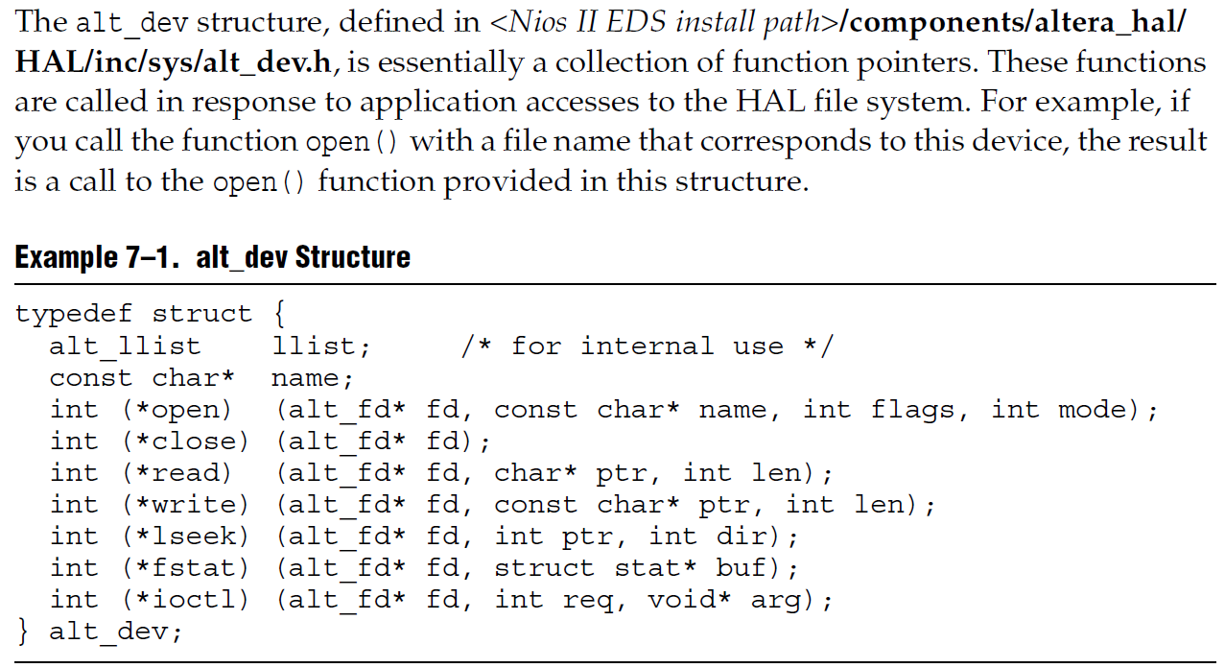
Standard device driver
Task: implement the character device functions in your driver (open, close etc.)
Example: unix character mode device

Slide 31
Notes about standard devices
No global address space
NIOS sram
NIOS sdram
HIBI bus
To send data between NIOSes (or any HIBI IP-blocks) we must make global agreement of identification (e.g. names of devices to refer to)
Must use same header files for this on all processor SW projects
Standard devices are at moderate low abstraction level and help abstracting the HW
Higher level APIs are required to make application e.g. OS indpenedent

Slide 32
Summary (example, not complete)
File | Depen-dency | Description / what defined | NIOS specific | HIBI specific | HPD specific
nios_2x_soc.vhd |  | VHDL file defining physical HIBI addresses | - | x
nios_2x_soc.h |  | Header file defining all system specific HIBI register and memory addresses | - | x | x
nios_1x_subsys.sopc |  | Defines SoPC project specific addresses. Note in this example we have one NIOS per SoPC | x | - | -
system.h |  | Processor subsystem specific address definitions (SoPC generated defines for NIOS address spaces) | x | - | -
sys/alt_irq.h |  | Defines NIOS specific interrupt service routines | x | - | x
hpd_isr_fifo.h hpd_isr_fifo.c |  | Generic interrupt queue (FIFO) for saving interrupt information (what interrupted), header and implementation | - | - | -
hpd_macros.h |  | System independent macros for accessing HIBI_PE_DMA registers | - | x | x
hpd_functions.h hpd_functions.c |  | System independent functions for handling initialization, sending, receiving, interrupt handling | - | x | x
hpd_functions_nios.h hpd_functions_nios.c |  | NIOS specific functions, interrupt | x | x | x
hpd_dma_device_nios_hal.h hpd_dma_device_nios_hal.c |  | Standard DMA device on NIOS HAL | (x) | - | -
mcapi_transport_nios |  | Multicore association MCAPI API for applications | - | - | -
main_with_no_os.c |  | User application (without OS) | - | - | x
main_with_ucosii.c |  | User application (with uC/OS-II RTOS) | - | - | -

Slide 33
TTA – HIBI integration

Slide 34
HIBI PE DMA and TTA integration
TTA-processor
Dualport RAM
Ctrl
DMA configuration and status registers
Tx
Rx
Tx
Rx
Rx
Rx
HI priority FIFO (Message)
LO priority FIFO (Data)
HIBI IP interface

Slide 35
HW and SW
HW:
For TTA, implement special load-store unit for direct HIBI IP wrapper side bus
SW:
Add macros and functions to handle direct HIBI interface
Add driver/standard device functions so that application is not dependent on HIBI functions
Character device, DMA device
Add to MCAPI transport implementation support for direct HIBI connection directly using functions or by using standard devices

