Slide 1
Instructions to build HIBI_PE_DMA testing system (SOPC+NIOS II Eclipse)
Lasse Lehtonen
Last modification: 29.3.2011

Slide 2
Intro
This document describes briefly how to build a SOPC and NIOS II Eclipse project to be used with the associated system level testbench and examples (..tb/system/*)

Slide 3
Abbreviations
HPD = HIBI_PE_DMA

Slide 4
Test system to be created
Nios
dual-port RAM
(on-chip)
instr.memory
(on/off-chip)
HIBI_PE_DMA
(DMA)
HIBI wrapper
Nios
dual-port RAM
(on-chip)
instr.memory
(on/off-chip)
HIBI_PE_DMA
(DMA)
HIBI wrapper
HIBI bus
Nios
dual-port RAM
(on-chip)
instr.memory
(on/off-chip)
HIBI_PE_DMA
(DMA)
HIBI wrapper

Slide 5
Design flow
Used tools: Quartus, Sopc, eclipse, modelsim
Quartus: base for SOPC project
SOPC: define the HW platform
Modelsim: simulate the whole system
Eclipse: create SW platform

Slide 6
Building SOPC project
Create Quartus II project and from there open SOPC builder.
Create a system according to the picture on next page
You’ll find hpd’s tcl file from hpd’s vhd directory to add the component to the project
Remember to set IP search path for it (tools->options)
Use same names
For this test set HIBI_PE_DMAs n_stream_chans_g to 0 and n_packet_chans_g to 8.
Make instruction memories large enough for software
Add reset ports to all CPUs
Other components should work with default settings
Use auto-assign for base addresses
Disconnect unnecessary IRQ connections
Check create simulation files and generate

Slide 7
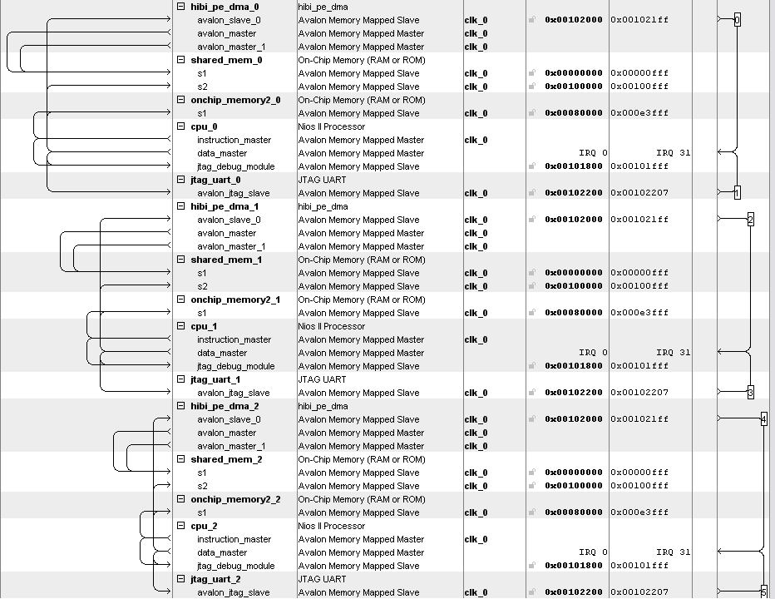

Slide 8
NIOS II Eclipse
Create three “NIOS 2 Application and BSP template” projects named cpu0, cpu1 and cpu2
Copy all source/header files to all projects (from ../tb/system/src_cpu#)
Create BSP for all
Rigth click -> nios II -> bsp editor -> generate
Compile all codes by selecting ”Build project” for each project

Slide 9
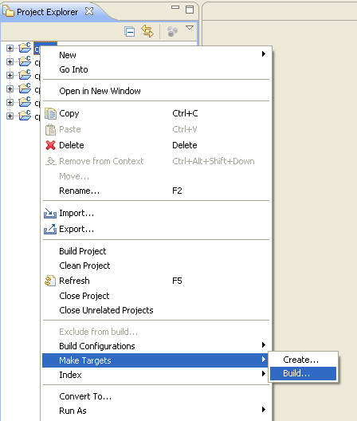
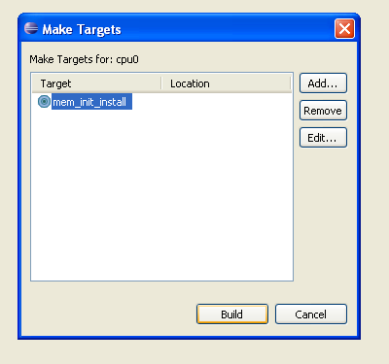
Create initialization files for memories

Slide 10
Modelsim simulation
Navigate your modelsim to the simulation folder it created earlier
Add hibi files to the compilation script
Add to setup_sim.do the contents of msim_includes.txt (change paths!) (tb/system/support)
Use hibiv3_r4 top level. Address ranges for cpus 0,1,2 are 0x000-0x1FF, 0x200-0x3FF, 0x400-0x5FF
Tb/system/ contains one
Add hibi to the simulation top level
Locate vhd file named after you SOPC project
Scroll to the bottom of it
Modify it to be similar to tb/system/support/hibi_add.vhd
Check DUT’s component name

Slide 11
Modelsim simulation
In modelsim’s transcript window type ”do setup_sim.do” to setup things
S: compiles hw files
Jtag_*: commands to see what CPUs are printing in console windows, by default goes to transcript window
It takes about 1ms before CPUs start executing main() and simulations take a lot of time
Modify CPU1’s main.c to adjust the amount of packets that ping-pong between CPUs
They do not stop automatically!

Slide 12
Next some examples how HPD should behave

Slide 13
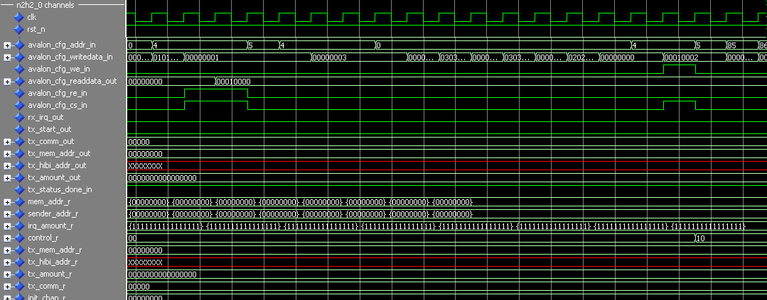
Enabling HPD to interrupt
// Enable interrupts on HPD side, set bit 1 high on register 4
IOWR(HIBI_PE_DMA_0_BASE, 4, (2 | (IORD(HIBI_PE_DMA_0_BASE,4))));
Write back
With bit 1 high
Read reg 4
Interrupts
on

Slide 14
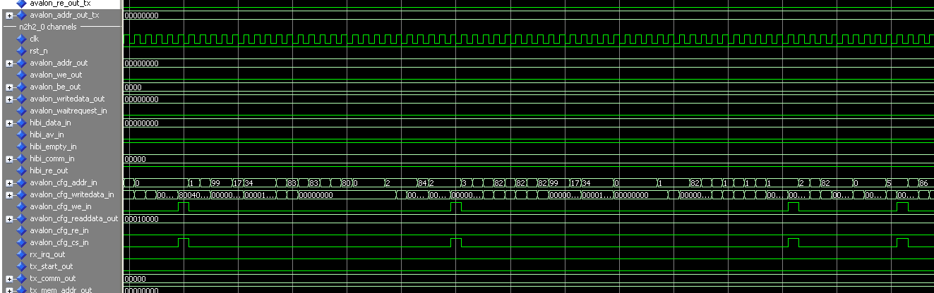
Channel rx configuration
Just four writes
// Set receive mem address for incoming data
IOWR(HIBI_PE_DMA_0_BASE, (rx_channel << 4), HPD_REGISTERS_RX_BUFFER_START + rx_addr);
// Set words to receive
IOWR(HIBI_PE_DMA_CHAN_0_BASE, (rx_channel << 4) + 2, rx_amount);
// Set hibi address to receive data
IOWR(HIBI_PE_DMA_0_BASE, (rx_channel << 4) + 1, hibi_addr);
// Initialize (enable) receiving
IOWR(HIBI_PE_DMA_0_BASE, 5 , 1 << rx_channel);

Slide 15
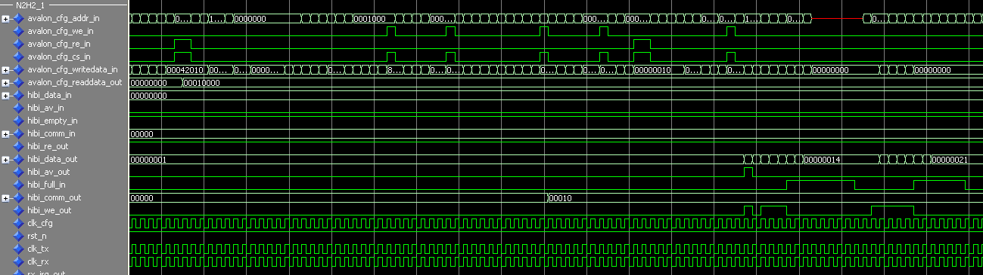
TX
// Poll HPD, until it's not sending previous tx anymore
while(((IORD(HIBI_PE_DMA_1_BASE, 4) >> 16) & 0x1) == 0) { }
// Set data source address
IOWR(HIBI_PE_DMA_1_BASE, 8, data_src_addr);
// Set amount to send
IOWR(HIBI_PE_DMA_1_BASE, 9, amount);
// Set target hibi command
IOWR(HIBI_PE_DMA_1_BASE, 10, 2);
// Set target hibi address
IOWR(HIBI_PE_DMA_1_BASE, 11, hibi_addr);
// Start the transfer, set bit 0 high in register 4
IOWR(HIBI_PE_DMA_1_BASE, 4, (0x1 | (IORD(HIBI_PE_DMA_1_BASE,4))));
Data is written to hibi from shared memory

Slide 16
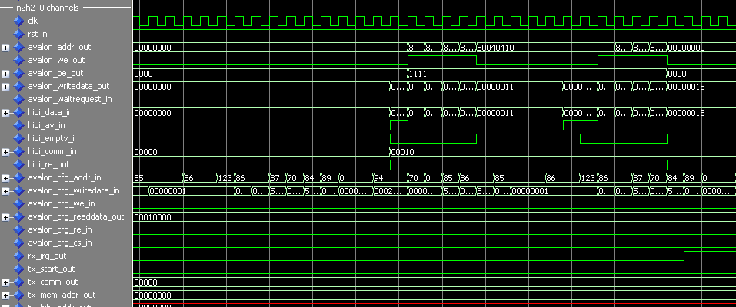
Preconfigured transfer receive
Words are forwarded directly to shared memory until all words have been received
When all have been received interrupt is raised
Forward to shared mem directly
First packet
Second packet
Interrupt

Slide 17
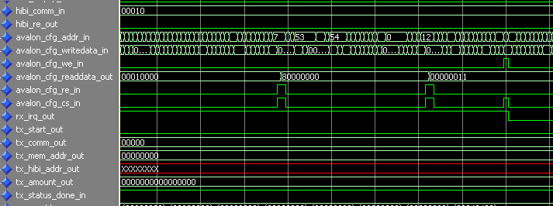
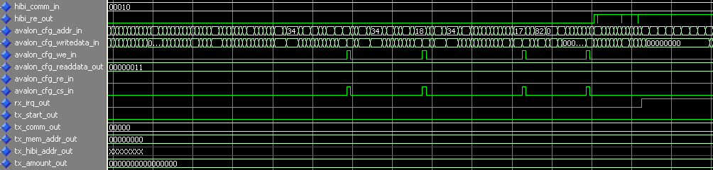
Unconfigured receive
CPU reads the cause of IRQ
And the unknown
Incoming address
Ack IRQ
IRQ has been raised quite many cycles ago
And later the same day (many many clock cycles):
CPU configures some channel for receiving to address 0x11 and N2H interrupts again when all data has been received

