Slide 1
Setting up udp-flood demo
Lauri Matilainen, Erno Salminen
TUT
April 2012

Slide 2
Phases
Connect Altera DE2 FPGA board to PC using a cross-connected ethernet cable
Synthesize logic and program FPGA
Controller for ethernet PHY chip
Logic for handling UDP/IP headers and packets
Simple flooder unit that just sends packet all the time
Reset switch is
Capture the incoming UDP packets on Linux PC
Using netstat -s
Using netcat: nc –lup 5000
Using test program udp_example.cc

Slide 3
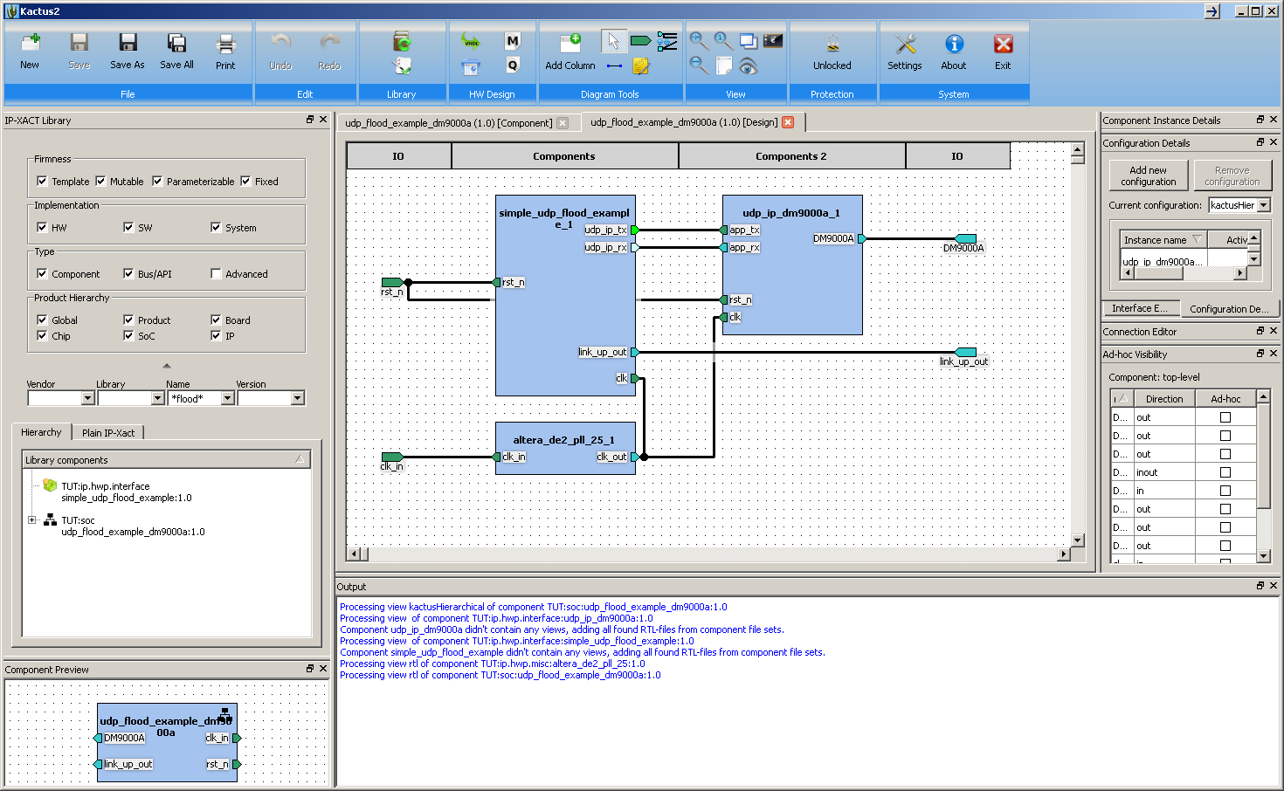
FPGA architecture
Run these

Slide 4
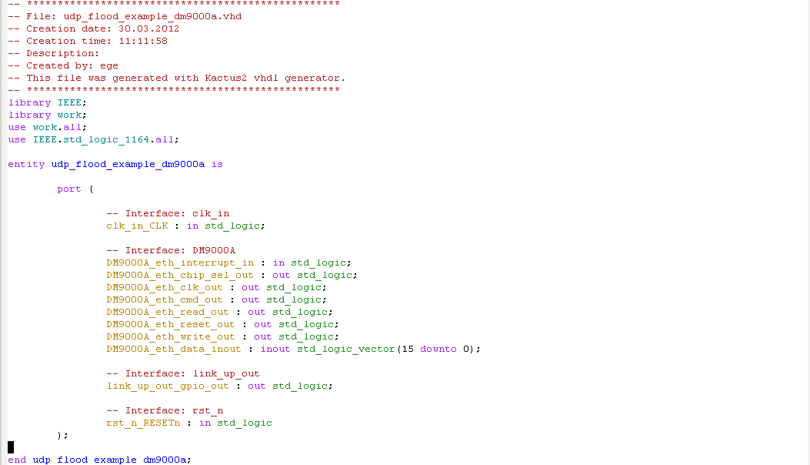
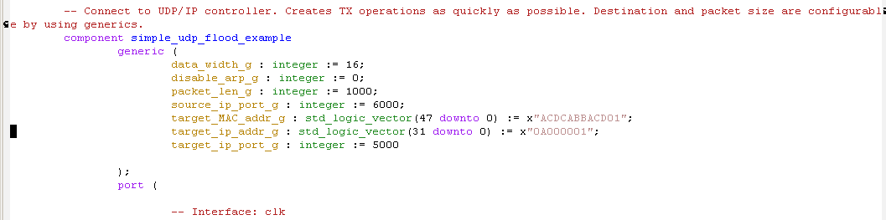
Generated top-level vhdl
…
Flooder will send packets to this IP address 10.0.0.1 and port 5000
MAC address is not needed unless…

Slide 5
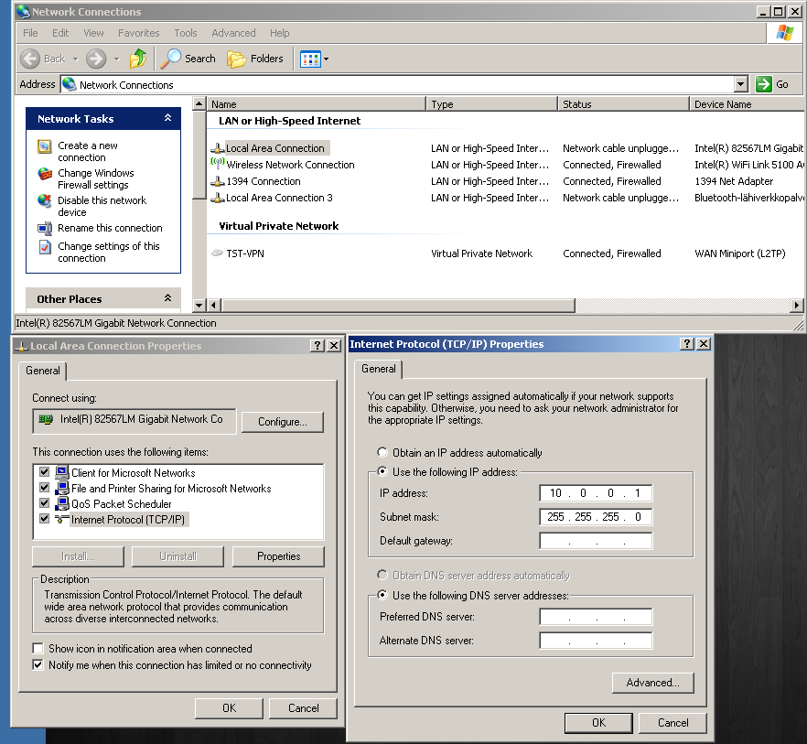
Setup the IP address of PC
Put the same IP address here as in vhdl (prev slide)

Slide 6
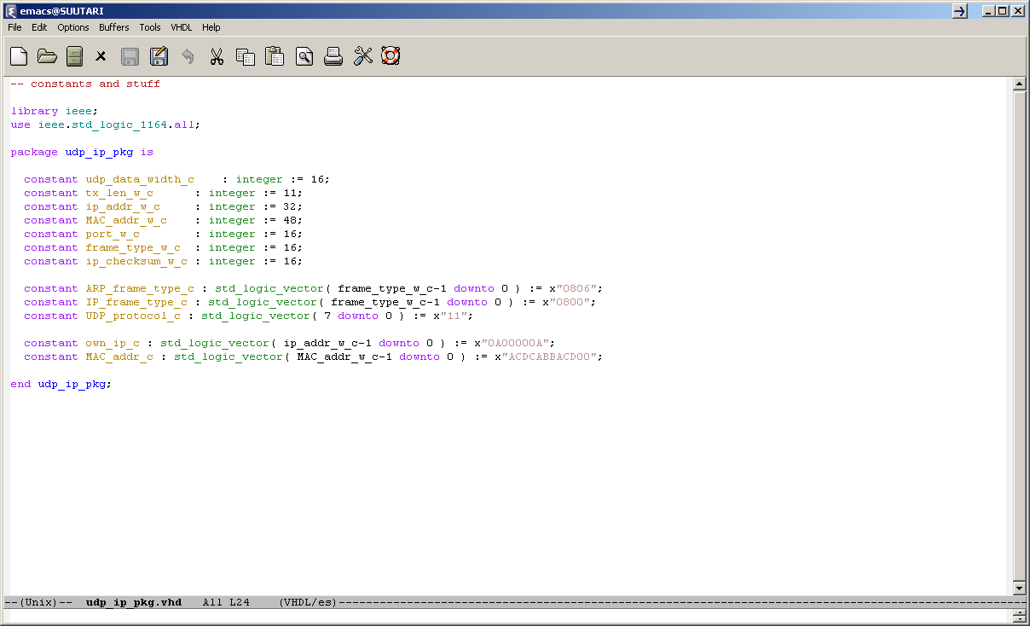
IP address of the DE2 board
DE2’s IP addr= 10.0.0.10

Slide 7
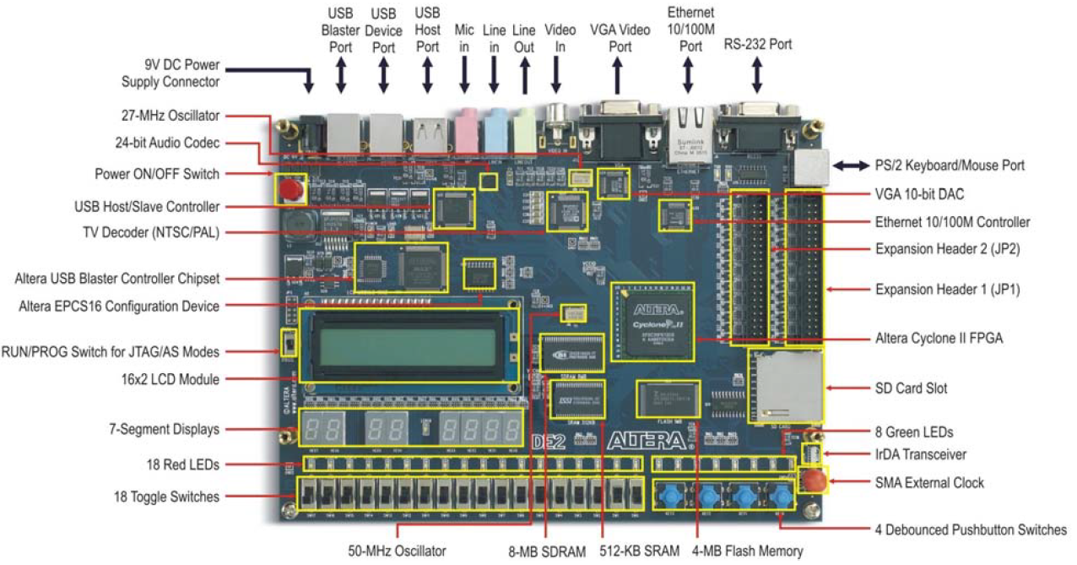
DE2 board
Use the mode ”RUN”
Switch17 (pinV2) is the reset. Up-position means normal operation, down-position means reset
LEDR0 (PIN_AE23) turns on/off when a packet arrives from PC in receiver test.
LEDG0 (PIN_AE22) lights up when link to PC has been established. This takes few seconds.

Slide 8
netcat
Make PC listen: nc –lup 5000
You should see one ASCII char per line in increasing order
Had to ask TSTWIN admin to change firewall settings for nc
-l means listen
- u UDP mode
-p xxxx defines the port
Send PC -> FPGA(udp_Receiver_example_dm9000
nc –uvv 10.0.0.10 6000
Led changes state for each packet that is received in FPGA
Each nc call just sends one packet (and gets stuck)
Press Ctrl-c and try again. Led should be inverted

Slide 9
netstat
Netstat -s
Look for category ”UDP statistics for ipv4”
”Datagrams received” tells the amount of data that PC recevied
Should increase continuously with flood example

Slide 10
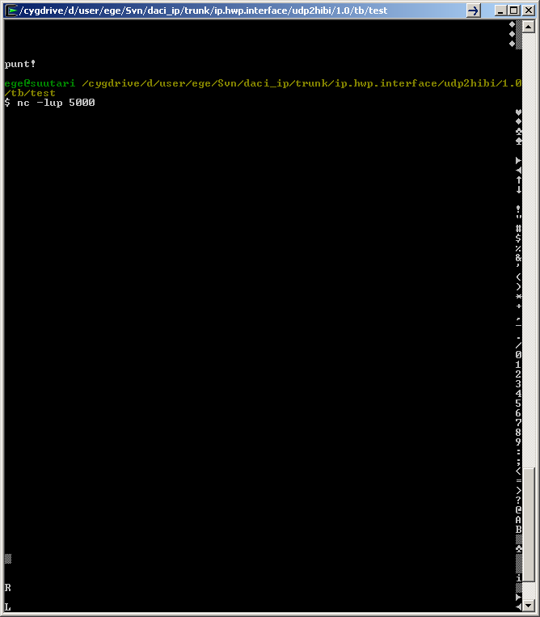
Flood + netcat
First symbols
Running numbers
After a while it starts looking funny but no worries…

Slide 11
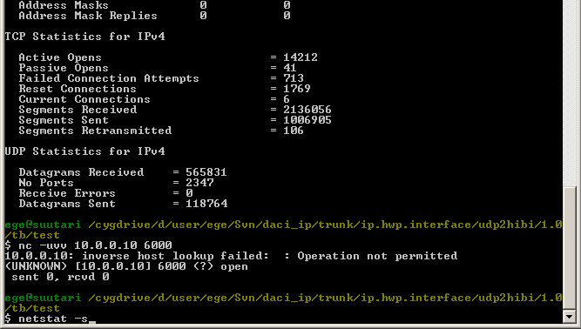
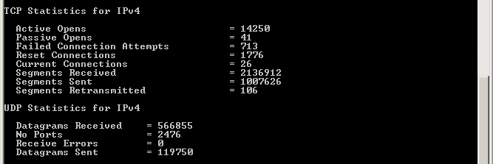
Receiver example +Netstat + netcat
$netstat –s
…
Some data has been sent PC -> FPGA
Send one UDP packet PC -> FPGA, led changes its state
Cryptic looking error does no harm(?)
… (part of mesasges hidden here)
Sent data amount has increased

Slide 12
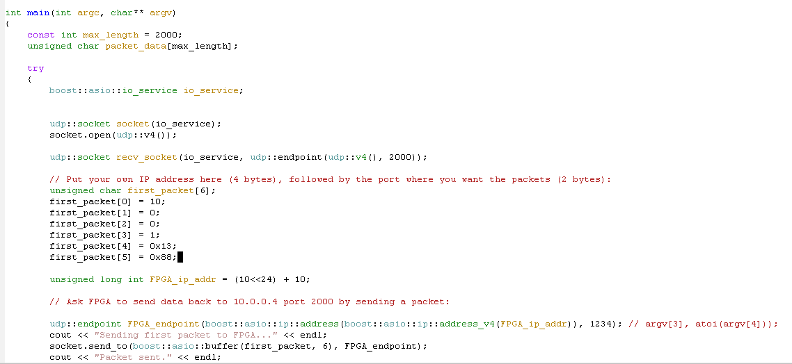
Test program udp_example.cc
Does not do anything useful with flood example (2012-03-30, ES)
Due to firewall settings???
Sends one packet = Invert the led on FPGA for each execution with receiver example. Note that most of code is not useful for receiver testing!
PC’s IP address 10.0.0.1
PC’s port 0x1388 = 5000
Send packets going to DE2 to this IP address 10.0.0.1
Send PC -> FPGA and nothing useful happens after print

Slide 13
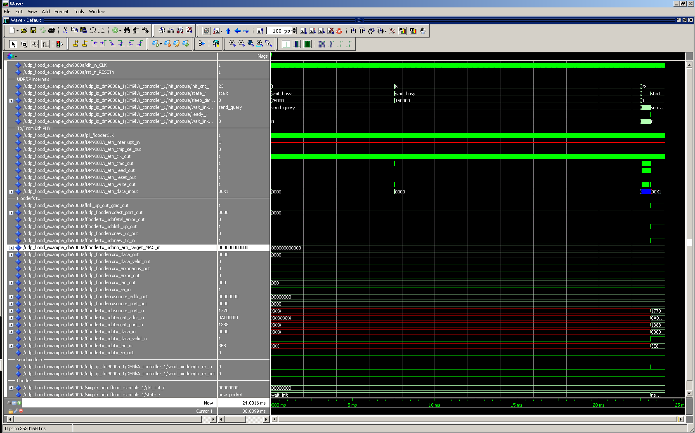
What all_waves.do looks like
3)Phase 23 is the last. Link_wait_ime_c was shortened by 10000x in this sim
1) Eth PHY is initialized
2)Some init phases take a long time
4)When eth phy is ready, flooder can start
4)When eth phy is ready, flooder can start. Cannot simulate further without an eth phy model, simple do-file cannot imitate it adequately

Slide 14
Summary
Easy.

