Slide 1



RESPONSIVE MEDICATION REMINDER WITH GUARDIAN ALERT
Guided By,
Mrs. R. JASMINE, M.E.,
Presented By,
SHANMATHI S (811722104141)
UMA MAHESWARI K (811722104170)
VEDHA VARSHINI V (811722104178)
11/06/2025

Slide 2


ABSTRACT
A Responsive Medication Reminder with Guardian Alert aims to enhance patient well-being by leveraging technology to improve medication adherence and provide a safety net during critical situations.
This system typically involves a user interface for managing medication schedules and emergency contacts, a reminder module for delivering timely notifications, and an emergency alert function that can transmit the user's location and relevant information to designated recipients upon activation.
By providing timely reminders and facilitating rapid access to help, such a system has the potential to significantly improve health outcomes, increase personal safety, and promote greater independence for individuals managing their health.
11/06/2025

Slide 3
OBJECTIVE
The primary objective of a medication reminder project is to design and develop a system that sends timely reminders to patients to take their prescribed medications, thereby improving medication adherence and reducing missed doses.
Medication Reminder aims to enhance patient outcomes by ensuring consistent medication intake, which is crucial for managing chronic conditions and preventing adverse health consequences.
By providing personalized reminders and tracking medication intake, the system seeks to empower patients to take control of their medication regimen and improve their overall health and well-being..
It aims to create a user-friendly and customizable platform that sends reminders and notifications to users via various channels, such as SMS, email, or mobile app notifications
11/06/2025

Slide 4
LITERATURE SURVEY
S.No. | Paper Title | Year | Remark
1 | Interfaces of Medication Reminder Applications | 2017 | the critical importance of user-friendly interface design in medication reminder apps to effectively support elderly users.
2 | Developing the Medication Reminder Mobile Application | 2017 | the “Seeb” application as a practical solution for improving medication adherence through mobile technology, particularly among patients with chronic conditions.
3 | Bilingual Medication (Med-Alert) Reminder Application for Patients | 2019 | reminder app that enhances accessibility and adherence by accommodating users in multiple languages, catering especially to diverse patient populations.
11/06/2025

Slide 5
LITERATURE SURVEY
S.No | Paper Title | Year | Remark
4 | An Automated and Online-Based Medicine Reminder and Dispenser | 2019 | dispenser system that combines hardware and software to ensure timely medication intake with minimal human intervention.
5 | Construction and application of medication reminder system: intelligent generation of universal medication schedule | 2021 | an intelligent system for generating universal medication schedules, enhancing personalization and precision in medication reminders through data-driven automation.
6 | Medication reminder APPs to improve medication adherence in coronary heart disease (Med App-CHD) Study: a randomised controlled trial protocol, | 2022 | the effectiveness of medication reminder apps in improving adherence among coronary heart disease patients, emphasizing the clinical relevance of digital health interventions.
11/06/2025

Slide 6
LITERATURE SURVEY
S.No. | Paper Title | Year | Remark
7 | medication reminder system | 2022 | the development and implementation of a medication reminder system, highlighting real-world challenges and solutions in enhancing patient compliance.
8 | Medicine reminder application | 2024 | the development of a medicine reminder application focused on improving user convenience and medication adherence through timely alerts and a simple interface.
9 | Prevalence and correlates of medication reminder app ‘use and use intention’ among older adults | 2024 | adoption among older adults, highlighting barriers and motivators for effective digital health engagement.
11/06/2025

Slide 7
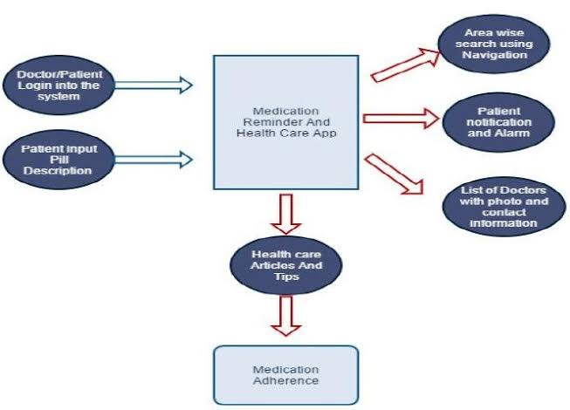
EXISTING SYSTEM
11/06/2025

Slide 8
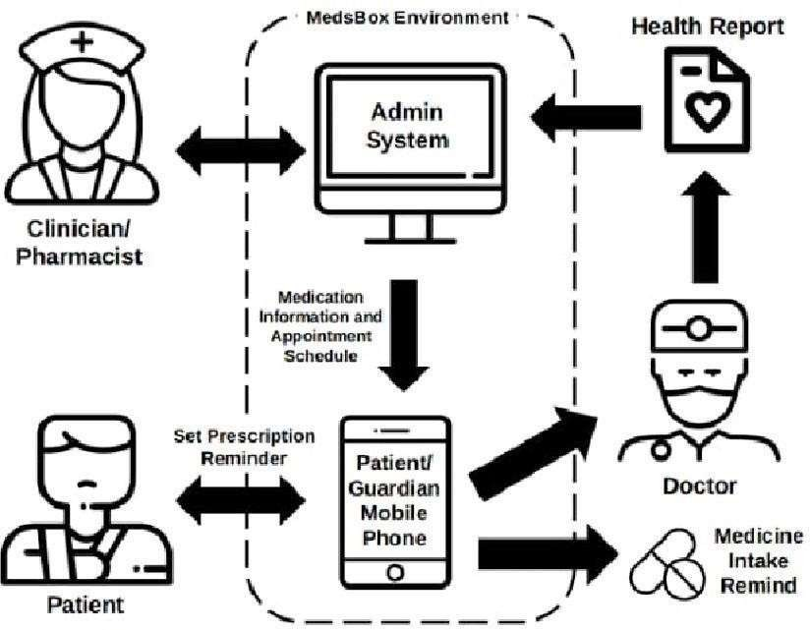
PROPOSED SYSTEM
11/06/2025

Slide 9
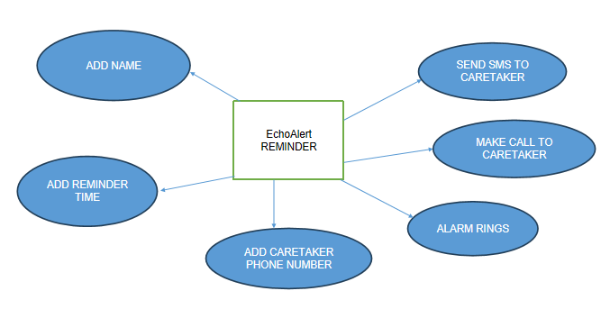
SYSTEM ARCHITECTURE
Medication Reminder
11/06/2025

Slide 10
MODULE 1 : User Registration & Profile Management
The User Registration & Profile Management module is a fundamental component of the “Responsive Medication Reminder with Guardian Alert” system.
This module is responsible for capturing and securely storing essential user information required for both personalizing the app and ensuring the effectiveness of the emergency alert feature.
When the user first launches the application, they are prompted to complete a simple registration process where they provide their full name, age, and most importantly, an emergency contact number-typically that of a guardian, caregiver, or family member.
11/06/2025

Slide 11
MODULE 2 : Alarm Configuration & Management
The Alarm Configuration & Management module serves as the central operational feature of the “Responsive Medication Reminder with Guardian Alert” application.
This module enables users to schedule and manage medication reminders in a flexible, user-friendly manner. Upon accessing this section, users can input specific details such as the time of medication, name of the medicine, dosage, and any custom notes.
The interface is designed to be intuitive, making it easy for users of all ages-including elderly patients-to set one-time alarms or configure recurring schedules based on daily, weekly, or custom intervals.
11/06/2025

Slide 12
MODULE 3 : Alarm Acknowledgment & Detection
The Alarm Acknowledgment & Detection module plays a critical role in ensuring user engagement and safety within the “Responsive Medication Reminder with Guardian Alert ” system.
After an alarm is triggered by the previously configured schedule, this module takes over by alerting the user through an audible alarm sound, vibration, and an interactive on-screen prompt
The prompt is designed to request immediate acknowledgment from the user, typically through a simple tap or button press indicating they have taken their medication.
11/06/2025

Slide 13
MODULE 4 : System Integration & Security
The System Integration & Security module forms the backbone of the Responsive Medication Reminder with Guardian Alert , ensuring that all core functionalities—from alarm scheduling to emergency alerting—operate as a cohesive and reliable system.
This module is responsible for managing seamless interaction between various components such as user registration, medication alarm configuration, user acknowledgment tracking, and the alternative contact notification system.
11/06/2025

Slide 14
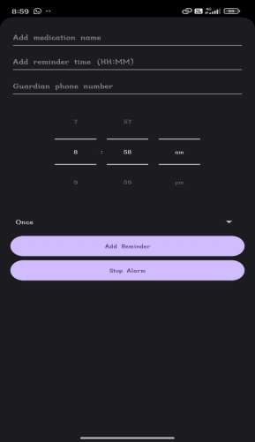
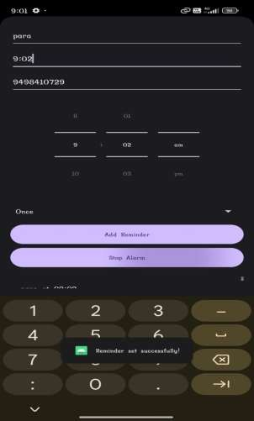
OUTPUT
11/06/2025

Slide 15
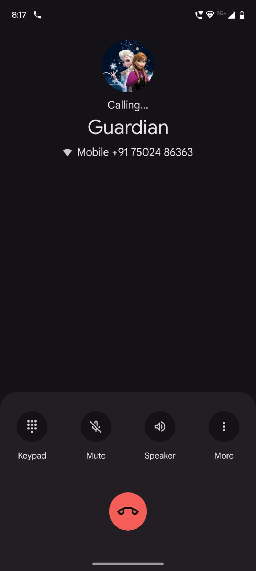
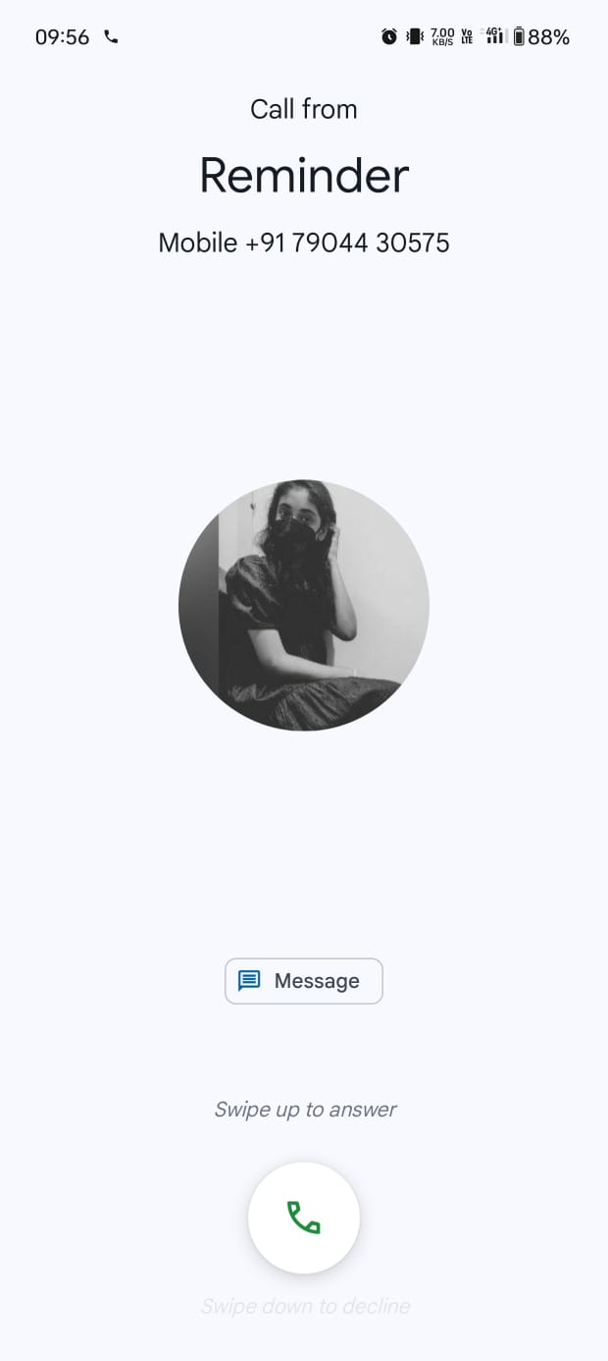
OUTPUT
11/06/2025

Slide 16
CONCLUSION & FUTURE ENHANCEMENT
The “Responsive Medication Reminder with Guardian Alert” application effectively addresses a critical need in the healthcare domain by combining medication management with real-time emergency support. Through the integration of alarm scheduling, user acknowledgment detection, and automatic guardian notification,
While the “Responsive Medication Reminder with Guardian Alert ” application fulfills its core purpose effectively, there are several areas for future enhancement that can further improve its functionality, usability, and reach. One potential upgrade is the integration of SMS or WhatsApp alerts alongside the emergency call feature, ensuring that guardians receive messages even if they are unable to answer a phone call.
11/06/2025

Slide 17
REFERENCES
Android Developers. (n.d.). Alarm Manager | Android Developers. Retrieved from:
World Health Organization. (2003). Adherence to Long-Term Therapies: Evidence for Action. Retrieved from:
Lee, J., & Kim, J. (2020). Development of a Mobile-Based Medication Reminder System for Chronic Patients. International Journal of Medical Informatics, 141, 104226. https://doi.org/10.1016/j.ijmedinf.2020.104226
Google. (n.d.). Permissions Overview | Android Developers. Retrieved from:
Kumar, P., & Tripathi, S. (2018). An Android-based Medicine Reminder System with Call Feature for Elderly People. International Journal of Advanced Research in Computer Science, 9(3), 42–46.
11/06/2025

Slide 18

DD/MM/YYYY

